Slide 1
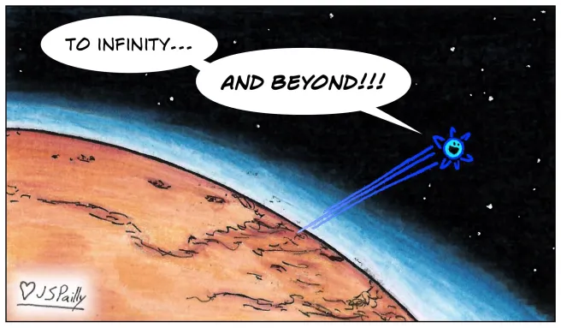
Jeans Escape Simulation
Emma Yu

Slide 2
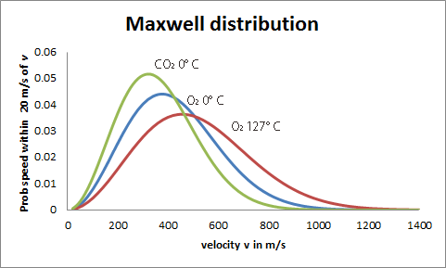
Jeans Escape
Goal: Visualize and compare Jeans particle escape across different planets, gases
Method:
  2D cross-section simulation
  Particles have Maxwell-Boltzmann velocities
  Bounce or escape depending on if speed >= escape velocity
Visualization:
  Escaped particles turn red
  Exobase line as escape threshold
  Temperature tripled for time scale
https://homepages.abdn.ac.uk/j.s.reid/pages/Maxwell/Legacy/MaxDistrb.html

Slide 3
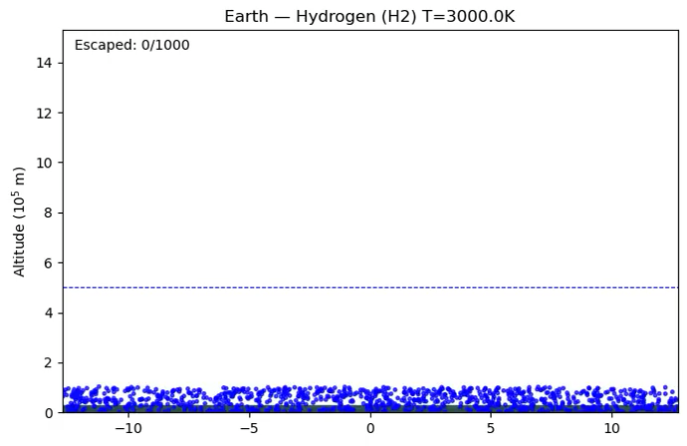

Slide 4
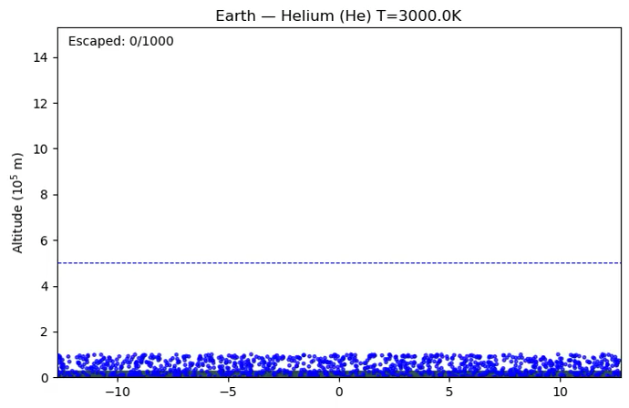

Slide 5
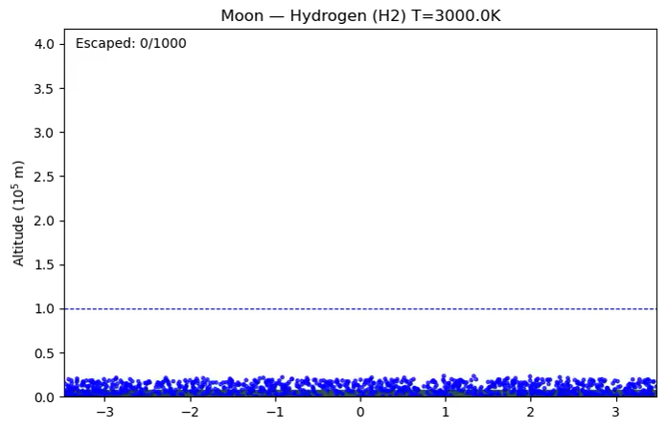

Slide 6
