Slide 1

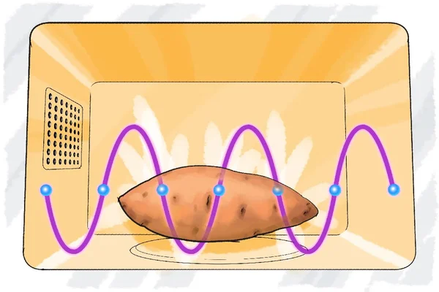
Uneven Heating of Microwave Ovens
Edward Wang

Slide 2

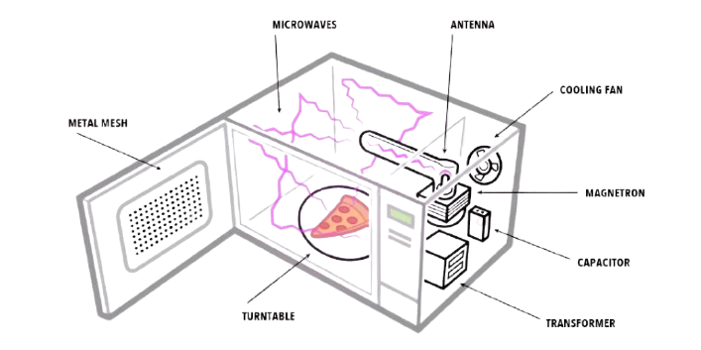
Background
Magnetron emits microwaves at ~2.45 GHz
Microwaves bounce around inside metal box
Most of the waves interfere with themselves and are canceled out
Only waves left are standing waves, created when two identical waves travel in opposite directions & adds their energy up
Fixed size oven, only waves with a whole number of half wavelengths within the box can perfectly reflect on itself, so there is a limited number of standing waves

Slide 3
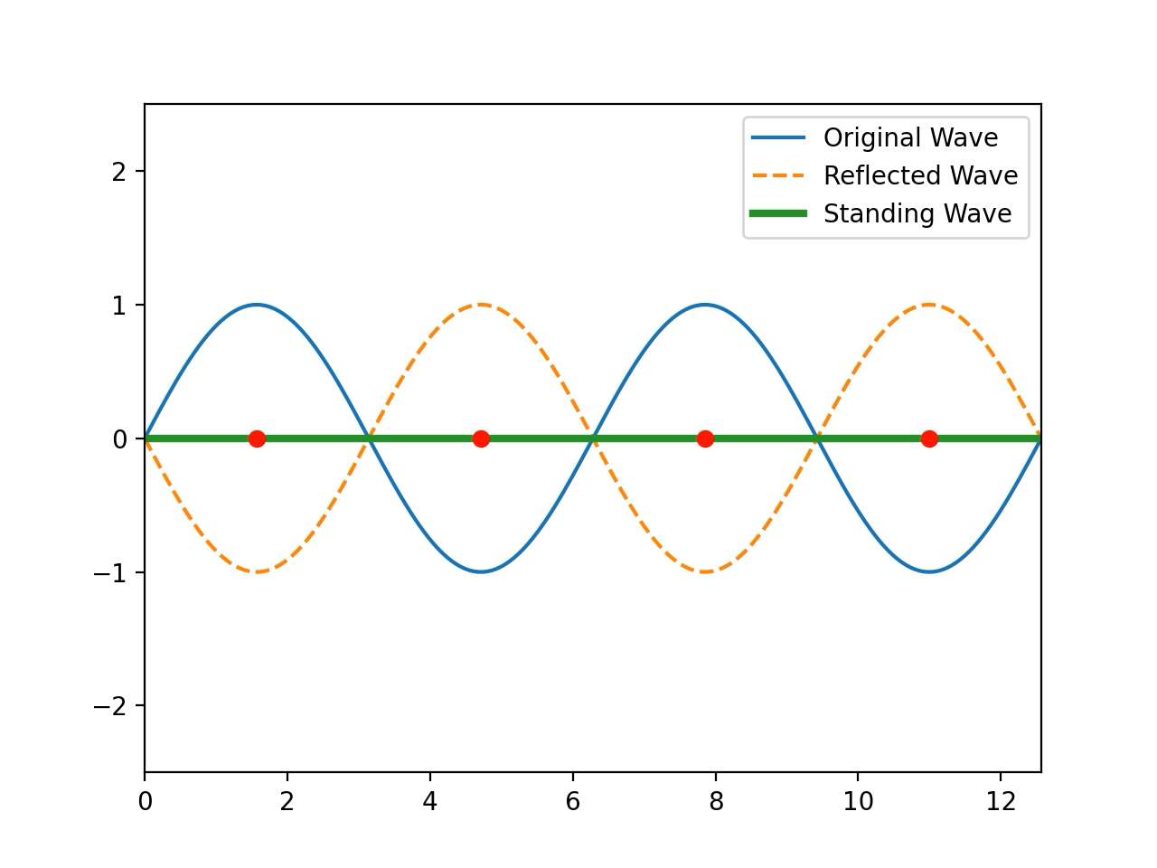
Standing Wave

Slide 4

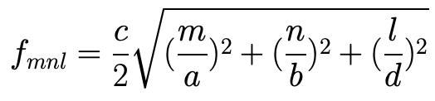

Calculations & Methods
2D Standing Wave Equation
Solve standing wave in each dimension
Find m and n for equations above
Get heat map using z(x, y)

Slide 5
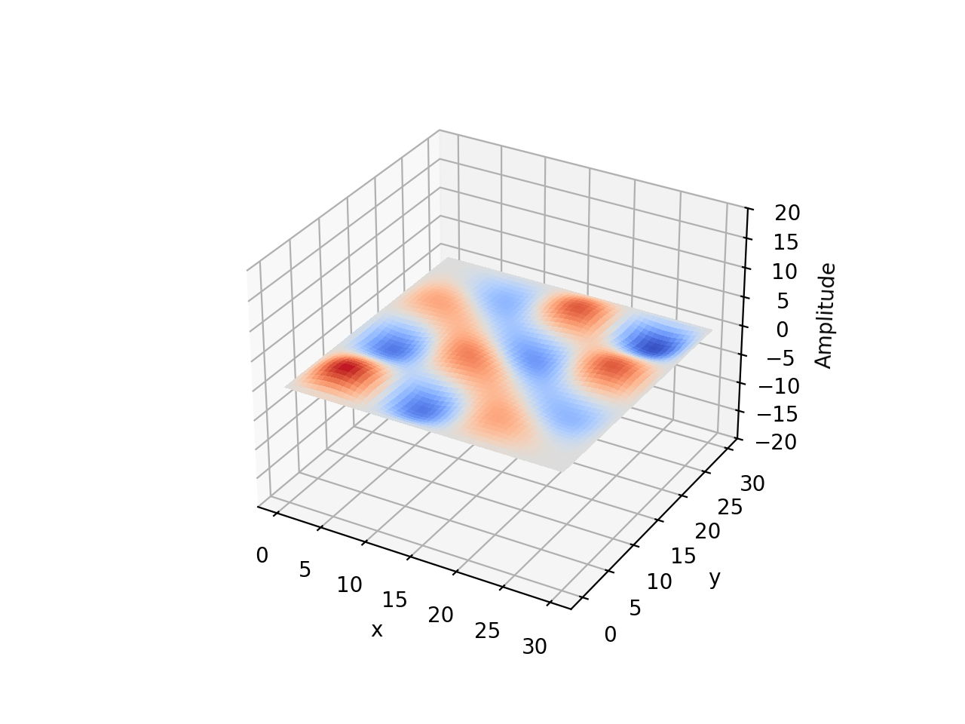
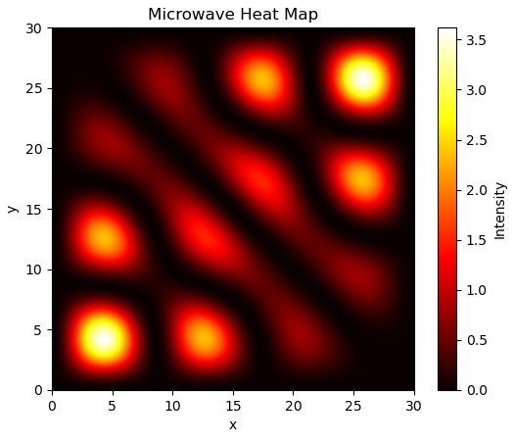
Heat Map

Slide 6
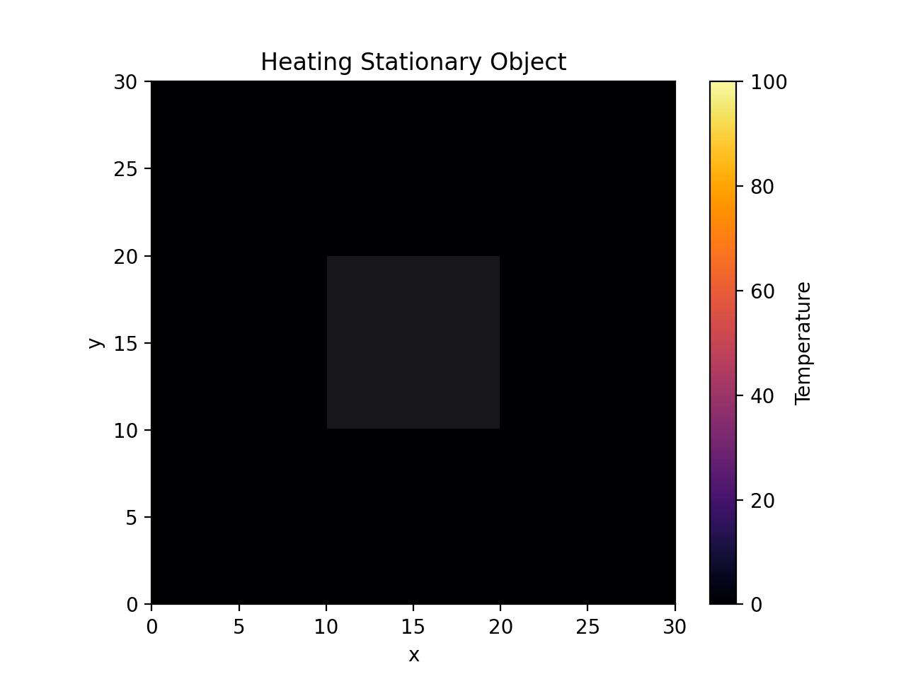
Stationary Object

Slide 7
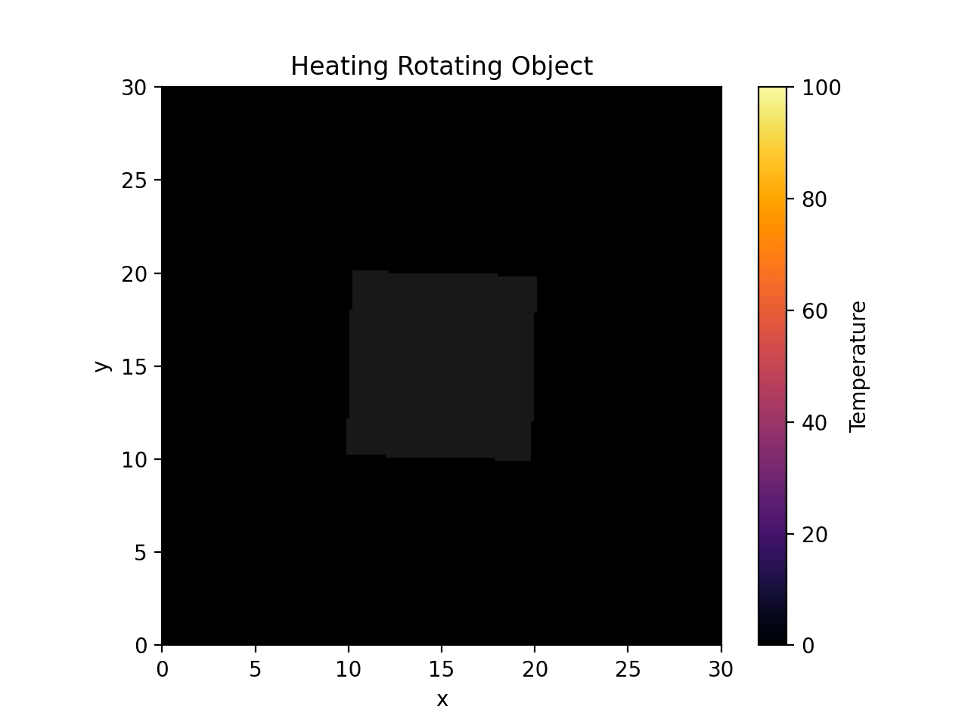
Rotating Object

Slide 8
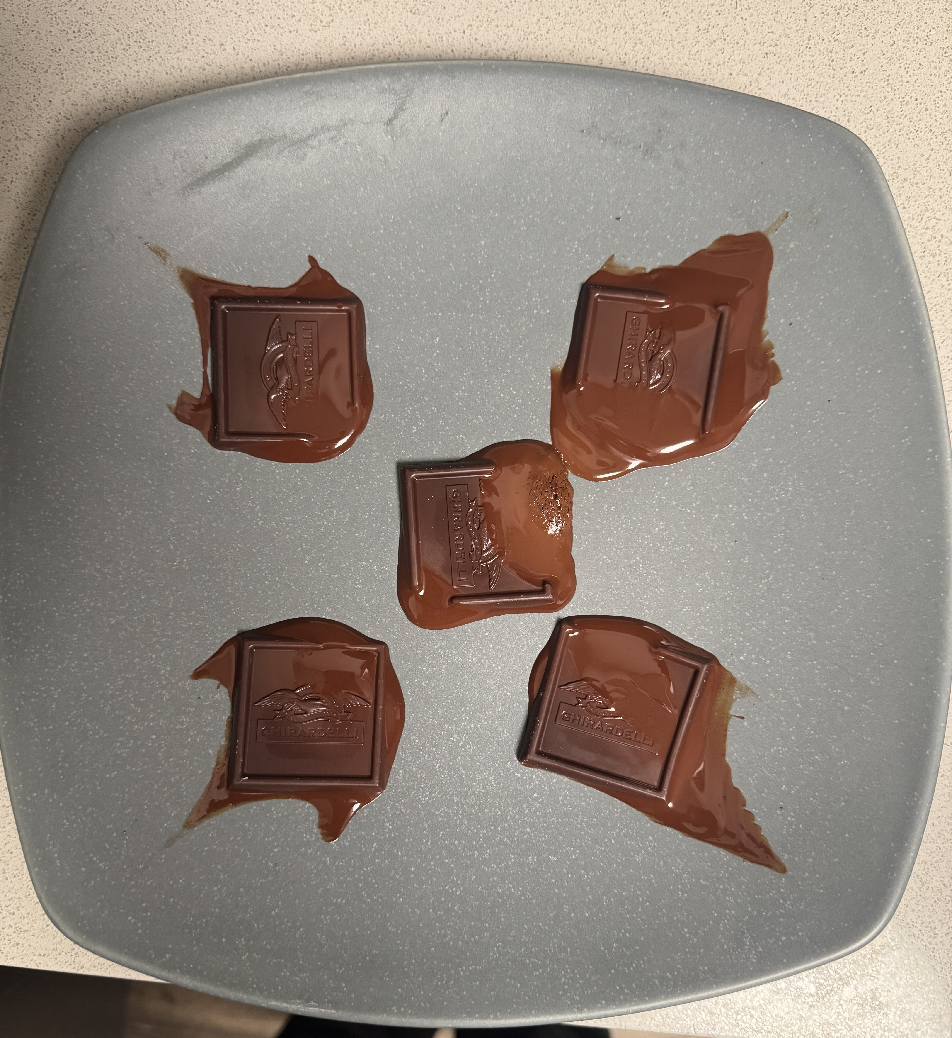
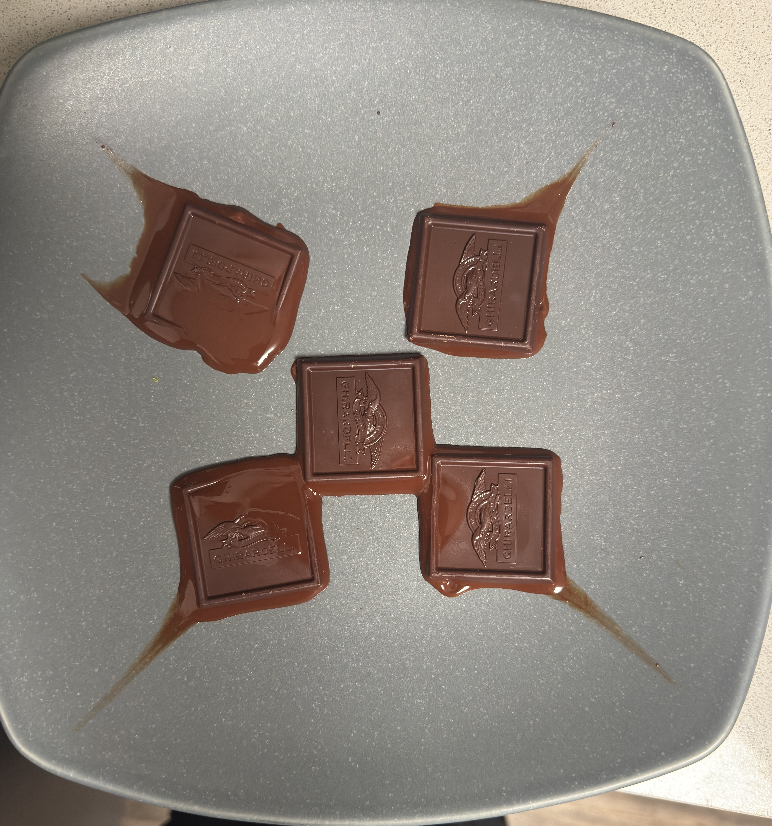
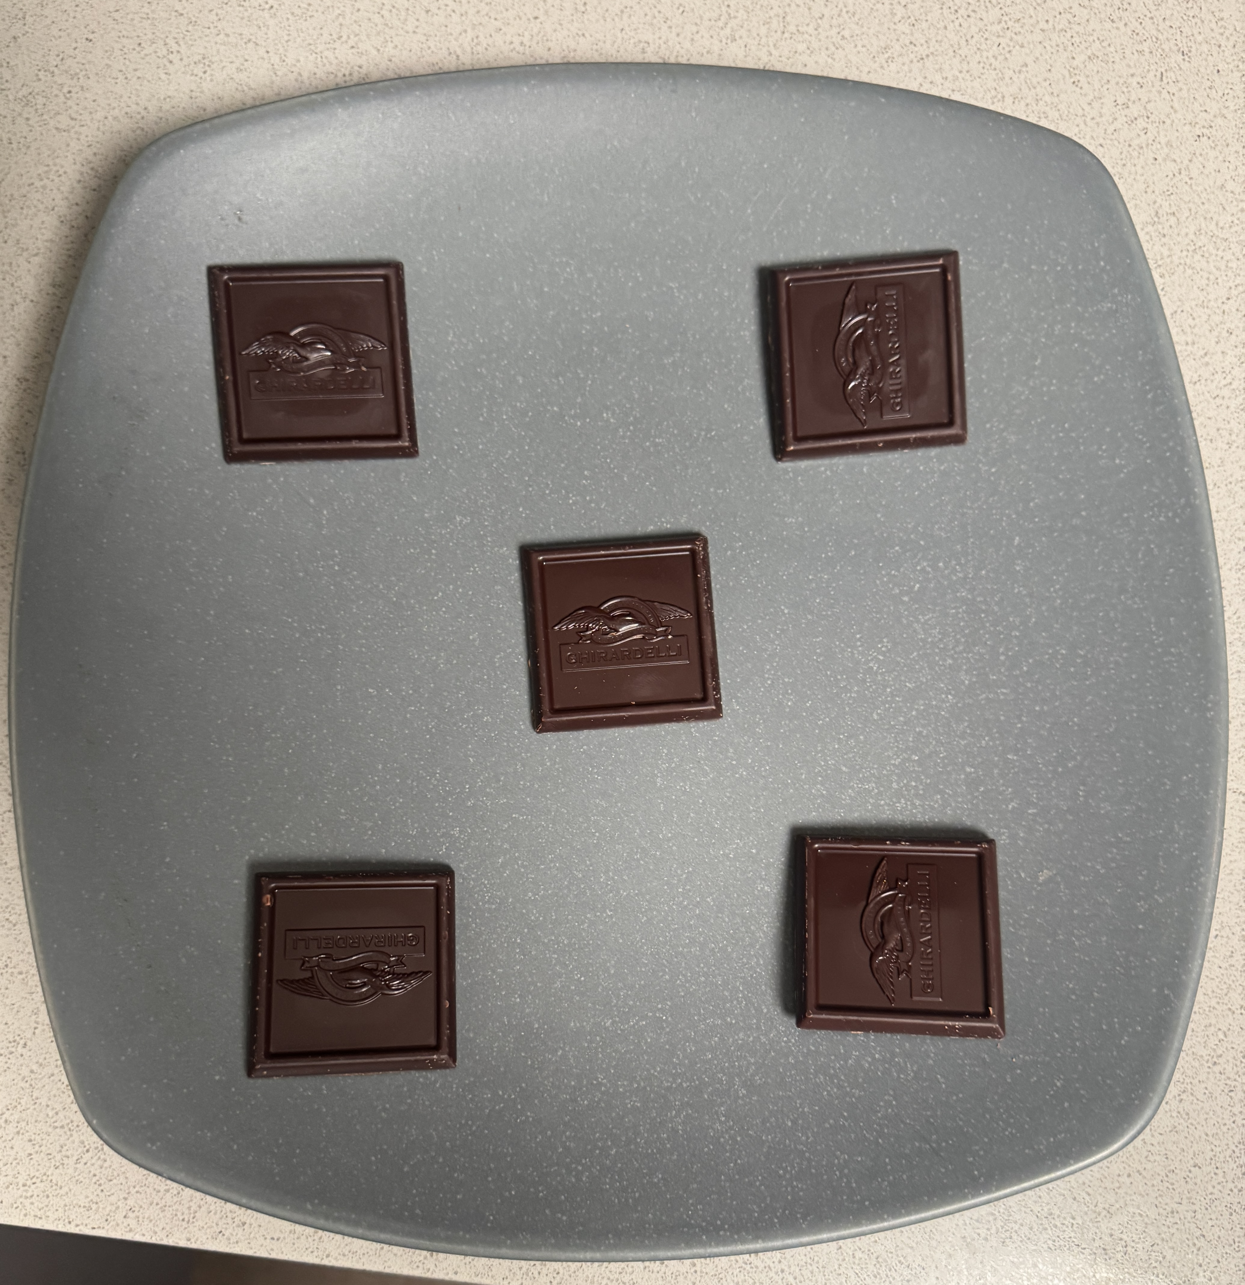
Real Life Demo
Original 1 minute, stationary 1 minute, rotating

Slide 9
Sources
https://davidmorin.physics.fas.harvard.edu/sites/g/files/omnuum12331/files/2025-10/waves_miscellaneous.pdf
https://remote2.ece.illinois.edu/~erhan/FieldsWaves/secure/notes/ECE450Sp10/350lect33.pdf
https://www.sfu.ca/phys/346/121/resources/physics_of_microwave_ovens.pdf
https://www.multiphysics.us/thermoelectromagnetics.html
https://docs.scipy.org/doc/scipy/reference/generated/scipy.ndimage.rotate.html

