Slide 1

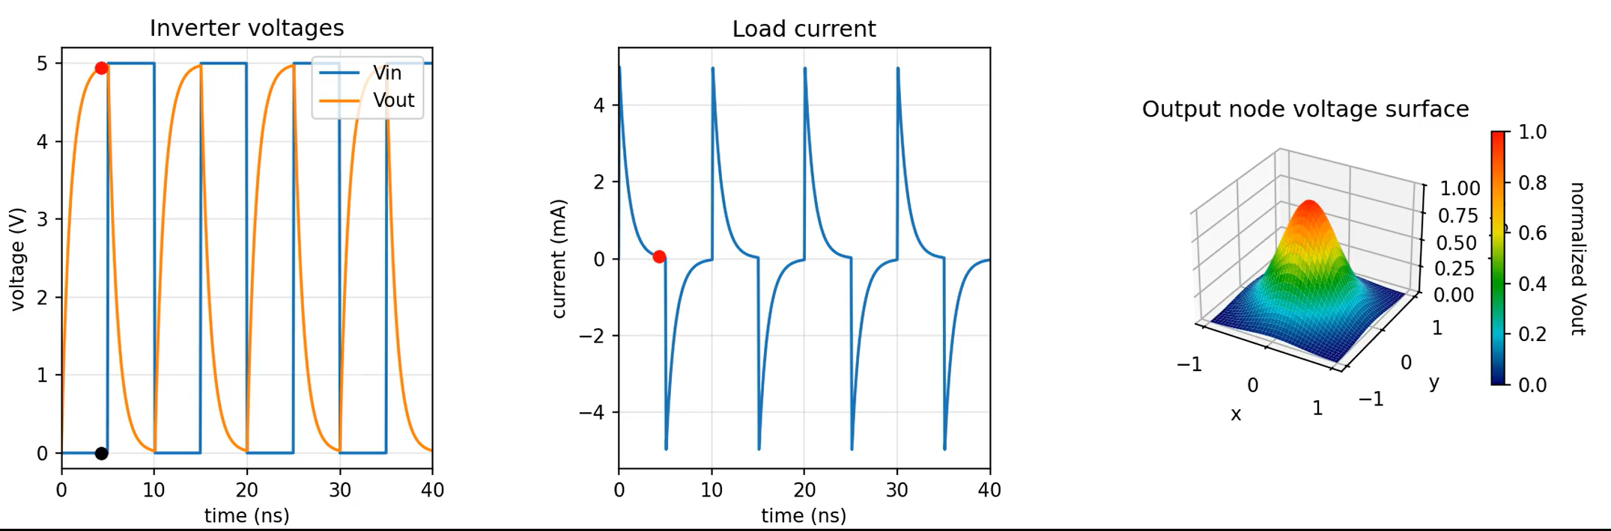
Switching Dynamics of a CMOS Inverter by Dorukhan User

Slide 2
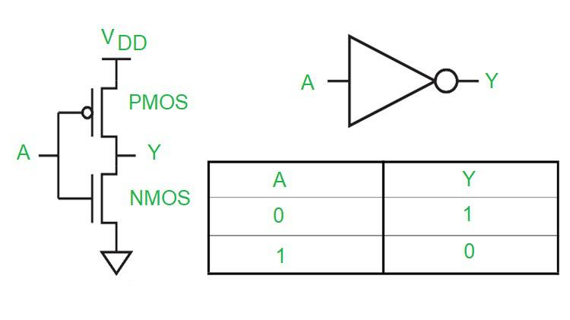
Project Overview and simulation method
I simulated the transient switching behavior of a CMOS inverter and visualized how the output node responds when the input toggles between logic states.
Simulation Method: Solved a system of ordinary differential equations (ODEs) describing the RC behavior of the inverter. There are PMOS/NMOS resistances and integrates dV/dt over time
Goals:
Model the charging and discharging of the load capacitance
Compute the resulting transient output voltage and load current
Visualize the switching event using a dynamic 3D surface plot
Key Outputs:
Input voltage waveform
Output voltage transition
Load current during charging/discharging
3D surface heat map
Note: To start the code, put the ffmpeg file and the Dorukhan_Code.ipynb file at the same folder and run the code.

Slide 3
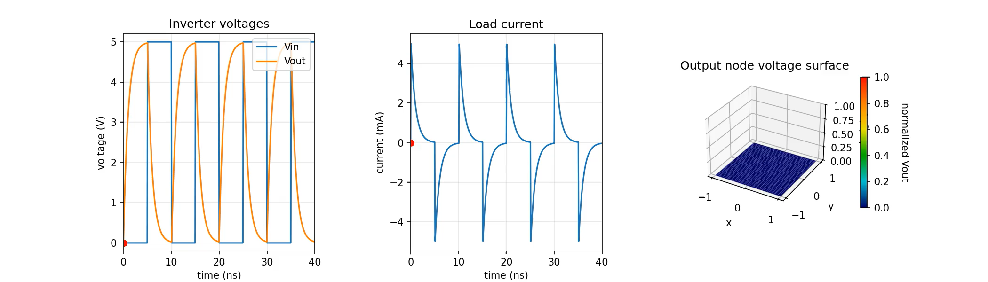
Animation ☺

