Slide 1
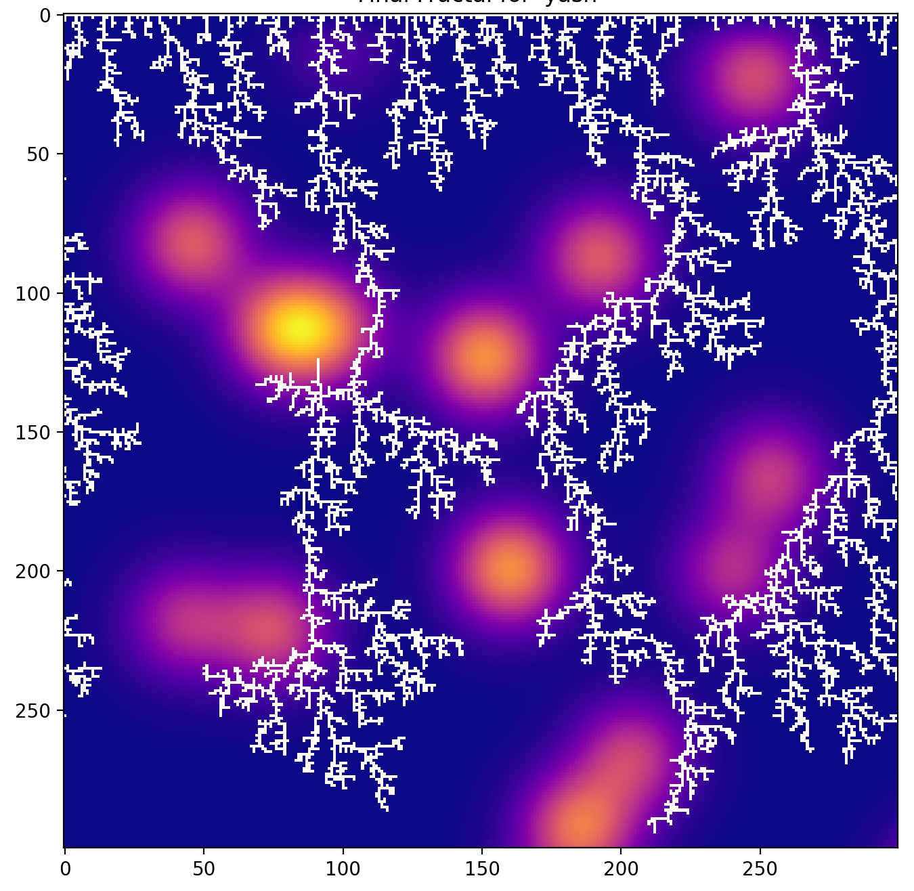
Text-Driven Diffusion: A Semantic + PDE Diffusion-Limited Aggregation
Yash Thapliyal

Slide 2
Topic + Methods of Simulation
This project explores how textual meaning can influence physical-style growth processes by combining:
Diffusion-Limited Aggregation (DLA) A classic particle-based fractal growth model where particles perform a random walk and stick when they touch the existing structure.
Partial Differential Equation (PDE) Field A 2D heat-diffusion equation is solved to generate a continuous scalar field. In this model, particles are repelled by high-value regions, causing the DLA fractal to bend and grow around PDE “hotspots.”
Semantic Encoding of Words Input words are converted into numerical features (stickiness, directional drift) using simple NLP-based heuristics. This “semantic signature” modifies the DLA’s movement probabilities.
Goal: To see how different words create different PDE fields and how those fields shape the resulting DLA fractal.

Slide 3
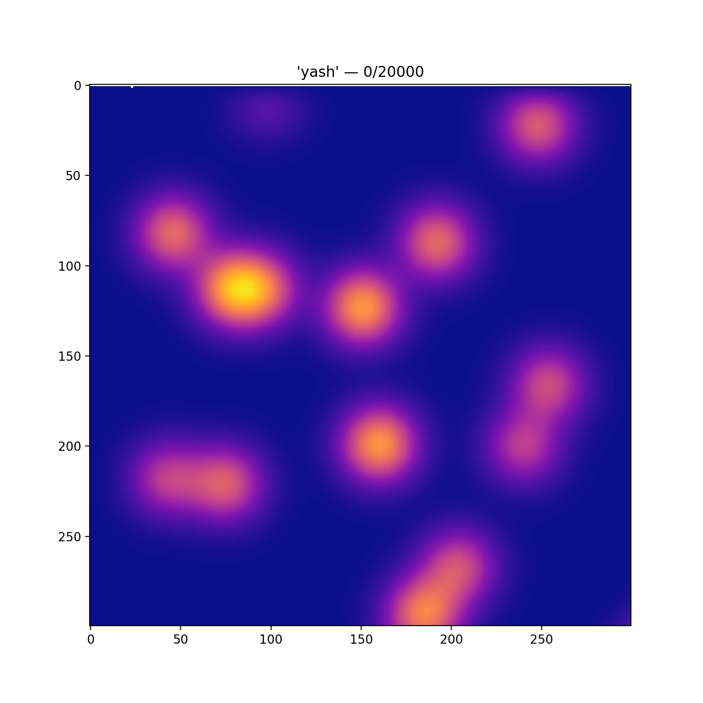
Animations!
This is for the word: Yash

Slide 4
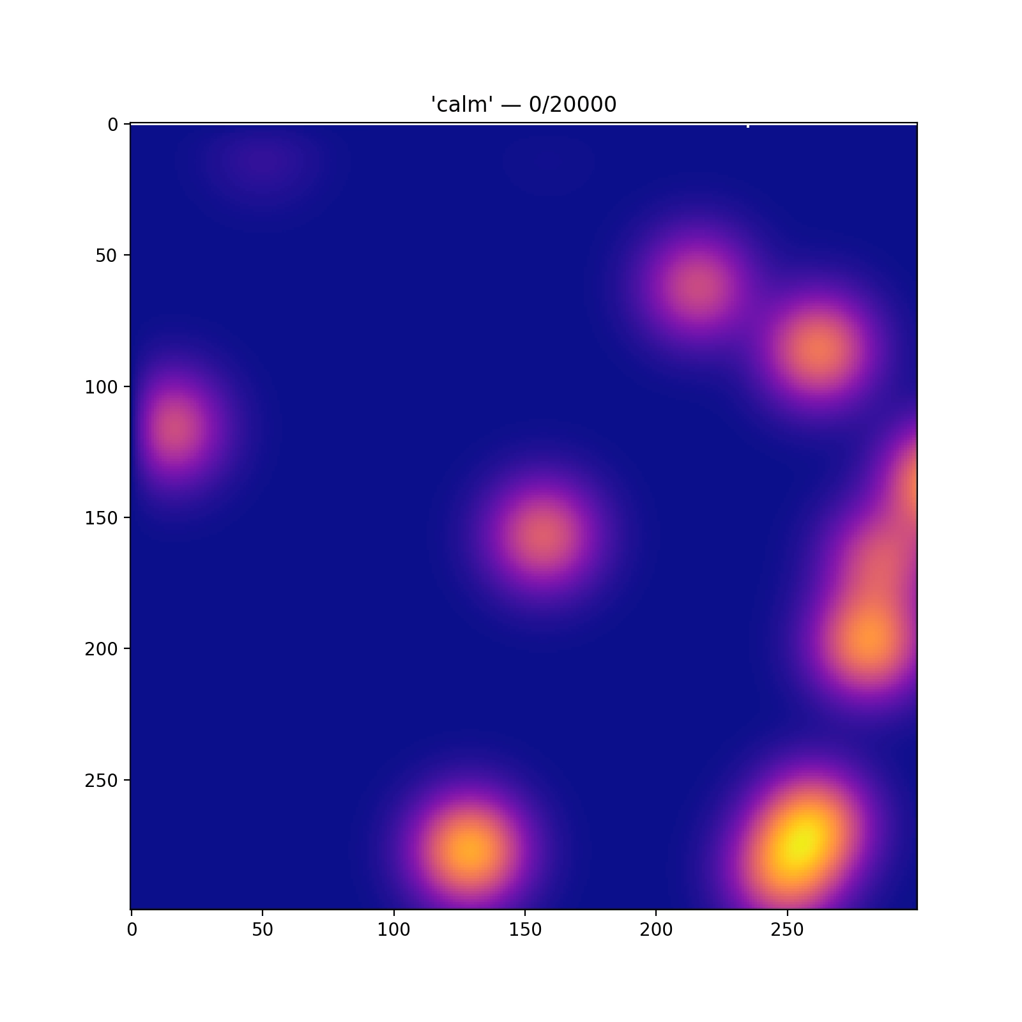
Animation 2:
This is for the word: Calm

Slide 5
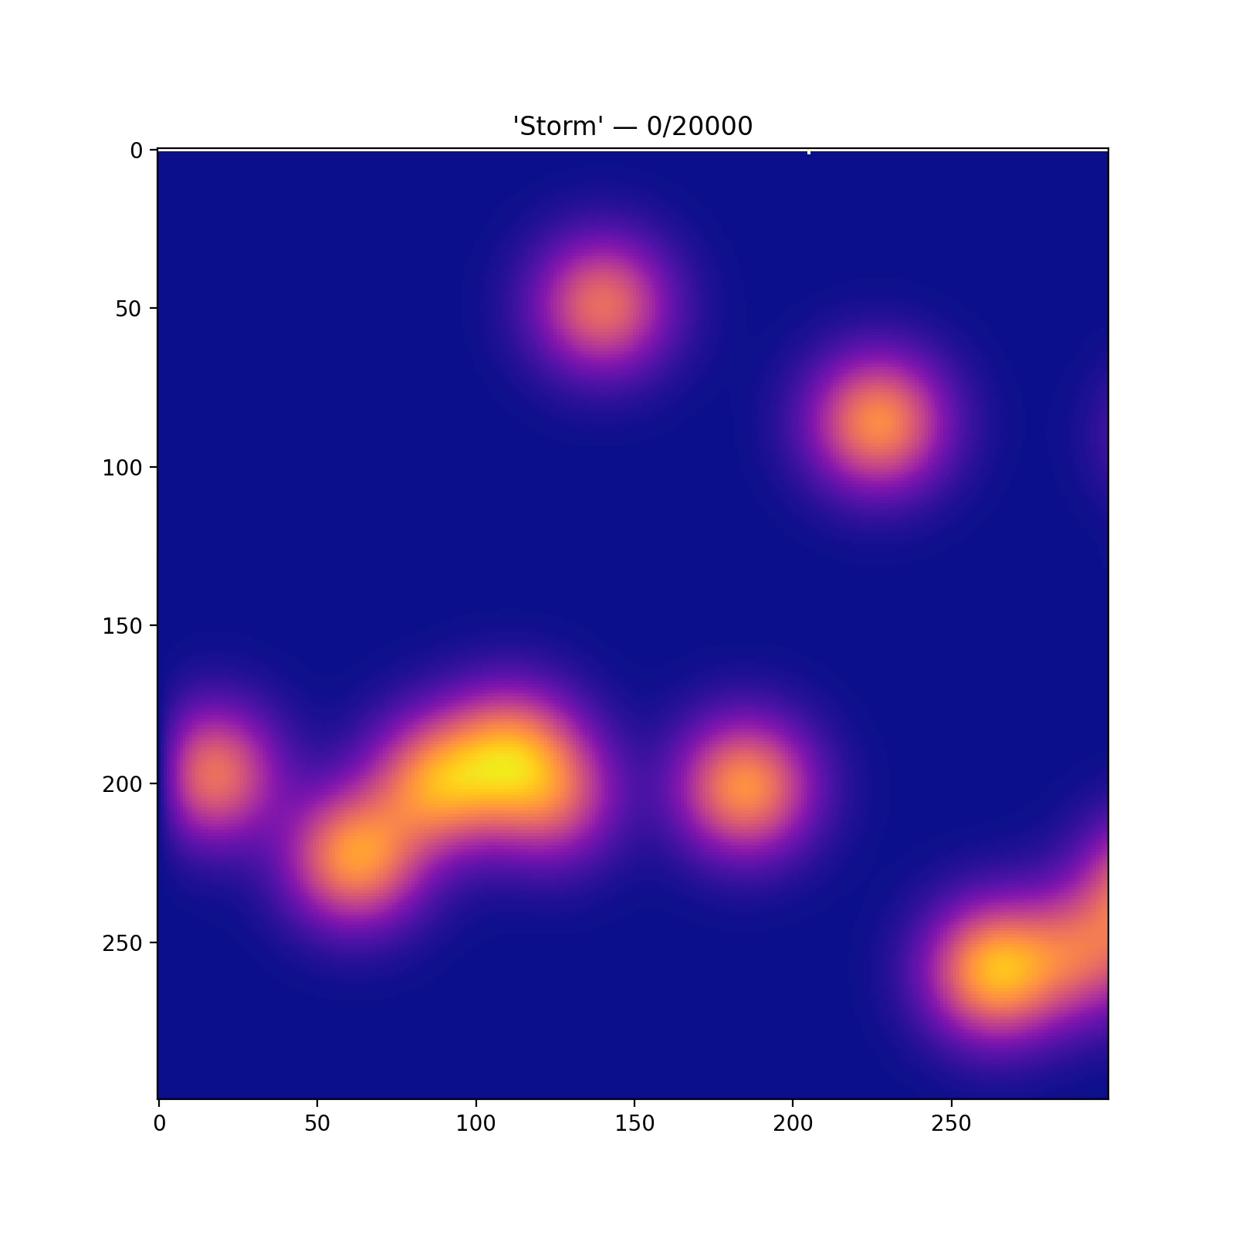
Animation 2:
This is for the word: Storm

