Slide 1
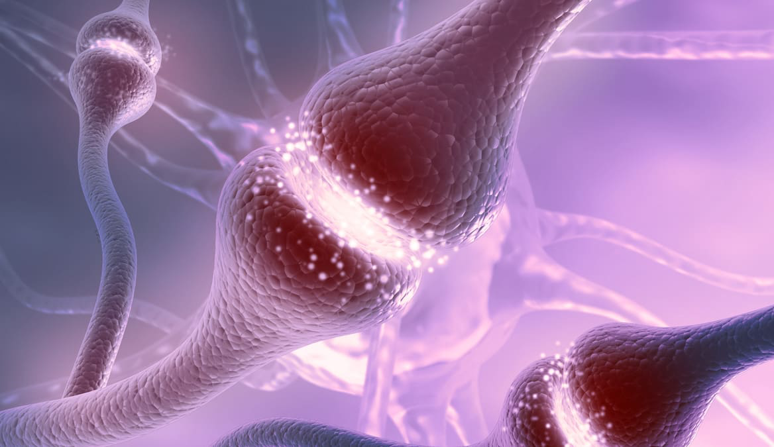
Neurotransmitter Diffusion Across Synapse
Pracheeti Shikarkhane EPS 109

Slide 2
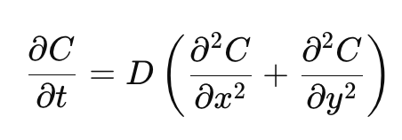
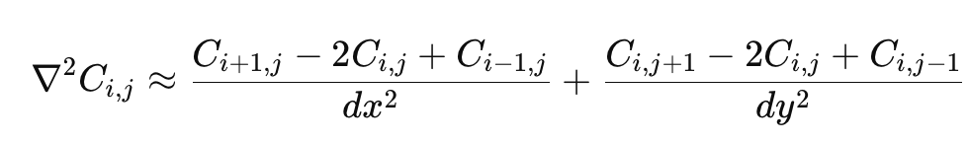
Methodologies: Basic
Goal: Simulate the diffusion of neurotransmitters released from the presynaptic terminal as they spread through the synaptic cleft and bind at the postsynaptic membrane
2D Diffusion Equation with boundary sink
Concentration peak near the presynaptic membrane (x=0) which represents neurotransmitter released from synaptic vesicles
Right boundary simulates neurotransmitter binding and acts as a sink
Discretize the continuous derivative to achieve

Slide 3
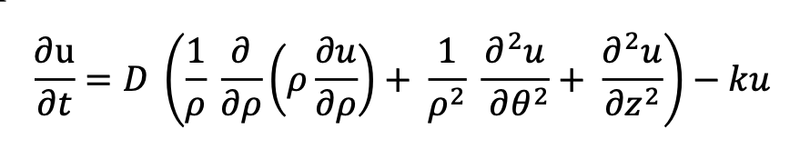
Methodologies: Advanced
Models neurotransmitter dynamics in the synaptic cleft following vesicle release and enzyme degradation. Used the analytical diffusion equation derived by UCSD researchers.
Model the diffusion process of glutamate over time along three dimensions in a cylindrical space (radial rho, vertical z). U is the concentration, K=100 s⁻¹ is the degradation rate, D=0.02 μm²/s is the diffusion constant, Z is cleft height.
Initial conditions are a Gaussian peak at the presynaptic membrane center (ρ=0, z=0). Boundary conditions include symmetry at ρ=0, absorption at the postsynaptic membrane (z=20 nm), and absorption at the active zone edge (ρ=400 nm). The simulation captures both radial spreading across the active zone and vertical diffusion toward postsynaptic receptors, demonstrating the competition between molecular diffusion and enzymatic degradation that shapes synaptic transmission timing and spatial precision.
Modeling Diffusion Process of
Neurotransmitter Across Synapse, UCSD

Slide 4
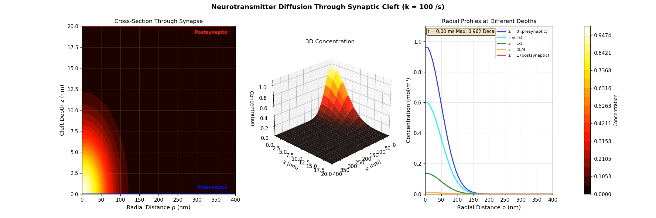
Simulation
Neurotransmitter_diffusion_ADVANCED.py

Slide 5
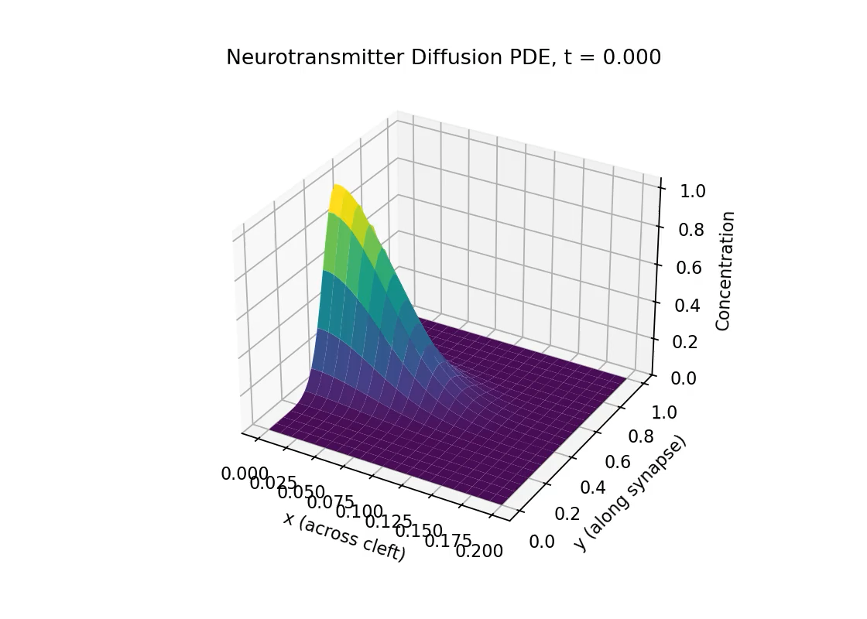
Simulation
final_pde_neurotransmitter.ipynb

Slide 6
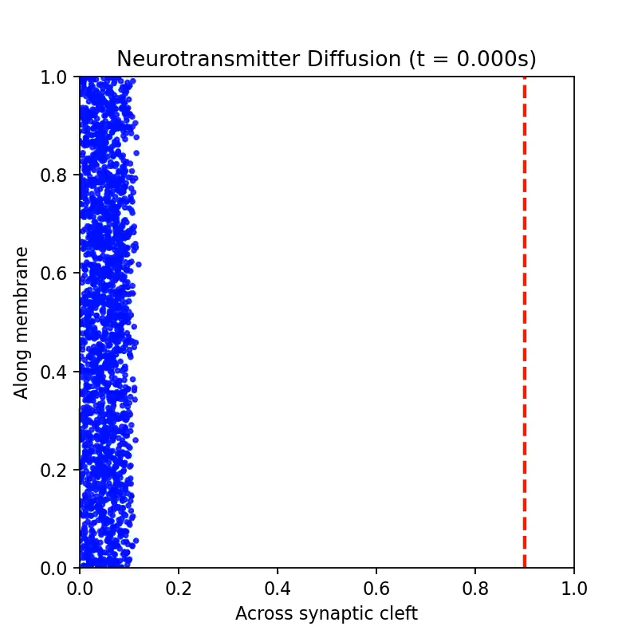
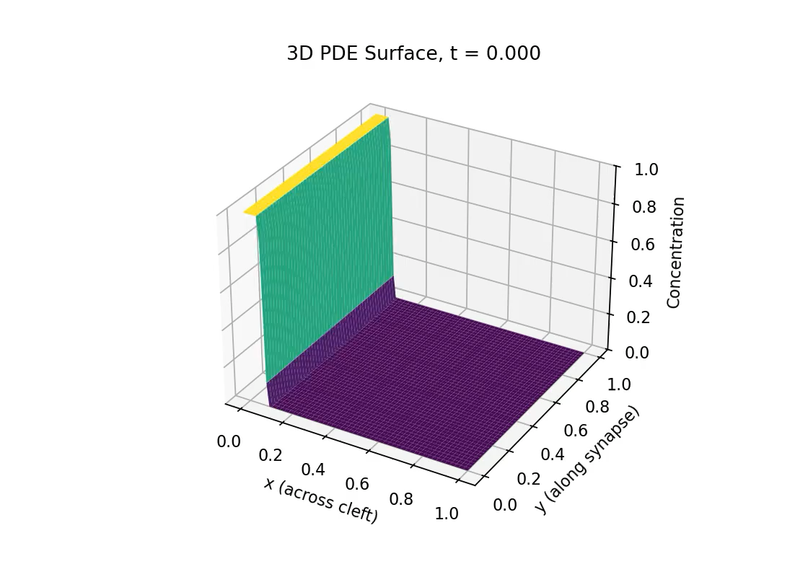
Simulation
random_walk.ipynb
wave_pde.ipynb

Slide 7
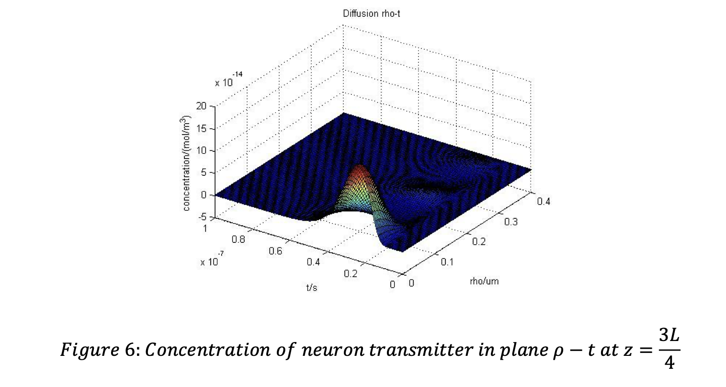
Sources
Class notes/labs/hw on PDE and random walk
Paper on neurotransmitter diffusion simulation: https://isn.ucsd.edu/courses/beng221/problems/2013/project-11-Modelling%20Diffusion%20Process%20of%20Neurotransmitter%20Across%20Synapse.pdf

