Slide 1
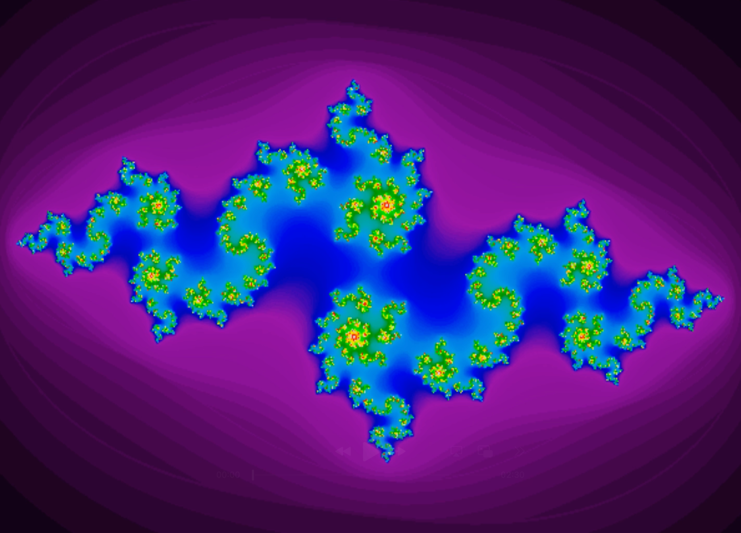
Musical Fractals
Avni Shah

Slide 2
Simulation Details
Julia Sets
Coordinates of the fractal evolve in real time based on music input.
Music21
.mid (midi files)
Instructions for playing music, not the actual song itself.
Mapping
Bass → Pulse zoom (lots of black area = bass detected)
Volume → Texture (loud = fuzzier/more distorted, softer = thinner, clearer)
Melody → Shape (lower = shorter tendrils, higher = longer)
Best practices: consistent BPM, distinct instrument ranges
Mandelbrot = travel, Julia = morphing… The Julia set yields more engaging visuals.

Slide 3
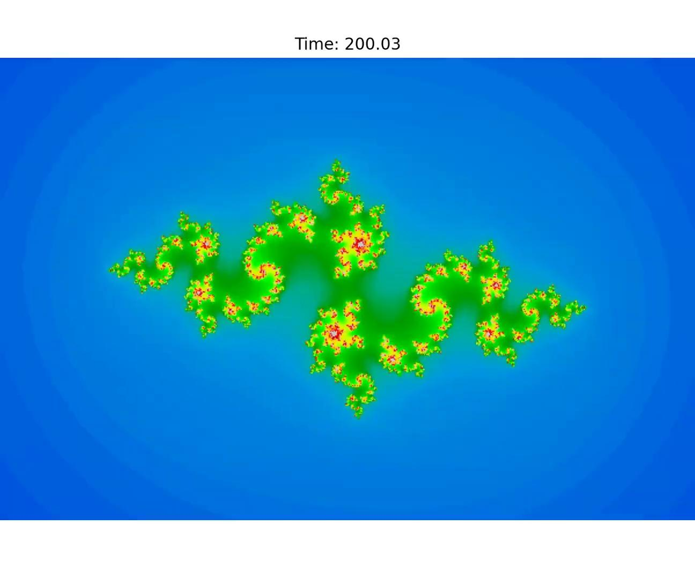
Song: Superstition by Stevie Wonder
Disclaimer: the video file for the whole song was larger than the 50 MB limit, so I cut the final product to the last 53 seconds

