Slide 1
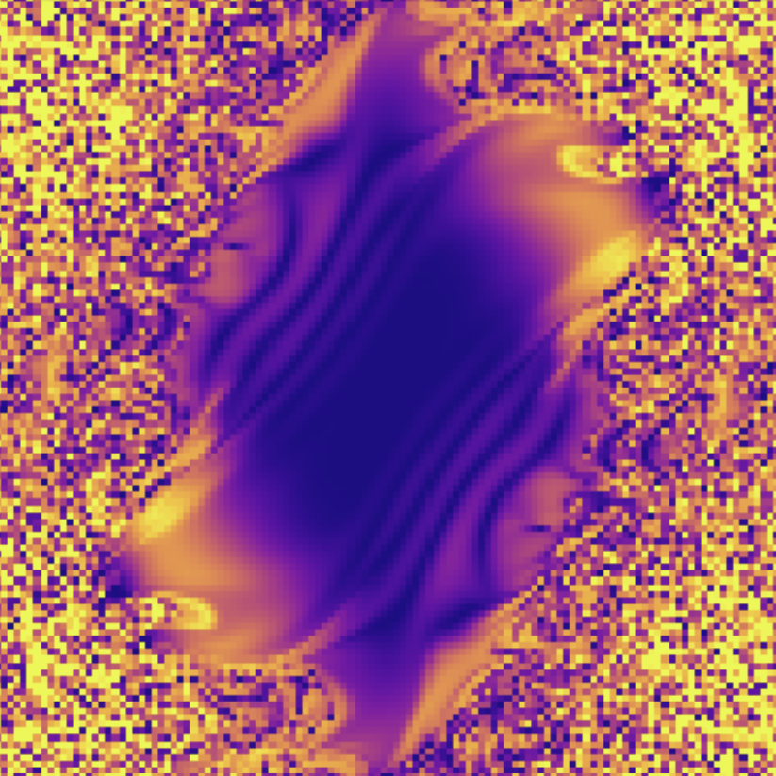
Stability Amidst
the Chaos of
Double Pendulums
Nate Russell

Slide 2
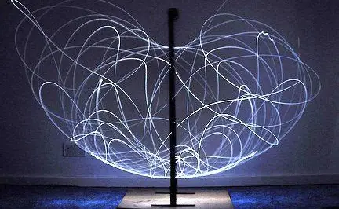
Overview
Double pendulums are a well known and commonly used example of a chaotic system. However, there are many initial positions, mainly ones low in potential energy, that result in predictable, non-chaotic systems.
We explore this region by watching a grid of double pendulums over time, and noting the regions that don’t evolve into chaotic noise.
We can also trace the path of a pendulum in position space across the stable region.

Slide 3
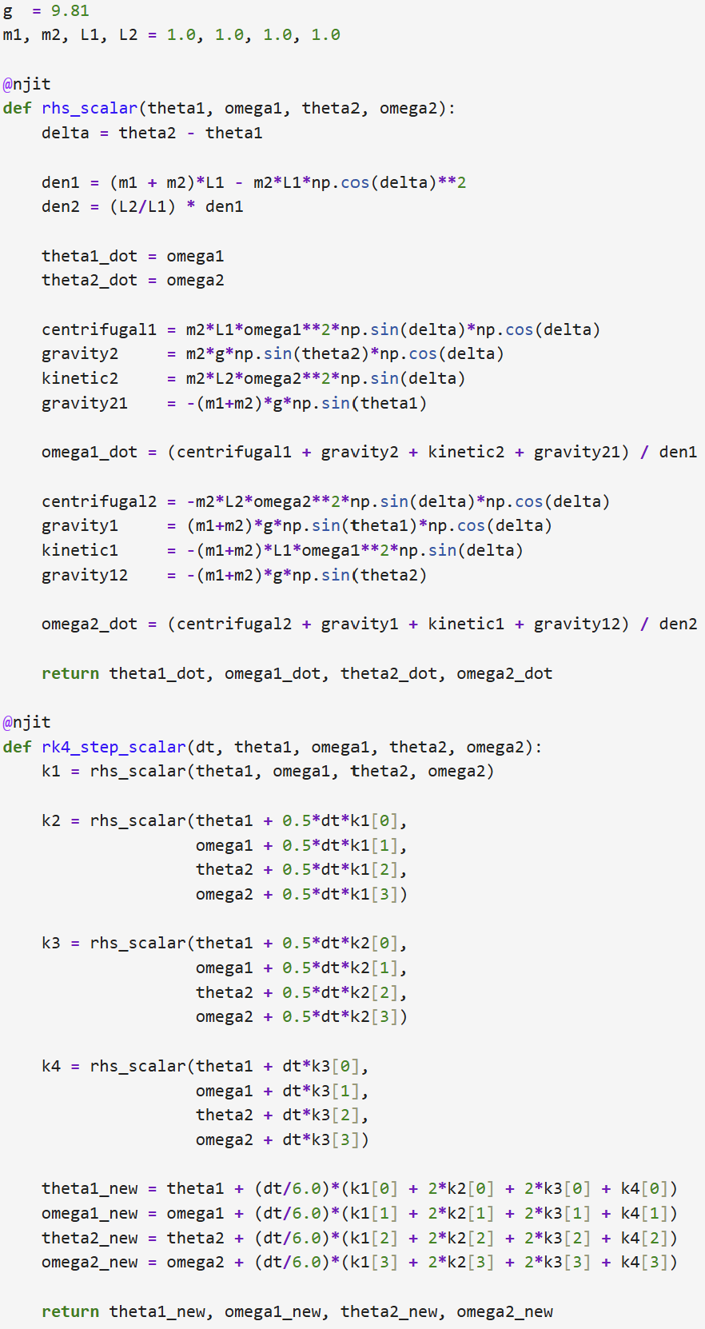
Simulating a Double Pendulum
We use the Runge-Kutta method, specifically RK4, to simulate the changes in position and velocity over small time-sets dt. While it’s important to note that the Runge-Kutta method does not conserve energy, our simulation will not run long enough for the energy to significantly diverge. Since we intend to simulate a large grid of pendulums, our RK4 function needs to be vectorized in order to compute multiple pendulums at once. Solving each pendulum individually would lead to absurd run-times.
This still needs a great number of calculations, so we use Numba to avoid needing to rely on nested loops, which severely slow our calculation.

Slide 4
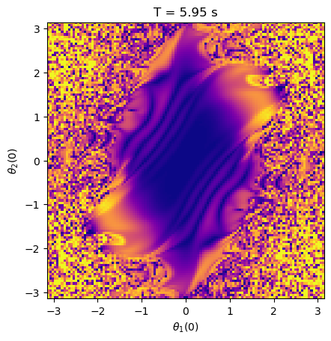
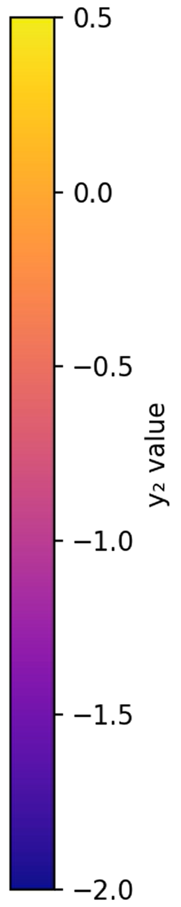
Initial Run
If we plot the lower pendulums’ y positions after letting them evolve for even a short amount of time, we can immediately see a fractal emerge.
Surrounding it is chaotic noise, with bright yellows suggesting that the lower pendulum is being tossed high in the air.
However, the fractal exhibits smooth regular, outward-travelling ripples that suggest predictable behavior being exhibited by the pendulums.
The fact that the fractal is approximately ellipse shape and centered at no elevation (no kinetic energy) suggests that pendulums with small initial angles, and thus lower initial potential energy, are much less likely to behave chaotically.

Slide 5
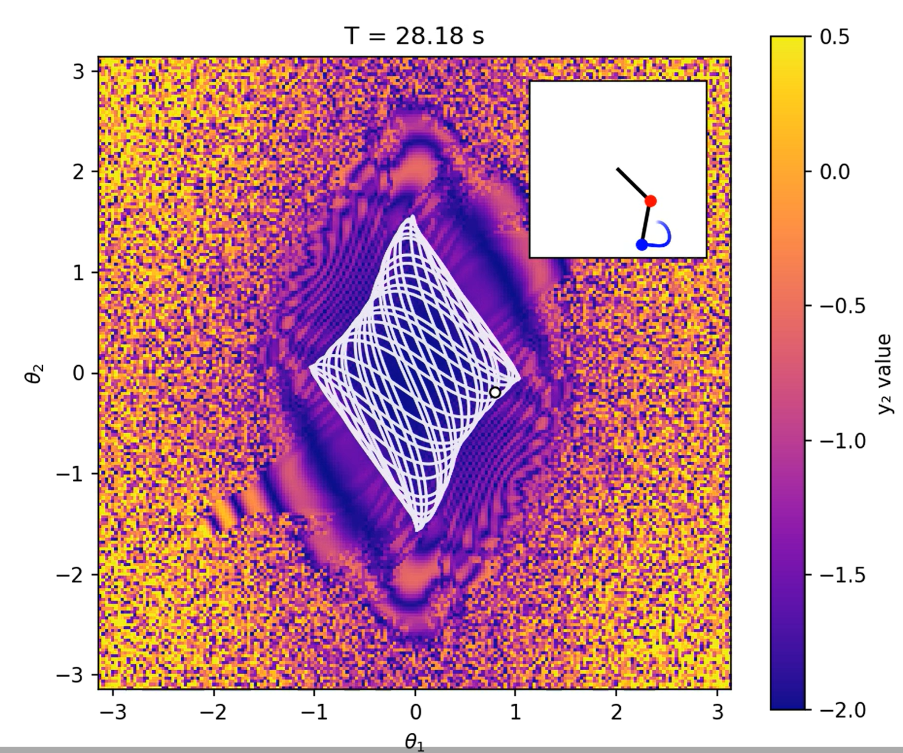
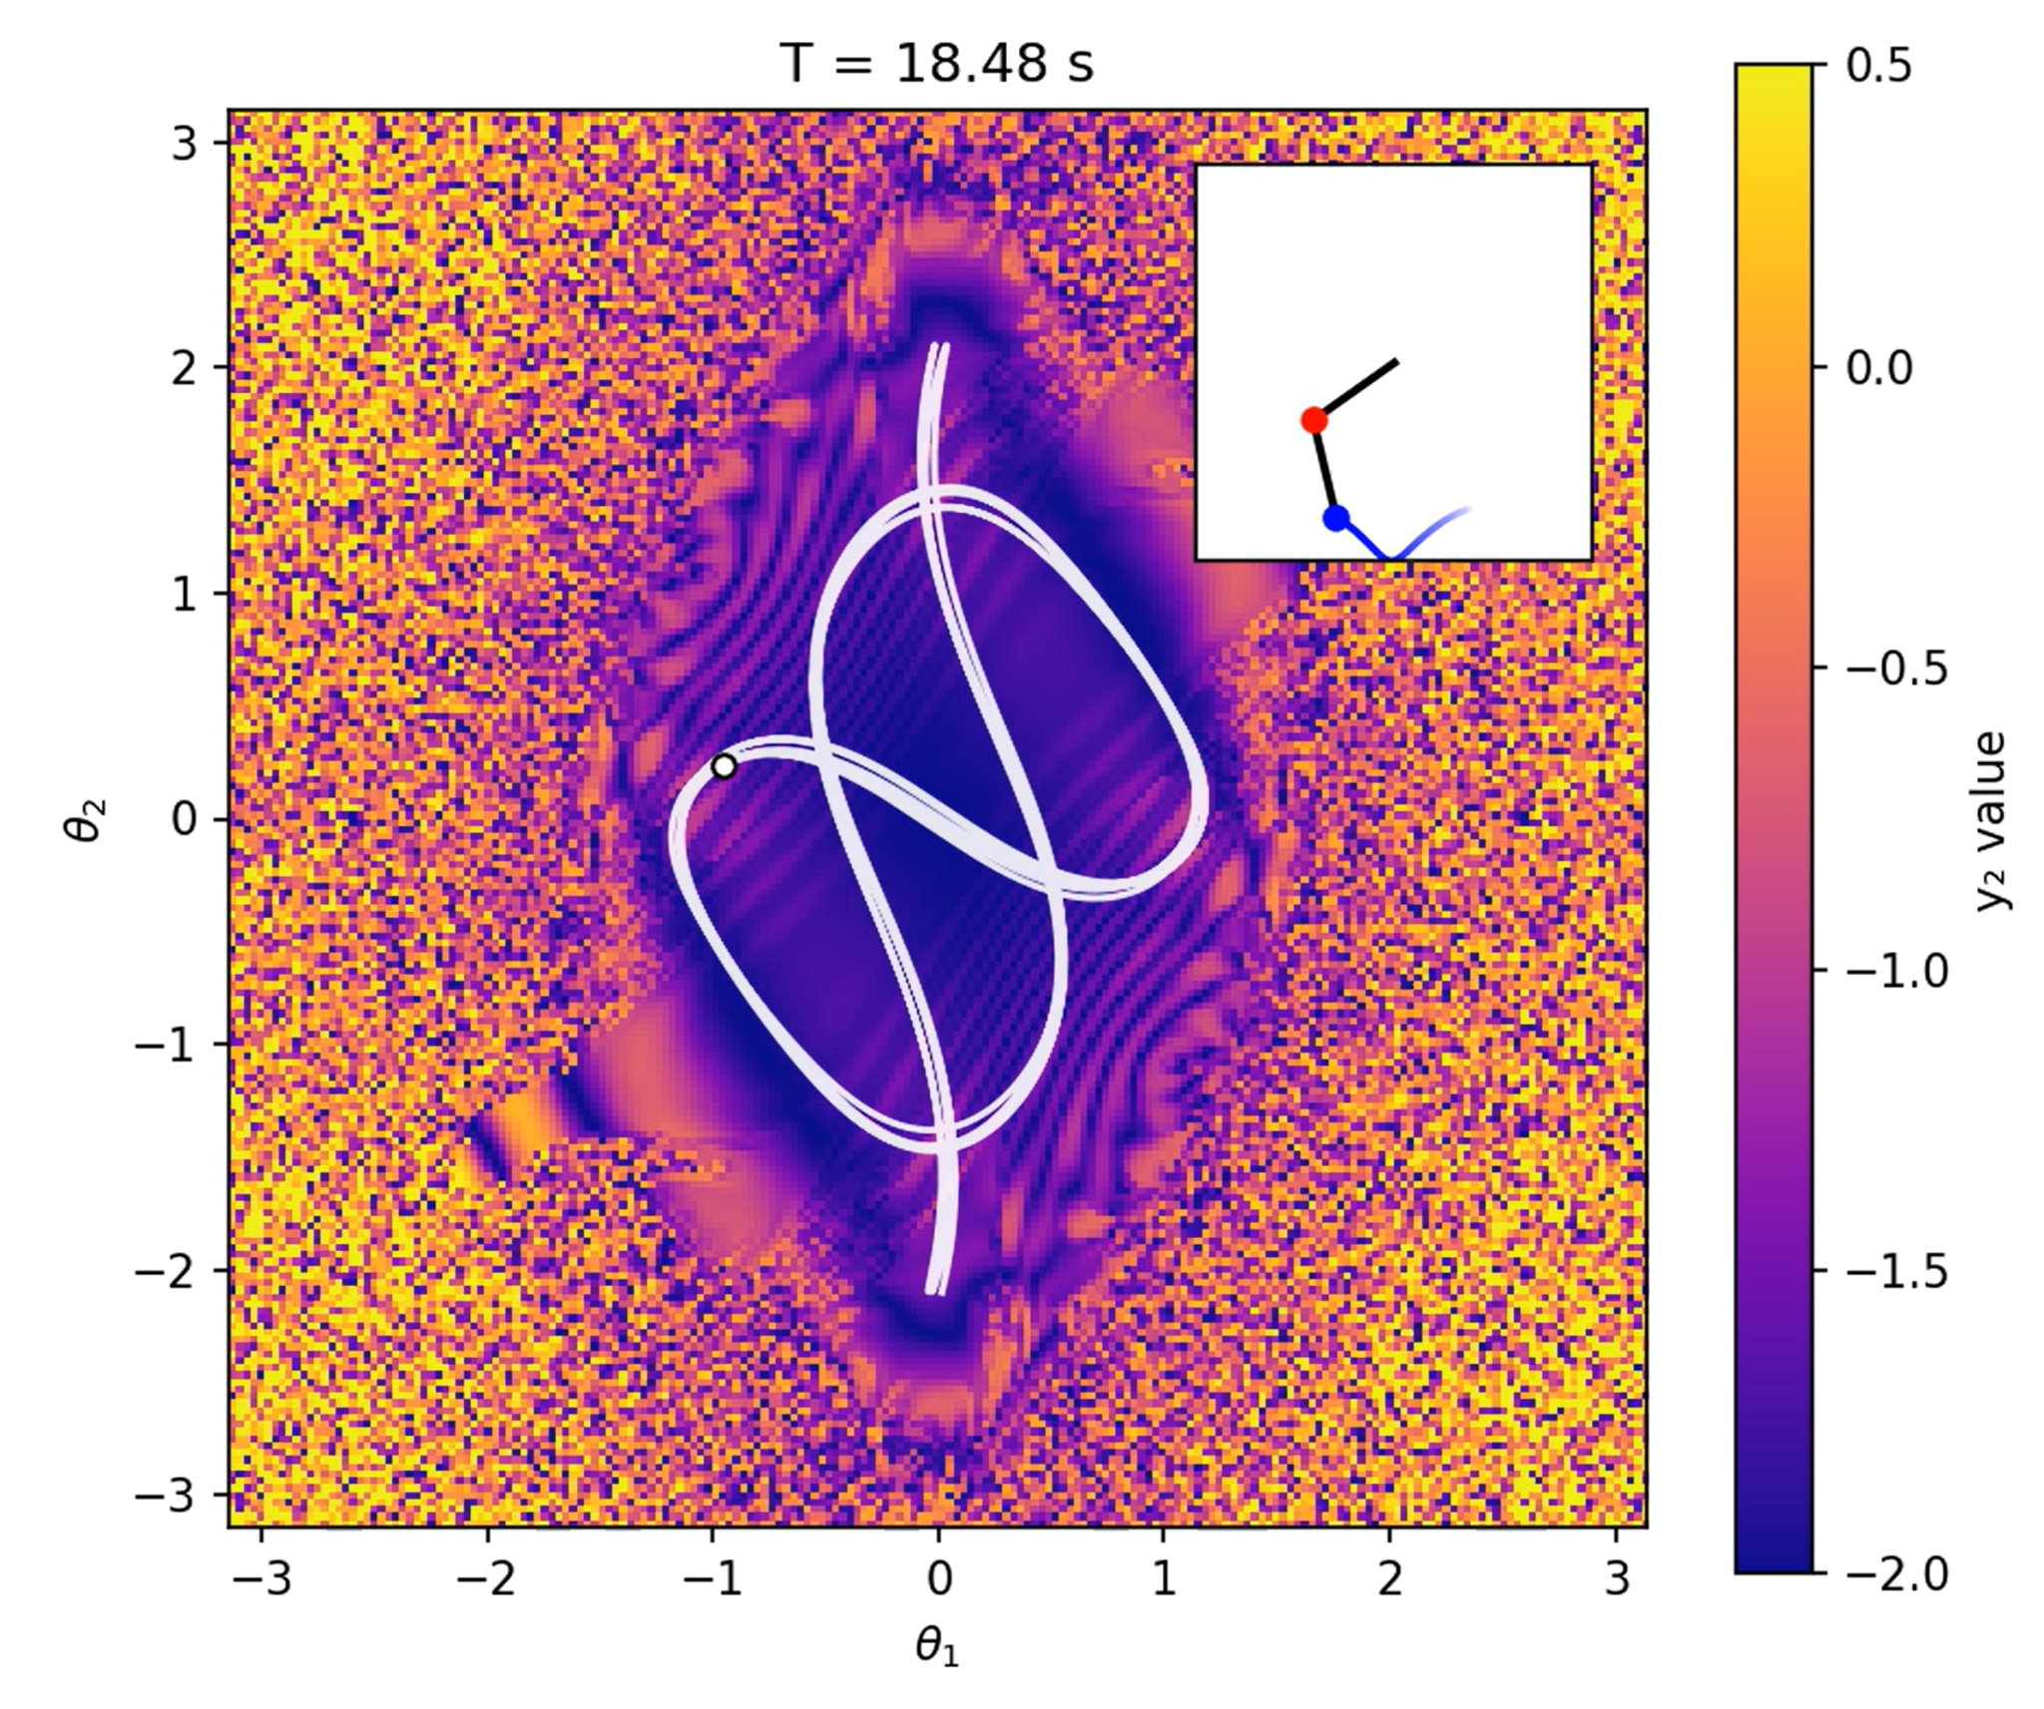
Traced Paths
If we follow the path specified pendula trace through momentum space, we can see that they trace a non-chaotic path that appears somewhat bounded by the fractal.
If the initial angles lie at the edge of the fractal, the trajectory might explore the interior of the fractal briefly before becoming chaotic. However, starting within the bounds of the fractal will lead to a non-chaotic system.
A sufficient amount of runs show that the traced path progresses slightly, but does not deviate from its course significantly enough to become chaotic.

Slide 6
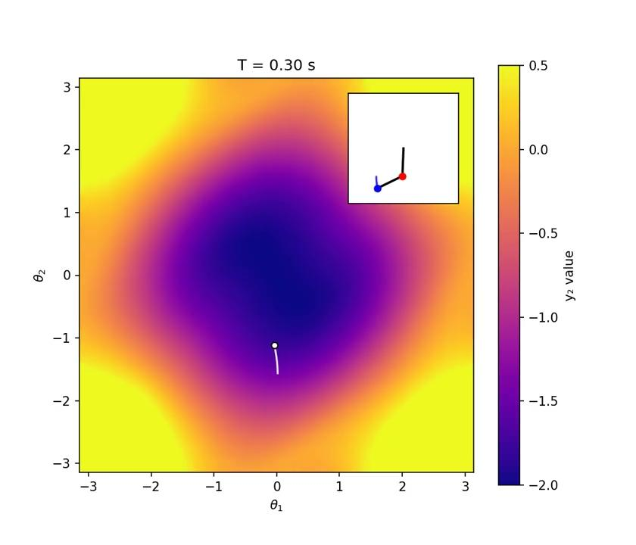

Slide 7
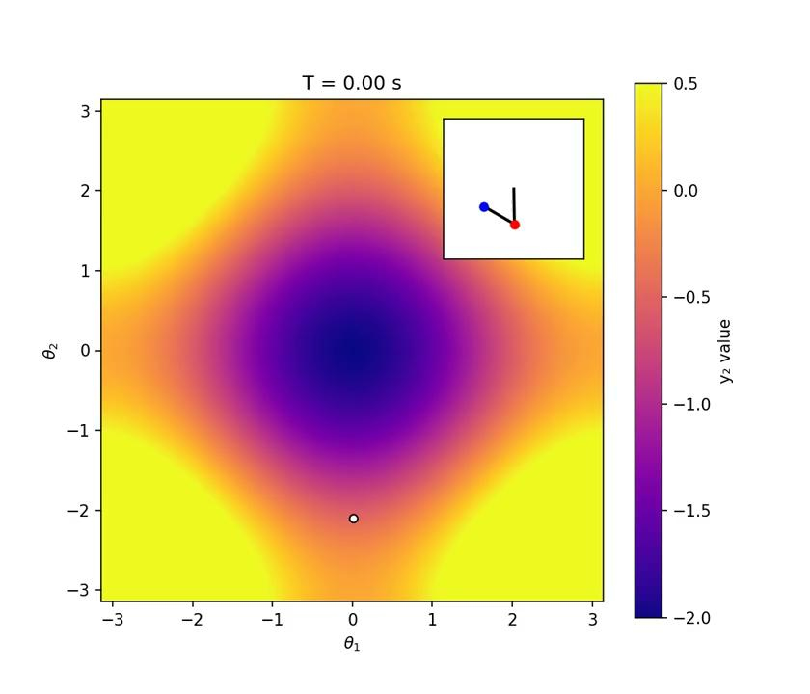

Slide 8
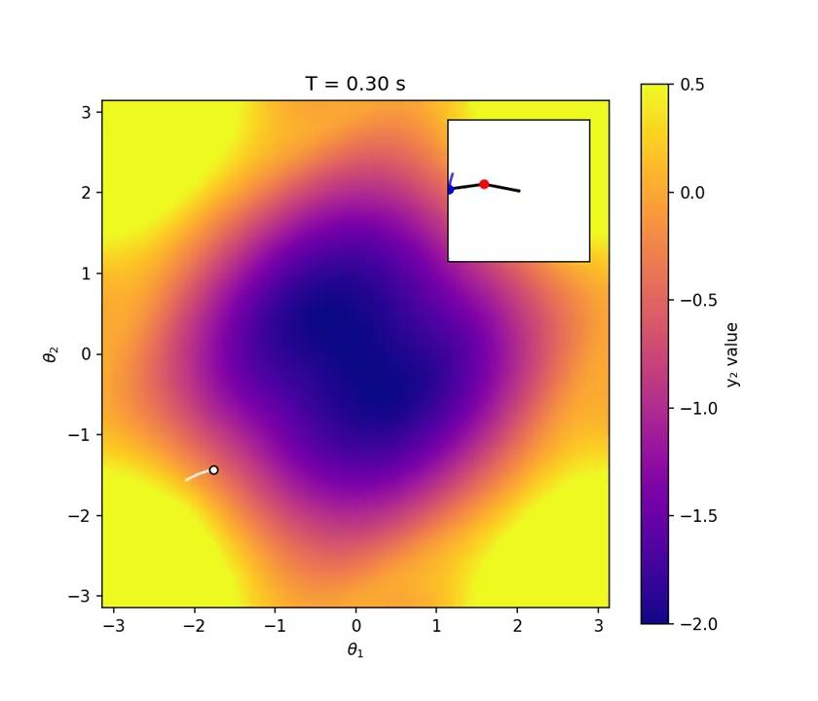

Slide 9
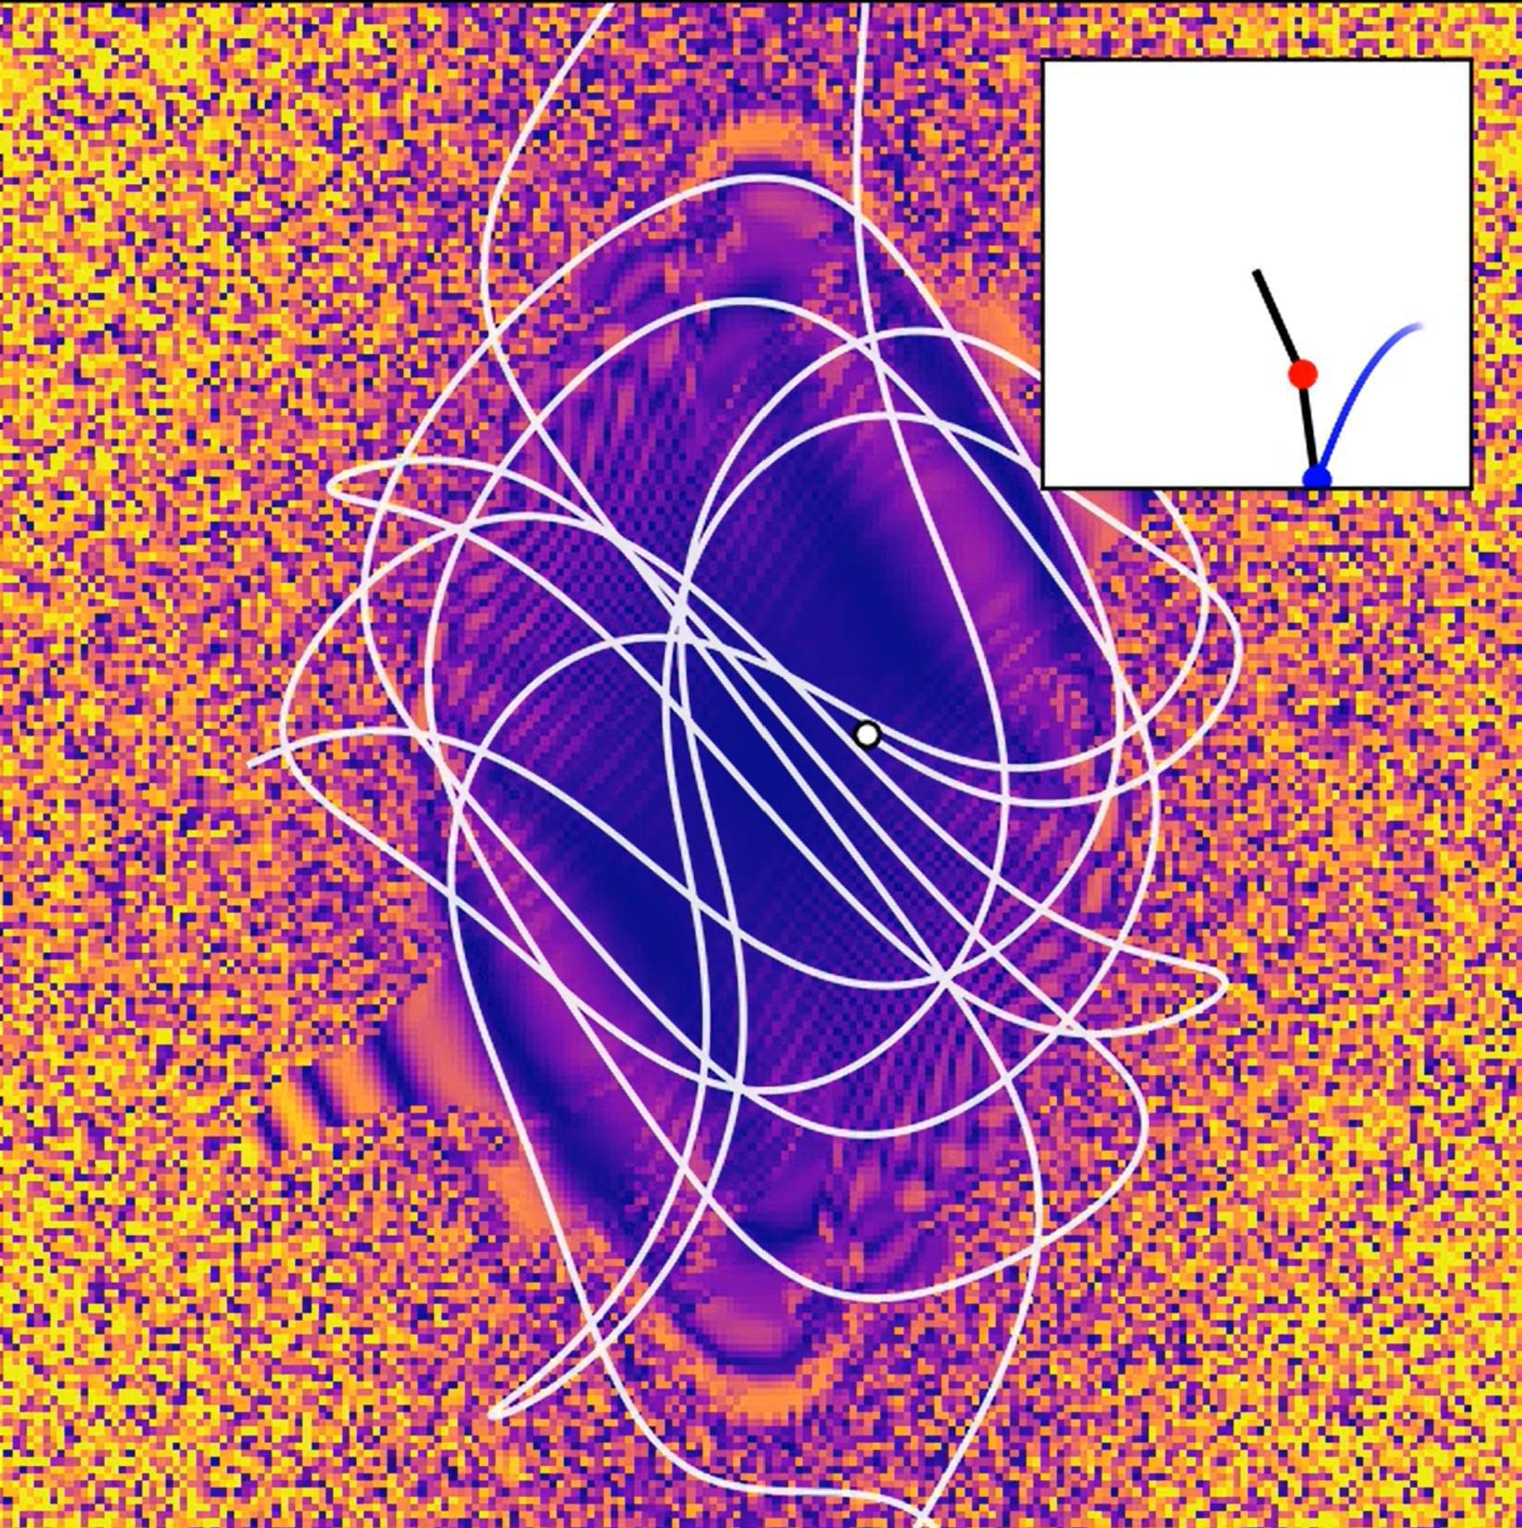
Unstable Pendulums
Following are some pendulums that start barely outside of the fractal and quickly diverge, following an irregular path across position space.
For each of these I slightly increase the total energy of the system by slightly lifting the pendulum directly attached to the fulcrum. The resulting paths are very different from each other.

Slide 10


Slide 11


Slide 12


Slide 13
Further Paths
Although the resolution from our simulation is not enough to show it, there exist some small islands away from the main fractal that maintain their stability.
I discarded the idea of using a kernel to sharply define the shape of the fractal, as the raw data better demonstrated the core concept of convergence vs divergence.
I settled on simulating the pendula in position space to nicely demonstrate the constrained path it follows, however starting the pendulums with varying momenta rather than position yields an entirely new fractal worth exploring.

