Slide 1
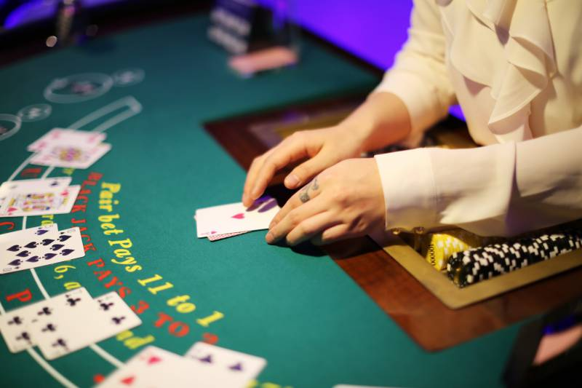
Simulating How Different Rules Affect House Edge In Blackjack By Zak Robertson
Casino de Monte Carlo

Slide 2
What is Blackjack?:
Card game where you get 2 cards, and your goal is to get the sum as close to 21 without going over.
You get two cards face up, and the dealer gets two with only one face up
Player goes first, then dealer
Player’s turn:
Hit: get another card. If you go over 21, you “bust” and automatically lose
Stand: end your turn
Double: get one more card and double your bet
Split: split hand into two separate hands, and hit both
Can only split two of the same card
Must double bet
Dealer’s Turn:
Dealer reveals card
If their total is less than 17, they must “hit”
If their total is less than yours or they “bust,” you win
In a tie, you get your bet back (“pushes”)
My Simulation:
Monte Carlo simulation of blackjack hands to see how different rulesets and strategies affect the house edge
10 million rounds per variation (10 players, 1 million rounds each)
Each hand played with “basic strategy”
Mathematically-optimal choice each turn
Rule/Playstyle Variation | EV (% of bet size) | Error
Standard rules | -0.01378% | ±0.00036
Blackjack pays out 6:5 rather than 3:2 | -0.02758% | ±0.00036
Dealer hits on soft 17 | -0.01640% | ±0.00036
Player always takes insurance when offered | -0.01559% | ±0.00036
Can’t double after split | -0.01559% | ±0.00036
4 Deck Shoe | -0.01350% | ±0.00036
8 Deck Shoe | -0.01429% | ±0.00036
Dealer doesn’t check for blackjack before player turn | -0.02211% | ±0.00036

Slide 3
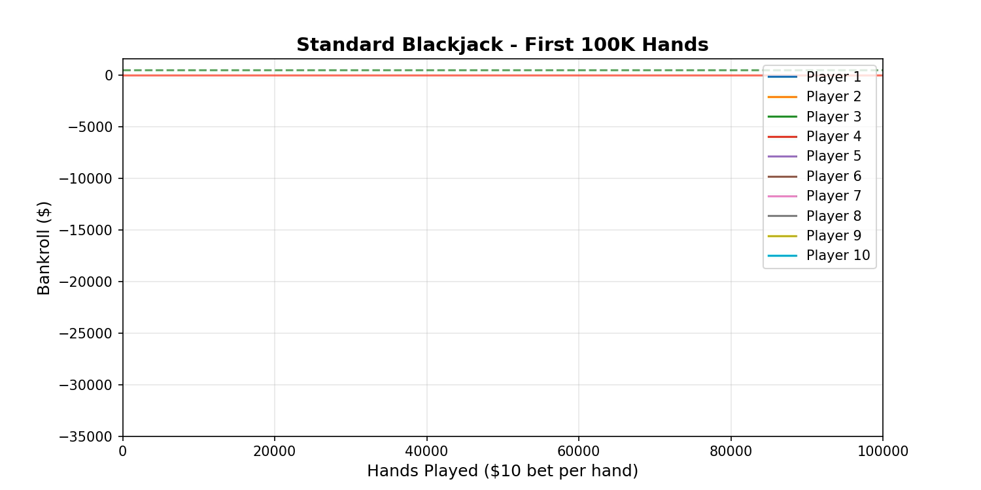
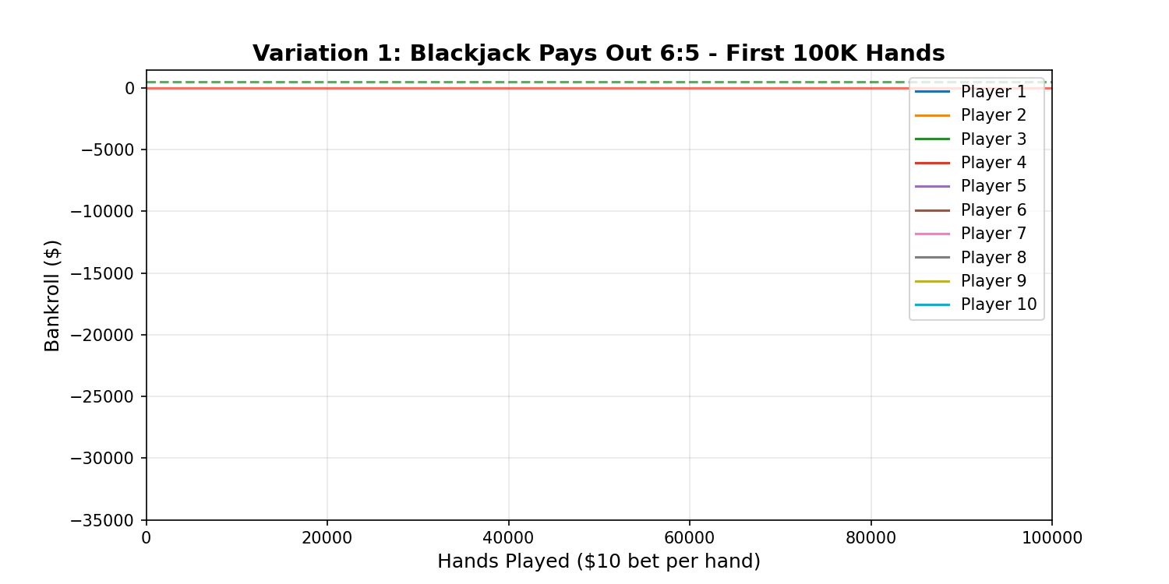
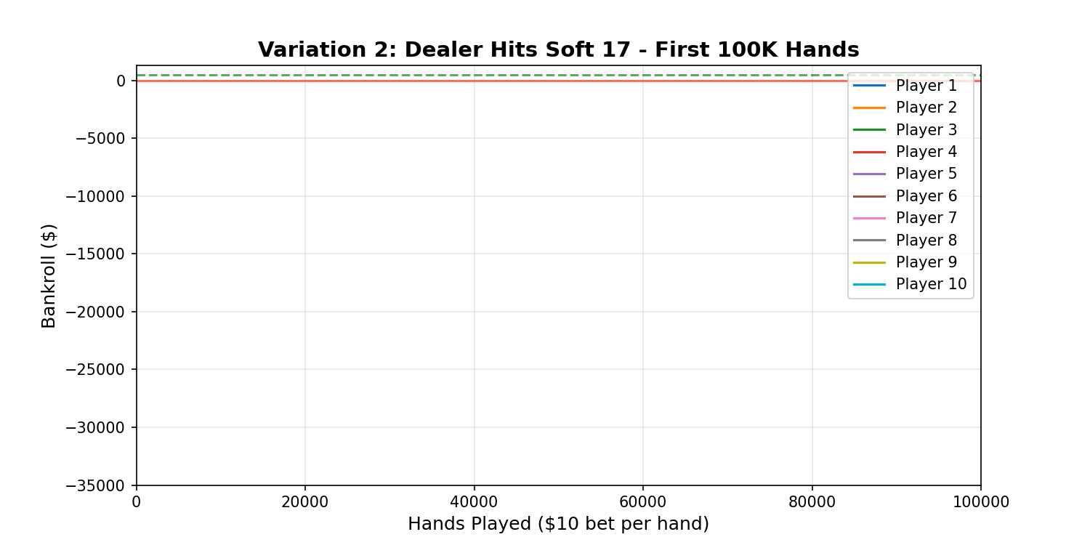

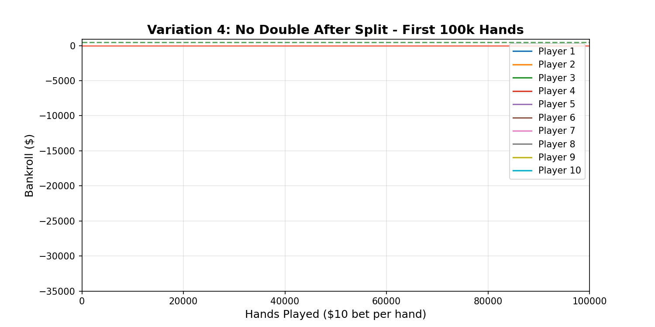
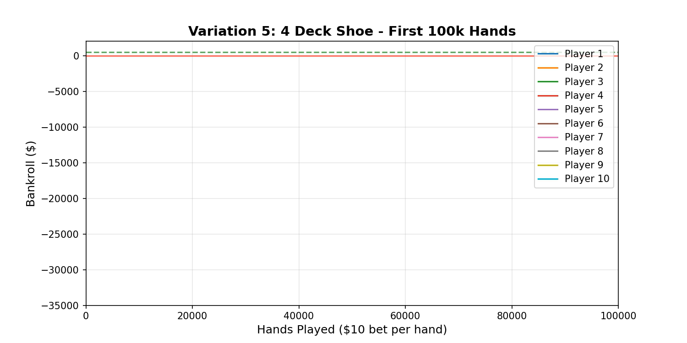
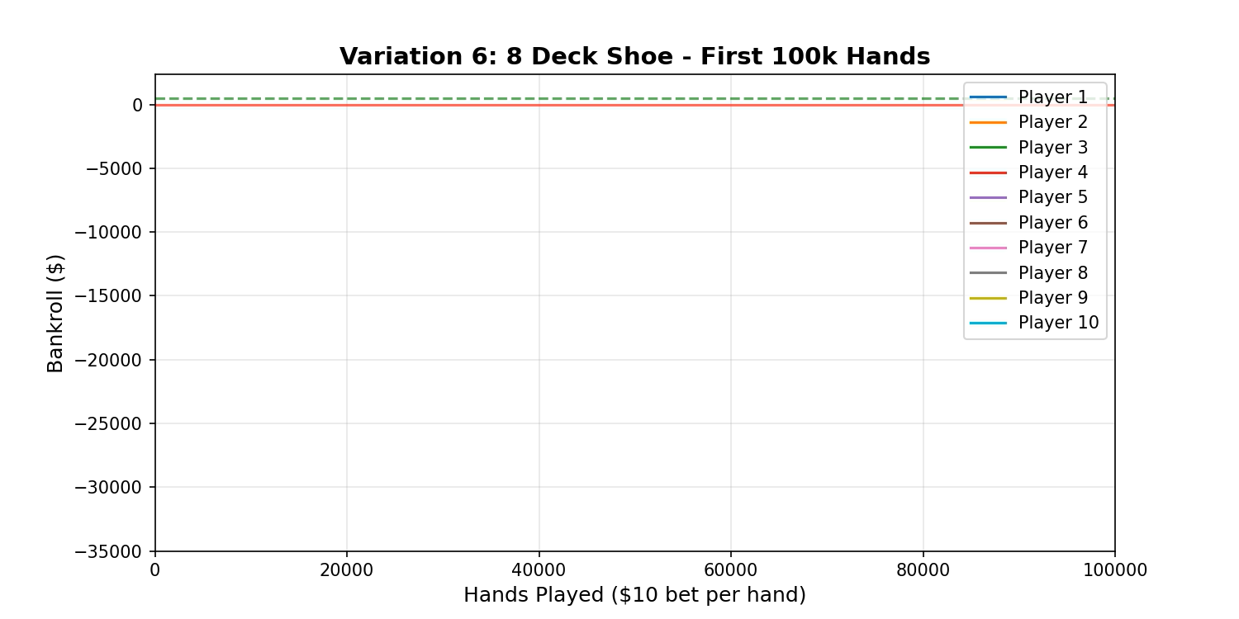
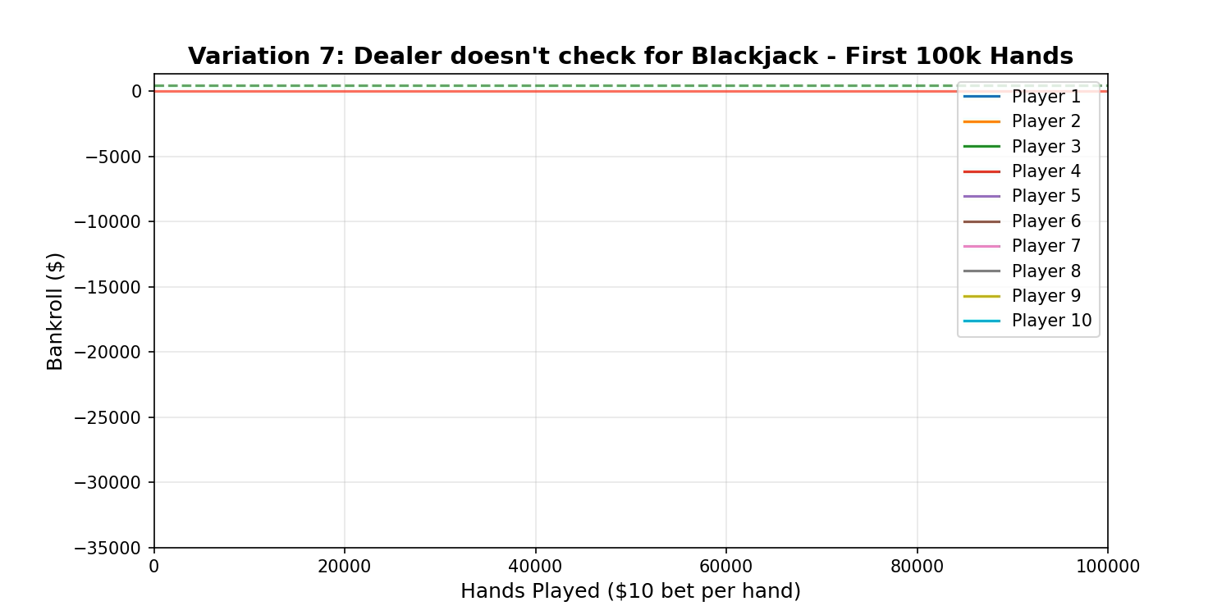

Slide 4
