Slide 1

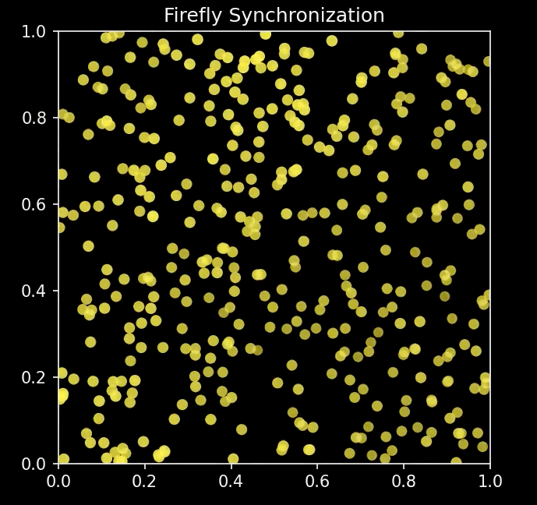
Firefly Frenzy
BEN PHAM

Slide 2

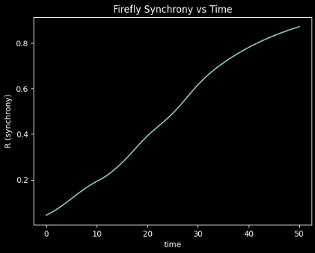
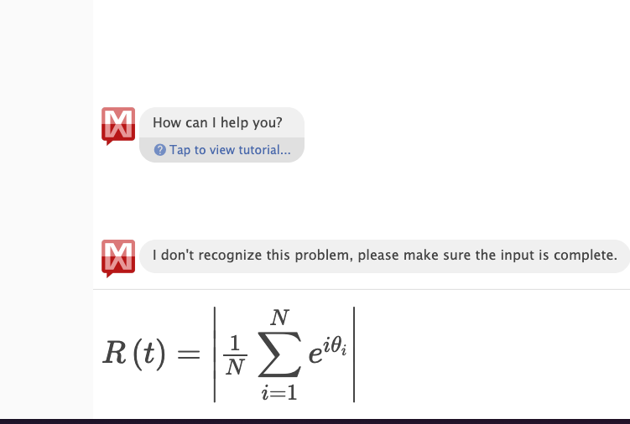
Topic and Methods
Topic
Real fireflies in nature sometimes end up flashing almost in sync
Q: Can simple local rules + a bit of communication make a random swarm synchronize over time?
Model
I model N = 400 fireflies at dots fixed in a 2-D box.
Each firefly has a phase θi(t) and its own natural flashing rate ωi≈1
The phase follows an ODE:
“natural term”: it runs at its own speed ωi
“coupling term”: it is slightly pulled toward the phases of nearby neighbors within a radius R
Numerical Method
Initialize all phases randomly
Time-step the ODE with an explicit Euler method (Δt = 0.02) for ~40 seconds

Slide 3
