Slide 1
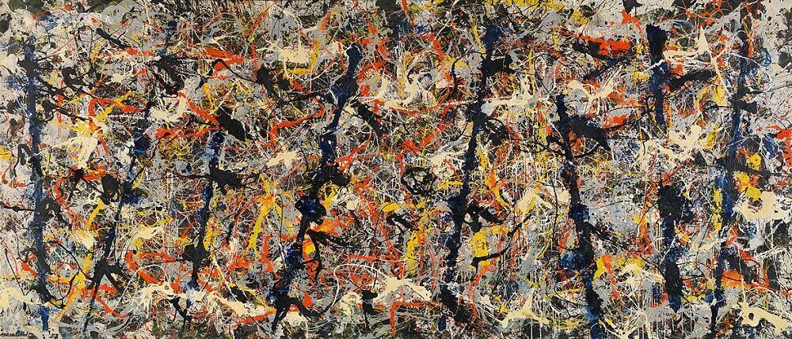
The Fractal Dimension of Splat Paintings
By Leo Pedersen

Slide 2

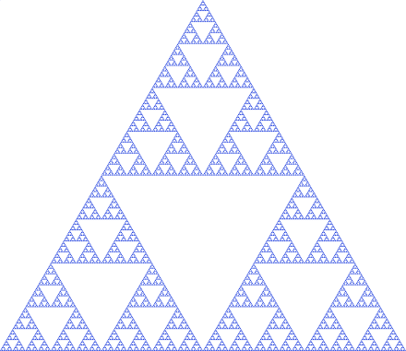

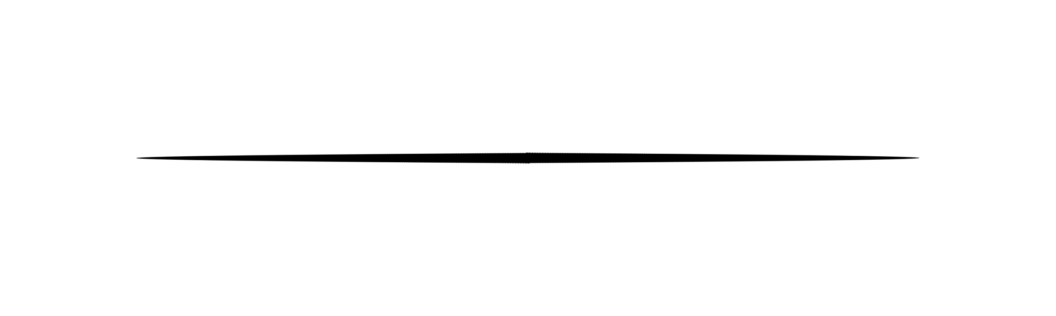
What is Fractal Dimension?
A fractal dimension is a number that describes how completely a pattern fills space as you look at it more and more closely.

Slide 3
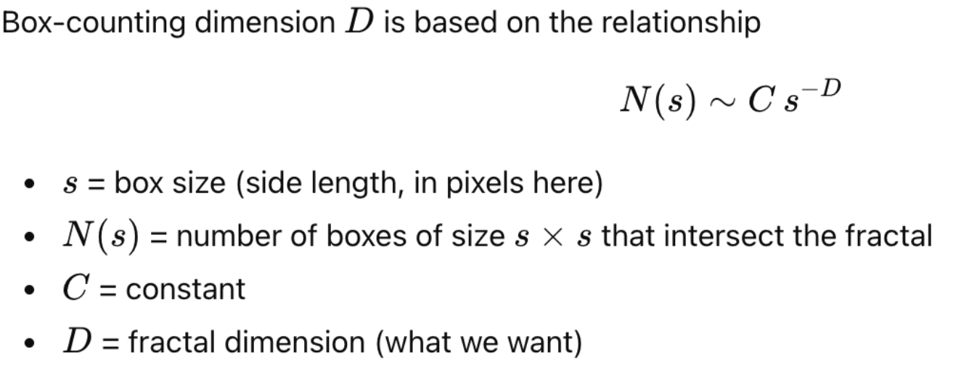
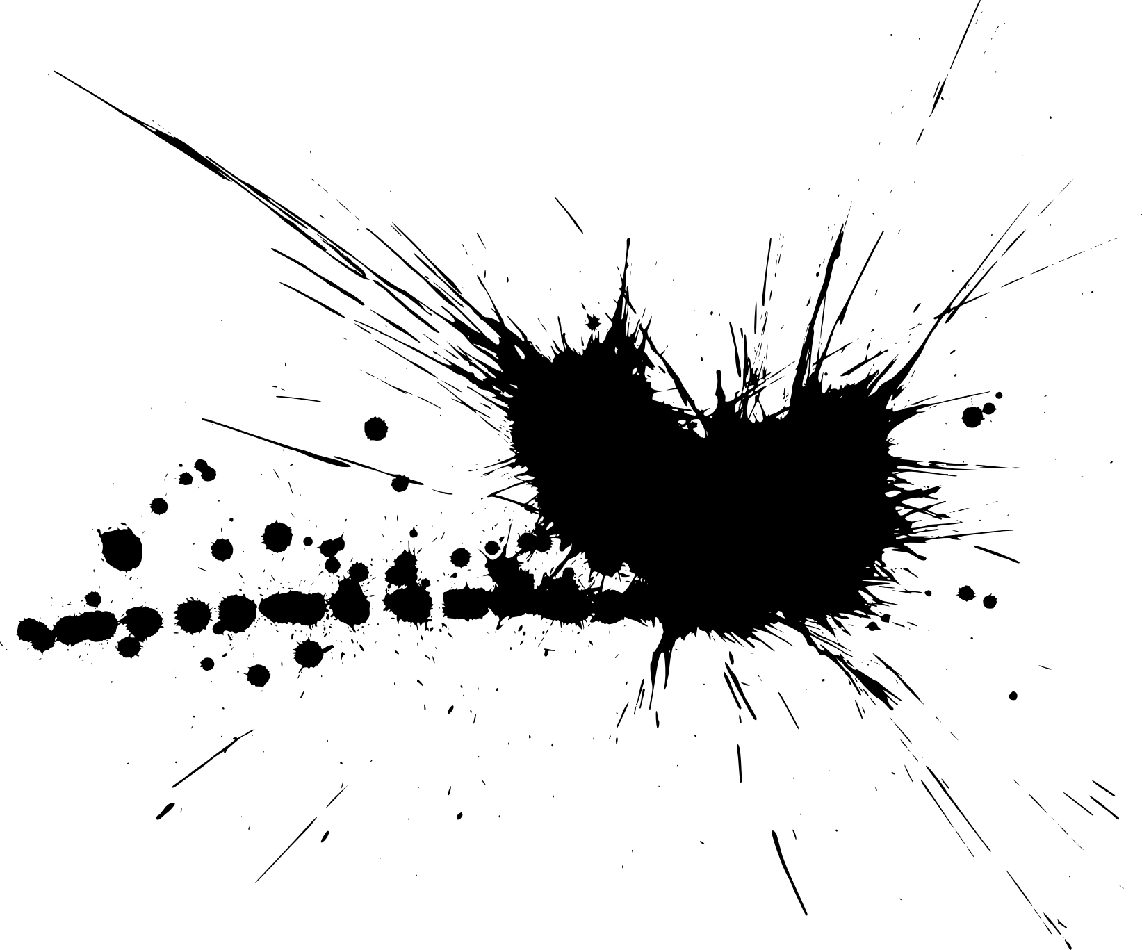
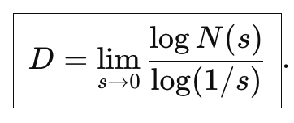
Method: Minkowski-Bouligand Box Counting

Slide 4
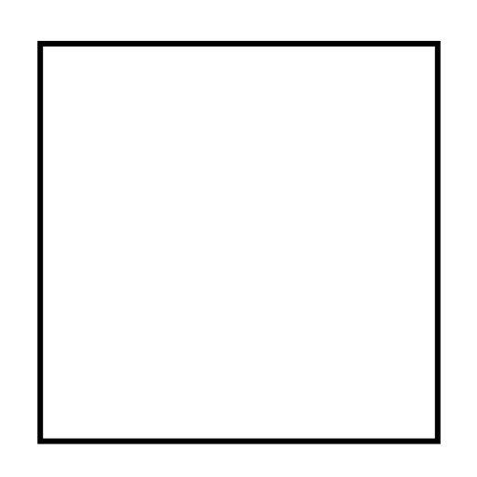
What is Fractal Dimension?
A fractal dimension is a number that describes how completely a pattern fills space as you look at it more and more closely.

Slide 5
What is Fractal Dimension?
A fractal dimension is a number that describes how completely a pattern fills space as you look at it more and more closely.

Slide 6
What is Fractal Dimension?
A fractal dimension is a number that describes how completely a pattern fills space as you look at it more and more closely.

Slide 7


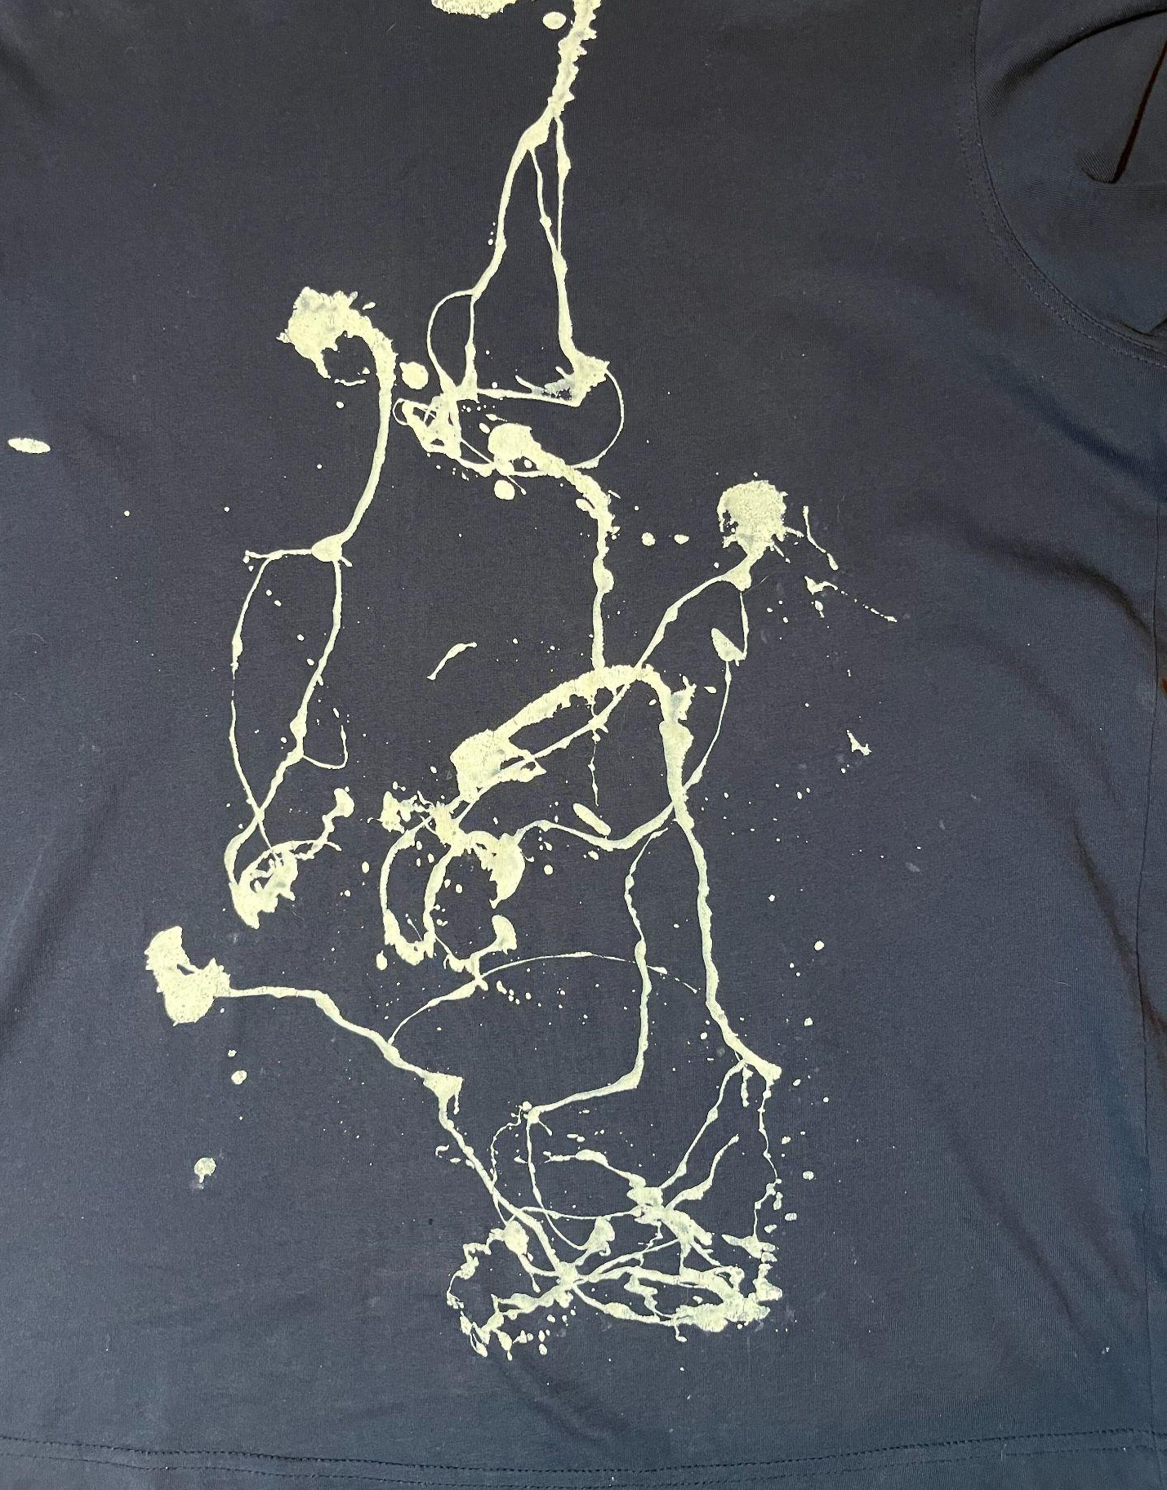
Fractal dimension: 1.4044312255939448

