Slide 1
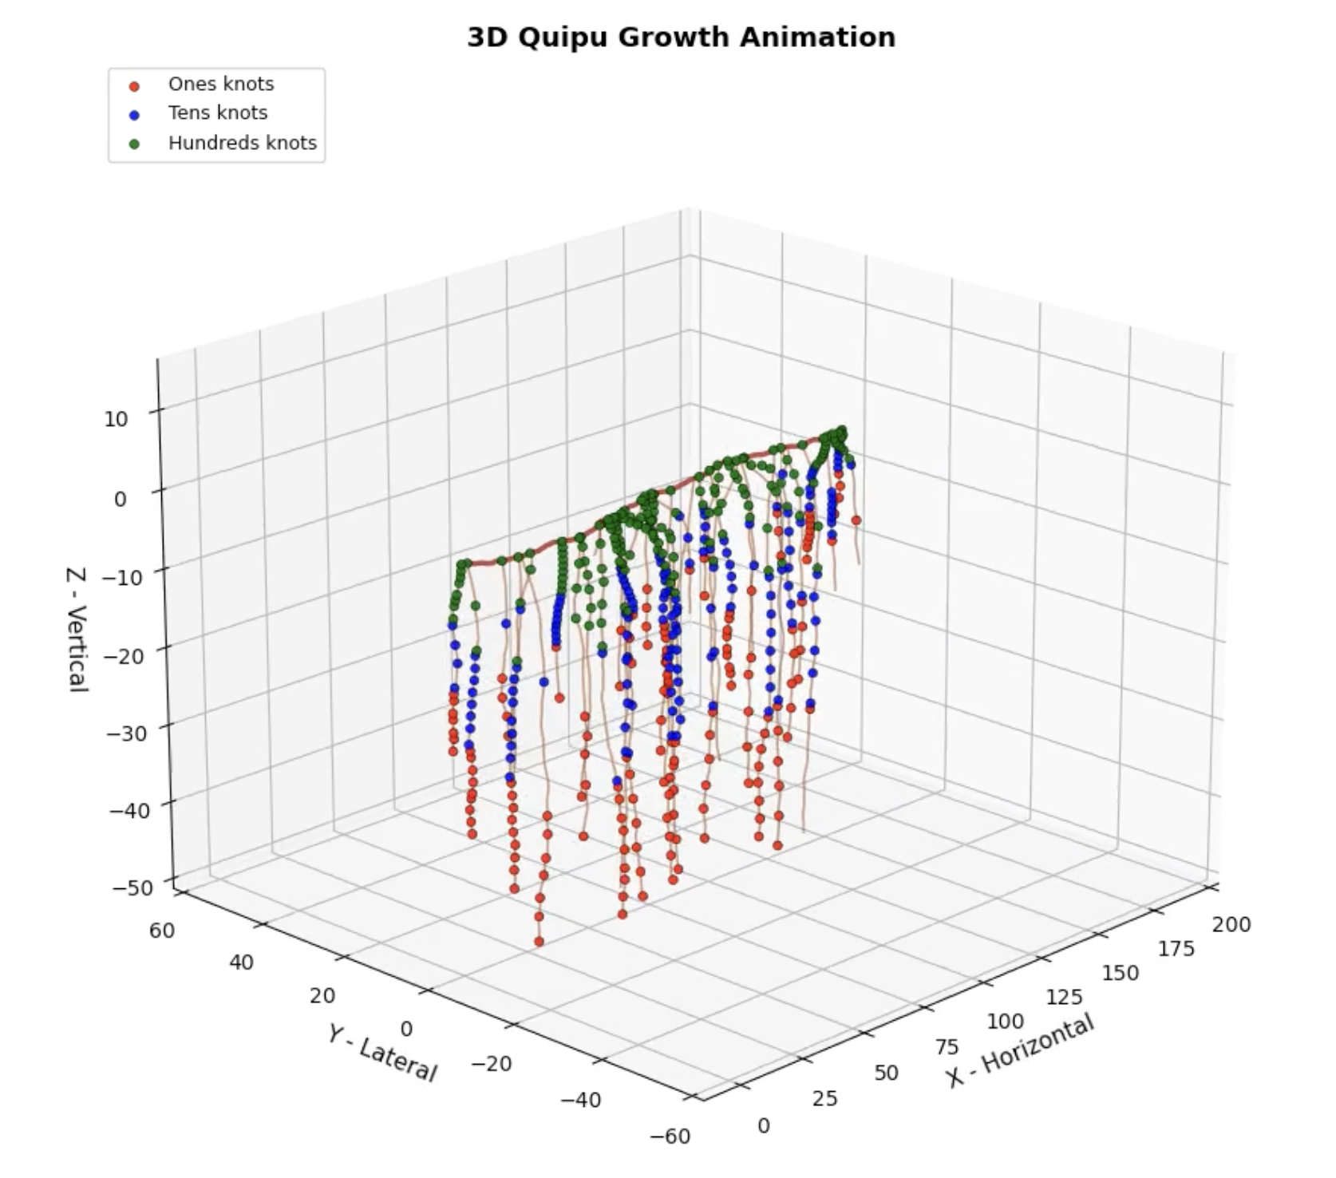
Quipu Growth: Generating Inca Knot Networks Using Biased Random Walks
AUTHOR: Socrates Osorio diaz

Slide 2
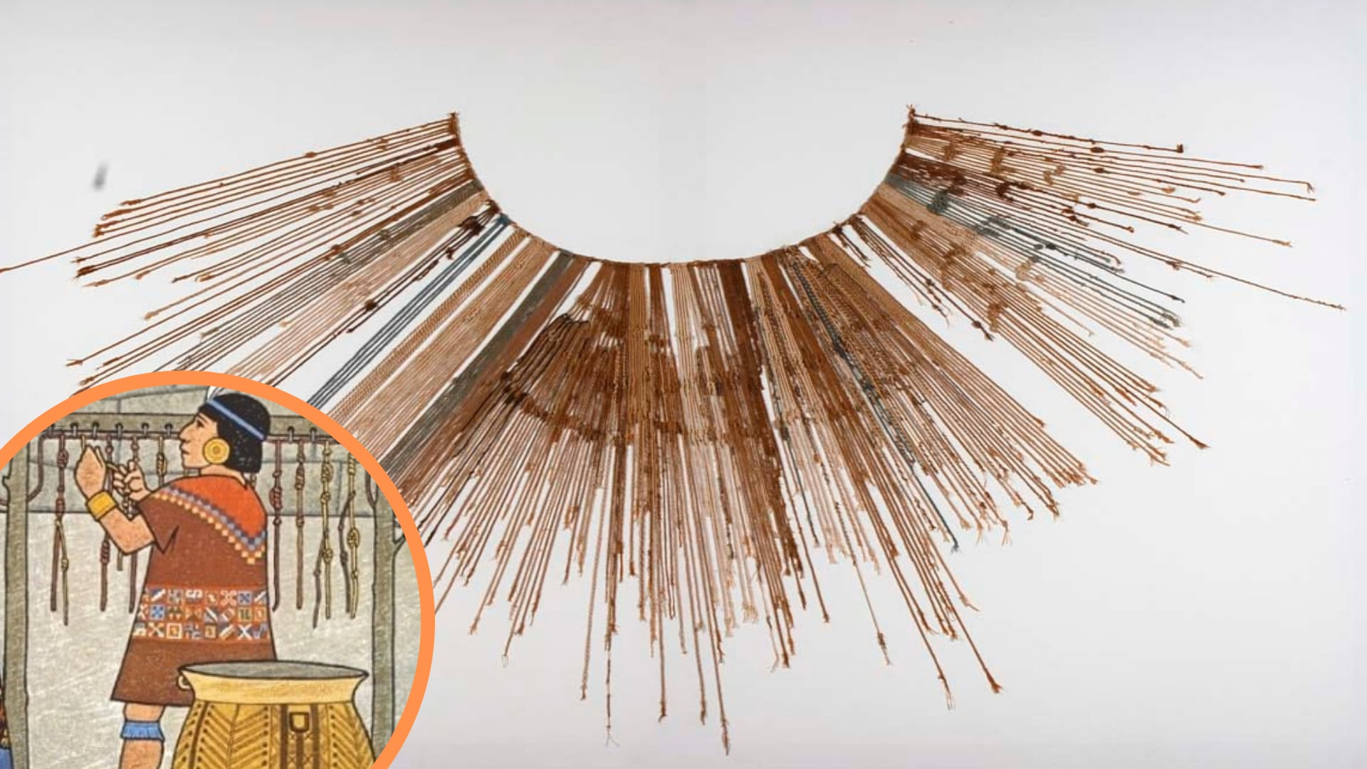
Topic Simulate the growth of a simple Inca-style quipu (cord + hanging cords + knots). Model how cords grow and how numbers (0-999) are encoded using knots. Model Main cord grows using a biased random walk (mostly right). Pendant cords grow downward using a biased random walk. Main cord occasionally spawns new pendants. Cords stop when reaching max length or leaving a boundary. Knot Encoding Each pendant gets a random number 0-999. Its length is split into: Top third → hundreds digit Middle third → tens digit Bottom third → ones digit That many knots are placed in each band. Numerical Methods Stochastic simulation using biased random walks + noise. Use arc length to place knots accurately along curved cords.

Slide 3
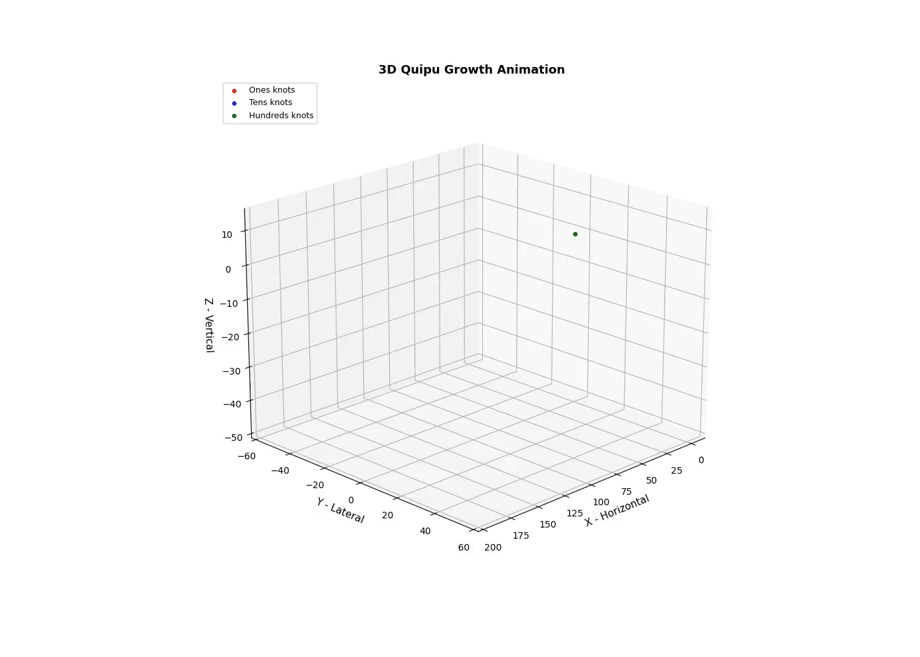

Slide 4
