Slide 1
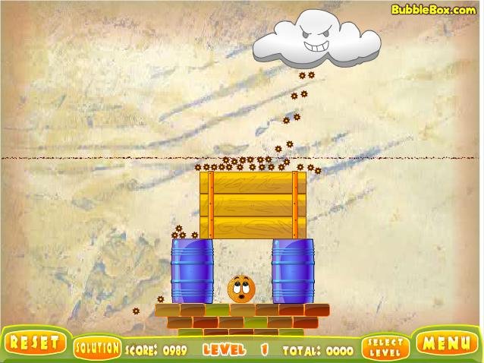
Simulating a Variation of the Cover Orange Game with Acid Rain and Random Walks
Rodrigo Ortiz

Slide 2
Topic and Simulation Methods Used
This project will simulate a variation of the Cover Orange game, where the orange must survive an acid rainstorm produced by a moving cloud.
Using stochastic modeling, we will understand how randomness can affect the orange's survival.
The project used biased random walks.

Slide 3
