Slide 1

Thermal Driven Lava Lamp Fluid Dynamics
Huan Nguyen

Slide 2





Methods
$$v\left(t+Δt\right)=v\left(t\right)+σ\sqrt{Δt} η\left(t\right)$$
$$v_{t+Δt}=v_{t}+Δt a_{t}$$
$$G_{i}\left(x,y\right)=B_{i}\exp{!}\left(−\frac{{\left(x−x_{i}\right)}^{2}+{\left(y−y_{i}\right)}^{2}}{2σ_{i}^{2}}\right)$$
$$x_{t+Δt}=x_{t}+Δt v_{t+Δt}$$
$$v\left(t+Δt\right)=\left(1−γΔt\right) v\left(t\right)$$
Attempt 1
Attempt 2
Attempt 3
Simple temperature model (heat at bottom, cool elsewhere)
Buoyancy based only on temp - 0.5
Basic blob motion: Euler integration, random stirring
Wall collision handling
Gaussian metaball blending (visual merging)
Inferno colormap rendering
Limitations:
Blobs are boxed at the corner
Blobs’ position is not randomized
Introduced phase-free rise/fall logic based on position thresholds
Blobs are now randomized with every run
More refined heating/cooling:
Heating on the bottom
Cooling on the top
Stronger turbulence + damping (SDE)
Updated wall correction
Limitations:
Blobs were only able to start heating/cooling once it physically hits the bottom/top
Added explicit blob phases:
0 = rising
1 = falling
Even more refined heating/cooling:
Heating as blobs goes down
Cooling as blobs goes up
Temperature directly impacts brightness and blending
Limitations:
Doesn’t fully simulate how lava lamp look like since there’s usually some blobs that goes up while some goes down. But all these blobs tend to merge at the end of the simulation

Slide 3
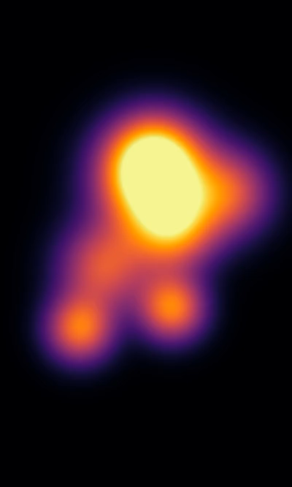
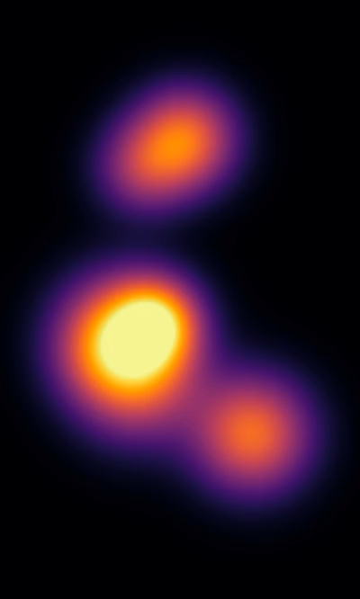
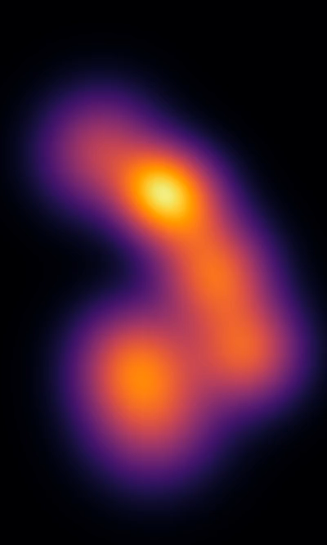
Animation
Attempt 1
Attempt 2
Attempt 3

Slide 4
References
https://www.reddit.com/r/computergraphics/comments/gj0nax/optimize_metaball_rendering_on_shader/
https://www.youtube.com/watch?v=ITFolyl_66U
https://byjus.com/physics/kinematics-equations/#:~:text=There%20are%20four%20basic%20kinematics,2%20+%202%20a%20Δ%20x
https://en.wikipedia.org/wiki/Ornstein–Uhlenbeck_process
https://en.wikipedia.org/wiki/Euler–Maruyama_method

