Slide 1
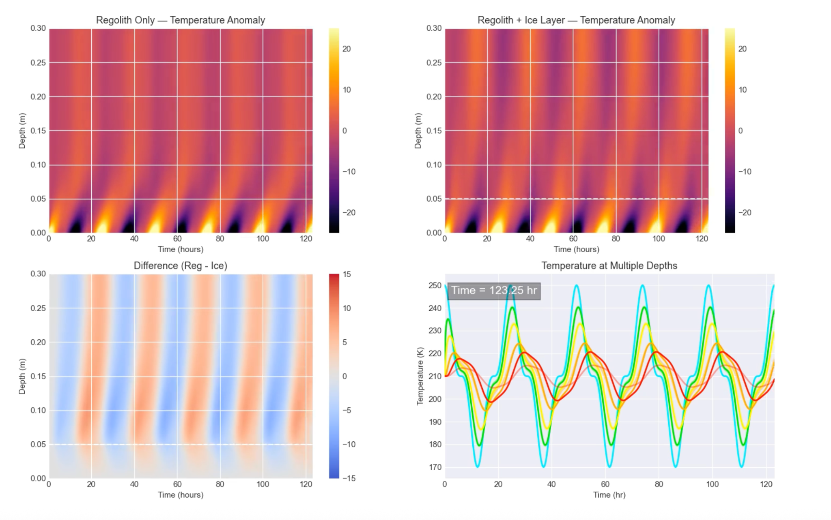
Thermal Diffusion in Martian Regolith: Detecting Subsurface Ice Using Heat Propagation
Temperature anomaly heatmaps and depth-dependent temperature curves for regolith-only (left) and regolith with a shallow ice layer (right). A buried ice sheet alters thermal wave propagation in a measurable way.
Sabrina Nazarzai

Slide 2
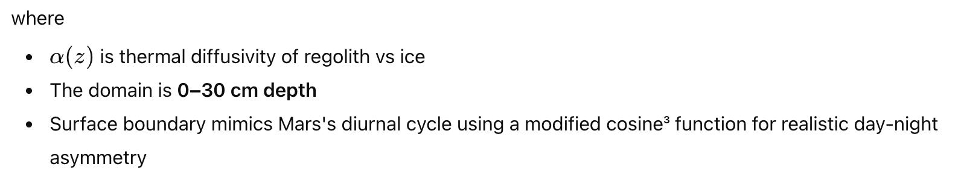
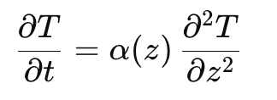
Topic
I modeled how heat diffuses through Martian soil (regolith) and how a shallow subsurface ice layer changes the daily temperature wave. This method is a foundation of remote subsurface ice detection used in planetary missions.
I solved the 1-D heat equation:
Numerical Method:
Explicit finite-difference scheme
200 depth nodes, dt = 0.5 s (CFL-stable)
Two simulations:
Regolith-only
Regolith with 5 cm ice layer
Output fields:
Temperature anomaly maps
Reg − Ice differences
Multi-depth time series
Scientific Goal:
To show how a buried ice layer produces a distinct thermal signature, enabling subsurface detection through passive thermal observations.

Slide 3
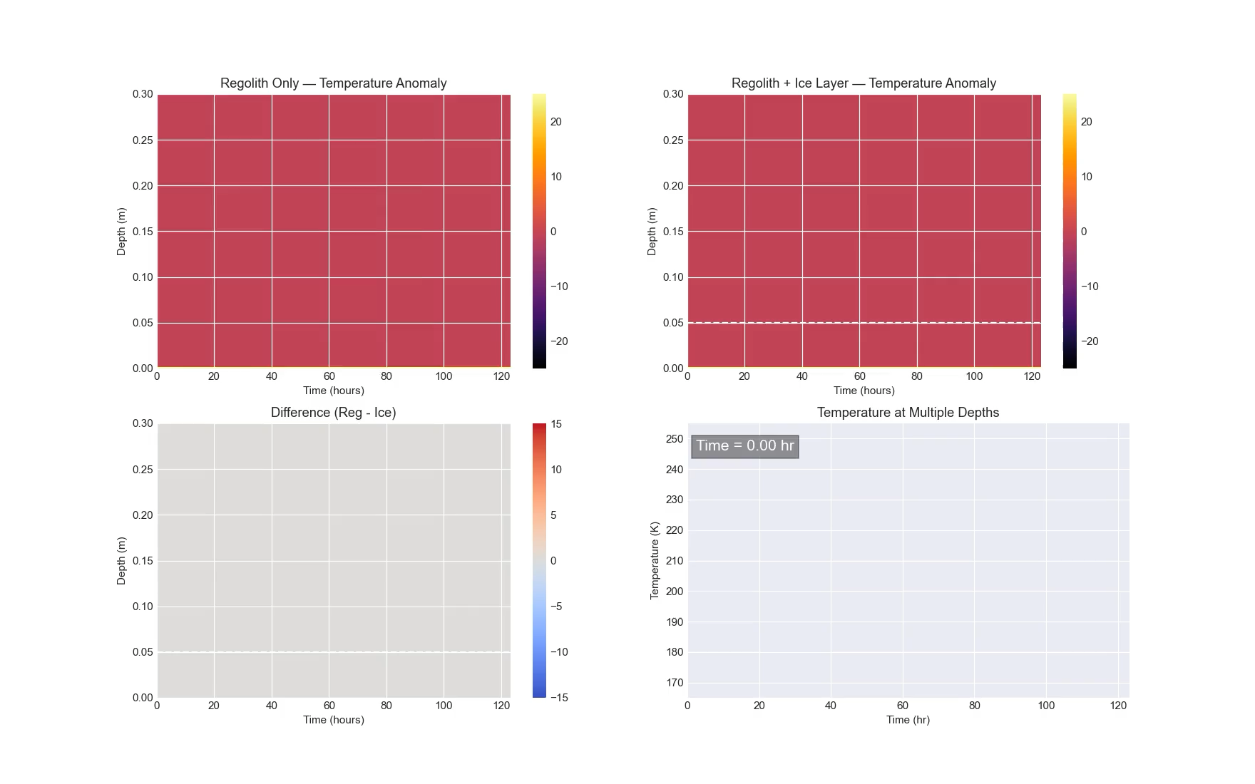
4
Company Name
Q1 / Month
Year
Today’s agenda
Summarize your meeting topics
1
2
3
Add a meeting
topic
Add a meeting
topic
Add a meeting
topic
Add a meeting topic

