Slide 1
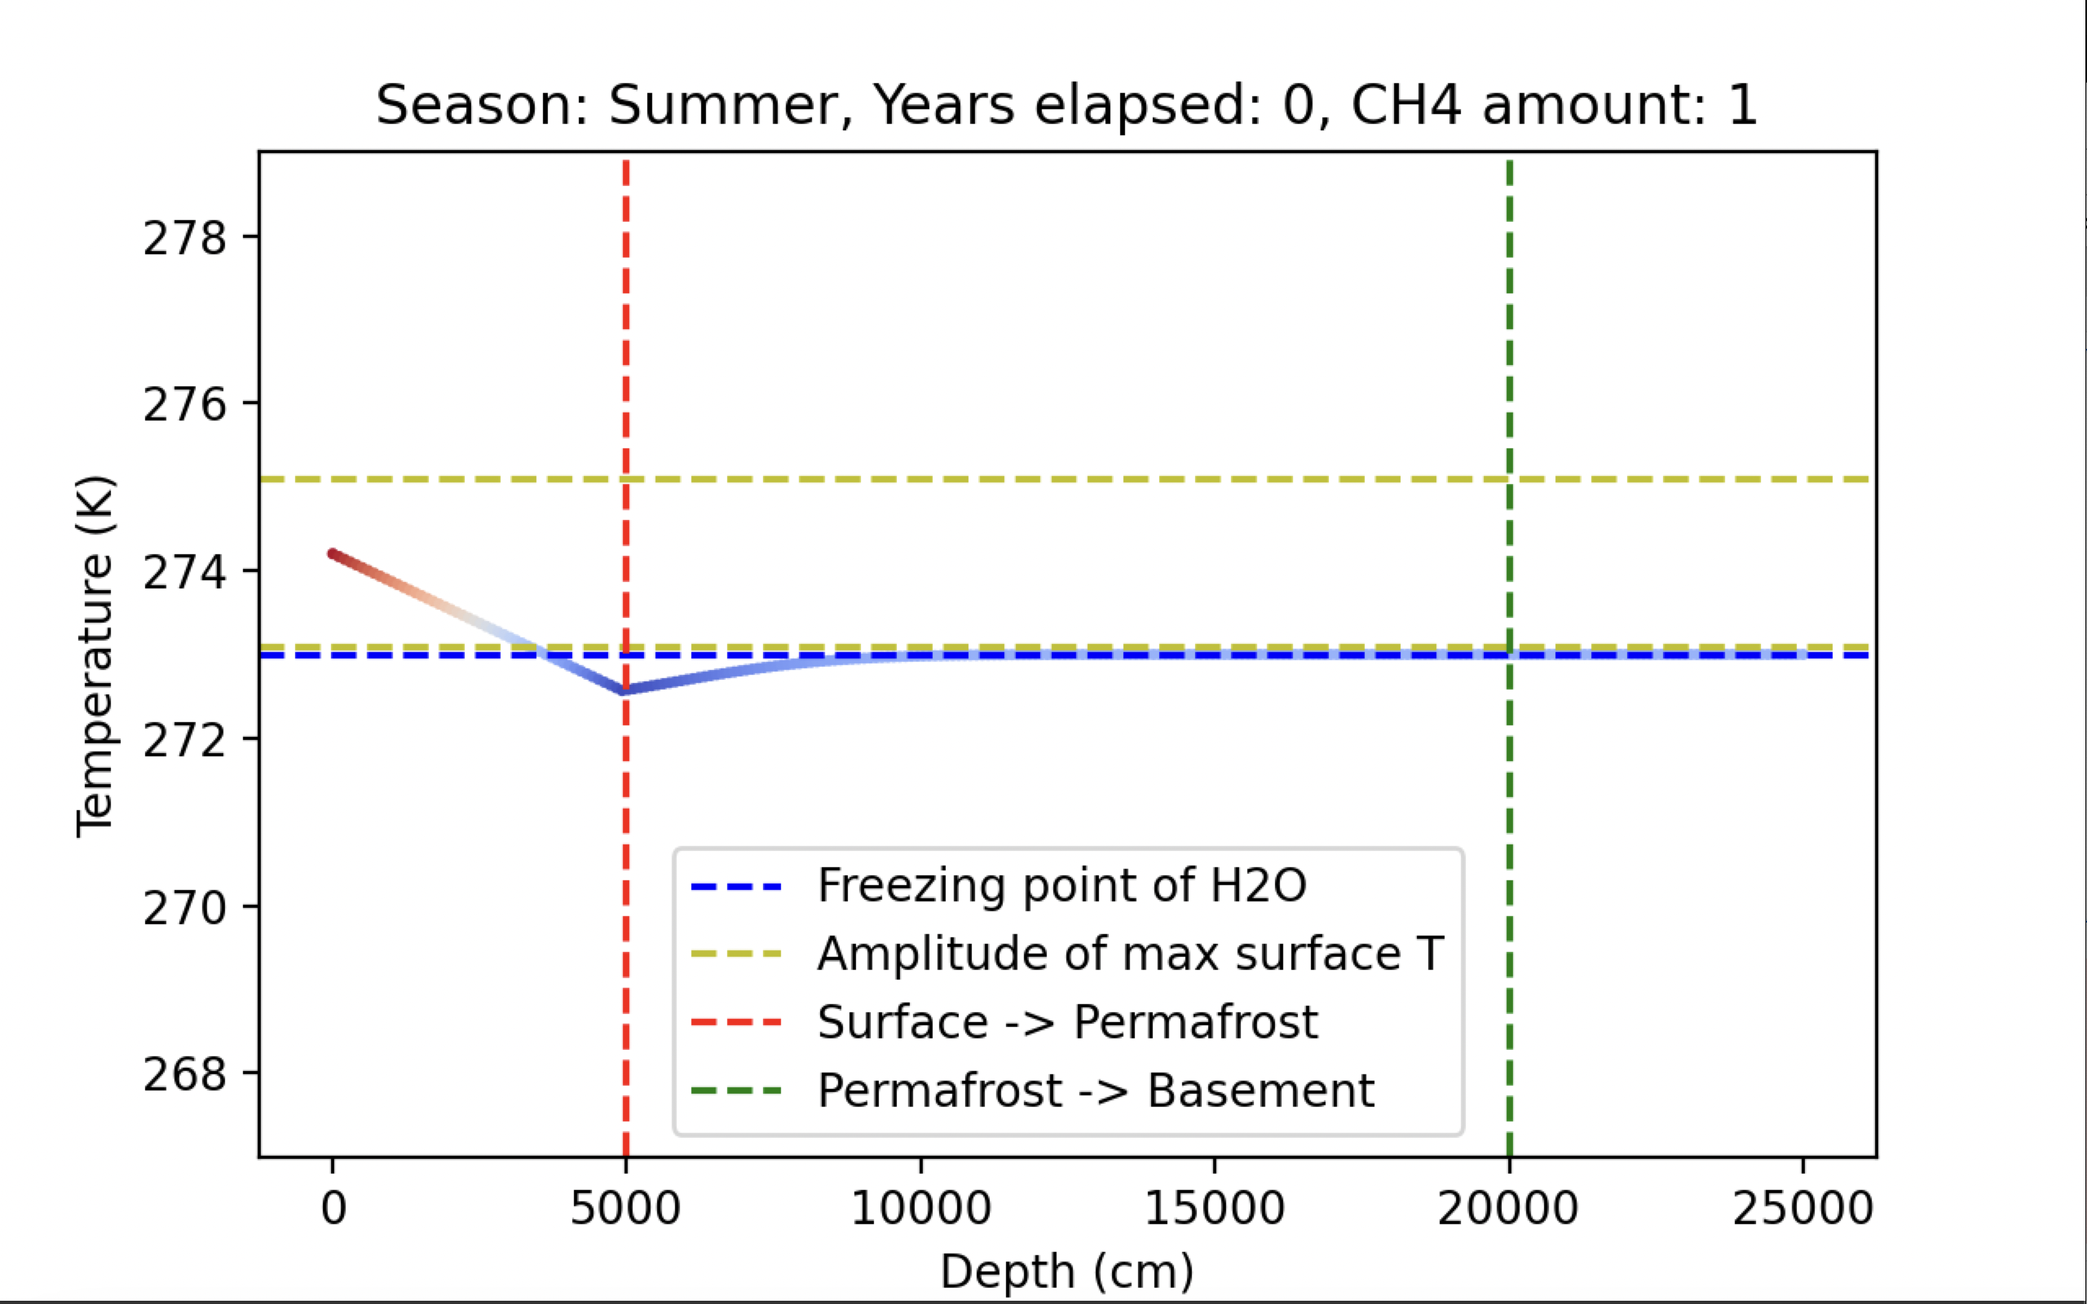
Permafrost Heat Flow + Positive feedback loops
By Alastair McCarthy

Slide 2
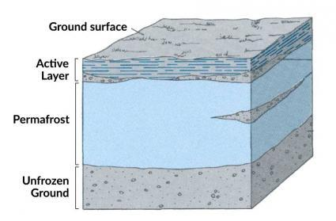
Methods + background:
- Principally, the simulation uses Partial Differential Equation heat flow equations, & back of the envelope conversions for variables.
Positive feedback loops are loops that continually amplify themselves, one example of a positive feedback loop is ice and the Albedo Effect.
- CH4 being released increases heat of the surface area- which then releases more heat. This is the positive feedback loop. It is possible to run this simulation WITHOUT heat generation too.
Image credit: EarthHow “What is permafrost?”

Slide 3
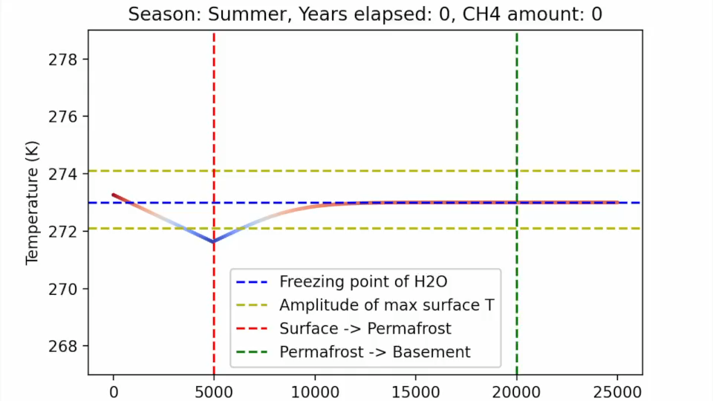
Three regions outlined, Surface being leftmost, Permafrost middle, and rightmost being the basement.
This animation is in a relatively stable state, unlike the next.
Yellow lines show amplitude of the surface temp, so you can see more clearly how it rises when CH4 increases
Past the freezing point, while in the permafrost region, CH4 is released.

Slide 4
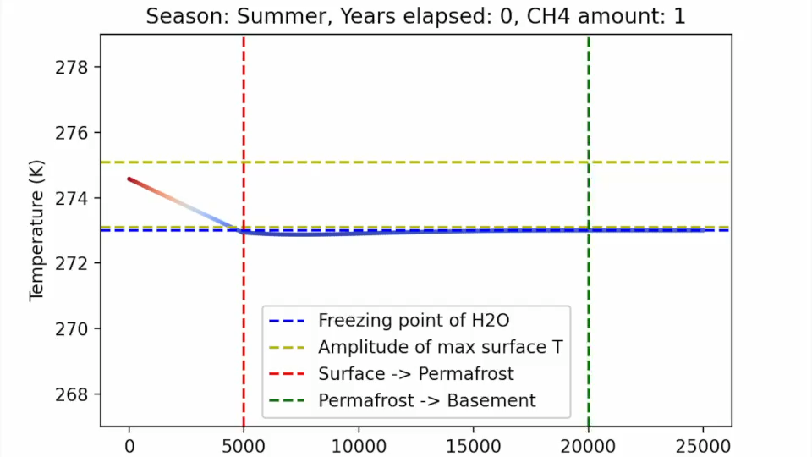
Unstable Positive Feedback Animation:
Initial CH4 count at 1 instead of 0 .

Slide 5
Sources:
(These sources gave me a few numbers I used in the simulation, and are cited properly in the code)
- Joseph F Batir, David D Blackwell, Maria C Richards, Heat flow and temperature-depth curves throughout Alaska: finding regions for future geothermal exploration, Journal of Geophysics and Engineering, Volume 13, Issue 3, June 2016, Pages 366–378, https://doi.org/10.1088/1742-2132/13/3/366
- de Bruin, J. G. H., Bense, V. F., & van der Ploeg, M. J. (2021). Inferring permafrost active layer thermal properties from numerical model optimization. Geophysical Research Letters, 48, e2021GL093306. https://doi. org/10.1029/2021GL093306
- Biskaborn, B.K., Smith, S.L., Noetzli, J. et al. Permafrost is warming at a global scale.Nat Commun 10, 264 (2019). https://doi.org/10.1038/s41467-018-08240-4

