Slide 1
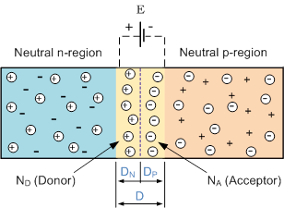
Visualizing PN Junctions
Ansh Maroo

Slide 2
Why is the PN Junction important?
The PN Junction is the most basic semiconductor device
  A junction between P-doped silicon and N-doped silicon
  Silicon is doped (made impure) with the goal of increasing charge carrier concentrations (P-type, N-type = holes, electrons)
Several important semiconductor devices can be made with PN junctions
A defining characteristic of a PN junction is its depletion region - a region of built-in potential difference between the differently doped silicon regions
This depletion region enables the useful behaviors of semiconductor devices

Slide 3
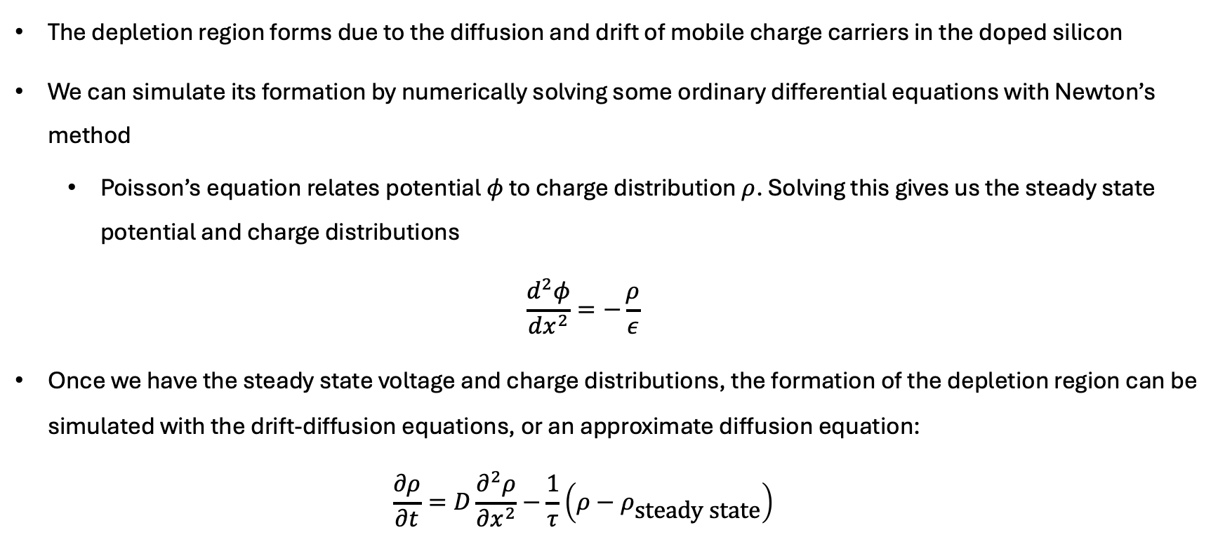
How can we simulate the depletion region?
The depletion region forms due to the diffusion and drift of mobile charge carriers in the doped silicon
We can simulate its formation by numerically solving some ordinary differential equations with Newton’s method
  Poisson’s equation relates potential $φ$ to charge distribution $ρ$. Solving this gives us the steady state potential and charge distributions
  $$\frac{d^{2}φ}{dx^{2}}=−\frac{ρ}{ε}$$
Once we have the steady state voltage and charge distributions, the formation of the depletion region can be simulated with the drift-diffusion equations, or an approximate diffusion equation:
  $$\frac{∂ρ}{∂t}=D\frac{∂^{2}ρ}{∂x^{2}}−\frac{1}{τ}\left(ρ−ρ_{\text{steady} \text{state}}\right)$$

Slide 4
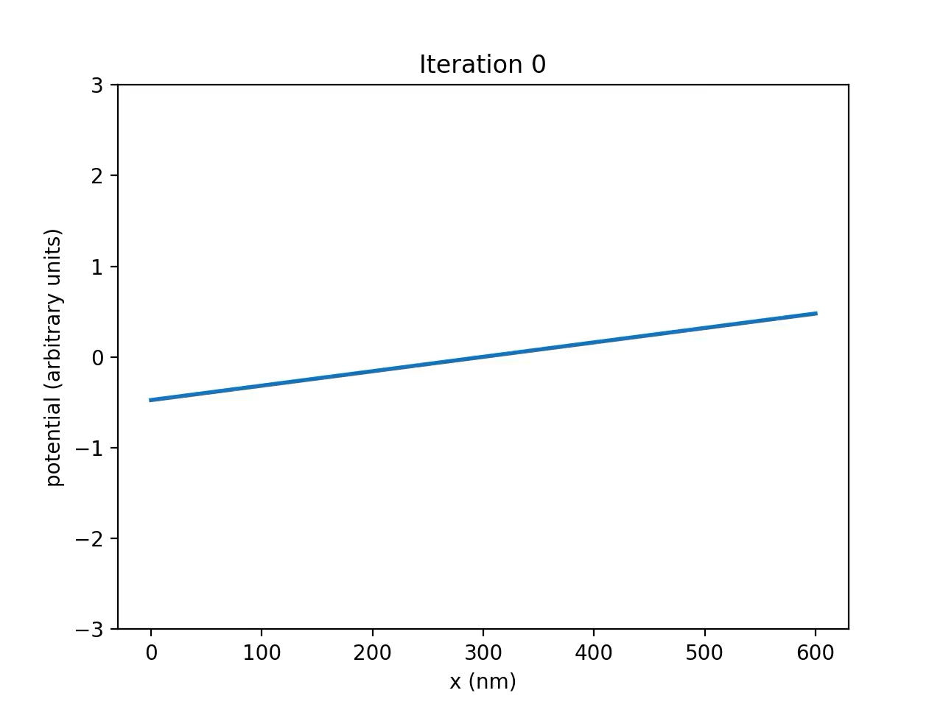
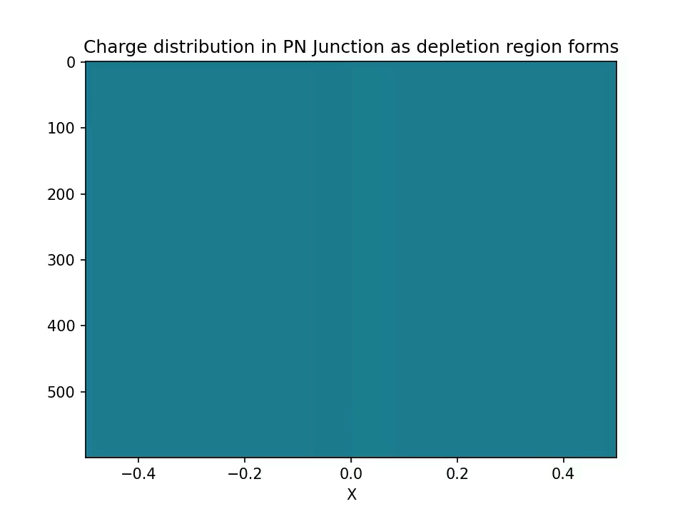
Animations
Relaxation of Poisson’s equation to steady state potential
Diffusion of charge forming depletion region (approximation)

