Slide 1
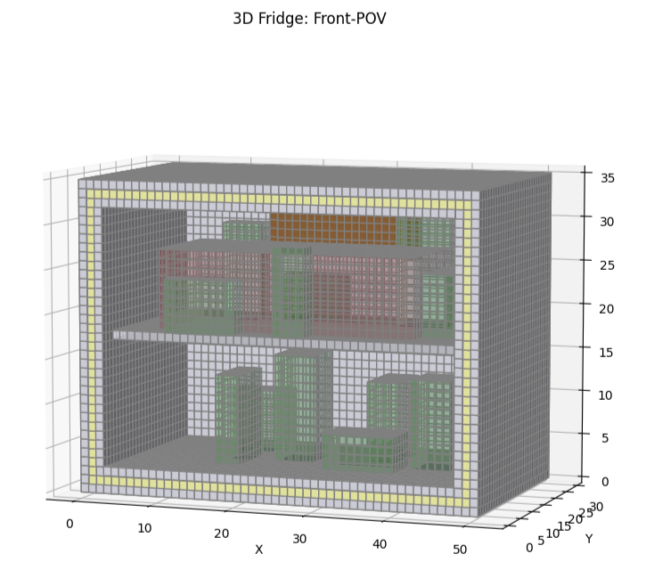
Food vs. Fridge vs. FDA:
Simulating Hot Food Cooling (Spoiling) in Your Fridge
Cindy Luong

Slide 2
Topic:
A ubiquitous food safety rule is to not put hot food directly in the fridge, in danger of bacterial growth.
Hot food warms the fridge interior, making it not cool down as effectively.
The food ends up being in the ‘danger zone’ (4.44C - 160C) for longer.
Project Goal:
Simulate the heat transfers within a fridge interior (walls, tupperware, other food items, etc.) after a tupperware of boiling hot soup is placed inside.
Methods:
Used a PDE-based simulation method.
Similar to Lab & Homework 07.
Applied 3D Heat Equation to each cube in model, and reinforced boundary conditions on each time iteration.
References:
“Turkey Cooking in PYTHON” by Mr P Solver on Youtube
https://www.youtube.com/watch?v=0N-SkvlLSbw
Starting the Code:
My code can by ran by running my main.ipynb file from beginning to end.
Before running, replace ffmpeg file path with your own personal path (if you’re a Windows user).

Slide 3
