Slide 1


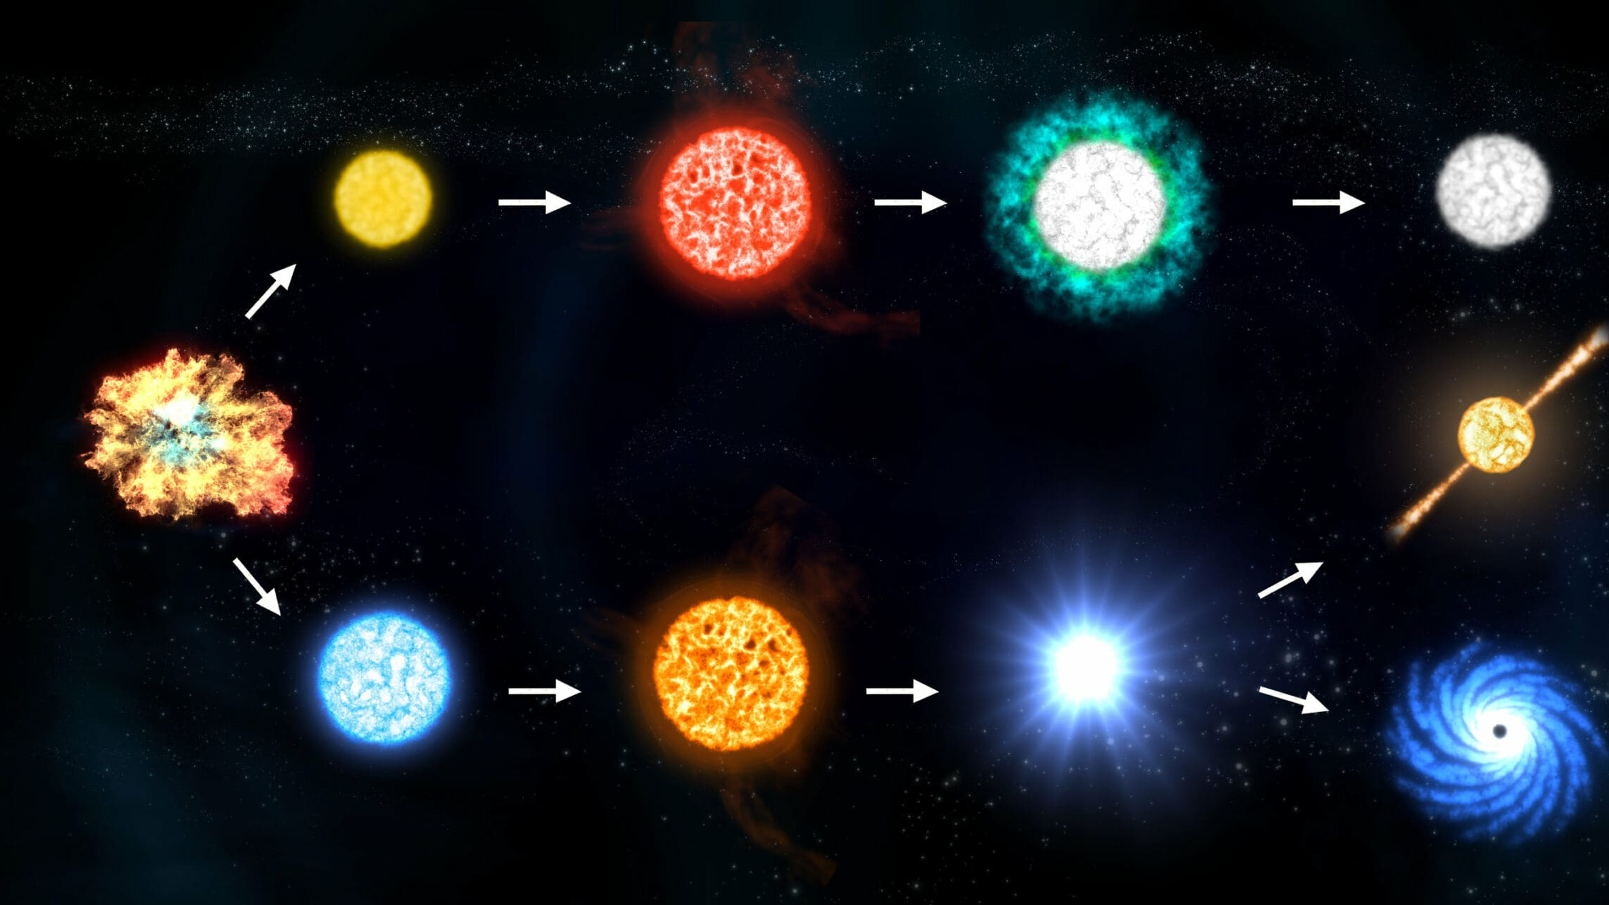
Temperature and Density Evolution of Stars
Kaitlyn Le

Slide 2
Topic and Methods
Topic: Analysis of how a star’s central temperature, central density, and effective temperature evolve over time
  Will be focusing on a star of 1 solar mass
  Basically observing how these properties change over time
Method: Ordinary differential equations
  Animating the time evolution of the stellar quantities
  Use system of ODEs to model evolution
  ODE solved using the ODEINT function
    Adaptive step-size Runge-Kutta methods
Initial conditions:
  T_c(0) = 1.5 × 10⁷ M² K
  ρ_c(0) = 150 M² g/cm³
  T_eff(0) = 5780 M^0.6 K
Integrated from 0 to 100 Myr
Number of time teps: 500 points

Slide 3
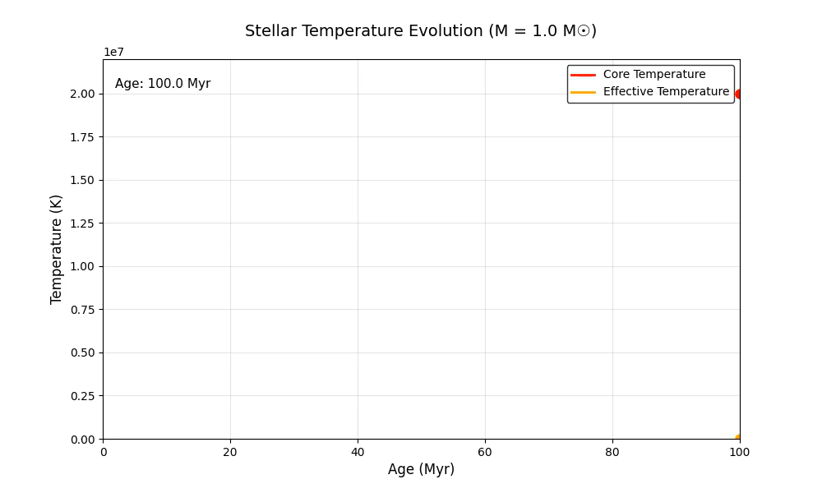
Core and Effective Temperature vs Age
Effective temp looks 0 but it’s just because effective temperature MUCH smaller than core temp
Core temps driven by nuclear burning rate; core temp declines as H is consumed

Slide 4
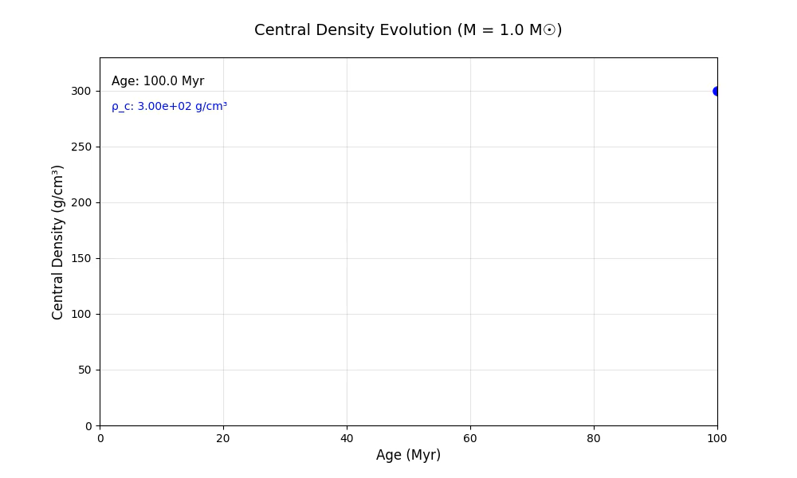
Central Density vs Age
Caused by gravitational contraction; increases as star contracts; exponential growth of compressing stellar core

Slide 5
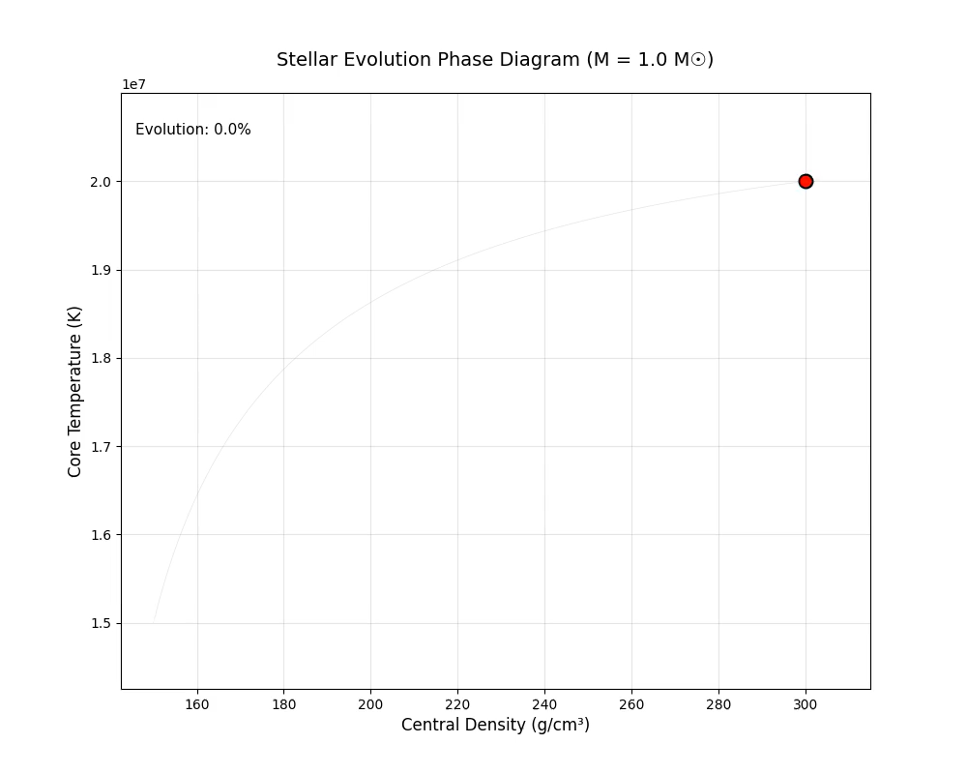
Core Temperature vs Central Density
Core temperature and central density increases over time; displays evolutionary track in phase space; thermodynamic evolution

