Slide 1
Random Walk Simulation of Amazon Forest Fire Plumes
By Roni Kriger

Slide 2
hello!
I am Roni Kriger
I am Brazilian and for that reason I choose the Amazon Forest Fire Plumes to explore

Slide 3
How my presentation is going to go
World Issue
Simulation Methods
Simulation

Slide 4
1. Amazon Rainforest
Fires in the Amazon Rainforest have never been worse

Slide 5
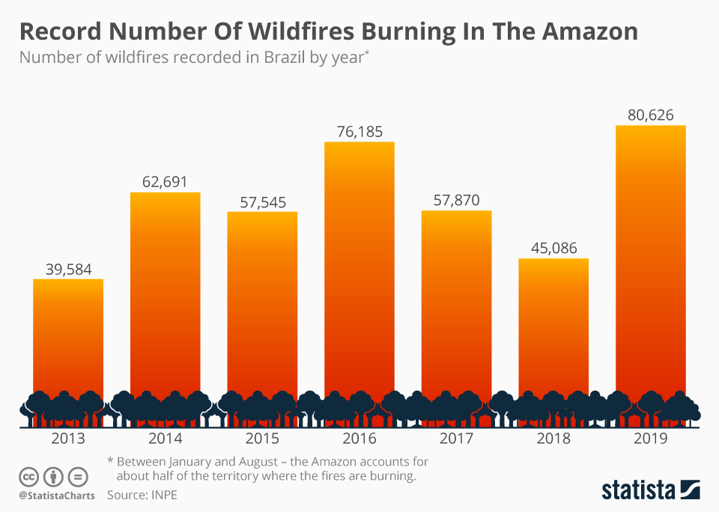
Fires, both human-inflicted and natural
420 million hectares of forest were lost from 1990–2020
Smoke travels thousands of kilometers
Fires released an estimated ~791 million tons of CO2

Slide 6
2. Simulation methods
The model shows how smoke from a single Amazon forest fire spreads in the lower atmosphere over several hours

Slide 7
4,000 smoke particles
Constant eastward wind
6 hours
All in 3D (x, y, z)
+ Random turbulent steps (Monte Carlo random walk)
Total simulation time

Slide 8
Simulation outputs
Top-down view (left)
Top-down smoke map over the forest.
Easy to see how the plume stretches with the wind across the Amazon landscape.
Vertical slice (center)
x–z vertical cross-section.
Shows how high the plume rises and how it tilts downwind over time.
Coarse grid (right)
“Game-of-Life” style grid of plume occupancy.
Summarizes where the plume is most intense and how the area of impact grows.

Slide 9
3. Simulation itself

Slide 10
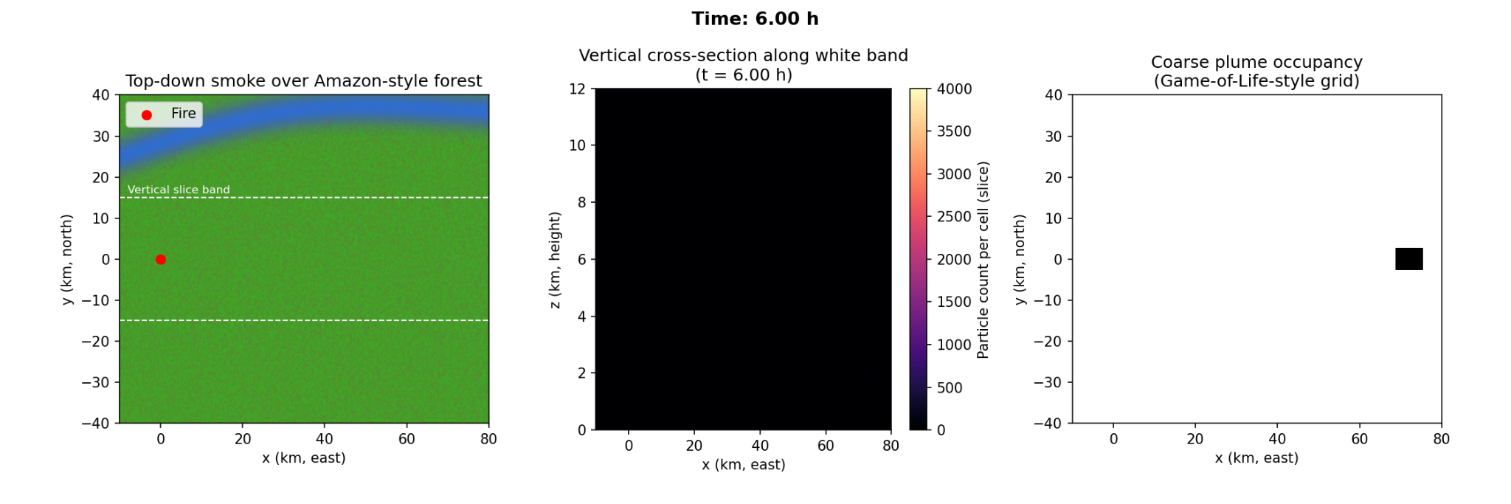
How my animation is shown
Top-down map:
like a satellite over the Amazon
Side view (vertical slice): cutting through the plume along the white band
“Game-of-Life” style grid showing where the plume is most concentrated
Notes:
Top-down map – like a satellite over the Amazon:
Shows where the smoke is thick or thin above the forest and river.
Side view (vertical slice) – cutting through the plume along the white band:
Shows how high the smoke rises and how it leans in the wind.
Coarse grid view – like a pixelated heat map:
Each cell lights up when the smoke there is above a threshold.
This makes it easy to see where the plume is strongest and how the affected area grows.

Slide 11
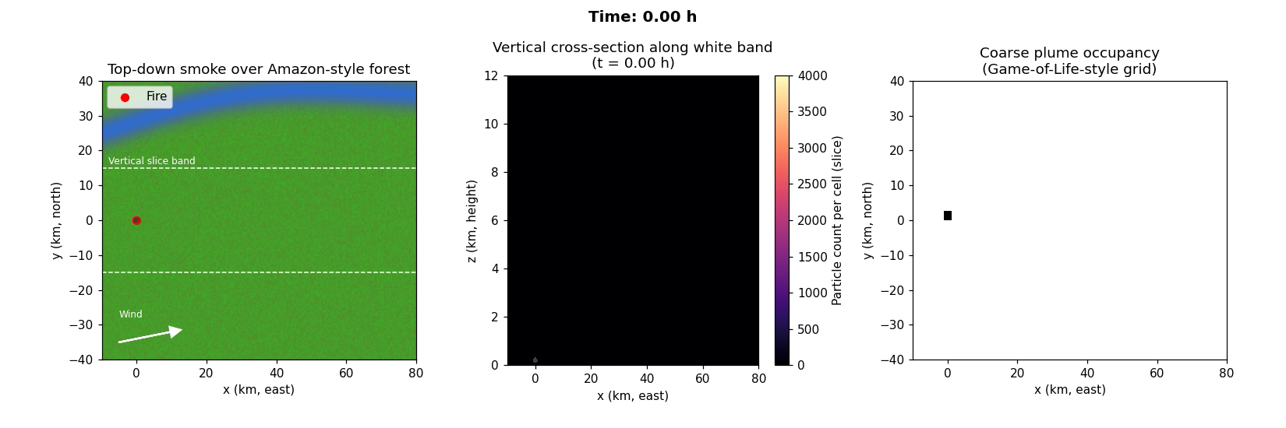

Slide 12
thanks!
Any questions?

Slide 13
CREDITS
Course & guidance: EPS 109 – Computer Simulations in Earth and Planetary Science
Real-world fire & smoke statistics GeoHealth, IPCC reports, Brazil public-health studies
Debugging some code and structure & wording assistance: ChatGPT 5.1 thinking model
Slides Carnival template

