Slide 1
Interplanetary Trajectory Simulations
EPS 109
University of California, Berkeley
Krishan Kanji

Slide 2





Numerical Model and Core Functions
2D heliocentric frame in the ecliptic plane.
Global constants for physical parameters (G, solar mass, AU, etc).
Sun at the origin planets on fixed circular orbits.
planet_pos(name, t): returns 2D position of a planet.
Spacecraft acceleration = sum of Newtonian gravity.
rk4_step(...): one RK4 integration step for position and velocity.
Integrated with a 4th-order Runge–Kutta (RK4) scheme. Solved 2-body / restricted 3-body problem in 2-D
rocket_acc: sums gravitational acceleration from celestial bodies.
Interplanetary Trajectory Simulations
3

Slide 3
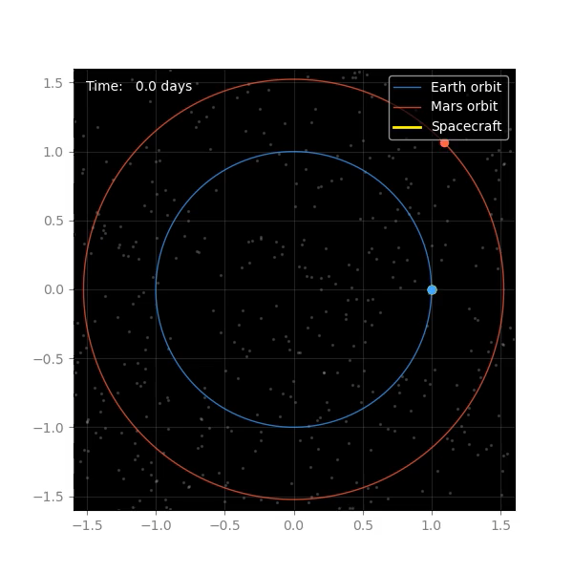
Earth → Mars Hohmann Transfer
Interplanetary Trajectory Simulations
5

Slide 4
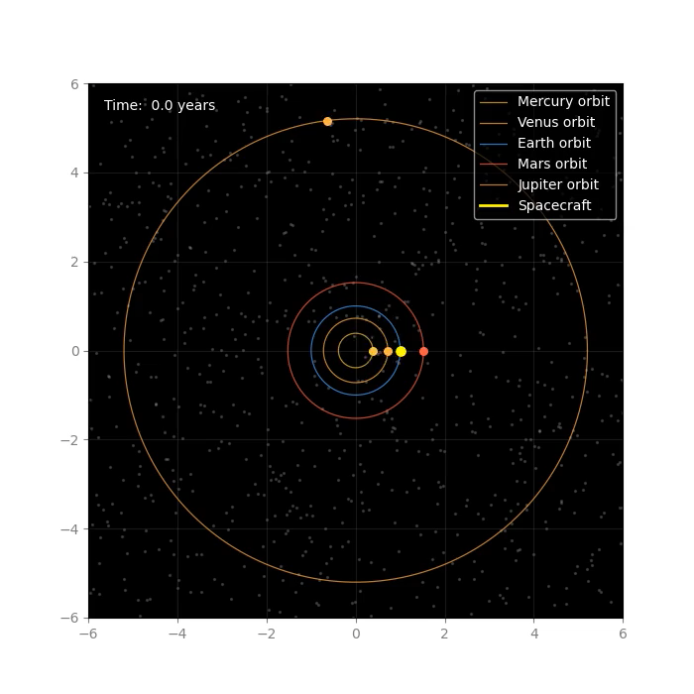
Earth → Jupiter Gravity Assist
Interplanetary Trajectory Simulations
6

Slide 5
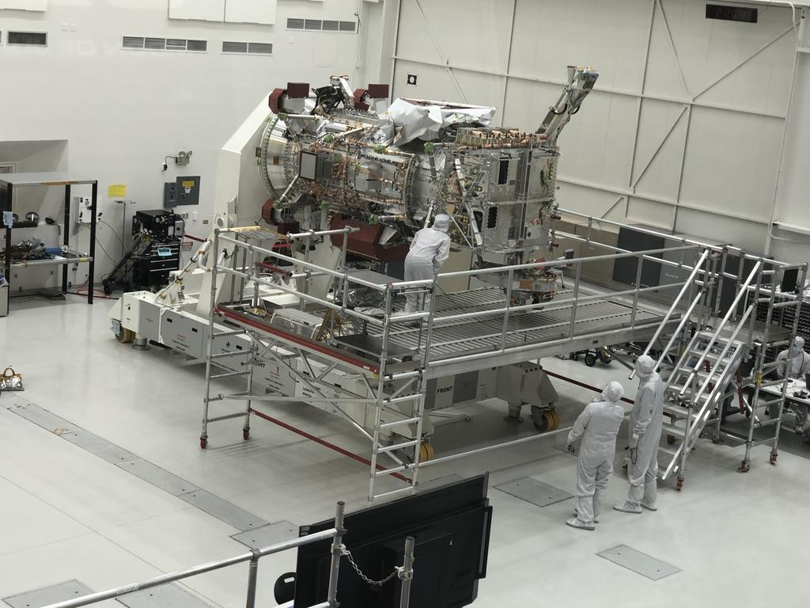
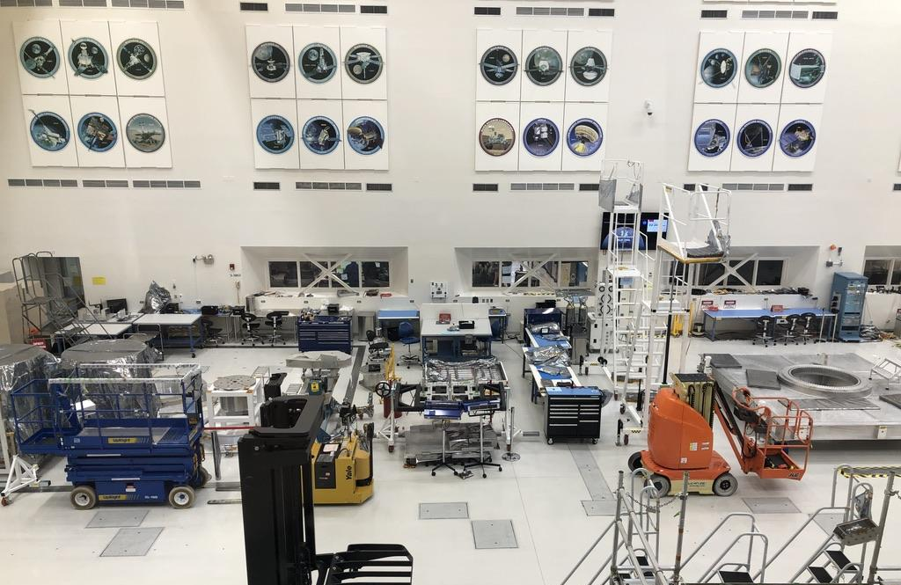
The Europa Clipper
Interplanetary Trajectory Simulations
6

Slide 6
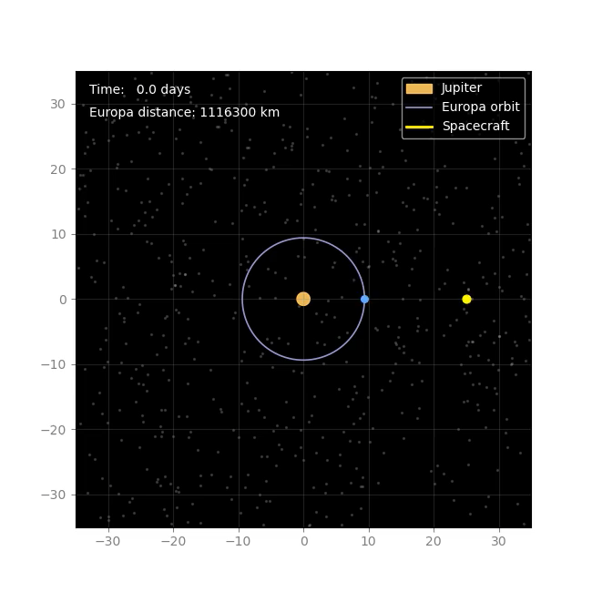
Jupiter–Europa Tour
Interplanetary Trajectory Simulations
7

Slide 7
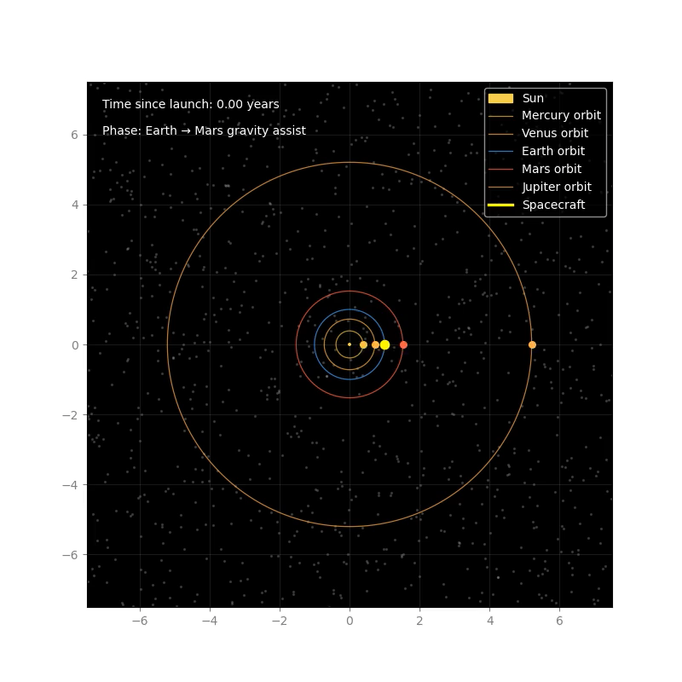
Earth → Jupiter / Europa Cruise
Interplanetary Trajectory Simulations
8

Slide 8
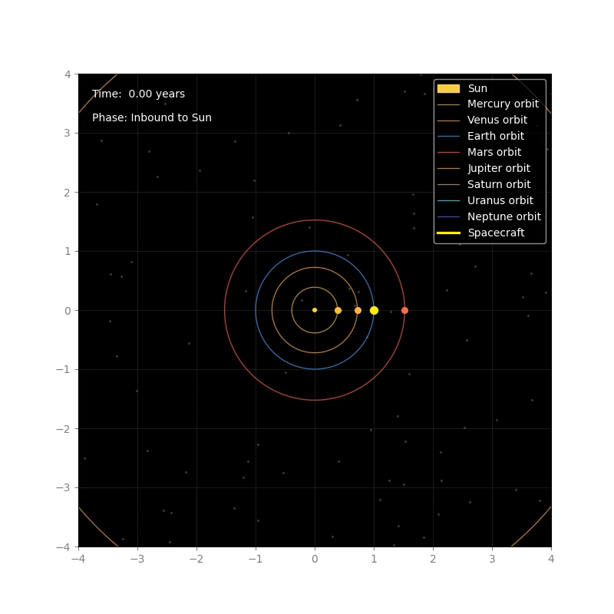
Sun Oberth Maneuver
Interplanetary Trajectory Simulations
9

Slide 9
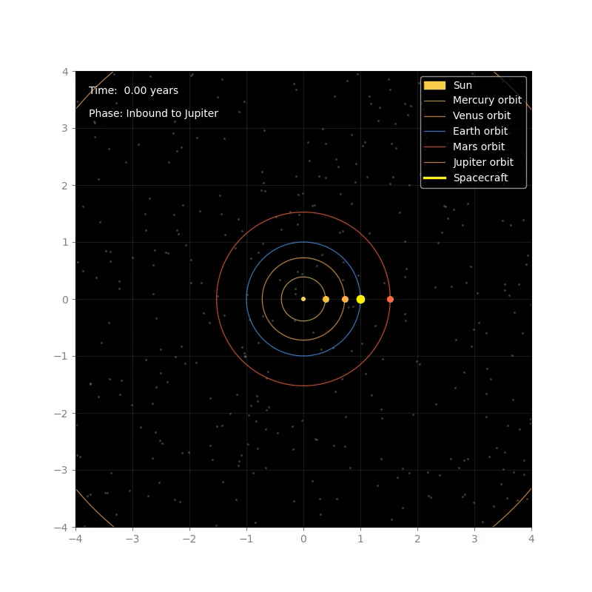
Jupiter Slingshot into a Sun-Dive Orbit
Interplanetary Trajectory Simulations
10

Slide 10
Thank You
Interplanetary Trajectory Simulations
11

