Slide 1
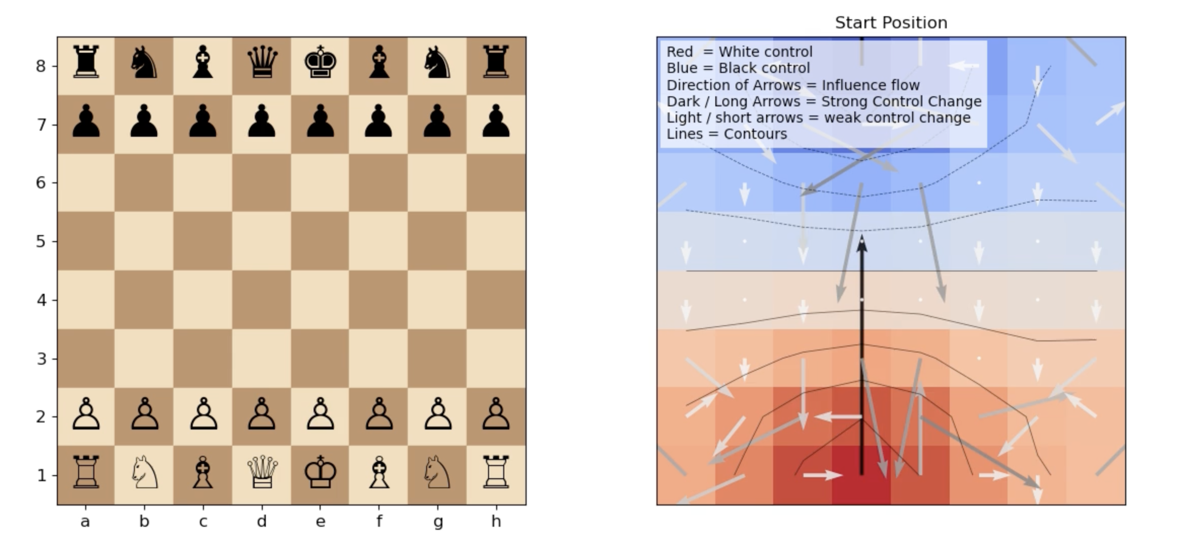
Heat Diffusion: How to Dynamically Evaluate Chess Positions
By James Jiang
EPS109

Slide 2
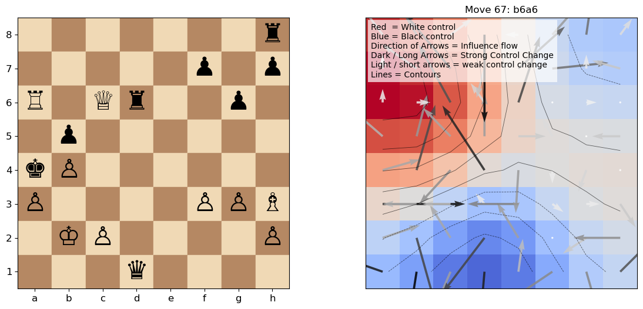
Methods used to show simulated heat diffusion
Colour Heatmap:
Each square dictated by a numerical “influence” based on pieces around it (queen > rook > bishop/knight > pawn)
Red = White, Blue = Black
Darker the square, stronger the control
Gradient Arrows:
Magnitude of influence/control on any given square as gradient vector
Long arrows = Strong influence
Up/Down arrows = influence increasing toward top/bottom of board
Contour Lines:
Lines of equal control
Boundaries where control switches between players
Tight spacing = Rapid change
Wide spacing = Calm change

Slide 3
