Slide 1
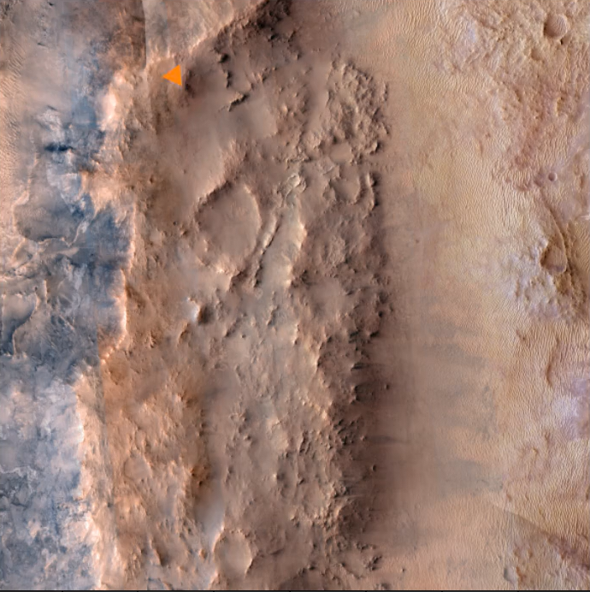
Rover movement on Mars
By: Joon Hwang

Slide 2

SPICE and spiceypy
SPICE Ephemeris Data
  Using NASA’s Rover and Instrument Deployment Device Geometry (IDDG) spk kernel that contain recording of rover positions
    Includes spk, iddg spk, lsk
SPICEYPY
  The python wrapper for the SPICE toolkit
  Sp.spkpos: return the target position relative to the observing body
  Sp.reclat: convert rectangular coordinates to latitude and longitude coordinates
Arctan2:
  direction
  Four-quadrant inverse tangent function
Notes:
nSPICE (spacecraft planet instrument C-matrix events): is a NASA information system that is used to computer geometric information used in planning and analyzing science observation
Lsk (Leapseconds Kernel) : Time conversion file
Pck (planetary constants kernel) :
SPK ( spacecraft and planet kernel) : contains the rover xyz positions on mars
IDDG SPK: contains the geometry of the rover’s arms, but its primary use is providing the rover’s main SPK
Spkpos: uses the target name, reference frame of position and what you wish to observe
Arctan2: a math function that is used to calculate the angle of a vector in a 2d plane, which allows me to determine where the rover is facing by using the difference of the current long,lat position to the next curr long,lat position.
Determine the next long,lat since the data gives all of them

Slide 3
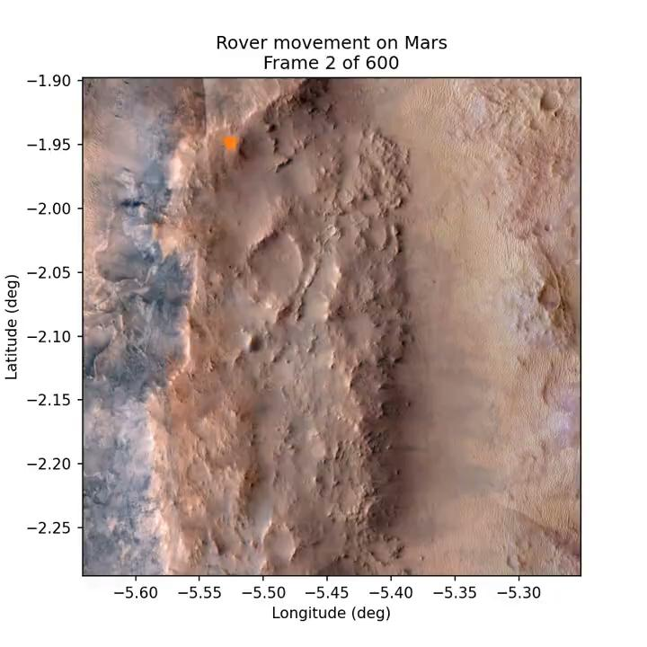
Animation

