Slide 1
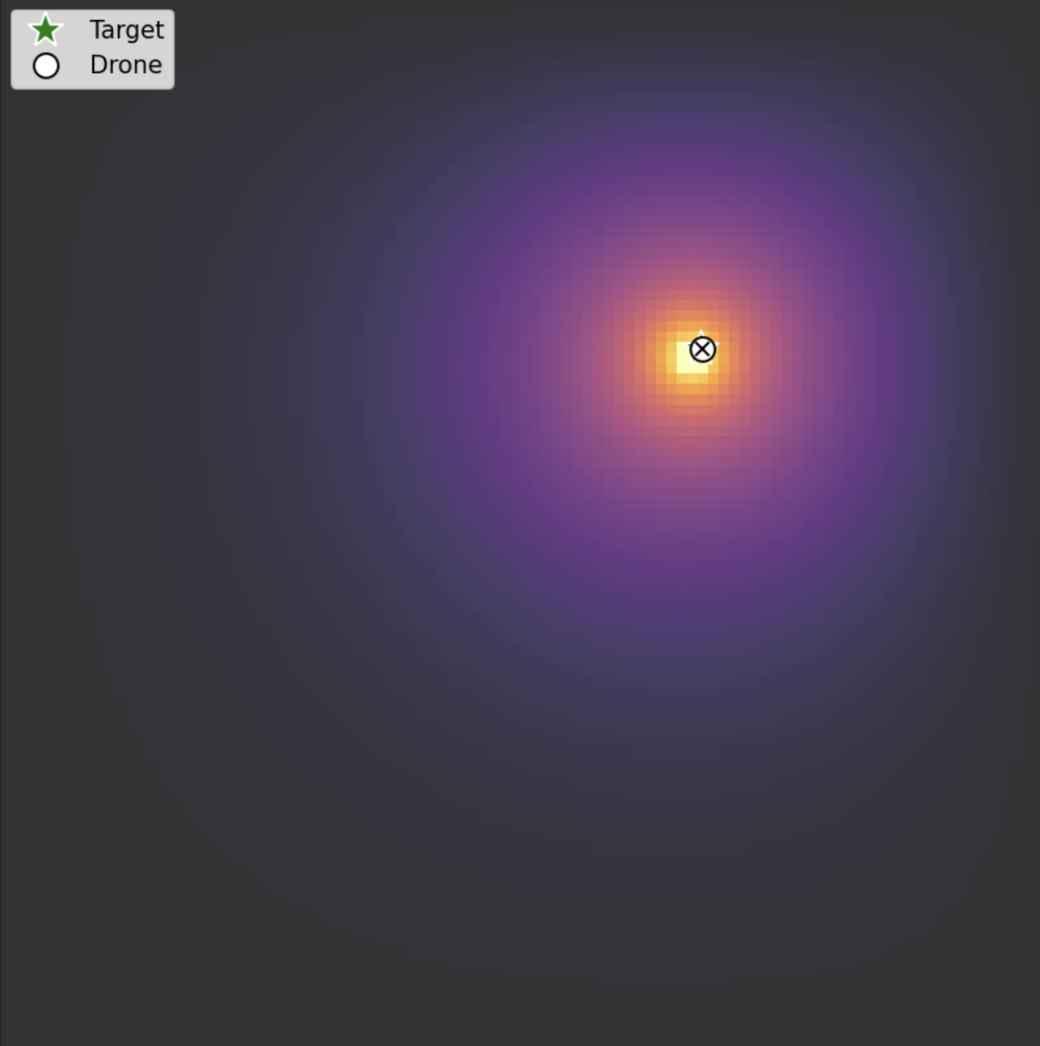
Drone Search Using Heat Diffusion Modeling
Diya Hasteer

Slide 2
Topic and Methods
Objective: Simulate a Search And Rescue Mission where a drone is trying to locate a distress beacon by tracking the gradient of its diffusing heat signal across a 2D terrain
Environment Model (PDE): Used the Jacobi Method of the Heat Equation to model to heat propagation with the beacon being a constant heat source$T_{\text{new}}(x,y)=\frac{1}{4}\left[T_{\text{old}}(x+Δx,y)+T_{\text{old}}(x-Δx,y)+T_{\text{old}}(x,y+Δy)+T_{\text{old}}(x,y-Δy)\right]$
Drone Model (ODE): Used Euler’s Method to follow the steepest ascent of the signal field. $x_{new}=x_{old}+Δt⋅\left(S⋅\frac{∂T}{∂x}\right)$ $y_{new}=y_{old}+Δt⋅\left(S⋅\frac{∂T}{∂y}\right)$
Other Details: Sub-cycling for heat diffusion, Upwind Scheme to model wind
upwind scheme source: https://en.wikipedia.org/wiki/Upwind_scheme

Slide 3
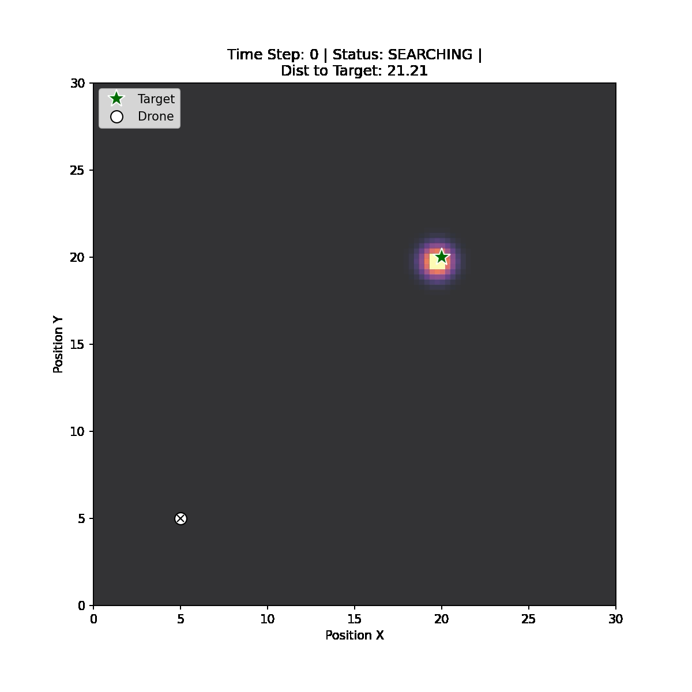
Static Target
Time Acquired: 110

Slide 4
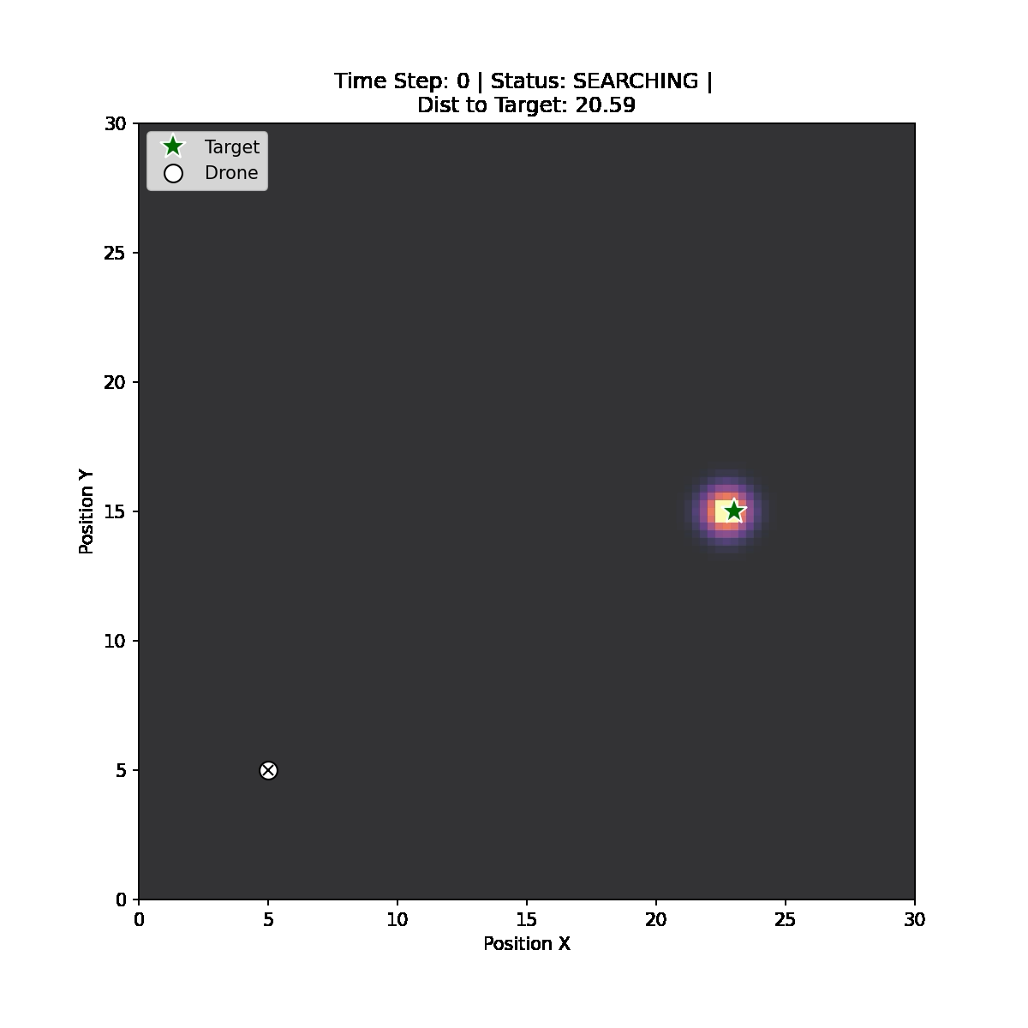
Moving Target
Time Acquired: 80

Slide 5
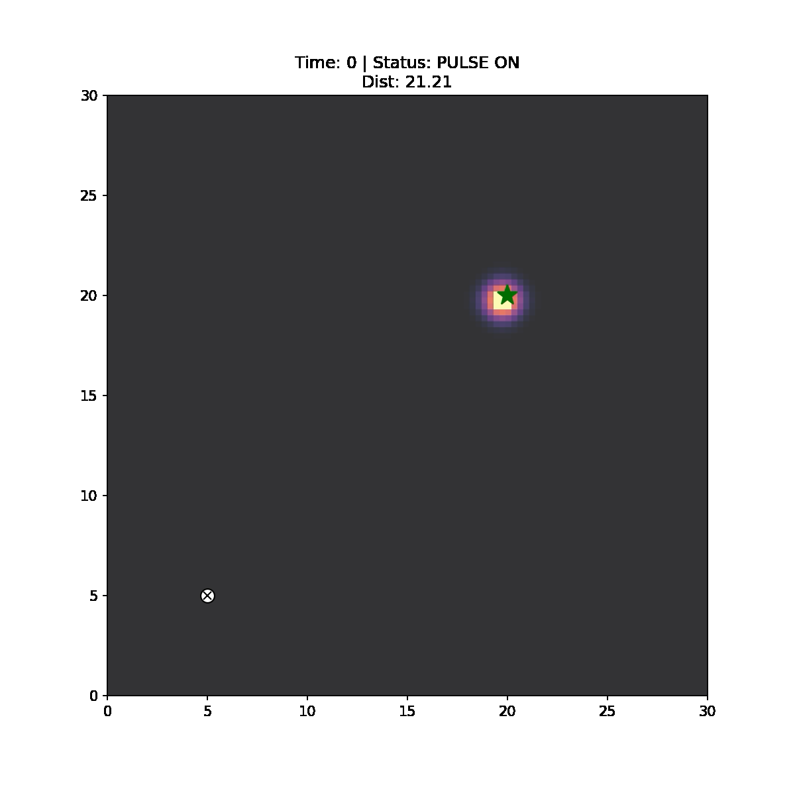
Pulsing & Static
Time Acquired: 114

Slide 6
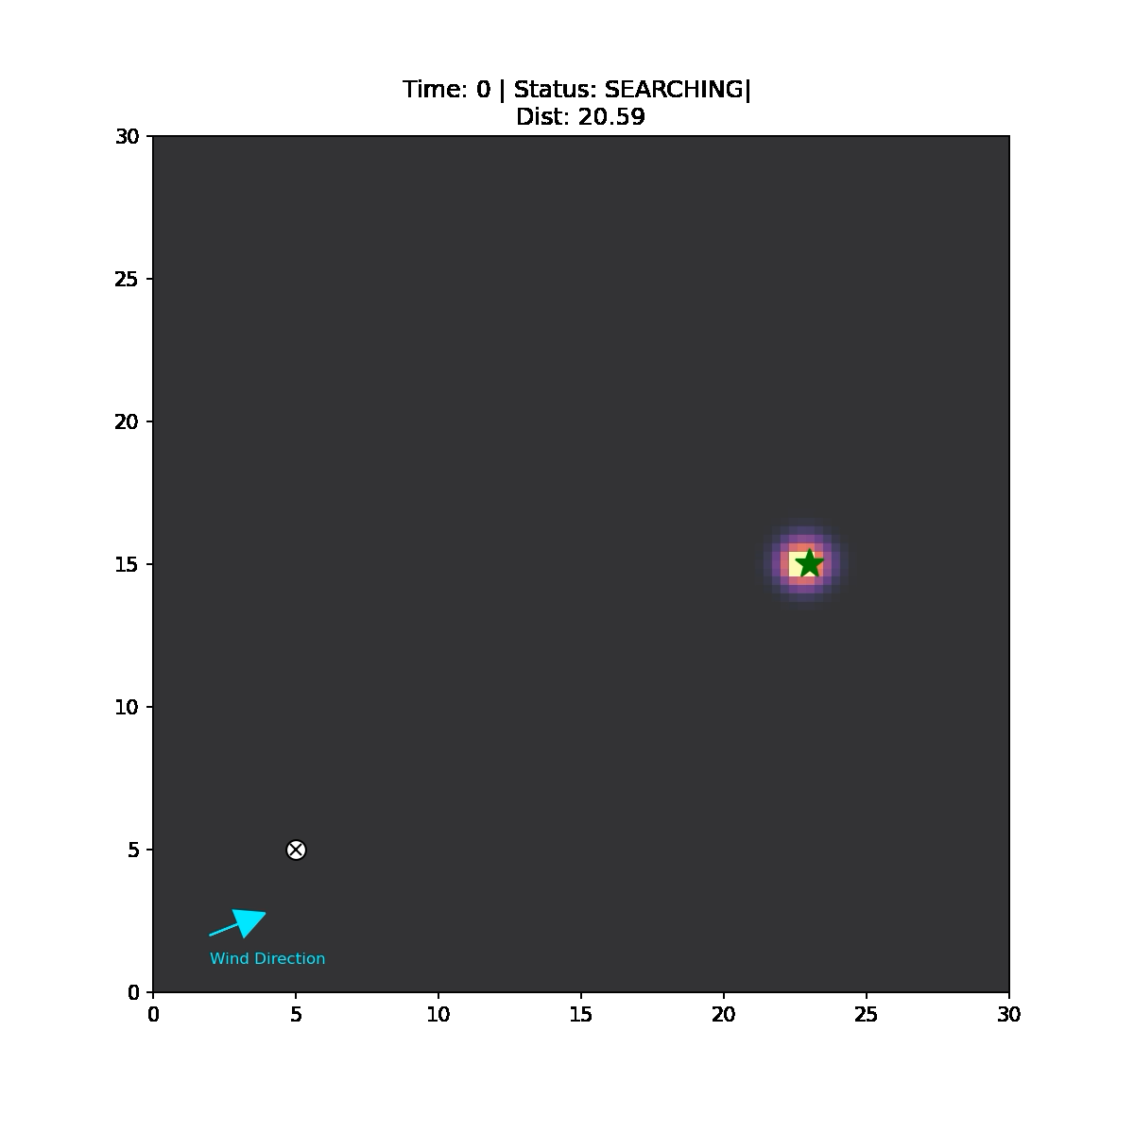
Windy & Moving
Time Acquired: 110

