Slide 1
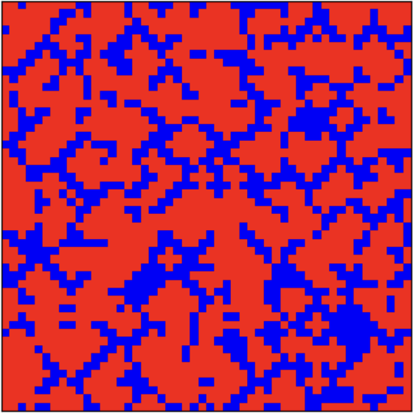
Trust and Betrayal: Evolution of Cooperation in a Social Game
By Tiffanie Guichard

Slide 2
Social Game and Simulation Method
Question & idea
I model a world where each agent can either cooperate (trust) or defect (betray) in a repeated social game (Prisoner’s Dilemma).
Goal: see how the rules of the game (payoffs for trust vs betrayal) change the long-term fraction of cooperators in the population.
Game rules (Prisoner’s Dilemma)
Two possible strategies:
Cooperate (C) = trust the partner
Defect (D) = betray the partner
Payoffs (per interaction):
Partner C Partner D
You C R, R S, T
You D T, S P, P
R: reward for mutual cooperation
T: temptation to defect (exploit a cooperator)
S: “sucker’s” payoff (you cooperate, they defect)
P: punishment when both defect
Spatial simulation:
Agents live on a 50×50 grid
Each cell holds one agent with a fixed strategy: C or D
Neighbors: 4 nearest neighbors (up, down, left, right) with wrap-around edges.
At each time step, every agent plays the game with its right and down neighbor, and payoffs are added up.
blue = defectors, red = cooperators
Evolution rule:
After payoffs are computed, each agent looks at: itself + its 4 neighbors, and finds the player with the highest payoff.
The agent copies the strategy of this best neighbor (with a small probability μ (mutation), the strategy flips: cooperator → defector or defector → cooperator.)
This update is repeated for 500 time steps.
Parameter sets:
Harsh world (betrayal favored)
R = 3, S = 0, T = 5, P = 1, μ = 0.02
→ cooperation collapses (~2% cooperators)
Medium-fair world (animation case)
R = 3.5, S = 0, T = 3.5, P = 1, μ = 0.01
→ mixed coexistence (~60–70% cooperators)
Cooperation-friendly world
R = 4, S = 0, T = 3, P = 1, μ = 0.01
→ high cooperation (~90% cooperators)

Slide 3
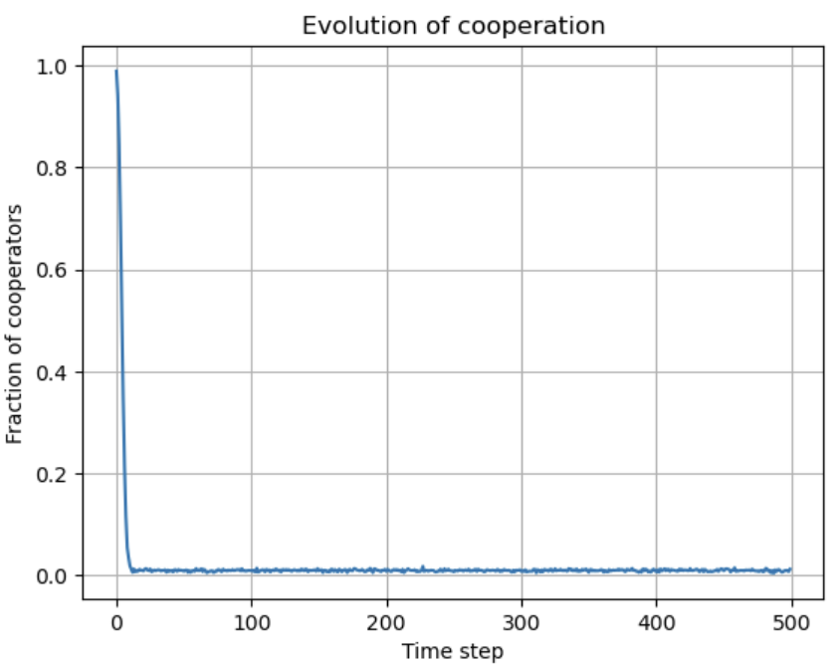
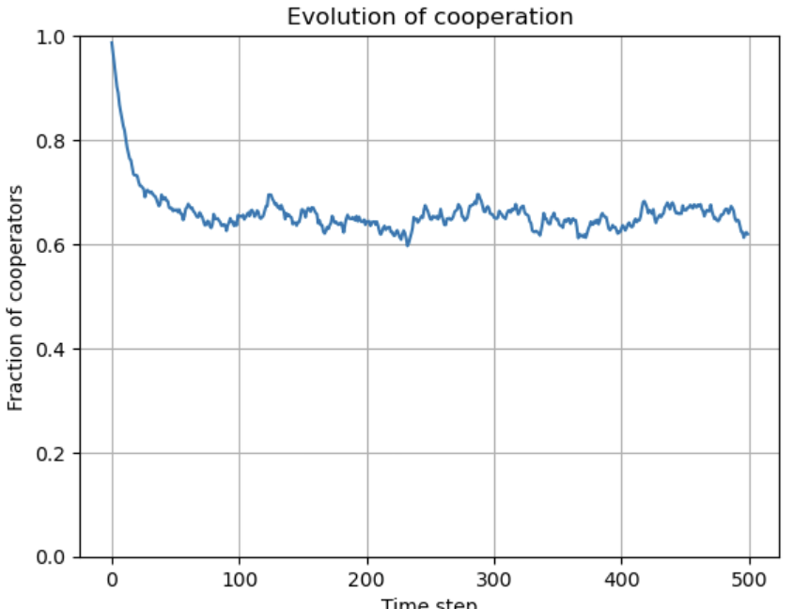
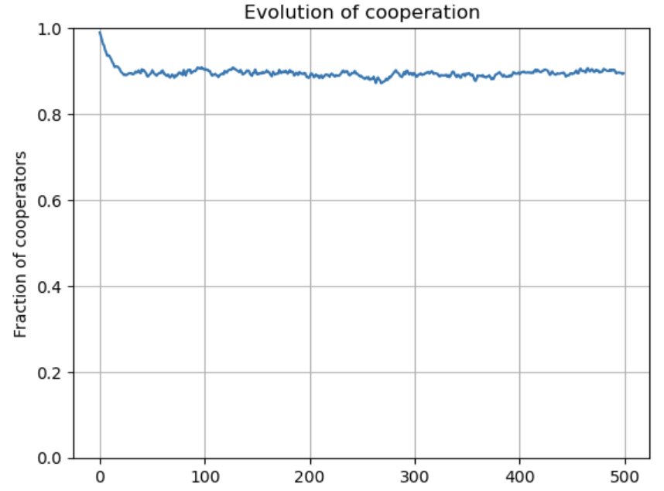
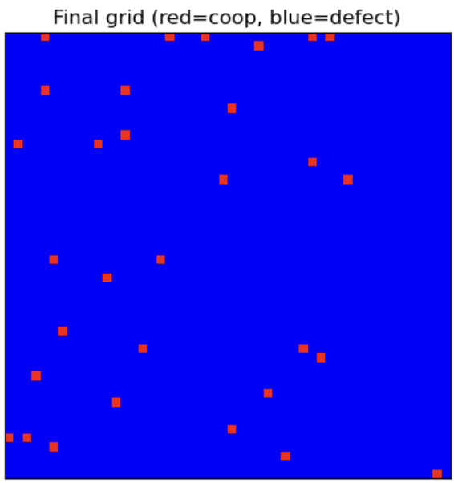
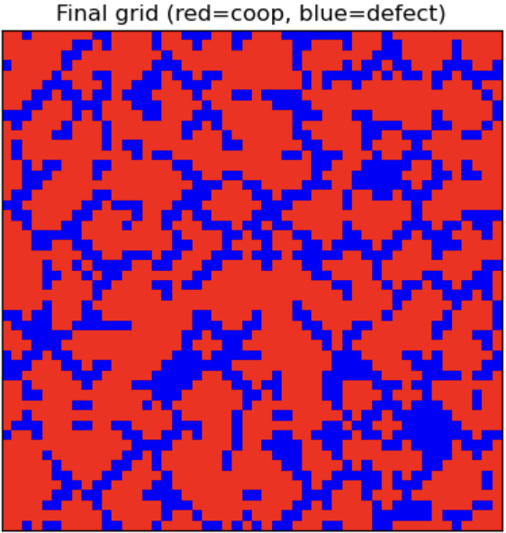
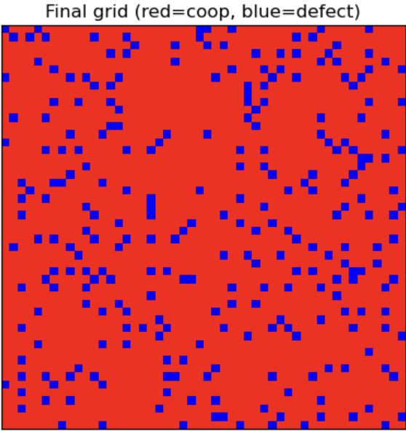
When Does Trust Survive?
Harsh world (betrayal favored)
R = 3, S = 0, T = 5, P = 1, μ = 0.02
→ starting from almost 100% cooperators, the fraction quickly falls to ~2% and stays low.
→ final grid: almost all blue defectors, red cooperators only appear as rare mutations.
Medium-fair world (shown in animation)
R = 3.5, S = 0, T = 3.5, P = 1, μ = 0.01
→ cooperation stabilizes around ~60–70%.
→ we see red cooperative clusters forming and surviving inside a sea of blue defectors.
Cooperation-friendly world
R = 4, S = 0, T = 3, P = 1, μ = 0.01
→ cooperation stays high, around ~90%.
→ most agents are red cooperators; blue defectors are scattered “mutants”.

Slide 4
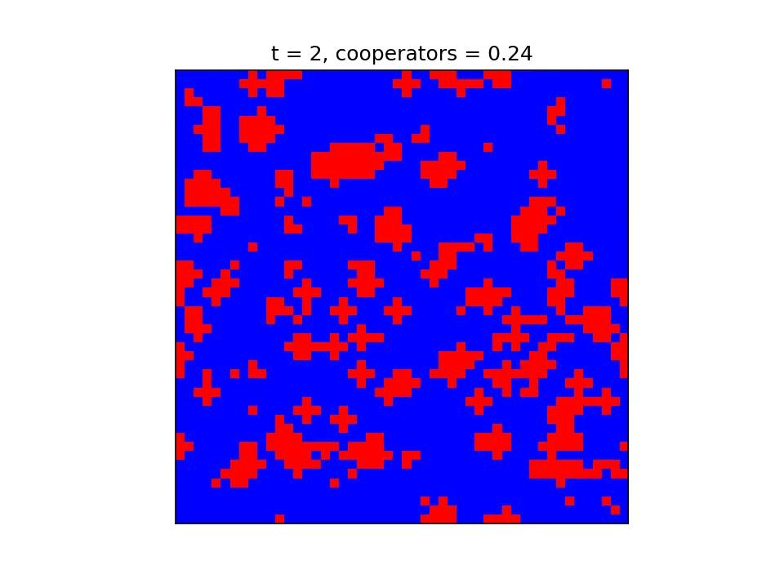
Simulation of Medium-fair world
50×50 grid,
R = 3.5,
S = 0,
T = 3.5,
P = 1,
μ = 0.01.
Red = cooperators,
blue = defectors.

