Slide 1
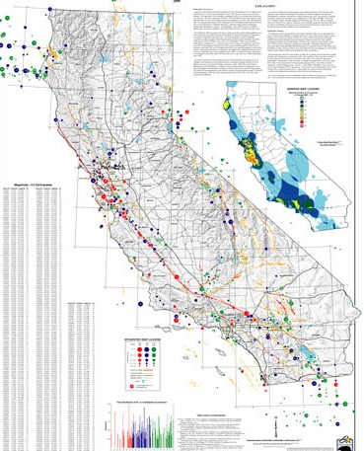
Modeling Recurrence Intervals of Major California Earthquakes
Ether Gu
M>=5 California Earthquakes, 1800-1999. conservation.ca.gov/

Slide 2
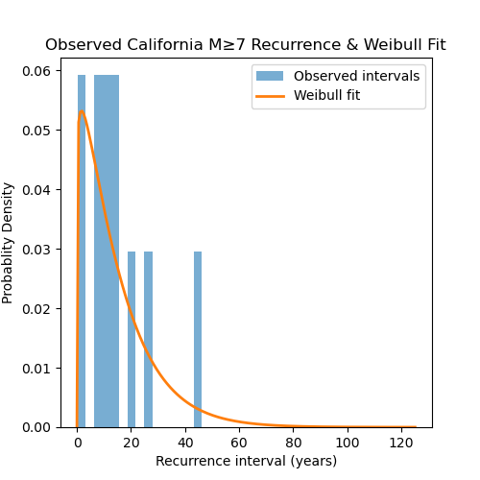
Topic and Methods
Download catalog of M7+ earthquakes in california 1850-present with Cartopy
Calculate recurrence intervals and fit to Weibull distribution with Scipy
Simulate future recurrence intervals using the distribution and see results

Slide 3
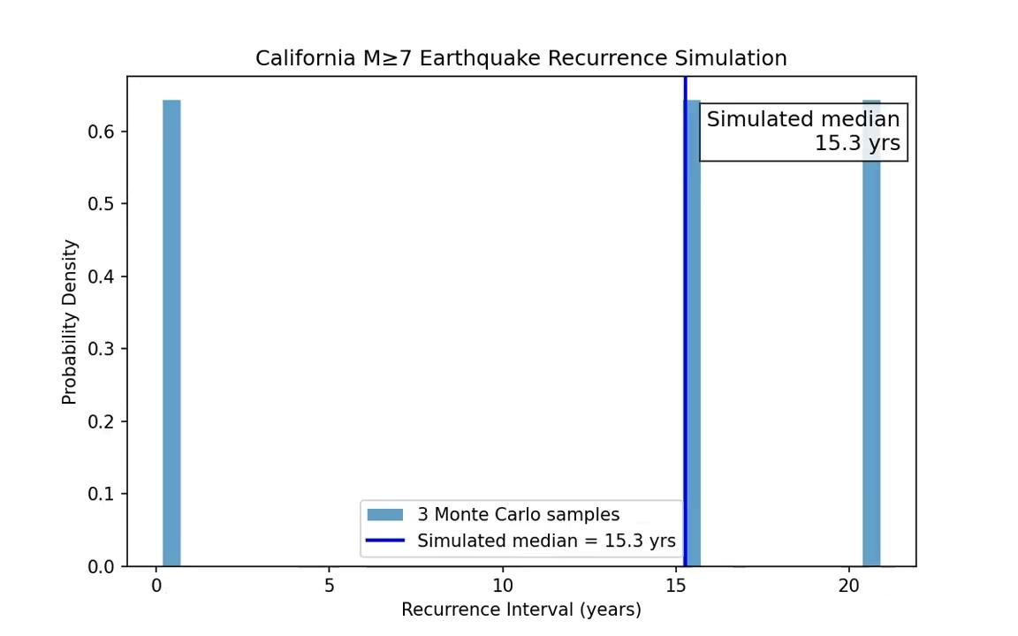
Results

Slide 4
References
Figure of M5+ earthquakes 1800-1999: https://www.conservation.ca.gov/cgs/documents/publications/map-sheets/MS_049.pdf
Paper on earthquake recurrence sims using probability distributions: https://agupubs.onlinelibrary.wiley.com/doi/full/10.1029/2007JB004998
Scipy Weibull distro documentation: https://docs.scipy.org/doc/scipy/reference/generated/scipy.stats.weibull_min.html

