Slide 1
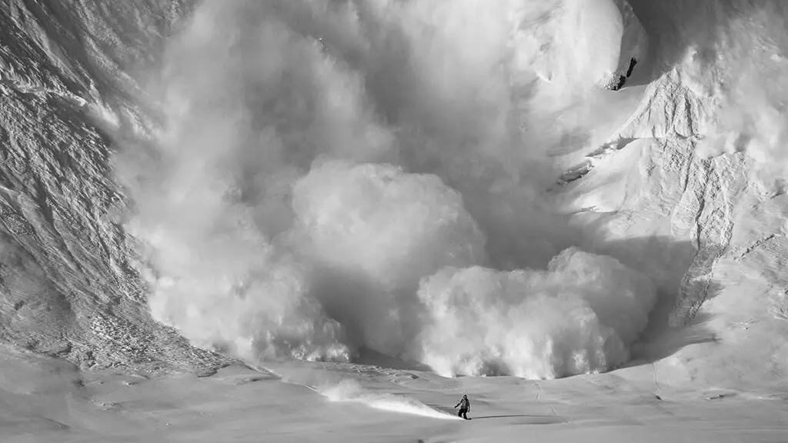
1D Dry Slab Avalanche Model
Natalia Grondin

Slide 2
Dry slab avalanche a ‘slab’ of snow breaks away above a weaker layer and slides as one unit before fragmenting.
Components:
Stratified snowpack (slab + weak layer): a relatively dense, cohesive slab overlies a weaker, poorly bonded layer in the snowpack.
Critical slope angle: slopes roughly in the 30–45° range provide enough downslope component of gravity for the slab to slide once the weak layer fails.
External loading / trigger: extra stress from a skier, new storm snow, a rock, etc. can overload the weak layer.
Fracture propagation: a local collapse in the weak layer can evolve into a crack that propagates across the slope, creating a crown fracture and detaching the slab as the moving avalanche.

Slide 3
Behavior
Once the slab detaches from the weak layer, it behaves like a dense flow of snow sliding down a path
I describe motion along this path using:
  s(t): position of the slab’s center of mass along the track
  v(t): speed along the track
  θ(s): local slope angle (steep release zone to gentler runout)
The dynamics are based on a Voellmy-type avalanche friction law used in hazard models:
  Driving force: gravity along the slope, proportional to g sin θ(s)
  Coulomb friction: a constant resistance μ g cos θ(s) from the bed (μ is friction between snow and ground x normal force)
  Turbulent drag: an additional resistance that grows with v^2, scaled by a drag parameter C and a flow thickness H (grains collide, air mixed in)
This captures the competition between gravity, friction, and drag that controls how fast the slab moves and how far it runs out.

Slide 4
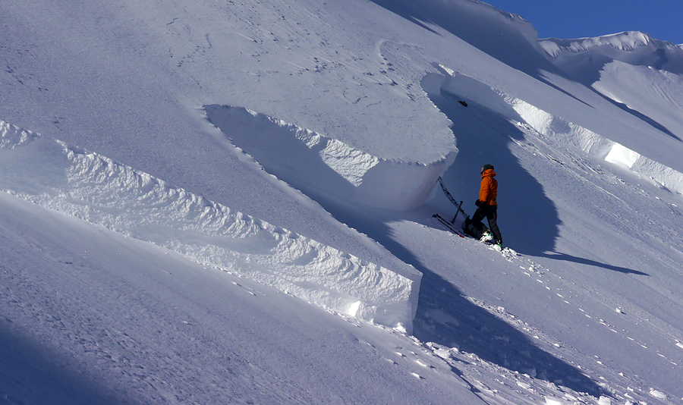
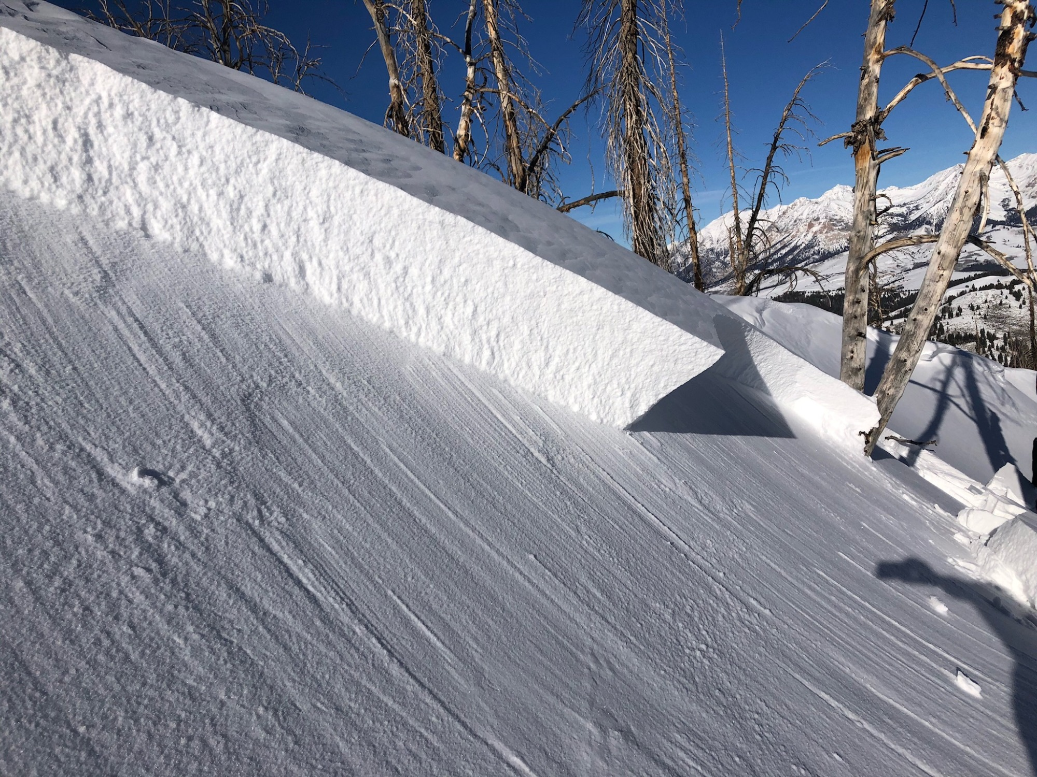
My Model
I build an idealized avalanche path with a steep upper slope, a mid-slope track, and a gentle runout, defined by a profile z(x).
The avalanche is represented as a single slab/block with position s(t) and speed v(t) moving along this path
At t=0 the slab is released from rest at the top, representing the moment after weak-layer failure.
I numerically step forward in time using the Voellmy sliding-block equations for s(t) and v(t).

Slide 5
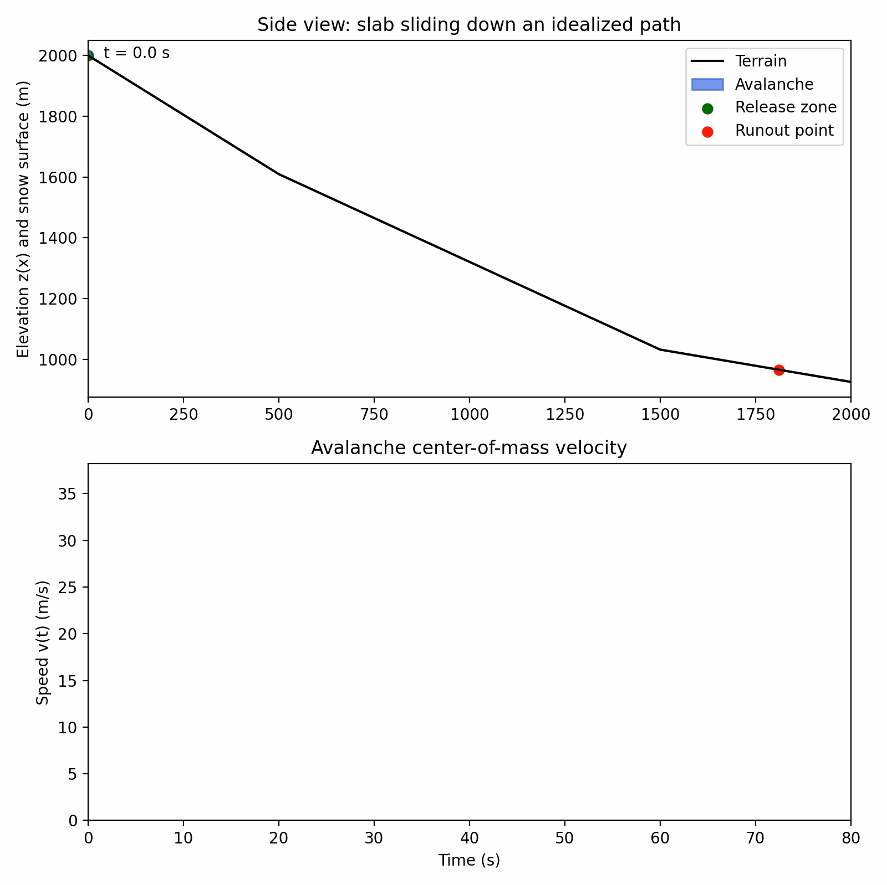
On the steep upper slope, the slab accelerates because gravity dominates friction and drag
As the path flattens, friction and turbulent drag overcome gravity, so the slab decelerates and eventually stops in the runout zone

Slide 6
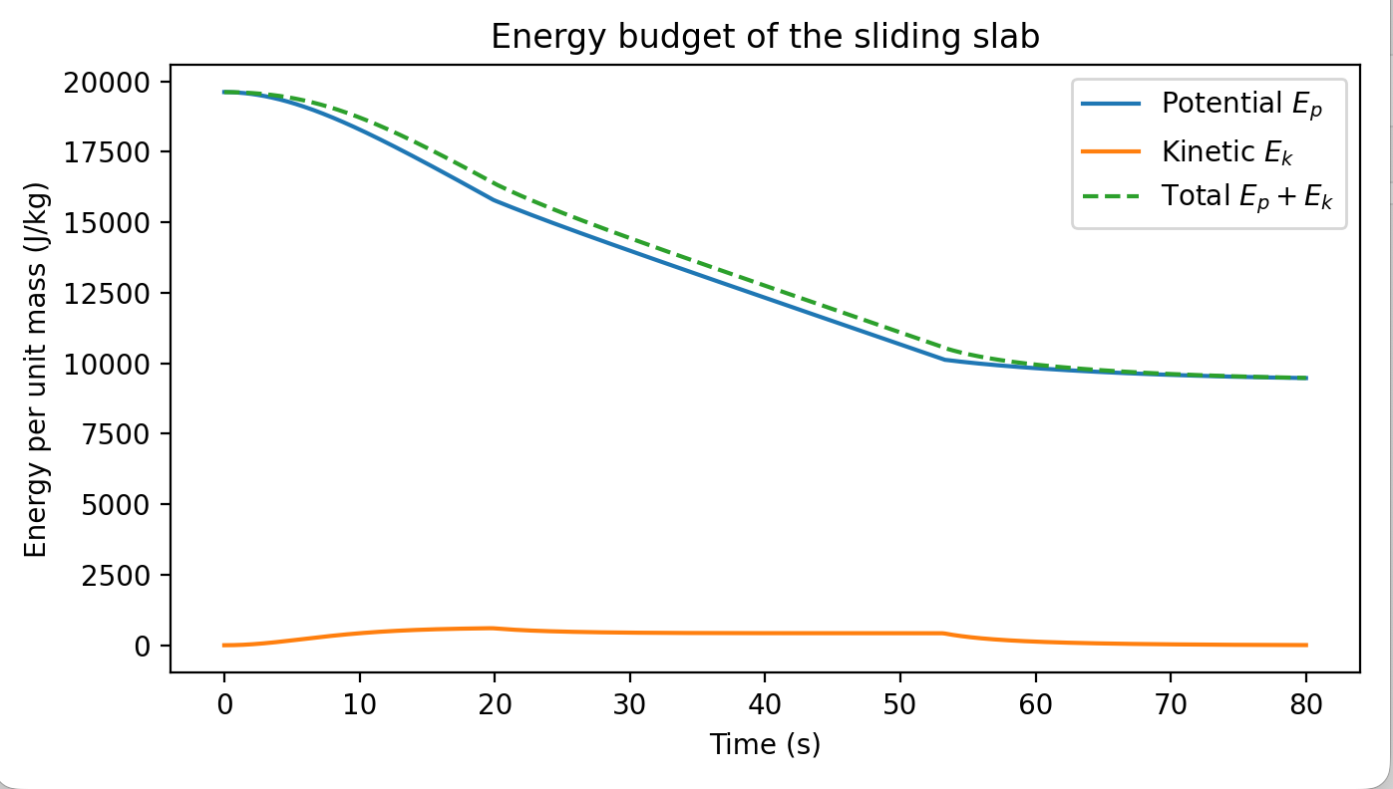
This energy plot shows potential energy decreasing, kinetic energy rising then falling, and total energy decreasing over time due to frictional dissipation.

