Slide 1
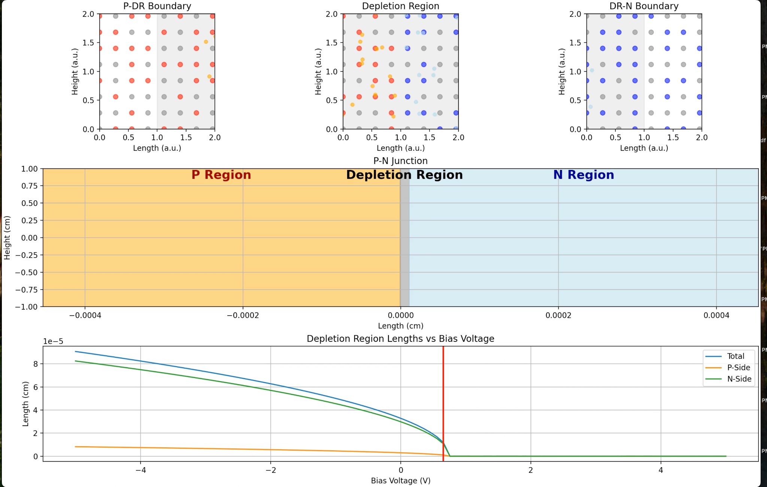
Mobility Carriers in a P-N Junction
Alvaro Estrella

Slide 2

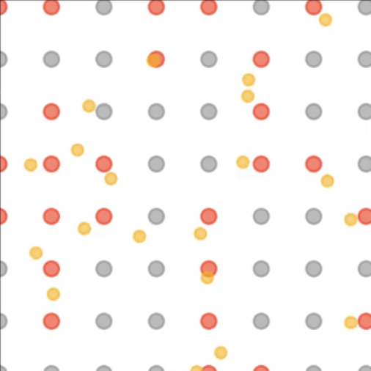
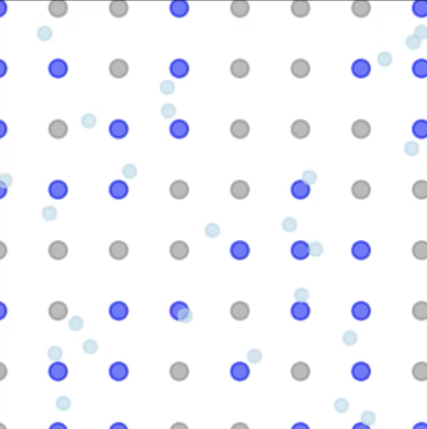
Topic
Simulation of a P-N junction highlighting the behavior of mobility carriers (holes, electrons) and the evolution of the depletion region when a bias voltage is applied.
P-N junctions are fundamental components of modern-day electronics, including diodes, transistors, and amplifiers.
P-Type Semiconductor
Lattice
N-Type Semiconductor
Lattice
Methods
Generated a 2D lattice silicon lattice with P-type and N-type dopants.
Simulated mobility carriers as point particles through random walks.
Manipulated mobility carriers positions through directional biases.
Attributed mobility carriers attractive and repulsive forces for like-charge and opposite-charge particles.
Attributed mobility carriers a repulsive force for neutral charge particles (lattice atoms).
Applied a bias voltage to simulate forward and reverse bias conditions.
Calculated depletion region based on applied bias and doping concentrations.
Silicon (Si)
Electron
Donor Dopant
Hole
Acceptor Dopant

Slide 3
