Slide 1
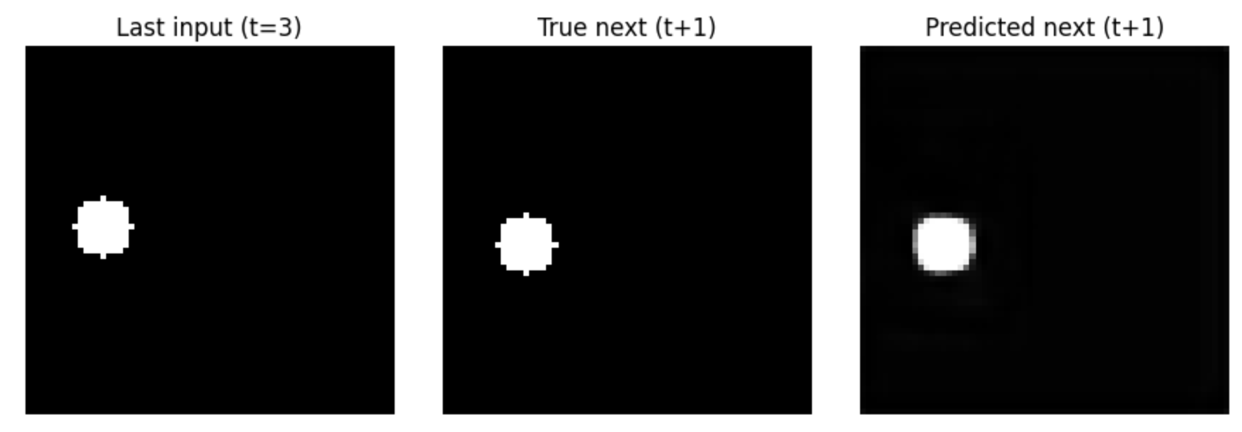
Next-frame prediction for a bouncing ball with CNNs
Mishty Dhekial

Slide 2
Simulation Topic + Methods
Dataset
Simulated about 200 independent trajectories of a single ball bouncing in a 2D box using kinematics (gravity + elastic wall collisions).
Each trajectory has 25 time steps, rendered as 64 × 64 grayscale images.
Each training example ([frame t, t + 1, t + 2, t + 3] and frame t + 4]
Split trajectories into 80% training and 20% test.
CNN model
Model with 3 convolution + pooling layers and 3 upsampling + convolution layers.
Input: 4 × 64 × 64 image.
Output: 1 × 64 × 64 prediction for next frame.
Trained with mean squared error (MSE) loss.
Goal
Simulate a 2D bouncing ball using kinematics simulation and train a convolutional neural network (CNN) to predict the next video frame from the prior frames.
Kinematics simulation
2D box with one ball; state is position and velocity.
Gravity acts downward each time step; elastic collisions at the walls (velocity component flips sign and is scaled by a bounce coefficient).
Each time step is rendered as a 64×64 grayscale image with a bright circular ball on a dark background.

Slide 3
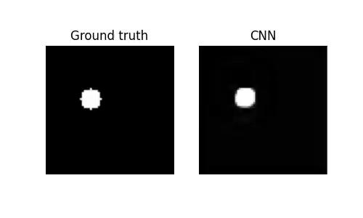
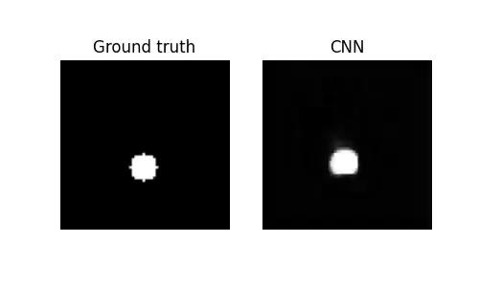
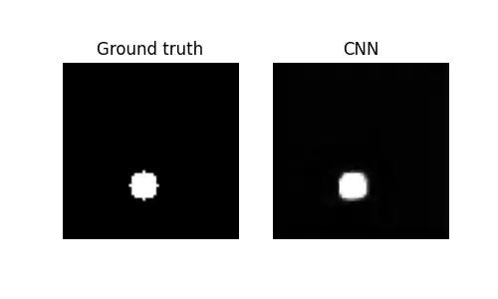
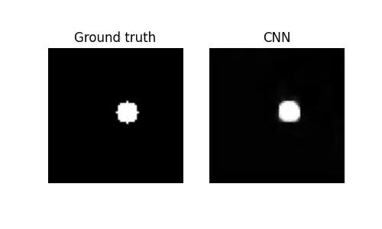
Animations

