Slide 1
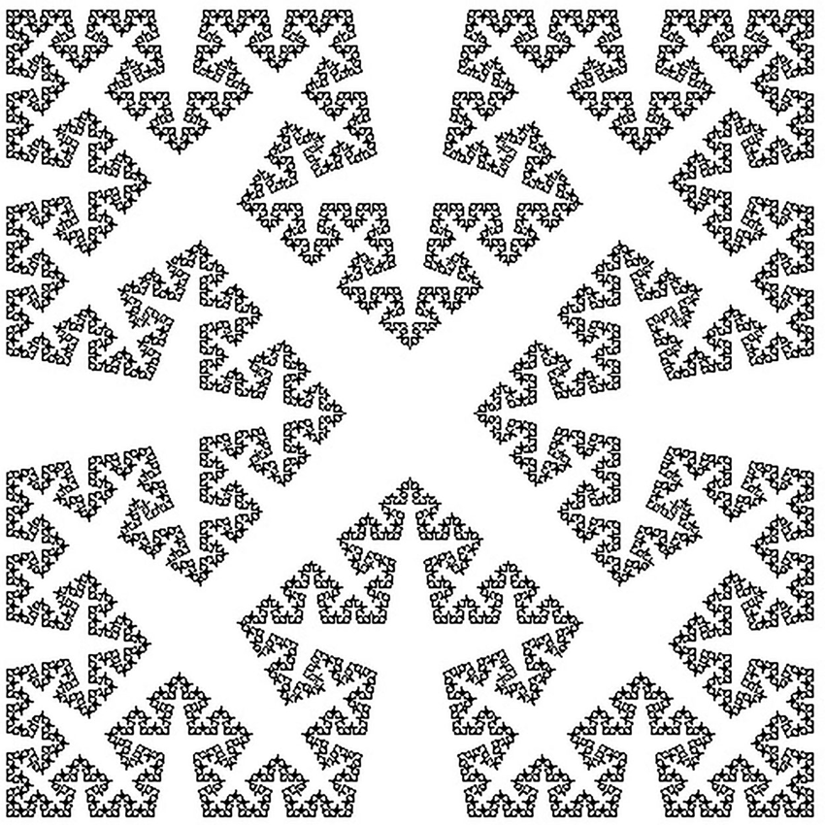
Exploring the creation of the Cesàro Fractal
Eliott Daspet

Slide 2
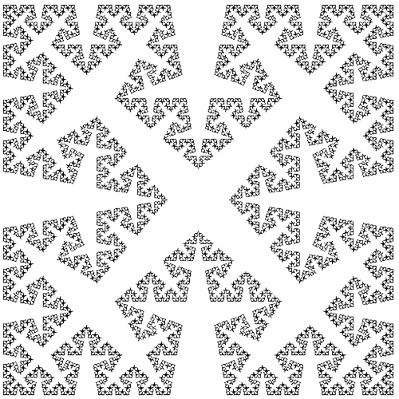
Topic and Methods used
What is the Cesàro fractal ?
4 self-similar curves, Cesàro curves
What methods were used ?
Lindenmayer systems
Recursion
Order 0 (axiom)
Order 1 (F -> F + F - - F + F)

Slide 3
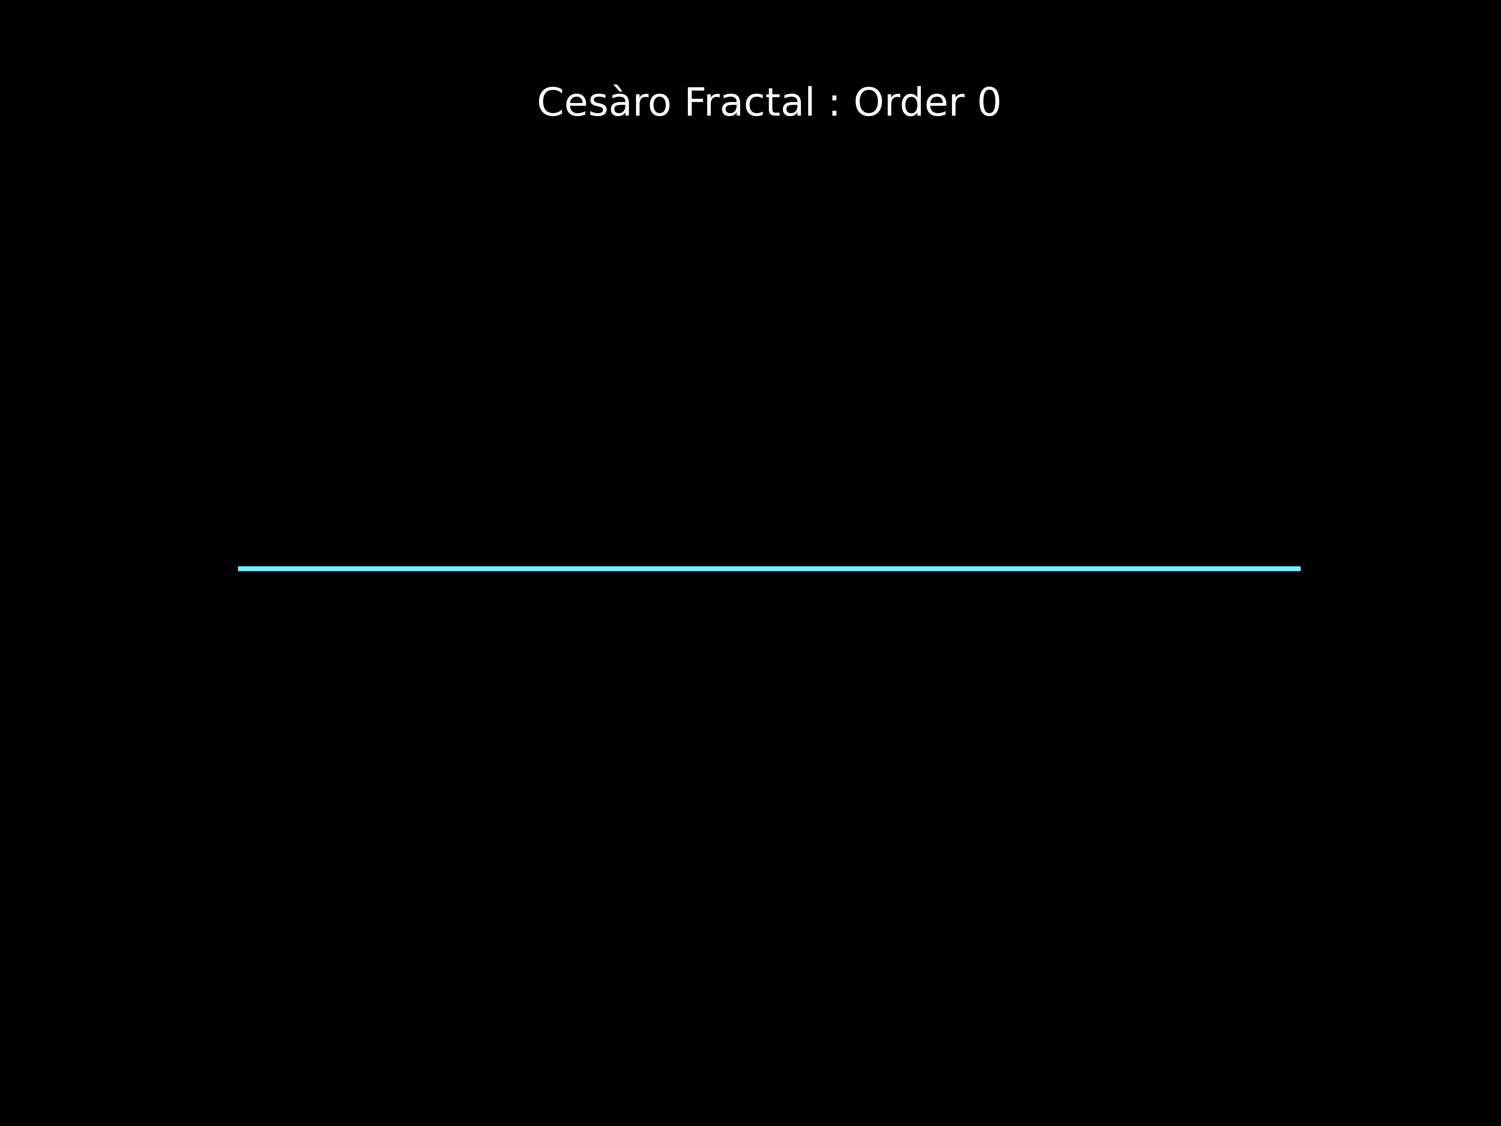

Slide 4
