Slide 1
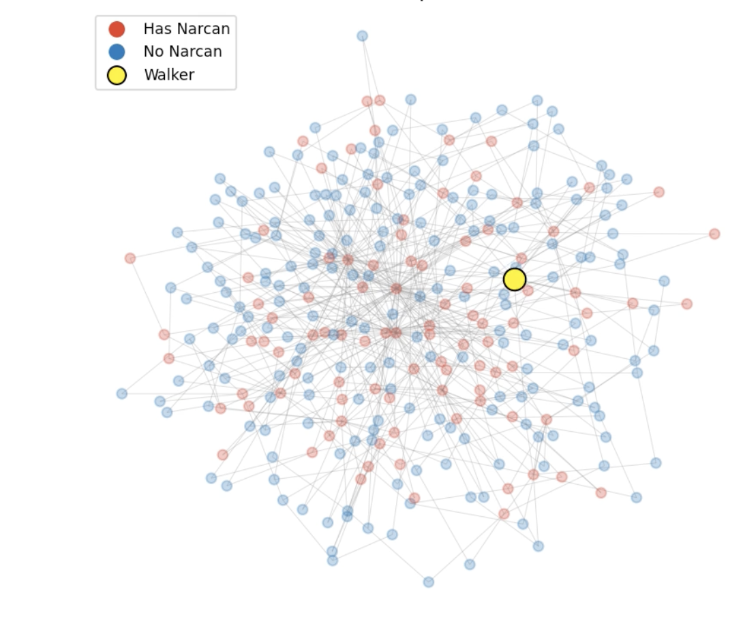
Respondent Driven Sampling as Random Walks
Kunal Baldava

Slide 2
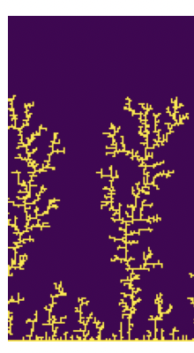
Topic and Methods
Random Walks
Sampling "Hidden" Populations (e.g. Opioid Users)
Illicit nature, stigma → traditional sampling is difficult.
Recruit a trusted seed and traverse their social network.
Animation 1: Degree Bias
Animation 2: Structural Bottlenecks
Animation 3: Homophily
Animation 4: Multi-Seed Correction

Slide 3
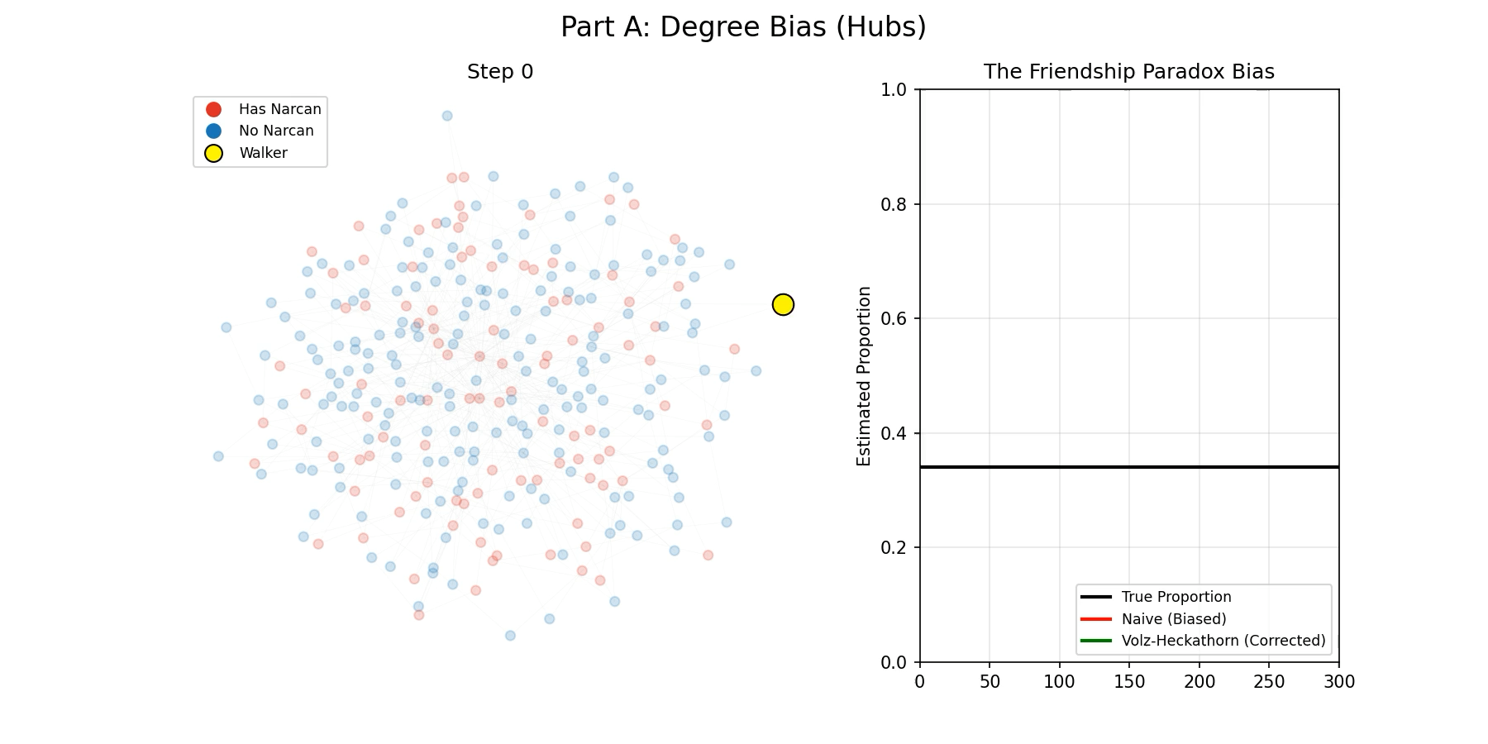

Slide 4
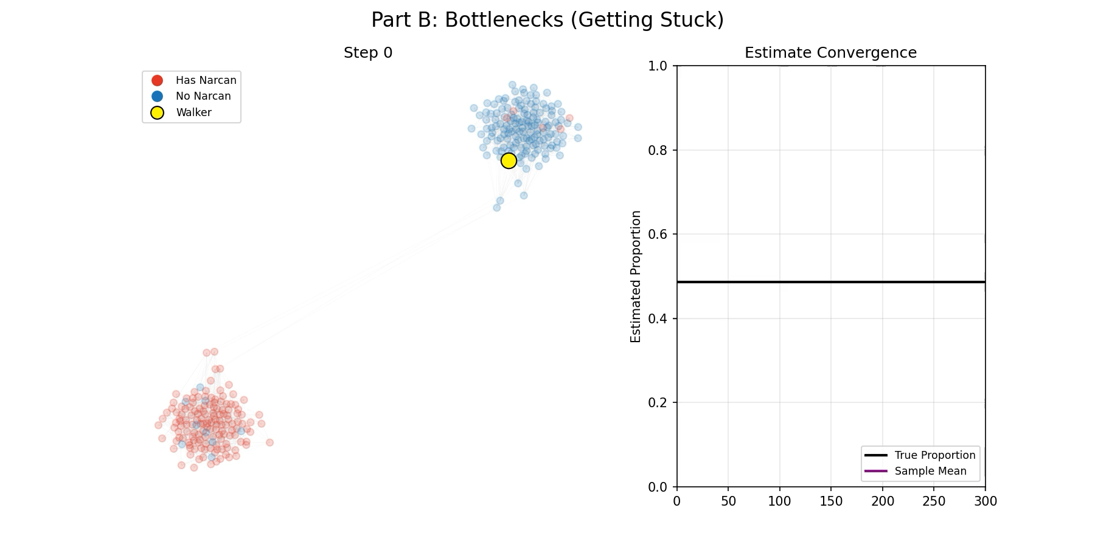

Slide 5
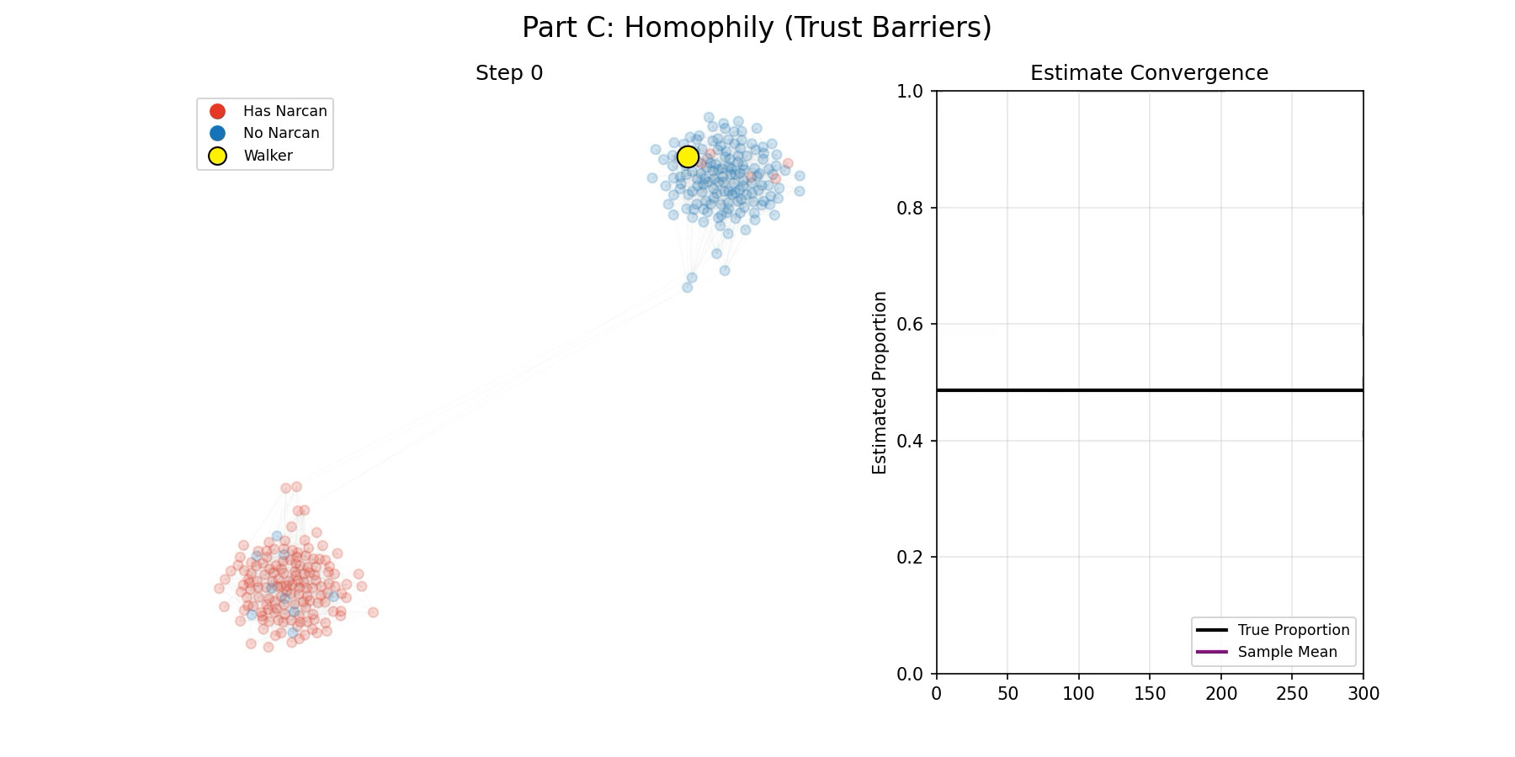

Slide 6
