Slide 1
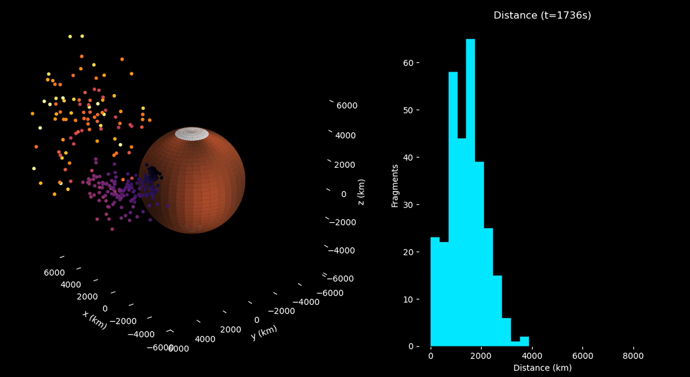
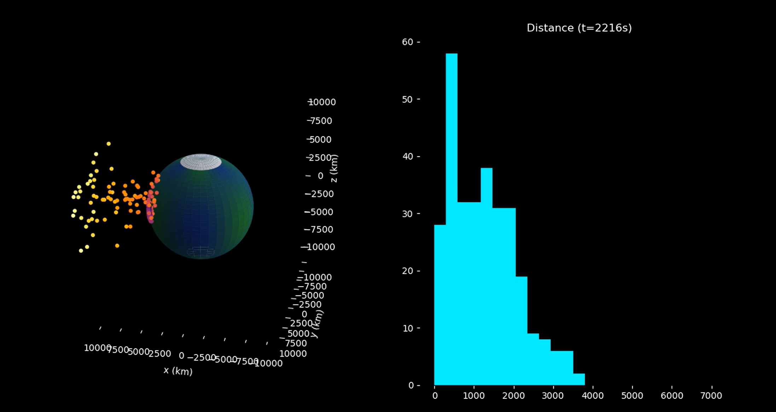
Impact Ejecta Simulation:
A DEEP DIVE on how rocks FLy
By: Eyouel Abate

Slide 2




Topic & Methodology (7 steps)
Topic: Simulating the ejecta that comes from an impact of meteor with planets of varying gravity, and how that affects their trajectory, velocity, and distribution.
Methods:
Planet Model: perfect sphere with radius (R) and gravity (g) with the gravitational parameter: -------------------------------------------------------------------------------------------------------→
Impact Geometry: impact is fixed at (R,0,0) with a meteor following a straight path to the planet
Ejecta Initialization: Two ejecta types, curtain (low angles and plume (high angles)
Physics Model: Each fragment is treated like an independent particle, and the only force I’m considering is the planetary gravity: ------------------------------------------------------→
Numerical Integration (ODEs): Find the motion with explicit time-stepping & fragments stops when it hits the surface: --------------------------------------------------------------→
Distance Tracking: For each fragment at teach time step we find the great-circle distance: ---------------------------------------------------------------------------------------------------------→
Visualization: 3D rotating planet with a rough approximation of the texture of the planets as the basis of the ejecta simulation. Histogram on the right for showing evolving distance distribution.

Slide 3
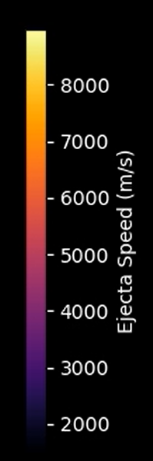
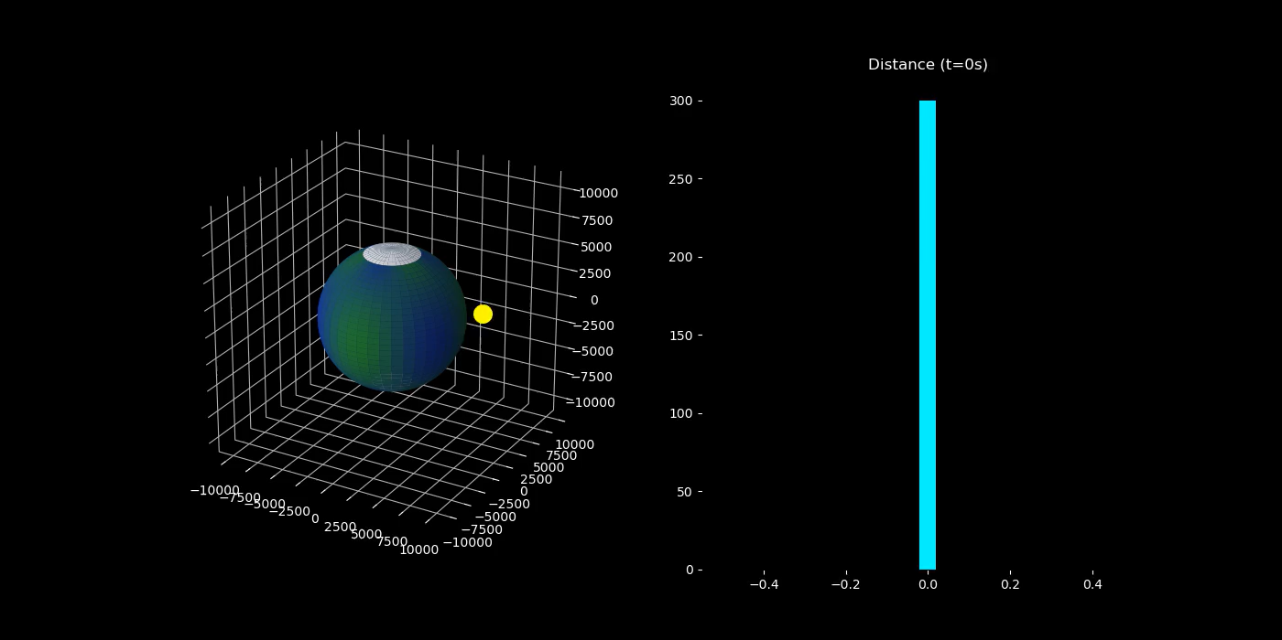
Animation 1: Earth’s impact (d=40 km, v=210 km/s meteor)

Slide 4
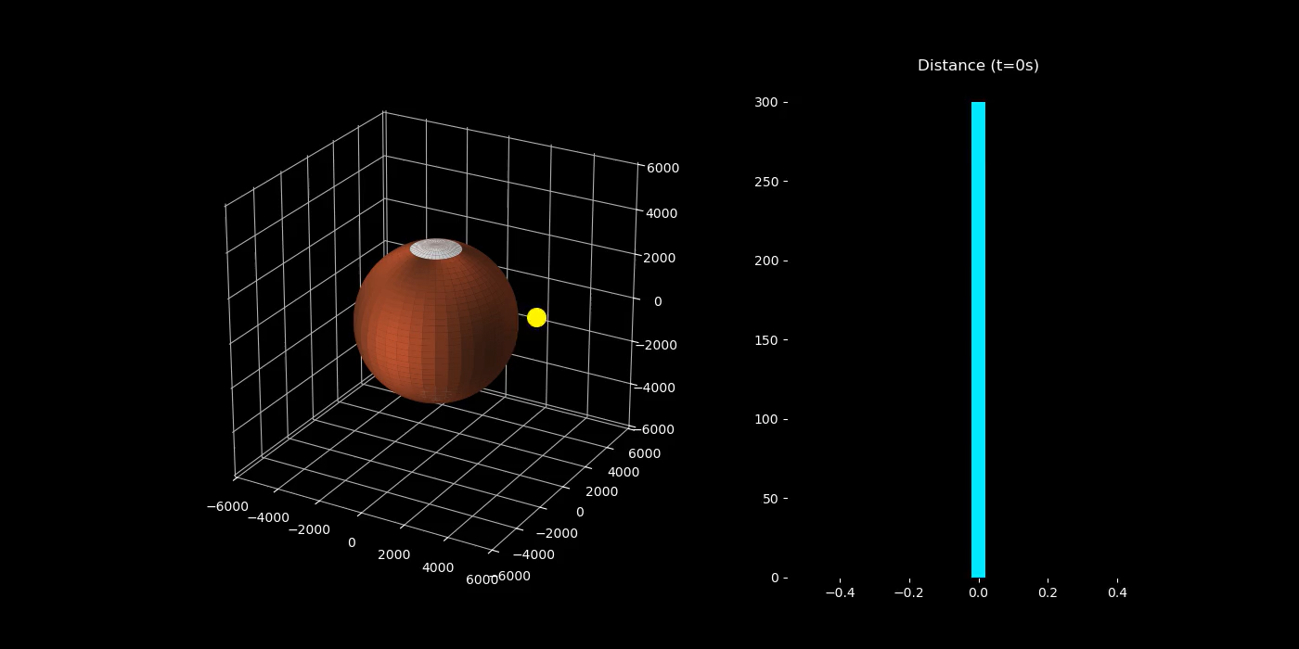
Animation 2: MARs’ impact: (d=40 km, v=112 km/s meteor)

