Slide 1
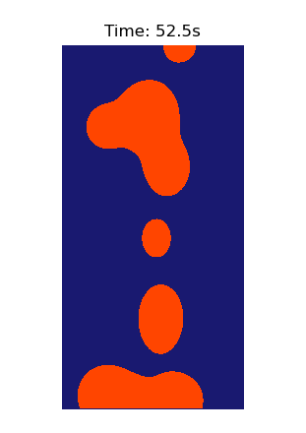

Ethan Zhou: Lava Lamp Simulation

Slide 2
Explanation: Simulation and Methods Used
The Simulation
This project models the core physics of a lava lamp, creating an emergent simulation of convection currents.
Blobs of 'wax' are simulated as particles that change density based on temperature.
A heat source at the bottom causes blobs to become less dense and rise. Away from the zone, blobs experience cooling and eventually fall back down.
This cycle creates a continuous, life-like, and unpredictable motion.
The Methods
The simulation uses a particle-based physics engine with a "gooey" visual layer.
Physics Engine: A system of ODEs (Ordinary Differential Equations) tracks each blob's state (position, velocity, temp).
Solver: Solved using scipy.integrate.solve_ivp with the adaptive RK45 (Runge-Kutta-Fehlberg) method.
Visuals: A Metaball algorithm is used to 'skin' the particles, creating the fluid "blobby" visual effect from their positions.

Slide 3
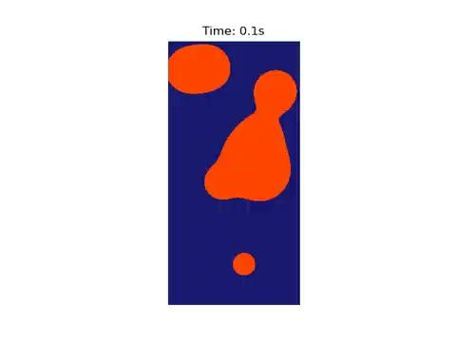
Video

