Slide 1
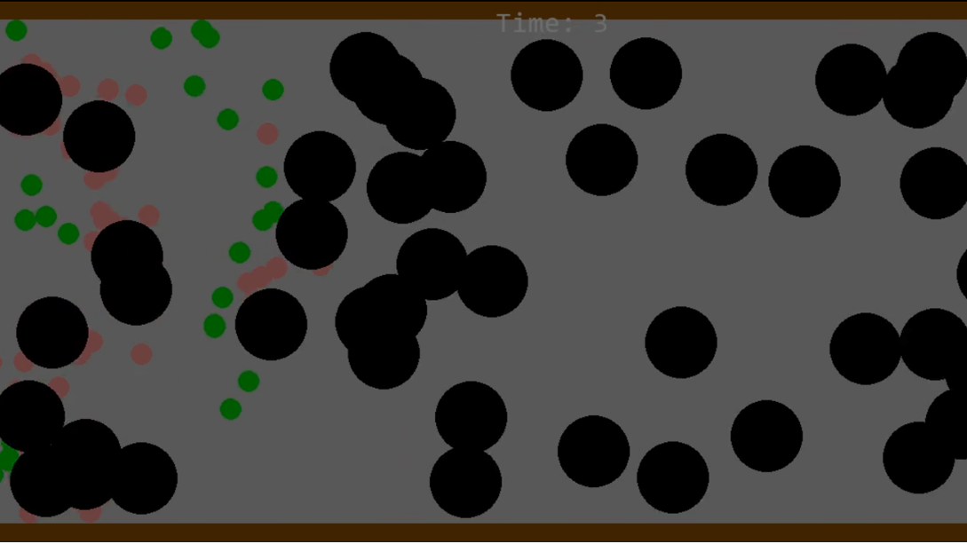
Random Walks in Evades.io
(Group Obstacle Evasion)​
Hanzhen Yu, LAB 105​

Slide 2




Random Walks Simulation Method​
Game: Group of heroes evade moving obstacles, if a hero gets hit, it can’t move but can be “revived” by teammates
Each hero’s movement is from random walk
Used three different random numbers
First number controls left/right direction + a multiplier for speed
Between -0.6 and 1.4 (negative = left, positive = right
Second number controls up/down direction + a multiplier for speed
-1 to 1 (negative = up, positive = down
Third number controls speed
0 to 100
X velocity = first number * speed
Y velocity = second number * speed
Result: hero can move in any direction with varying speed
Also implemented a random timer to change direction (0.05 to 0.4 seconds)
How long the hero moves in one direction is also random
Reason: more variability, not just “jitter” movements
Enemy speed is also somewhat random!
How to run code: run main.py, I did not use .ipynb because settings are all controlled through settings.py and its very easy to change them.

Slide 3
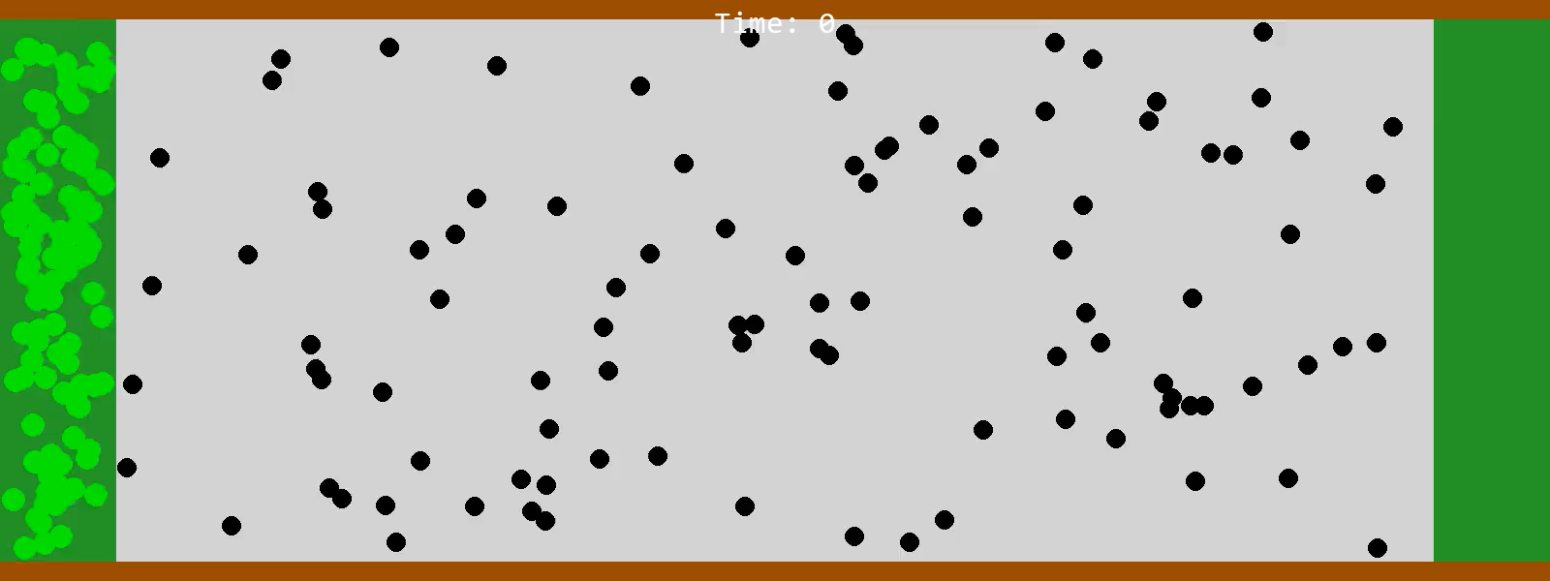
In Settings.py, use:
HERO_SPEED = 20
ENEMY_SPEED = 25
ENEMY_SIZE = 10
NUM_HEROS = 100
NUM_ENEMIES = 100

Slide 4
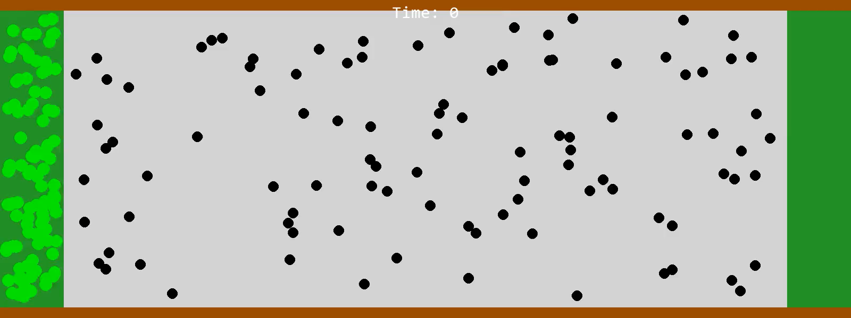
In Settings.py, use:
HERO_SPEED = 20
ENEMY_SPEED = 25
ENEMY_SIZE = 10
NUM_HEROS = 100
NUM_ENEMIES = 100
Same settings as before, my simulation creates a lot of variability. After experimenting with other settings, higher hero speed leads to higher variability in outcome

Slide 5
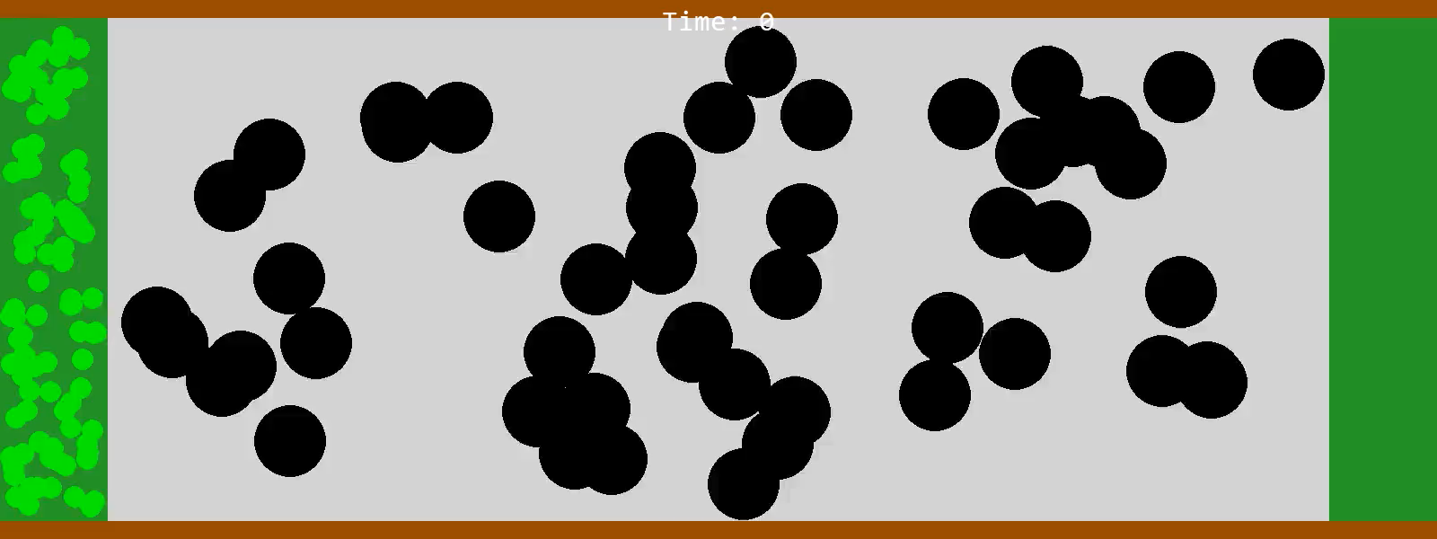
In Settings.py, use:
HERO_SPEED = 20
ENEMY_SPEED = 100
ENEMY_SIZE = 40
NUM_HEROS = 100
NUM_ENEMIES = 50
20 speed, the heroes did not even make it past halfway

Slide 6
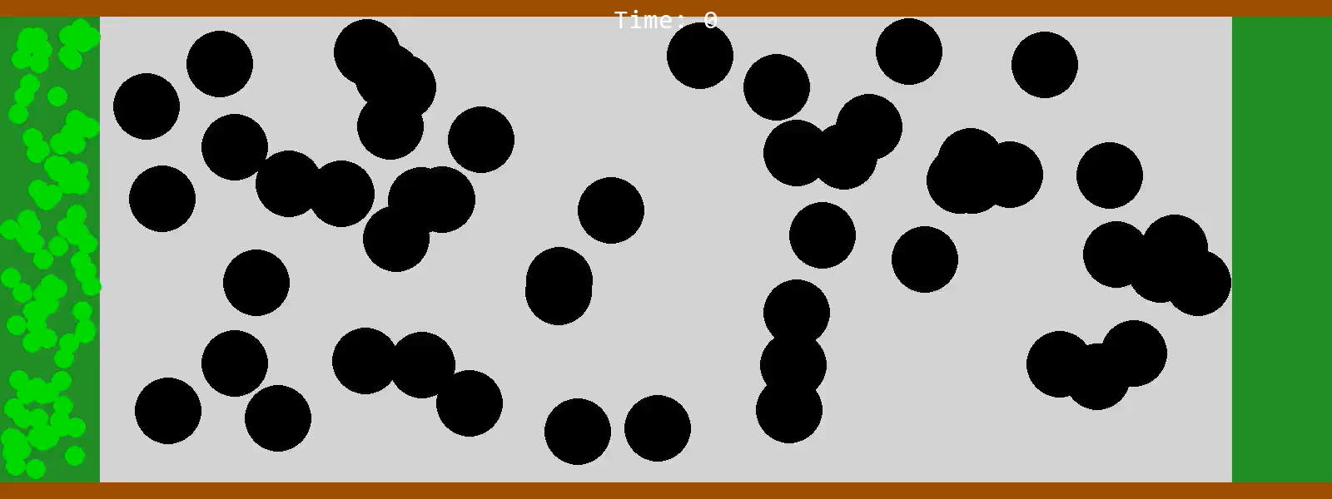
In Settings.py, use:
HERO_SPEED = 200
ENEMY_SPEED = 100
ENEMY_SIZE = 40
NUM_HEROS = 100
NUM_ENEMIES = 50
200 speed, a lot more variability and heroes were able to get farther

Slide 7
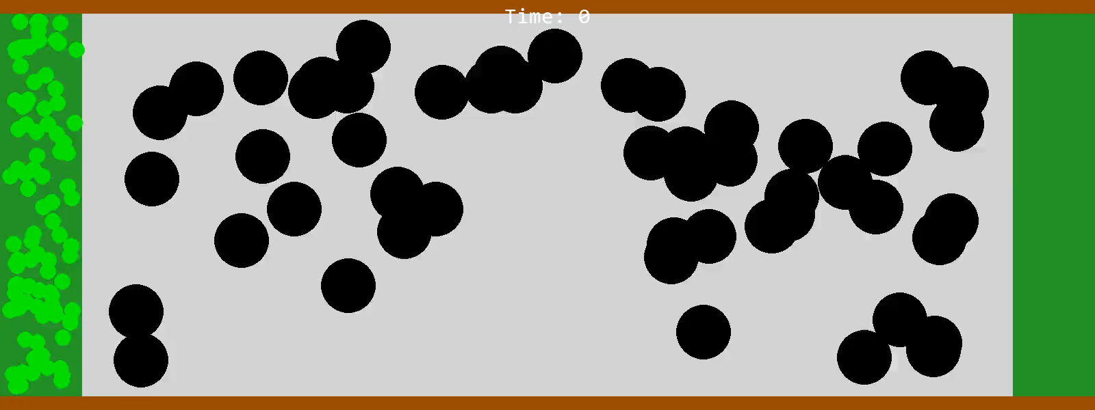
In Settings.py, use:
HERO_SPEED = 200
ENEMY_SPEED = 100
ENEMY_SIZE = 40
NUM_HEROS = 100
NUM_ENEMIES = 50
This time evasion was successful!

Slide 8

In Settings.py, use:
HERO_SPEED = 100
ENEMY_SPEED = 200
ENEMY_SIZE = 80
NUM_HEROS = 100
NUM_ENEMIES = 5
Bonus!
There’s a bunch of other settings that also make the simulation very interesting. I could also change down timer which changes how long heroes can be revived for.

