Slide 1
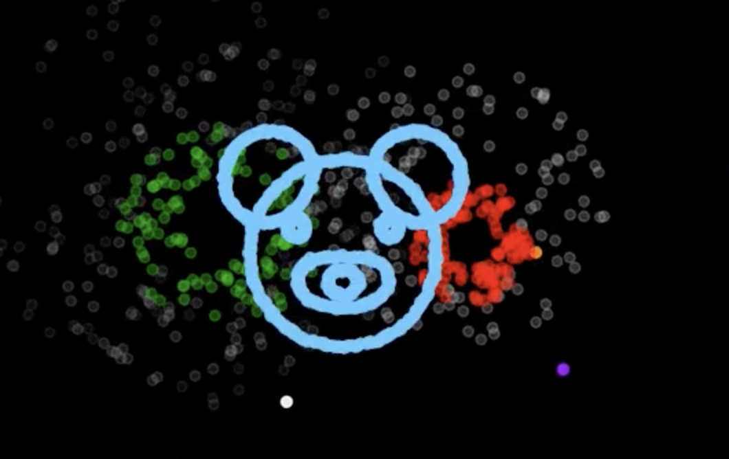
Firework Symphony
Tamnhi Vu

Slide 2
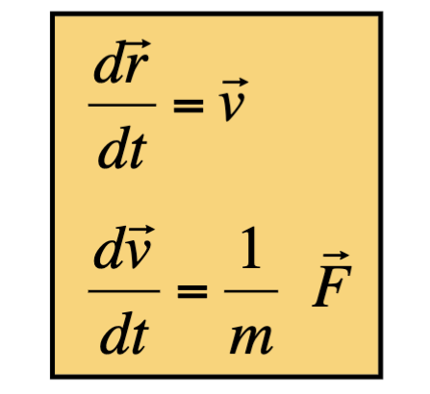
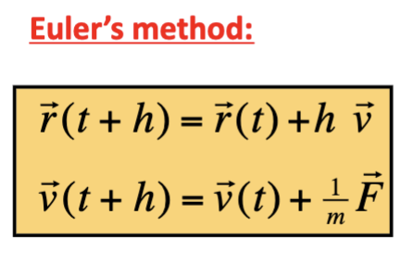
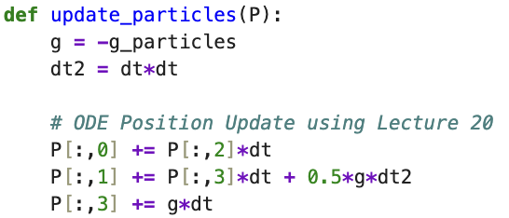
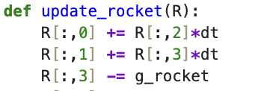
Project Overview
Goal
Simulated fireworks with synchronized music using real physics, random motion, and particle dynamics
Key Features
Rockets launches based on physics
Explosions create multiple particles
Particles disperse, fade, and fall under gravity
Custom shape fireworks
Beat detection will trigger timed rocket launches
Techniques Used
Newton’s equations of motion
Ordinary Differential Equations updates per animation frame
Random walks via noise in particle velocities
Beat detection using librosa
Scatter-plot animation using matplotlib
Inspiration (ODE Lectures)
Made my rocket and particles obey Newton's Equations where gravity acts as the main force
Lecture 20: Euler Method Update
Used discrete-time update formulas for position and velocity update
Implemented these update equations for each animation frame where each particle has a state vector and the updated vector will replace the previous one

Slide 3
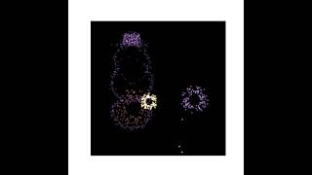

Slide 4
