Slide 1
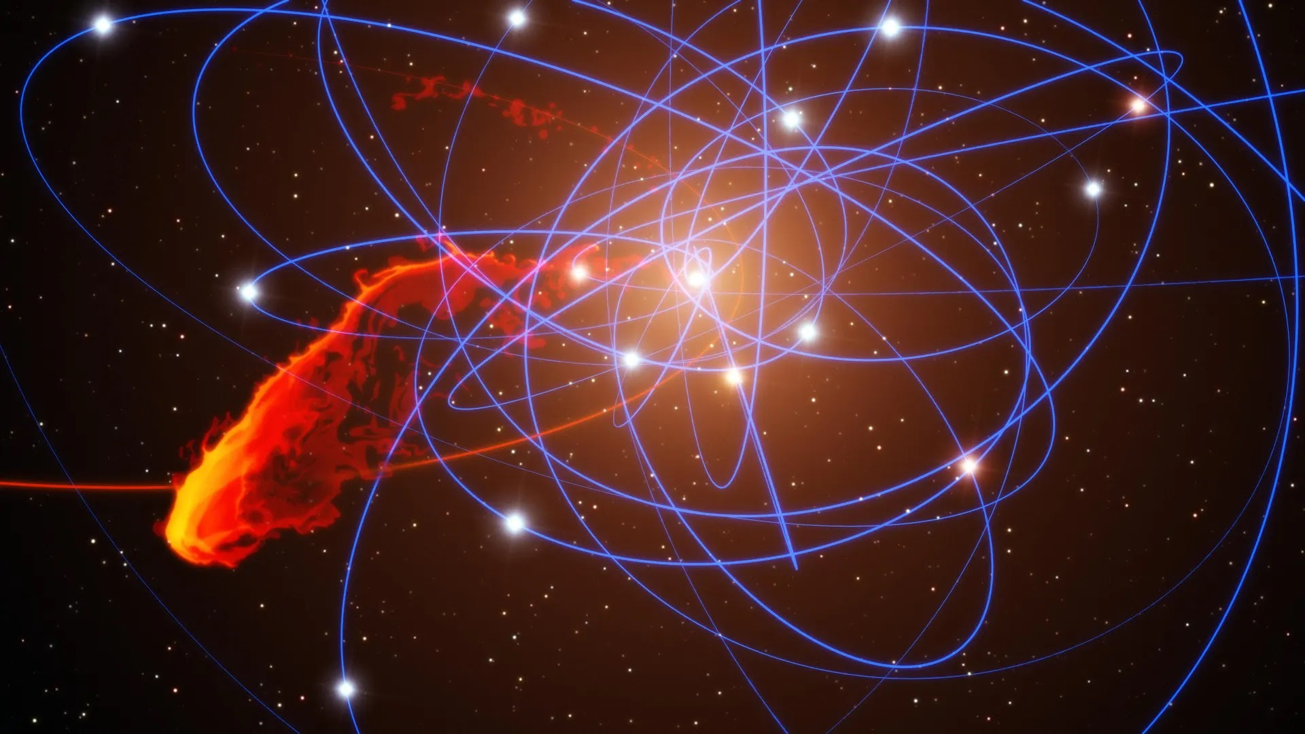
The Loss Cone in Tidal Disruptions
By Max Velasquez

Slide 2
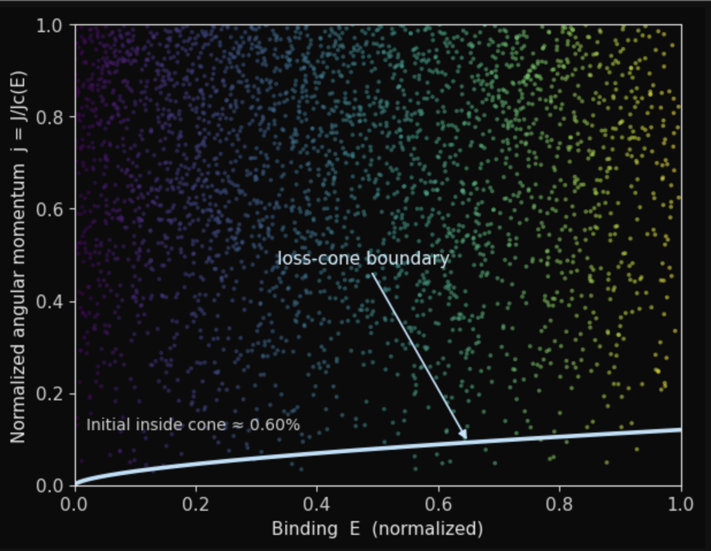
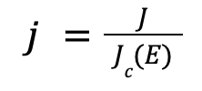


What is the Loss Cone?
The set of orbits that dive too close to the black hole; depends on stars angular momentum
Defining Equations:
j = Star’s normalized Angular Momentum
J = Star’s Angular Momentum
= Angular Momentum of Circular Orbit
E = Orbital Energy
= The critical angular momentum @ the tidal radius
Loss Cone Region: j <
-lower j → star passes closer to Black Hole
Notes:
If the star’s angular momentum is small enough, it’s pericenter will fall into the blackhole’s tidal radius and be ripped apart. The star is then disrupted and lost. If j is closer to 1, it will have a higher likelihood of falling into the BH, if j is close to 0 it will likely never fall in the BH. Tiny Kicks from other stars diffuse j downwards.

Slide 3
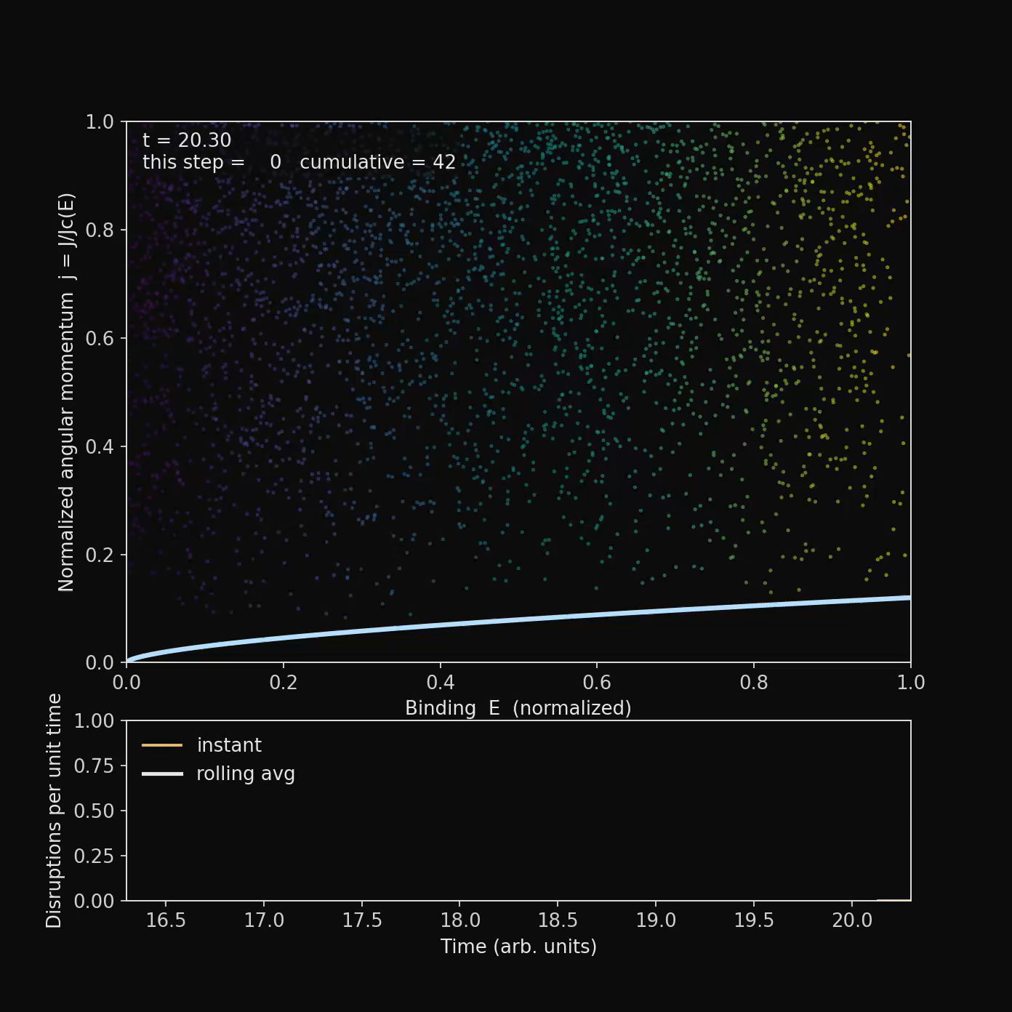
Overtime, each star’s gravity will interact with another star, pushing some into the loss cone

Slide 4
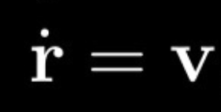
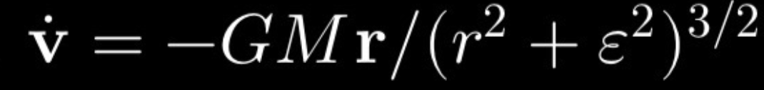
Methods & What's Being Simulated
Monte Carlo Diffusion in angular momentum (j)
Random stellar encounters contribute to angular momentum diffusion in J over time
Kepler ODE - Velocity-Verlet For Kepler Orbits
Loss Cone Rule: j < including when the pericenter distance is < tidal radius
Staged Accretion by predicting when pericenter distance is roughly equal to the tidal radius
Small Velocity Reorientations contributing to feeding of the loss cone
Disk Visuals: Debris Particles & Increased Brightness of disk the more it accretes
Notes:
The variable,epsilon ,is added to ensure gravity at the center of the Black Hole does not blow up to infinity; = (0.3 * Tidal Radius) in this simulation

Slide 5
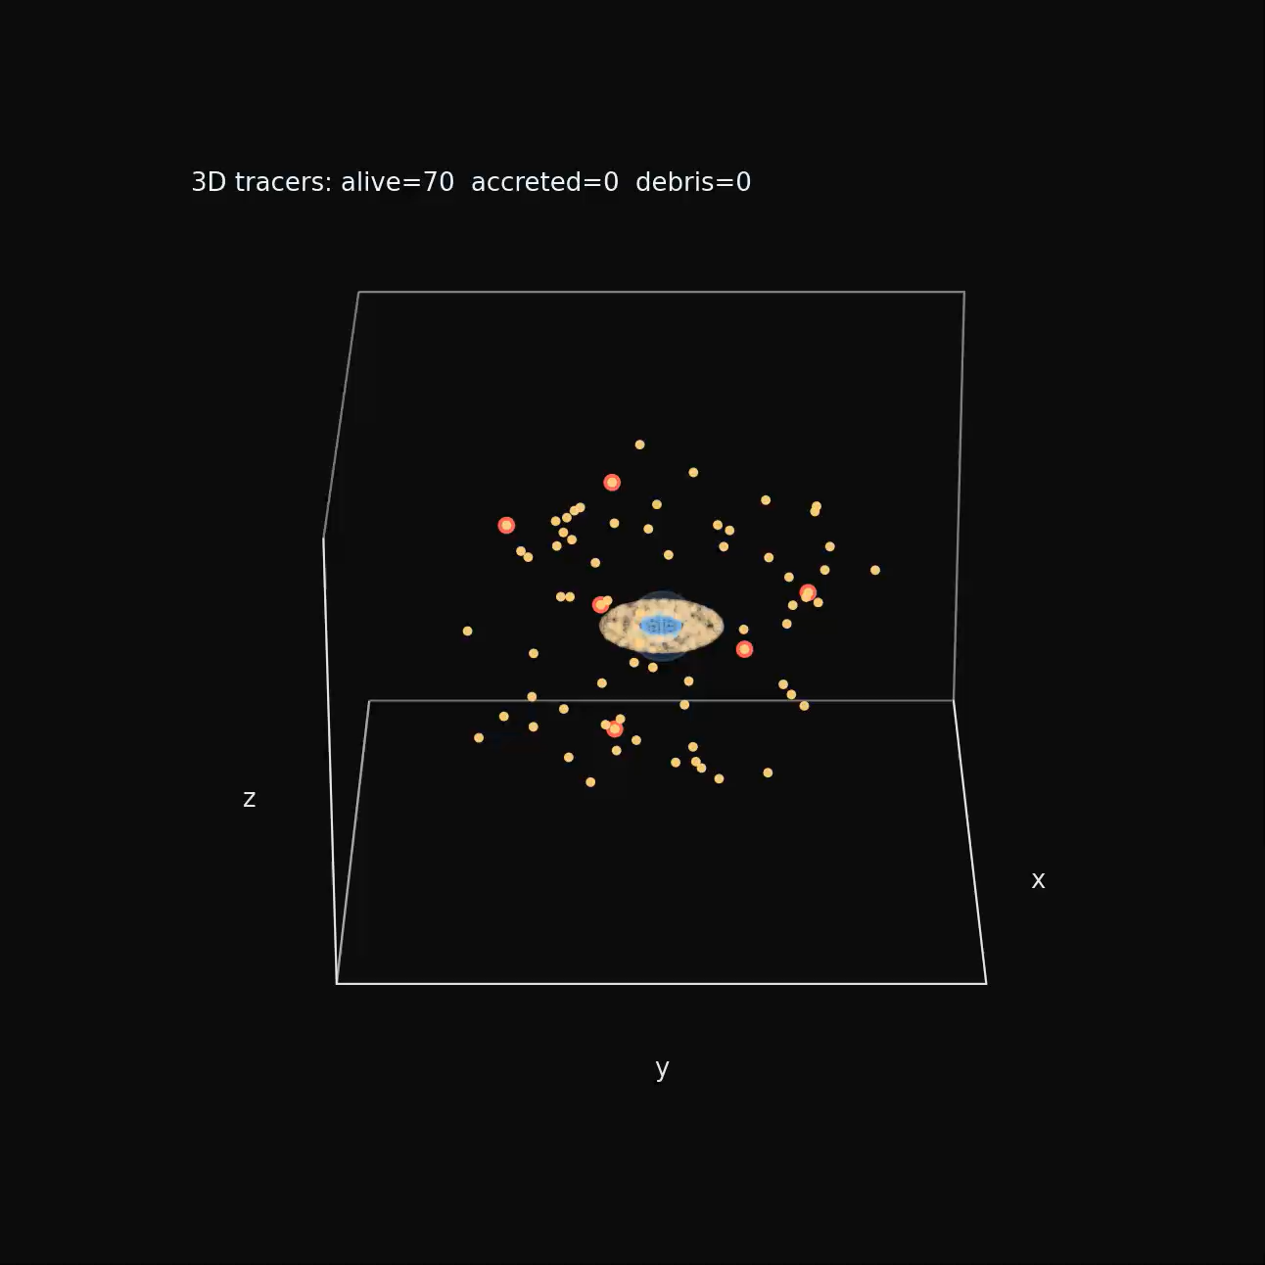
Results: 3D Loss Cone Accretion (Normal Speed)

Slide 6
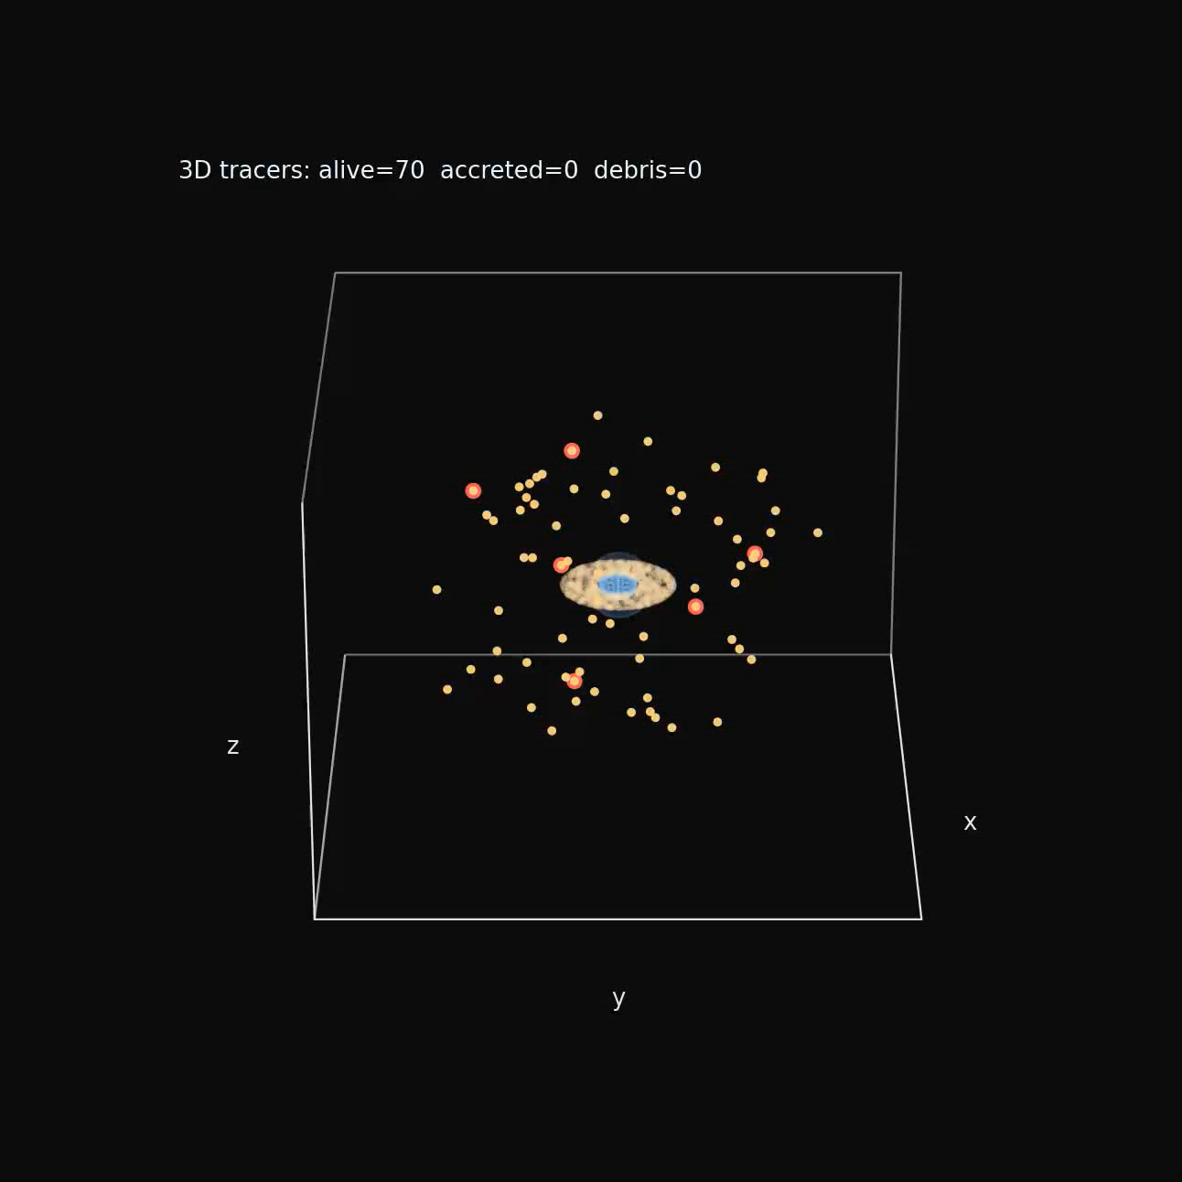
Results: 3D Loss Cone Accretion (Slowed Down)

