Slide 1
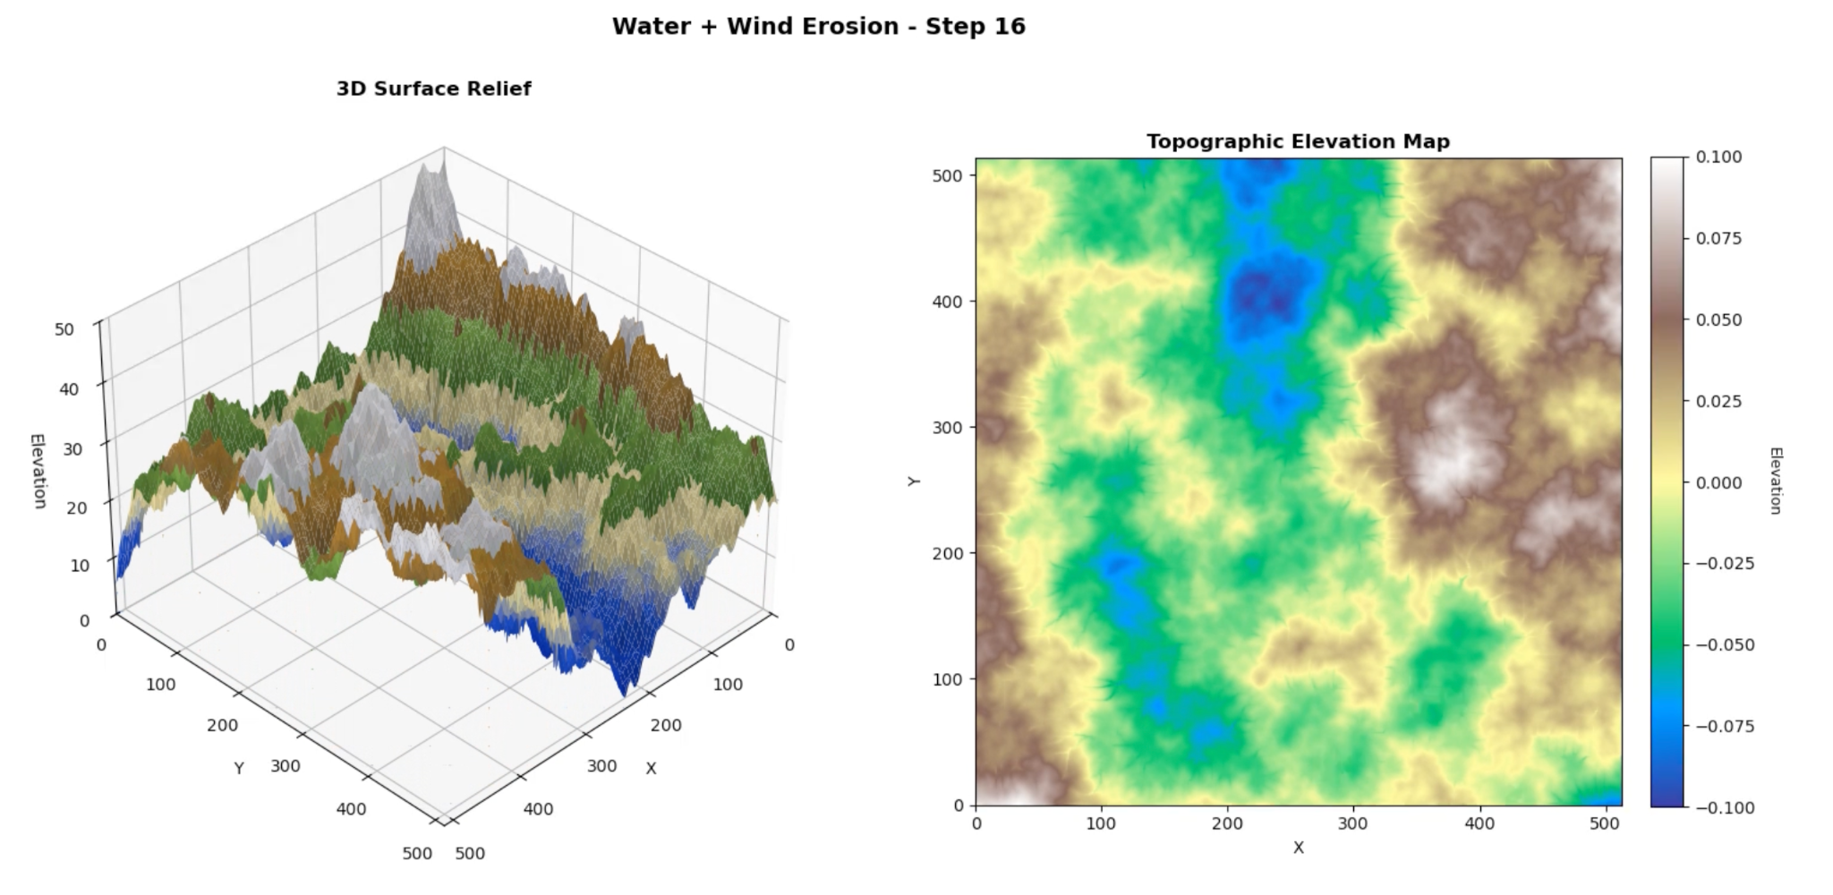
Using Diamond Square Algorithm and Simplex
Noise for Terrain Generation w/ Erosion
Maria Rufova - EPS109 2025

Slide 2
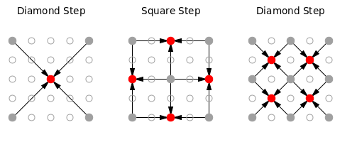
Topic of Simulation + Methods Used
Simulation Methods covered: Fractals (Diamond-Square), Gradient Noise (Simplex), PDEs (Erosion) (Lec 5 and Lec 14)
Goal: Use computer graphics methods to generate more realistic looking landscapes and see how water and wind erosion reshape them over time
Diamond-Square Algorithm: Recursive fractal algorithm similar to Mandelbrot
Use 4 randomly-generated corner values of a 2D array (dim. = 2n+1) to fill in inner values via midpoint displacement
Creates smooth structure at multiple points, but directional bias
Simplex Noise: Noise algorithm interpolates pseudo-random gradients to produce smooth, continuous elevation patterns with fewer visual artifacts
Erosion: Time dependent PDEs that evolve the terrain elevation Z over time
Water erosion uses ∂z/∂t = -k·A^m·S^n
(rate of elevation change = coeff. * drainage area * local slope
Wind erosion uses ∂z/∂t = -k·|∇z|
(rate of elevation change = coeff * local slope
Primarily I used our homework and lab assignments. But these resources also came in helpful for my specific goal:
- https://en.wikipedia.org/wiki/Diamond-square_algorithm
- https://dl.acm.org/doi/pdf/10.1145/358523.358553
- https://medium.com/@nickobrien/diamond-square-algorithm-explanation-and-c-implementation-5efa891e486f
- https://py5coding.org/how_tos/generate_noise_values.html
- https://yonatankra.com/how-to-create-terrain-and-heightmaps-using-the-diamond-square-algorithm-in-javascript/
Notes:
Generates realistic terrain using Diamond-Square and Simplex algorithms, then simulates geological erosion over time
Diamond square is a procedural terrain-generation algo used in CGI, games, and other visual applications
Erosion: Time dependent PDEs that evolve the terrain elevation Z over time
Hydraulic erosion uses ∂z/∂t = -k·A^m·S^n
(rate of elevation change = coeff. * (drainage area ^ drainage exponent) * (local slope ^ slope exponent)
Wind erosion uses ∂z/∂t = -k·|∇z|
(rate of elevation change = coeff * local slope

Slide 3
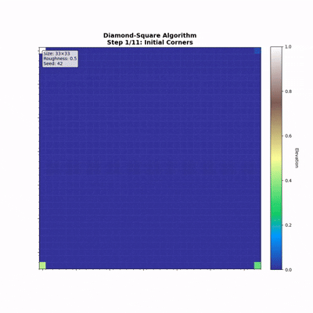
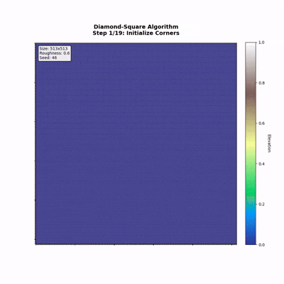
Video Demo - Diamond Square Algorithm
Size: 33 x 33
Size: 513 x 513
Notes:
Step-by-step diamond algo building a height map

Slide 4
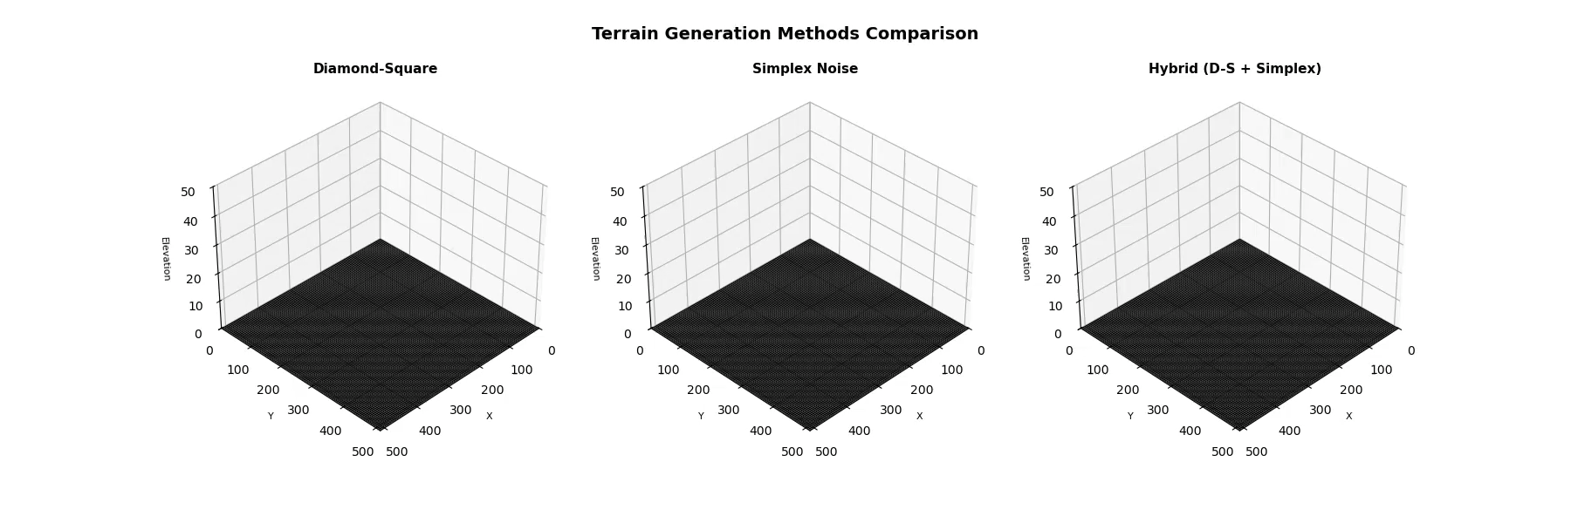
Video Demo - Diamond Square / Simplex Comparison
Smooth structure at multiple points, cool dramatic features, but directional bias, roughness parameter is global
Very diverse, fine details, no grid artifacts, but less dramatic features and can be very sporadic
Hybrid: Interesting features with organic flow
Notes:
Comparison of the three terrain generationmethods

Slide 5
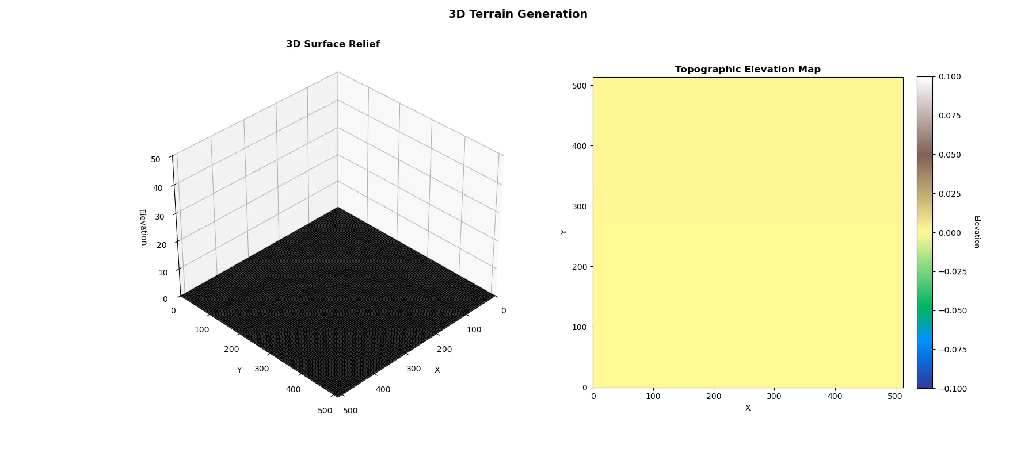
Video Demo - Final Terrain + Erosion
Notes:
Erosion shaping the terrain over hundreds of iterations

