Slide 1
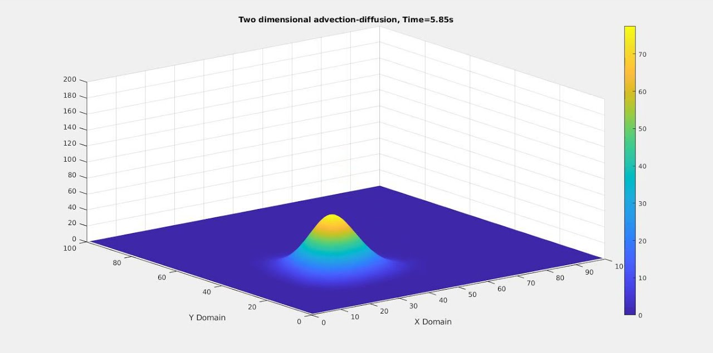
Simulating Fog Dynamics Over Terrain: A 2D Advection–Diffusion Simulation
Noor Rauf
Image source: https://share.google/images/hxydHUJE52MKfdPeb

Slide 2
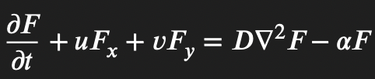


Topic
Method
Goals
Model fog forming and dissolving over natural terrain produced by Perlin noise
Include lighting, shadows, and atmospheric scattering
Consider environmental forces that effect fog dynamics: wind gusts & rainfall
Produce a visually realistic animation using simple physics + numerical methods
Fog density model
Fog density is governed by a simplified partial differential equation.
The first component is advection, which moves fog according to the wind field.
The second component is diffusion, which smooths the fog and imitates small-scale turbulence.
Finally, I applied source and sink terms to represent evaporation, rainfall clearing fog, and terrain-based pooling.
Numerical methods
Grid-based finite-difference method
Explicit time-stepping (Euler forward)
2D convolution kernels for Laplacian
Lagrangian style advection for stability
GPU-accelerated through NumPy broadcasting (fast enough for animation)
Equation | Name
 | Advection–Diffusion–Decay PDE
Upwind derivative formulas | First-Order Upwind Advection
5-point Laplacian | Finite Difference Laplacian
 | Buoyancy From Terrain Gradient
F^n+1= F^n + Δt (Advection + Diffusion + Sunlight) | Forward Euler Method

Slide 3
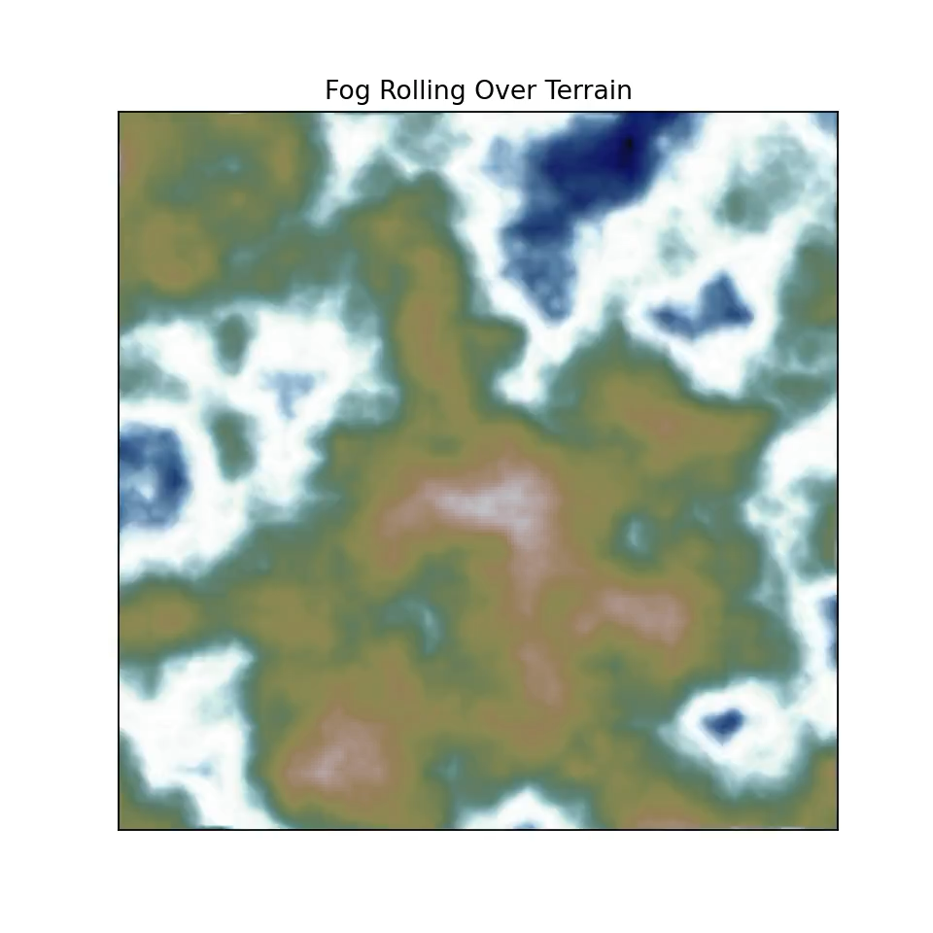
Animation

