Slide 1
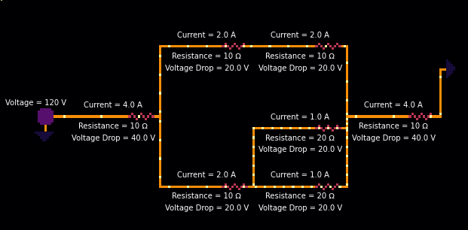
Current Flow in a Circuit
Tavisha Patel

Slide 2
Simulation/Methods Used
I created classes for resistors, sources, and grounds, which keeps track of each item’s x and y positions, as well as the item that comes after. I also made a class for a “branch” between two adjacent items. I used this to draw the circuit and the wires between each item.
I used Ohm’s Law (V = IR) to calculate the voltage drop for each resistor and the current in each part of the circuit. I then used this information to simulate how current flows in a circuit. The speed of each point as it moves across the circuit approximately represents the amount of current.
I also simulated a Wheatstone Bridge and used the equation (R_{x} = R₂R₃/R₁) to calculate the unknown resistance.
Sources:
https://www.electronics-tutorials.ws/blog/wheatstone-bridge.html
https://matplotlib.org/stable/api/_as_gen/matplotlib.pyplot.text.html

Slide 3
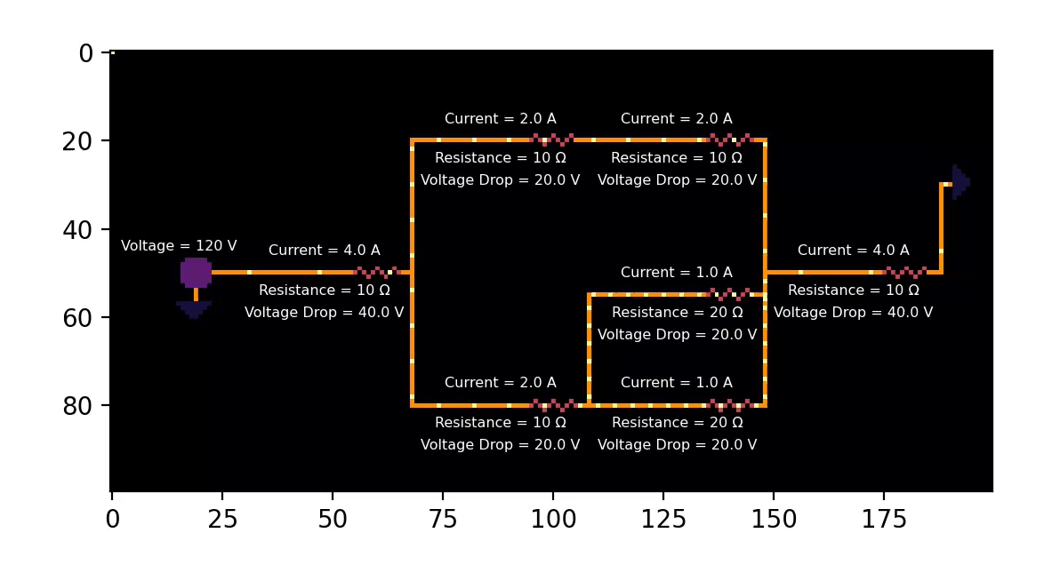

Slide 4
