Slide 1
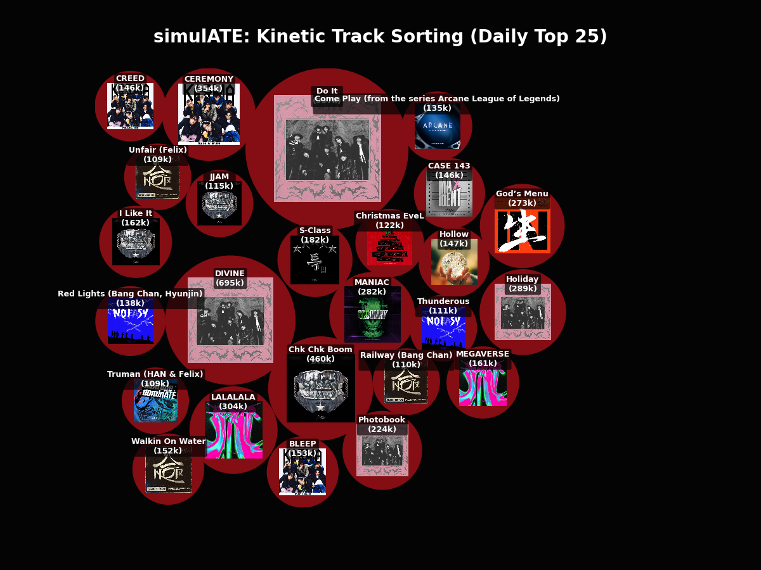
simulATE: Kinetic Track Sorting (Daily Top 25)
Visualizing sorting algorithms using Molecular Dynamics and Collision Physics.
EPS 109 Fall 2025
Thanhbinh Nguyen
The following screenshots of this project use streaming data from 12/7/2025.
EPS 109
Thanhbinh Nguyen - Final Project
Fall 2025

Slide 2
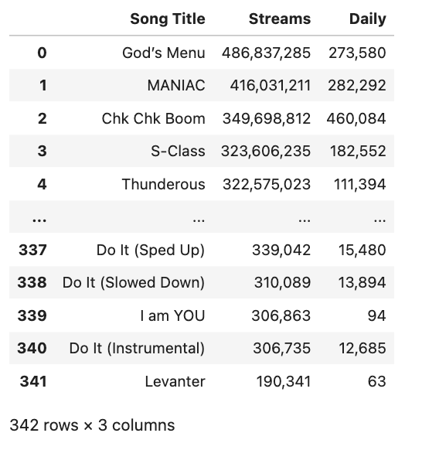
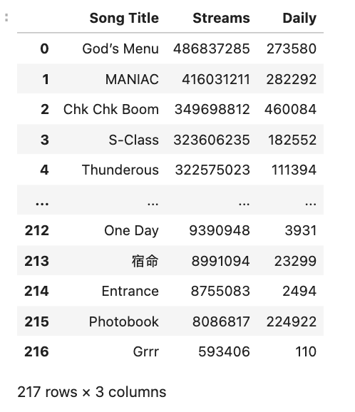
Initial Task – Data Wrangling
Data: https://kworb.net/spotify/artist/2dIgFjalVxs4ThymZ67YCE_songs.html
Kworb: public website that stores stream data from artists daily from streaming platforms like Spotify + iTunes.
Unique Tracks: Regex-ed out instrumentals, other language versions, remixes, was featured.
Methods: Beautiful Soup (HTML from using inspect tool) + Request (load in the https website) + Pandas (dataframe/dataset) Python libraries + iTunes Search API
References:
https://www.youtube.com/watch?v=8dTpNajxaH0
https://performance-partners.apple.com/search-api
Initial Data
Final Data
EPS 109
Thanhbinh Nguyen - Final Project
Fall 2025

Slide 3
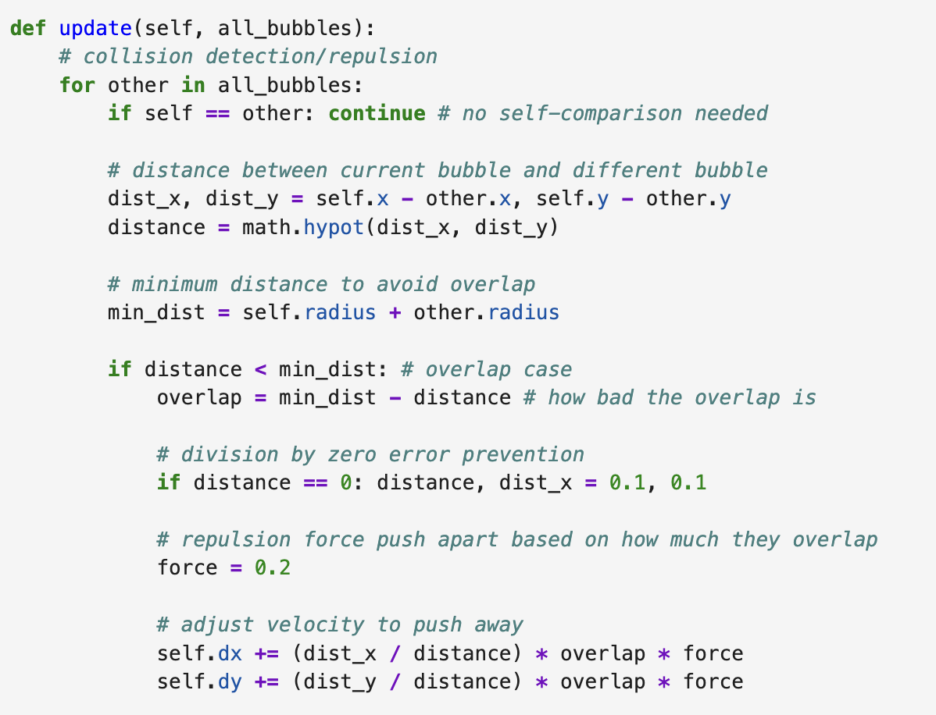
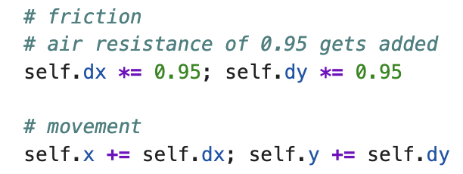

Final Task - Code vs. Math
Euler's Method / Molecular Dynamics
Euler’s Method on Newton’s 2nd Law:
At every frame, the code calculates the Force, updates the Velocity, and then moves the Position.
Molecular Dynamics:
Replaced the atomic Lennard-Jones potential with a simple Repulsive Spring Force.
Code
EPS 109
Thanhbinh Nguyen - Final Project
Fall 2025
$\frac{dv}{dt}=\frac{1}{m}F\left(x\right)$
$\frac{dx}{dt}=v_{x}$
Lecture 18 + Lab 12
$$V\left(R\right)=\sum_{i}{\sum_{j > i}{V_{p}\left(r_{i}−r_{j}\right)}}$$
$$K=\sum_{i}{\frac{1}{2}m_{i}{{\vec{v}}_{i}}^{2}}$$
$$F_{i}=m_{i}a_{i}=−\frac{∂V}{∂r_{i}}$$
$$\frac{∂v_{i}}{∂t}=\frac{F_{i}}{m_{i}}$$
$$\frac{∂r_{i}}{∂t}=v_{i}$$
Lecture 23

Slide 4
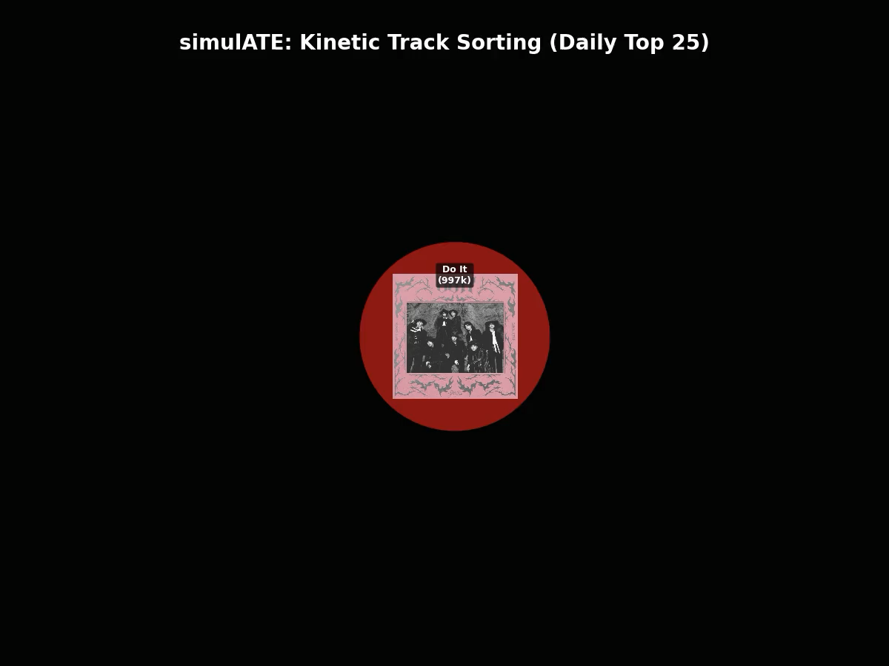
EPS 109
Thanhbinh Nguyen - Final Project
Fall 2025

