Slide 1
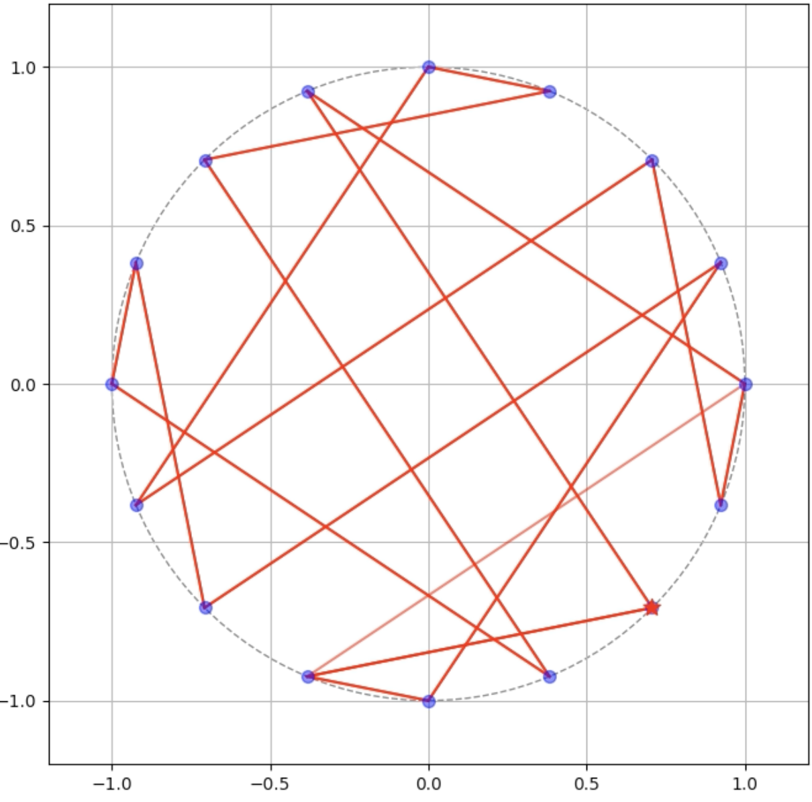
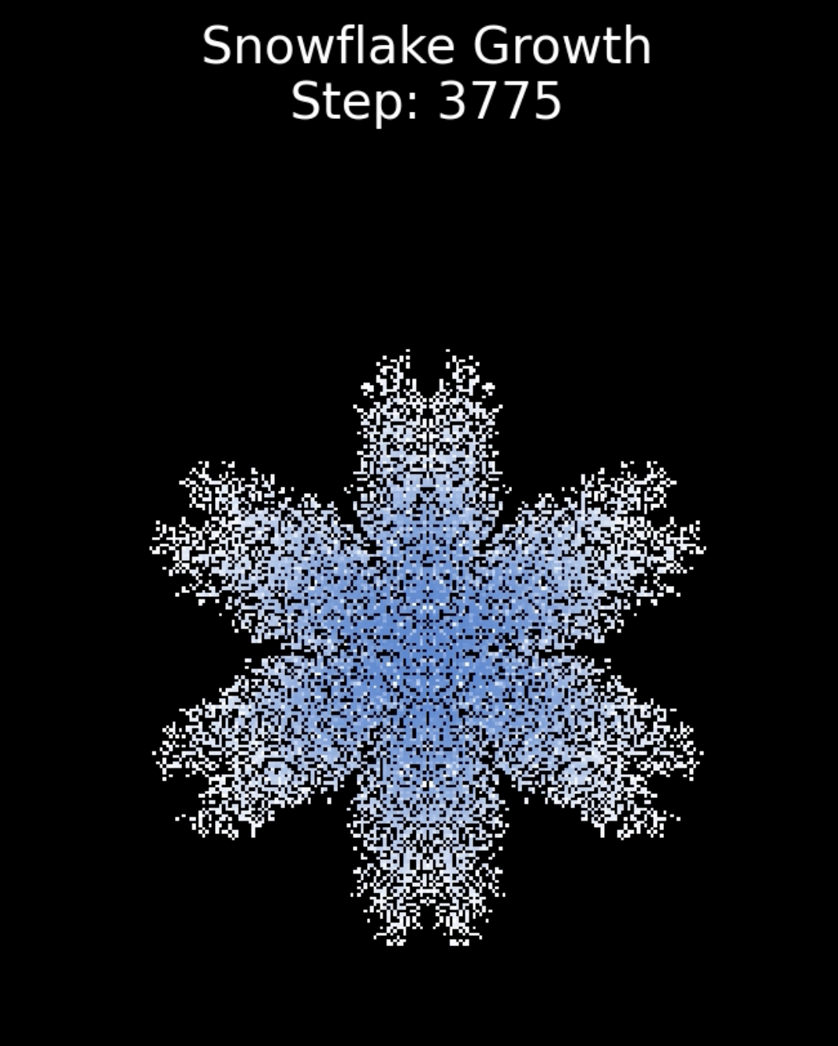
Visualizing Pseudorandom Number Generators
With Snowflakes!
By Ronit Nagarapu
EPS 109 Fall 2025

Slide 2
Cryptography: Pseudorandom Number Generators
Pseudorandom Number Generators (PRNGs) generate “random” values in a deterministic manner. Used for block ciphers, secure keys, etc
Linear Congruential Generator :
X_{n+1} = (a*X_{n} + c) mod m
Typical parameters : a=1664525, c=1013904223, m=2³²
However, incorrect configurations of these generators can lead to outputs that are not sufficiently random
Mersenne Twister is another more advanced PRNG

Slide 3
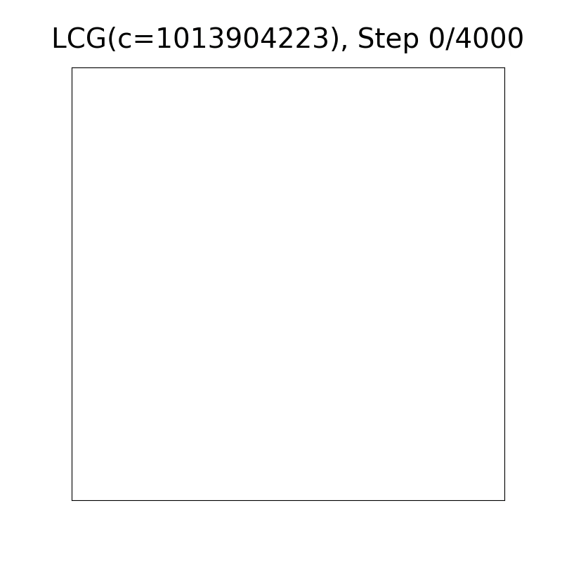

Grid Fill with LCG
With a bad LCG, the distribution is non-uniform

Slide 4
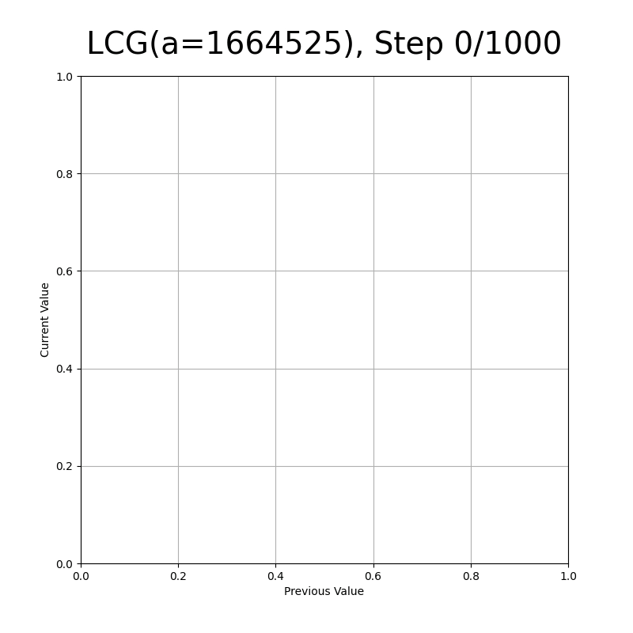

Correlation Plot
With a bad LCG, the generator could get stuck

Slide 5
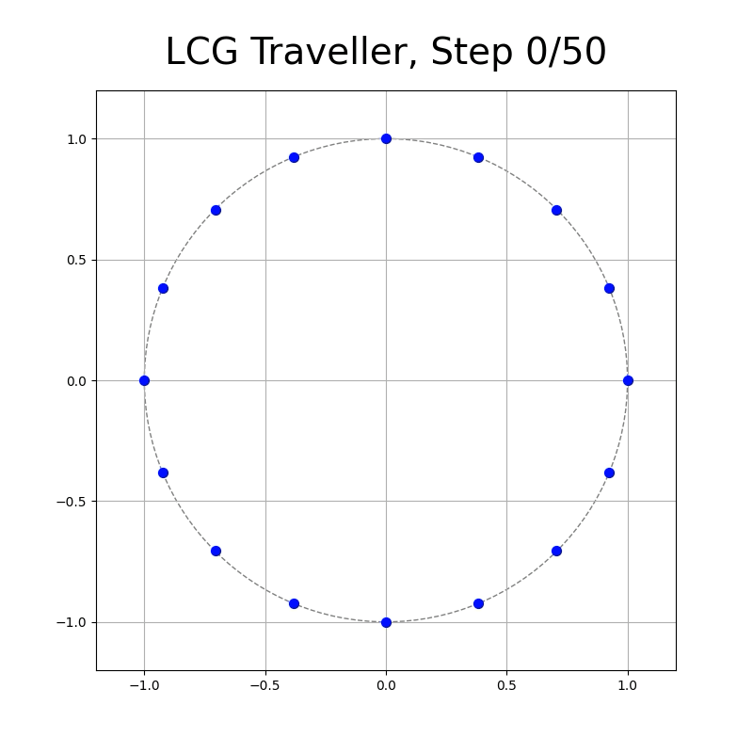
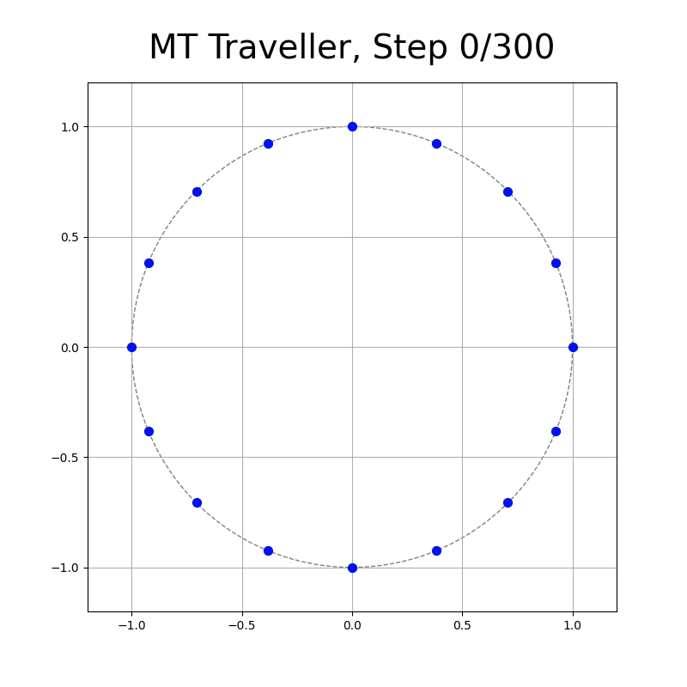
Circular Traveler Plot
With a bad PRNG, the pattern is predictable

Slide 6
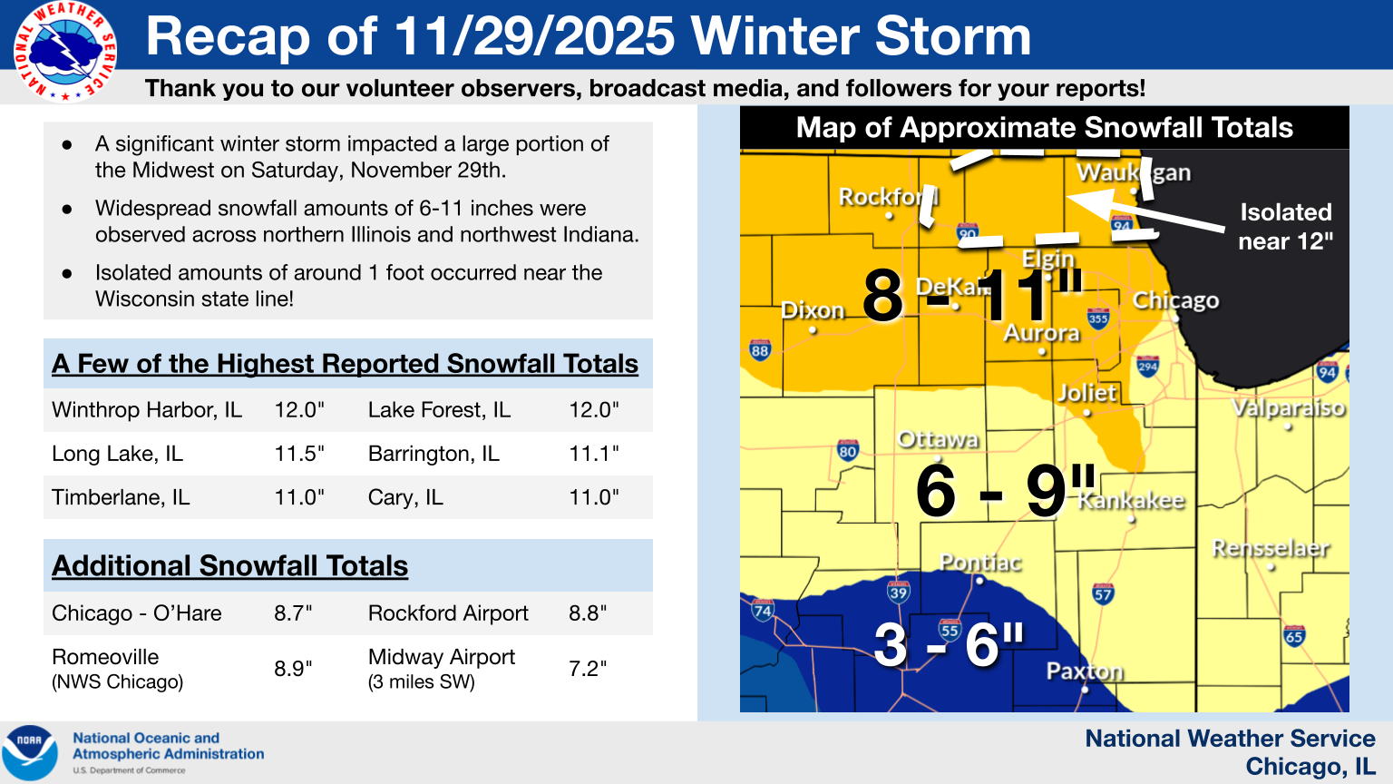
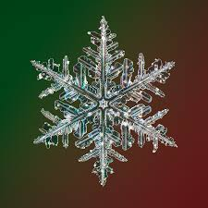
Growing Snowflakes
Inspired by the massive snowfall I saw back home in Chicago this Thanksgiving, I thought to use the random number generator to make snowflakes

Slide 7
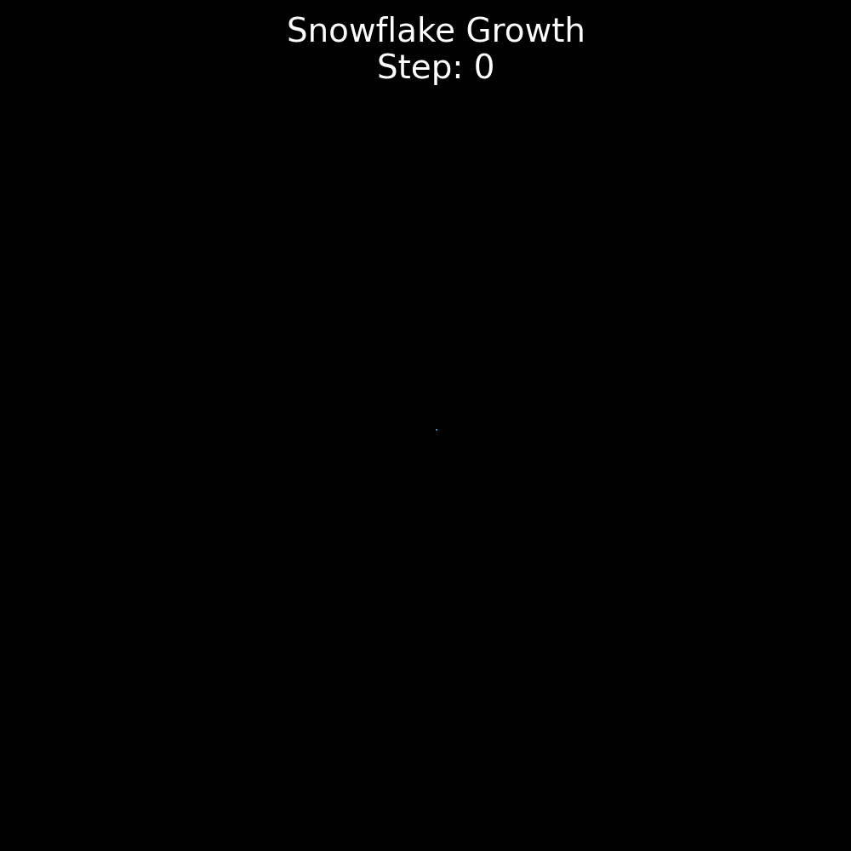
Growing Snowflakes
I used particle aggregation strategies to build the snowflakes
Parameters like the branch thickness, sharpness, radial rate are used to define the growth pattern
The PRNG is used consistently to drive the growth, yielding unique patterns depending on the seed

Slide 8
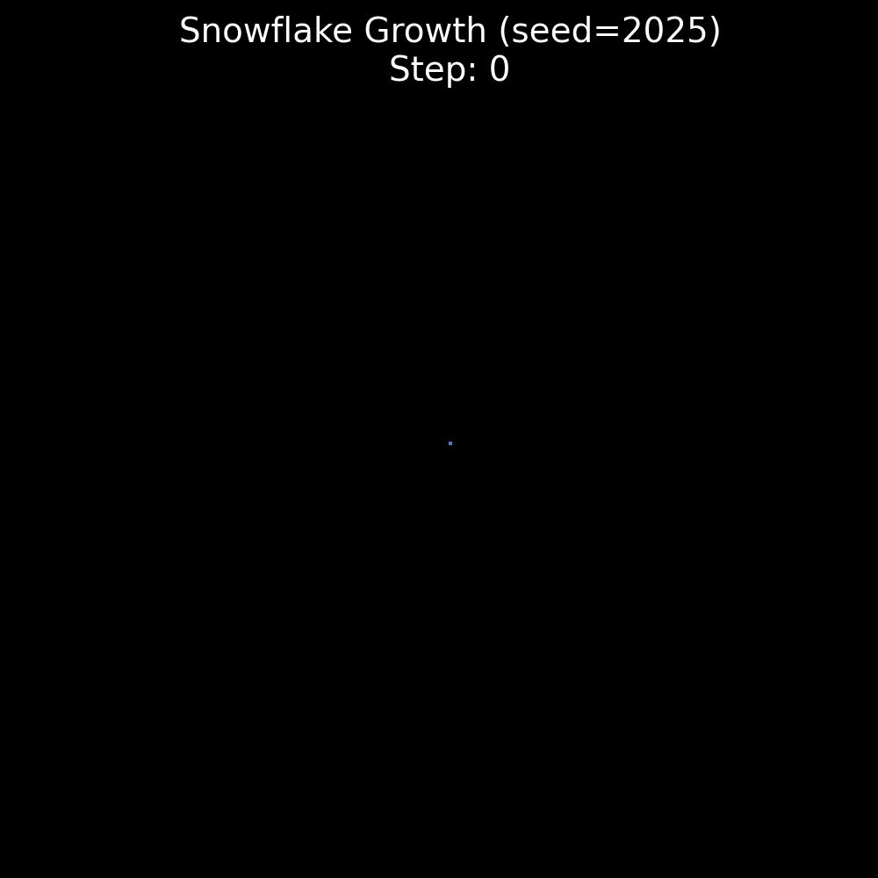
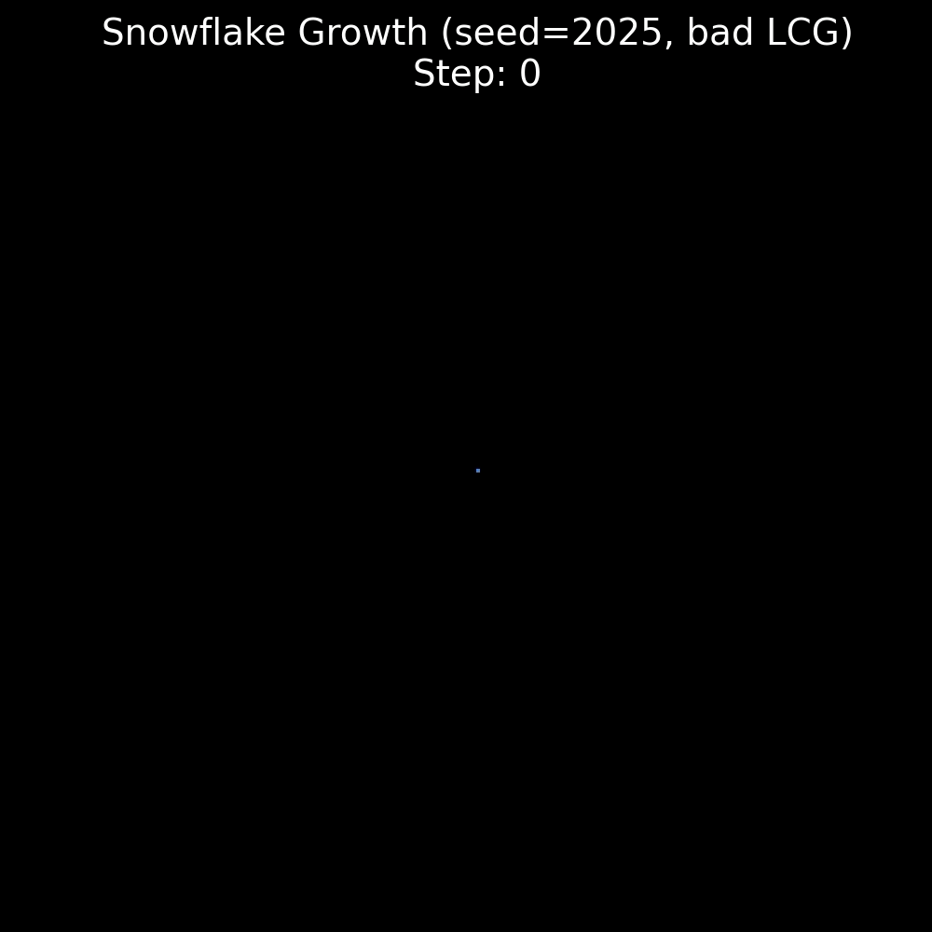
Growing Snowflakes
With the bad LCG, the growth is incorrect

Slide 9
Making Personalized Snowflakes!
Using names as seeds for the PRNG

Slide 10
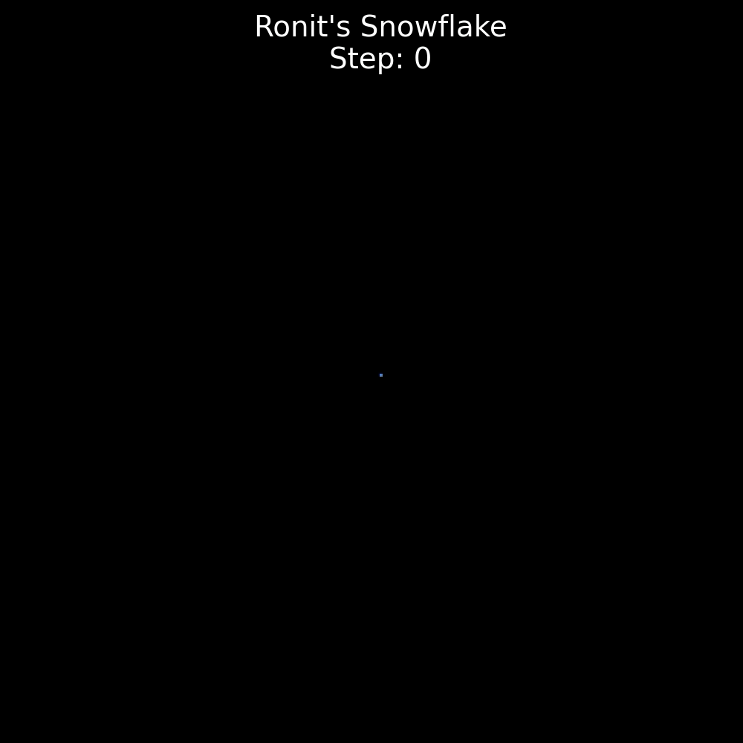
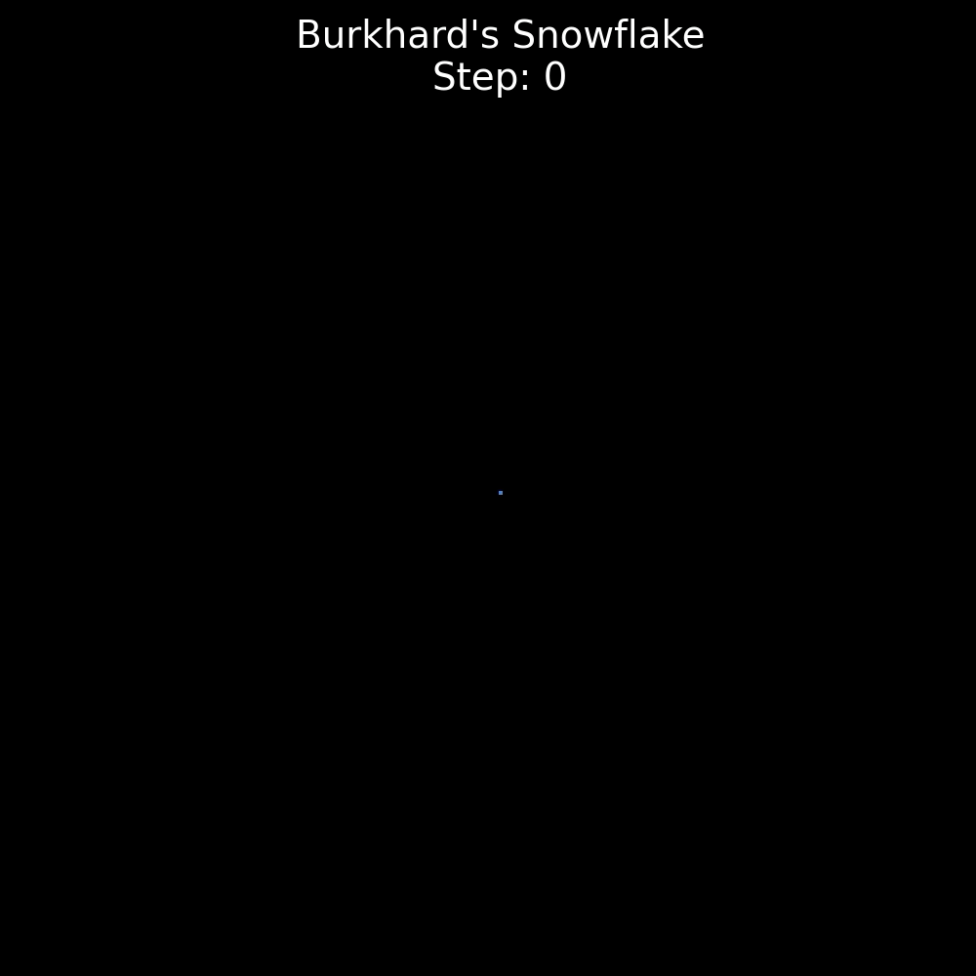

Slide 11

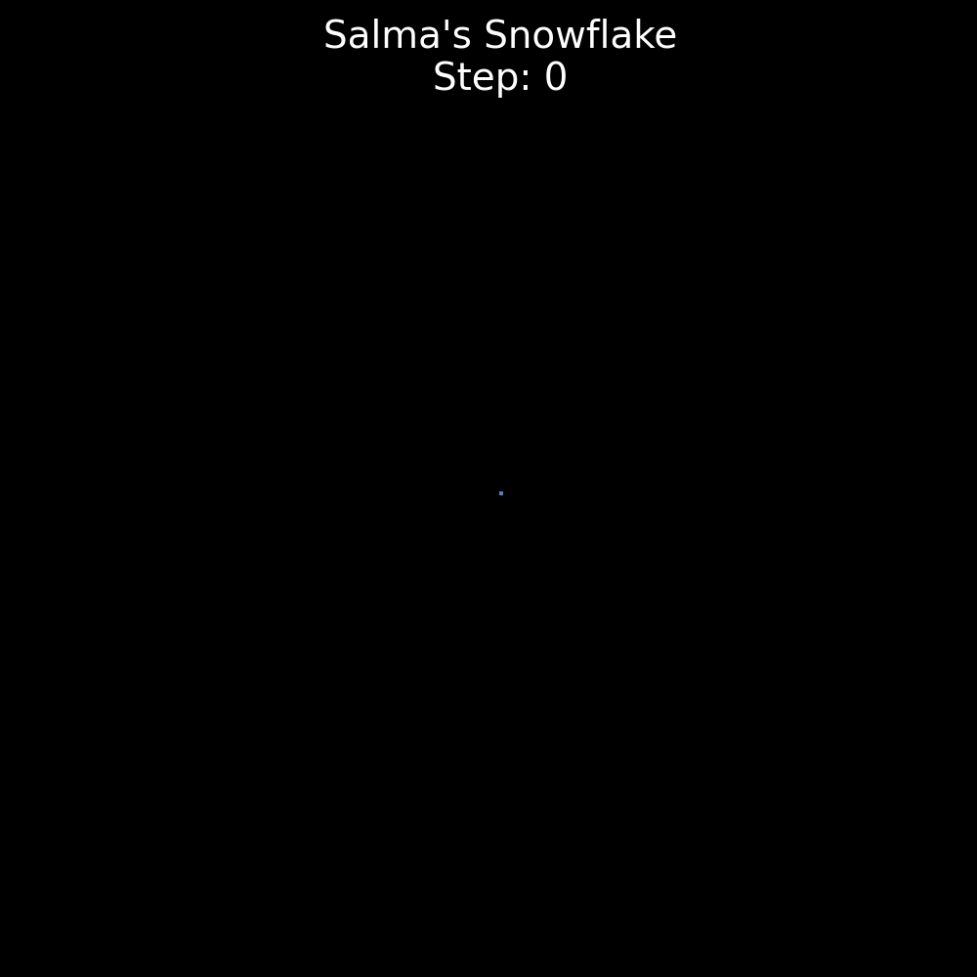

Slide 12
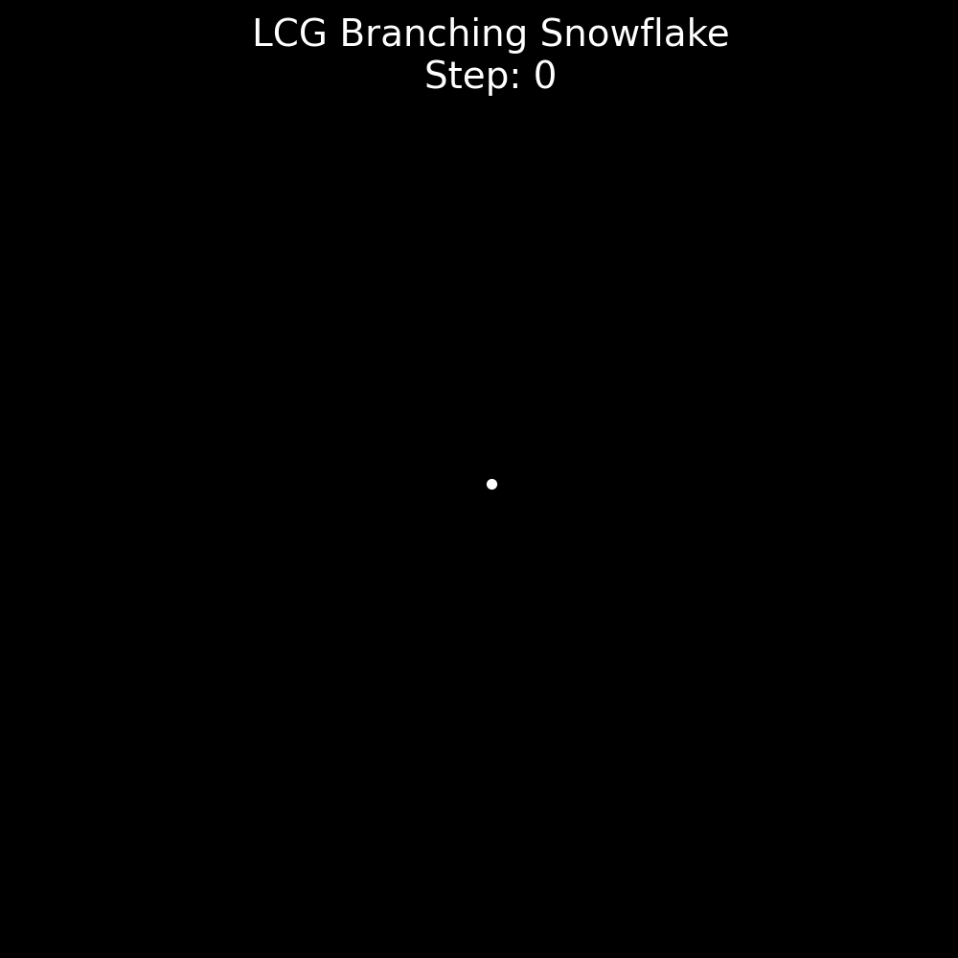
Thank You! Questions?

