Slide 1
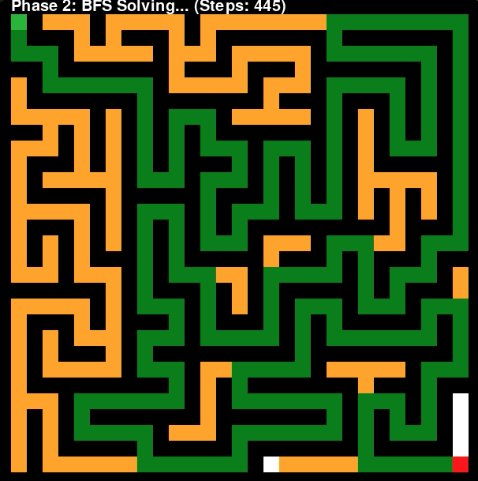
Maze Solvers:
BFS vs
Random Search vs
Water
Kenneth Llontop

Slide 2
Mazes and Methods
Topic: Simulating maze solving techniques via random walking, BFS, and water
Methods:
Random Walk: Simulating decision-making through random exploration (randomly choosing a valid direction)
BFS: Simulating decision-making by exploring every possible path in that layer
Water Flow: Simulating water navigation influenced by gravity and air pressure. Algorithm relies on a precomputed BFS path because in reality water will try to fill up the dead ends but is pushed back by air pressure that can’t break the surface tension. Assume water height = 0.3 m, gravity = 9.8 m/s²
Sources: Can water solve a maze? Steve Mould - Youtube

Slide 3
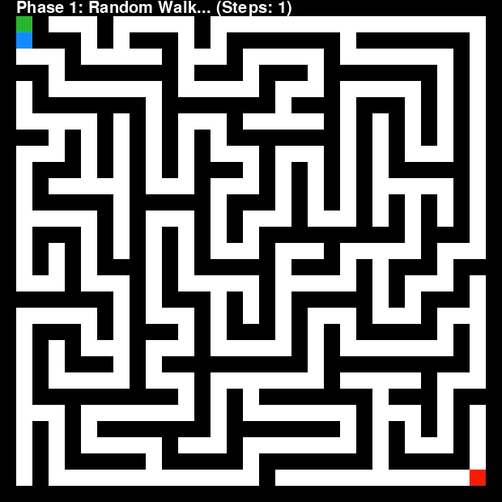
Method: Random Walk

Slide 4
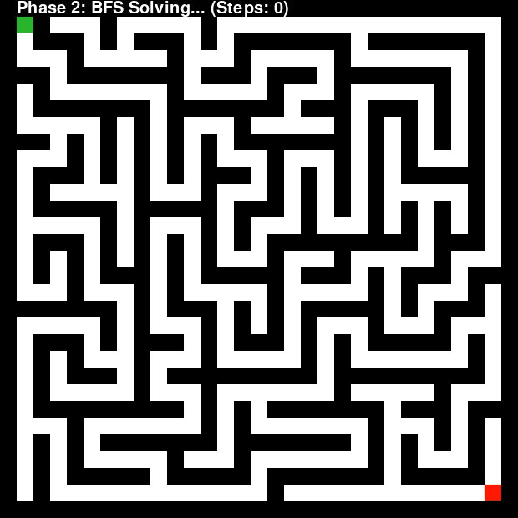
Method: BFS

Slide 5
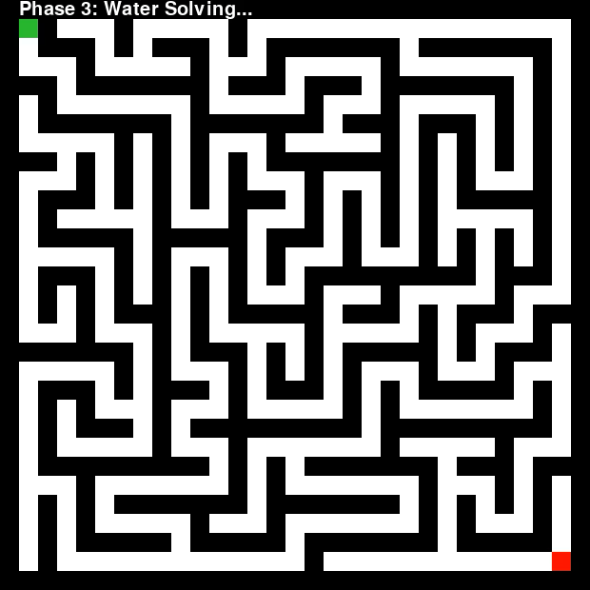
Method: Water

Slide 6
Statistics
 | Time (seconds) | Distance (cells) | Final Path (cells)
Random Walk | 8.35 | 501 | 0
BFS | 7.42 | 445 | 257
Water | 10.57 | 257 | 257

