Slide 1
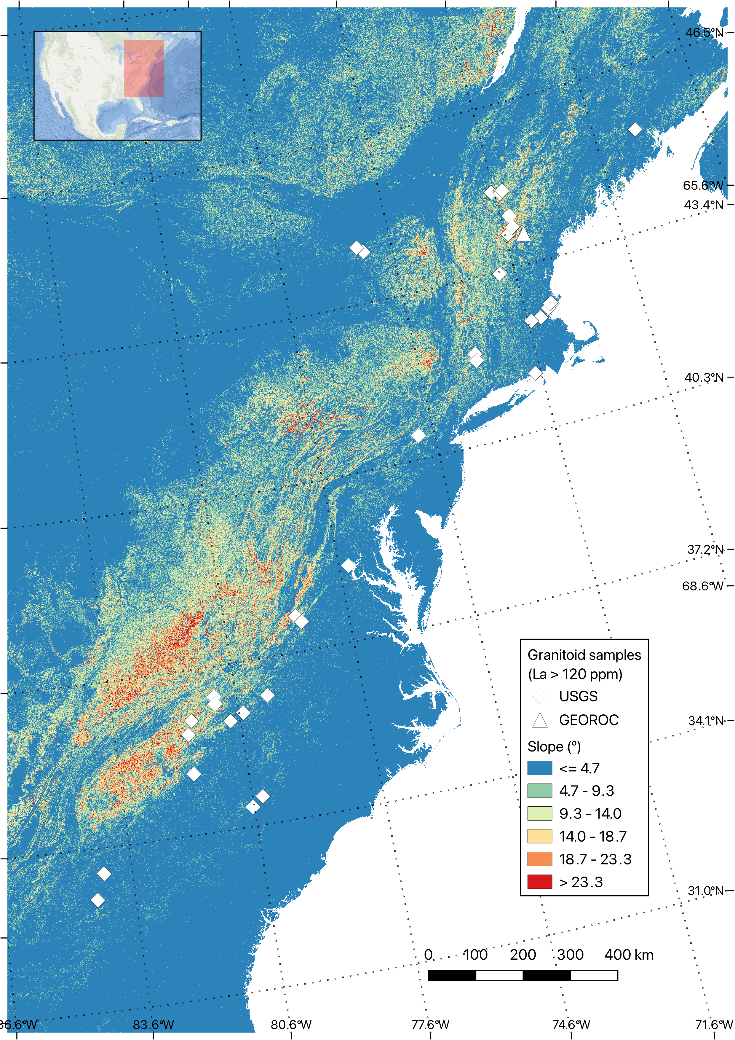
Slope–Erosion Simulator for REE Enrichment in Regolith
James Li – EPS 109

Slide 2
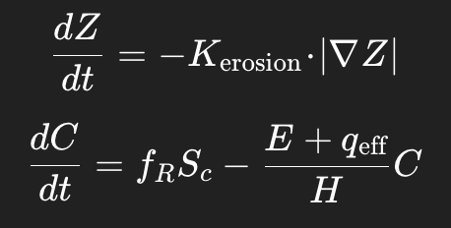
Topic and Method Explanation
• Input data: 200 × 200 DEM window of the southern Appalachians • Slope → Erosion: Steeper terrain → faster loss • Erosion → REE removal: Material & REEs leave regolith • Weathering → REE supply: Slow addition of new REEs • Simulation: • Each grid cell updated
every two years (dt = 2 yr) • 1000 steps total (2000 years) • Stored every 5 steps for animation • Some of the parameters: K_erosion = 0.008,
H_regolith = 20 m,
f_R = 0.6,
Sc0 = 0.03 yr⁻¹,
q_eff = 0
Credits of this model goes to Professor Don DePaolo

Slide 3
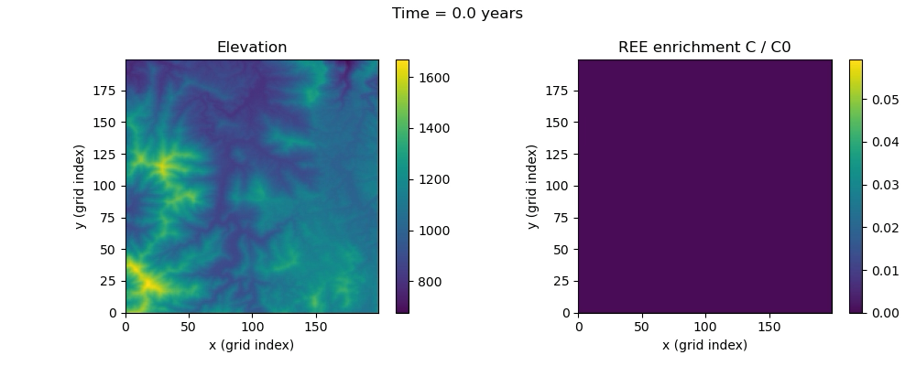
Results and Animation

Slide 4
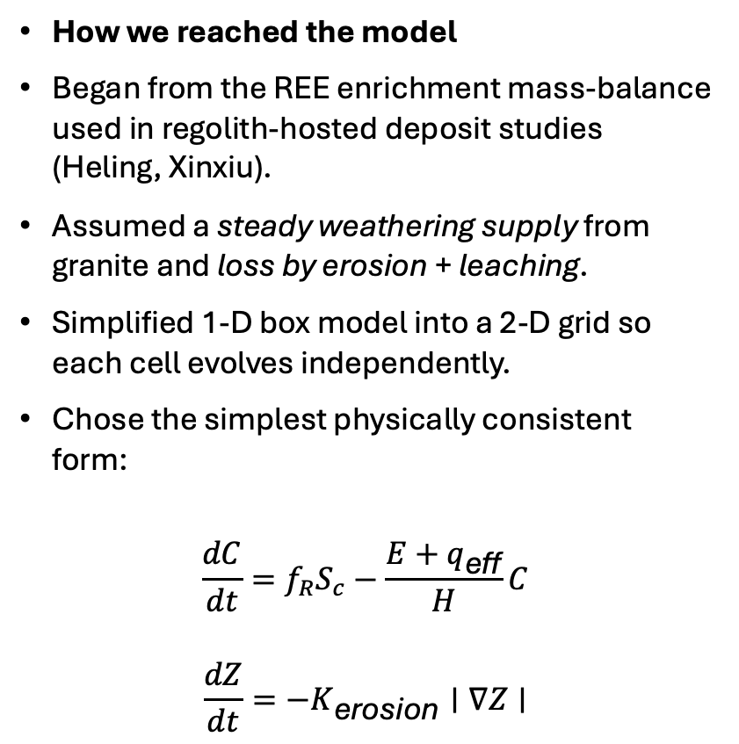
More on Setup: From REE Model to Simulation (If time…)
Parameter meaning
- K_erosion (0.01–0.05): scales how slope drives erosion.
- S_c (0.01 yr⁻¹): weathering strain rate → REE supply.
- f_R (0.5–0.7): fraction of REEs retained in regolith.
- H_regolith (20 m): storage thickness controlling response time.
- q_eff (0–0.01 m/yr): flushing/leaching strength.
- C₀ (120 ppm): parent-rock baseline for normalization.
How the simulation captures the model
- Elevation grid gives slope → erosion field E(x,y).
- Each time step updates Z and C using finite-difference ODEs.
- Animation stores every few steps to show transient buildup.
- No lateral transport: enrichment purely local, slope-controlled.
Bigger-picture goal
- Demonstrate the physics visually behind regolith-hosted REE zoning.
- Build a visual bridge between QGIS spatial patterns and the lab-scale theory.
- Generate synthetic slope–enrichment data to guide U.S. exploration targets.
How we reached the model
Began from the REE enrichment mass-balance used in regolith-hosted deposit studies (Heling, Xinxiu).
Assumed a steady weathering supply from granite and loss by erosion + leaching.
Simplified 1-D box model into a 2-D grid so each cell evolves independently.
Chose the simplest physically consistent form:
$$\frac{dC}{dt}=f_{R}S_{c}−\frac{E+q_{\text{eff}}}{H}C$$
$$\frac{dZ}{dt}=−K_{\text{erosion}}∣∇Z∣$$
Credits of this model goes to Professor Don DePaolo

