Slide 1
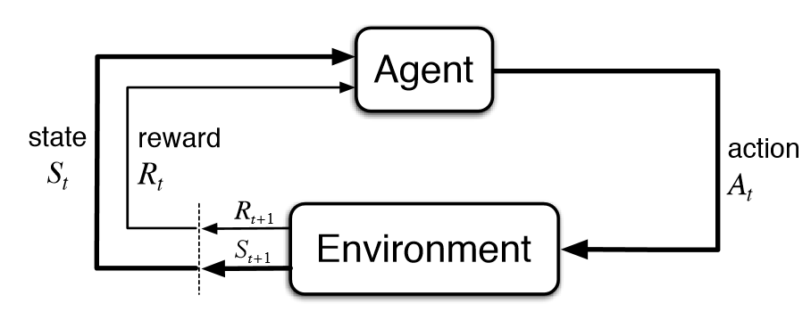
Ahmed Ismail
*Standard RL Training Loop (Sutton & Barto)
Training a Robot Arm to Push Objects to a Target with Deep Reinforcement Learning

Slide 2
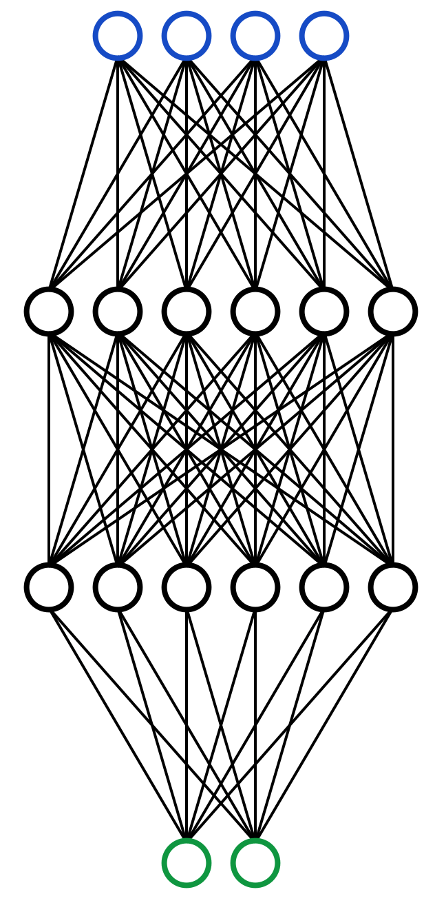
01
02
×2
03
RL Framework
The robot learns by by computing gradients from rewards and backpropagating them through a neural network.
• It tries actions → receives rewards → gradually updates the policy (learned strategy) to make good actions more likely.
Actor and Critic
• Two neural networks work together: an Actor proposes actions, and a Critic estimates how good those actions are.
• The critic’s feedback guides how we update the actor’s policy, reducing variance and making learning more sample-efficient.
Architecture and Setup
• Both Actor and Critic are 3-layer neural networks with 64 neurons per hidden layer.
• The robot controls 7 joints and observes 23 features in its environment, including its joint angles and positions of the object and goal.
*External Sources:
1. PPO training loop adapted from CleanRL 2. MuJoCo Pusher-v5 environment from Gymnasium

Slide 3
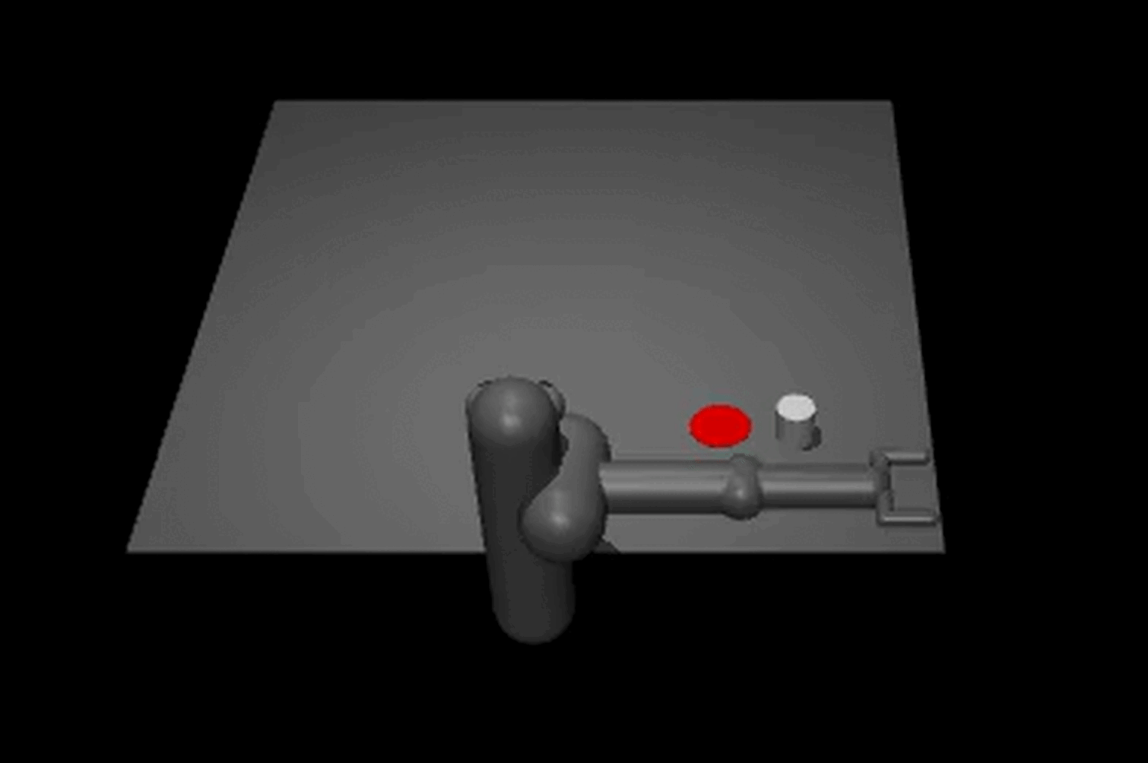
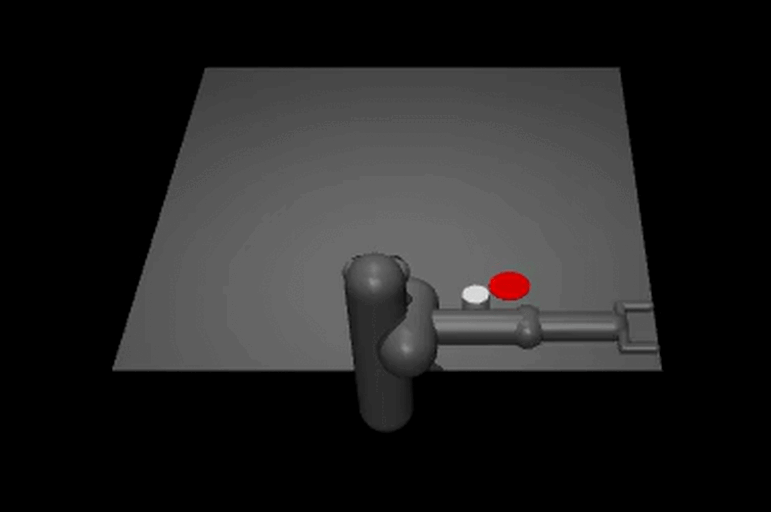
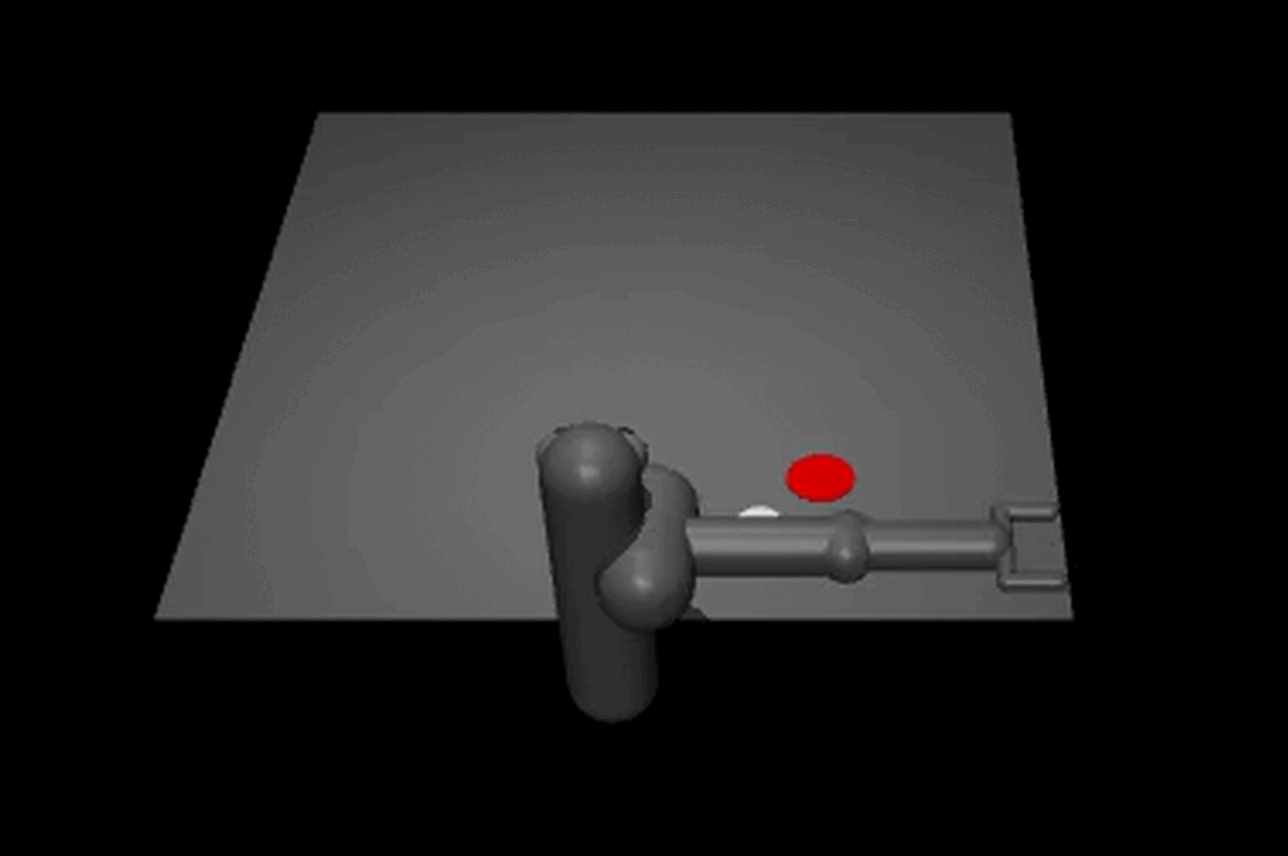
2,000,000 Simulated Actions.
*2,000,000 steps × 0.05 seconds per step = 100,000 seconds ≈ 27.8 hours of simulated robot training.
Before Training
Mid Training
After Training

