Slide 1
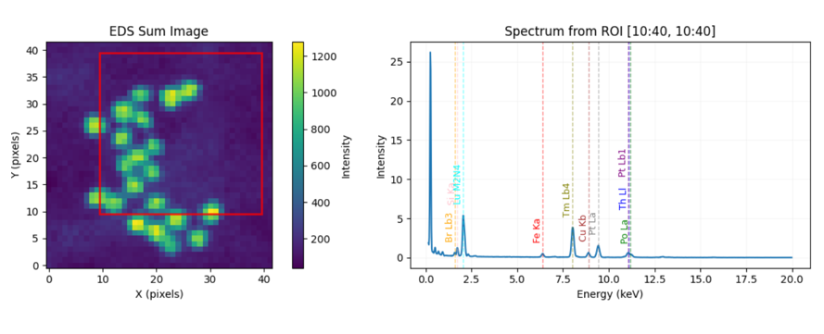
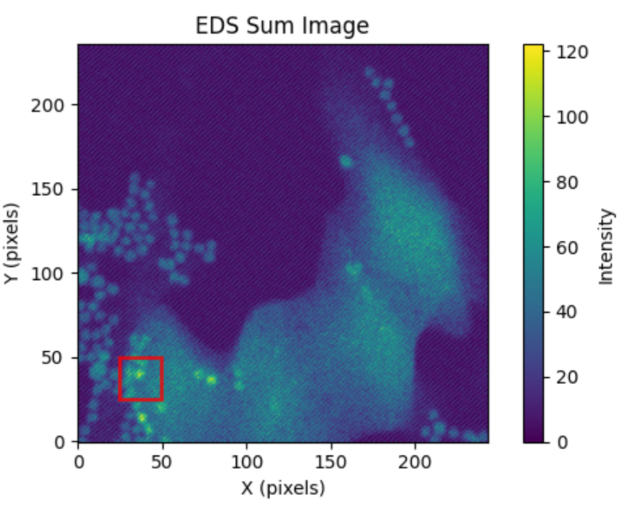
Simulating Energy-Dispersive X-Ray (EDS) Spectra in an Electron Beam Scan
Sanya Gowda
12/02/25

Slide 2
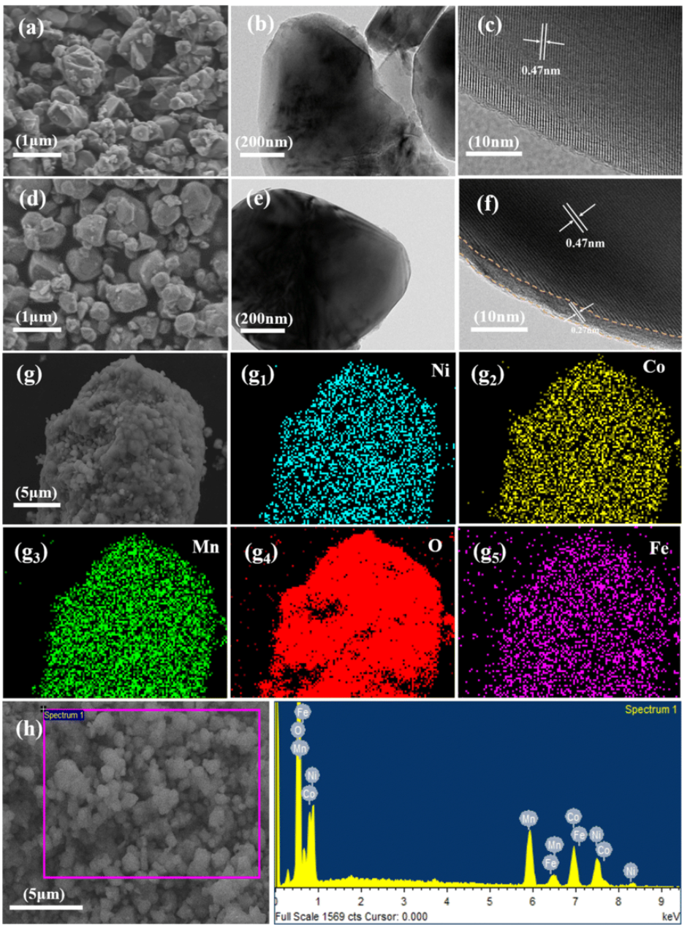
Purpose
To model how an electron beam generates X-ray signals as it moves across regions with different elemental compositions, producing distinct spectra, and how a raster scan builds up elemental maps (core ideas in material science EDS mapping).
Methods Used
Synthetic sample creation: I defined a simple 2D material made of three “elements” (A, B, C), arranged so that the top and bottom halves have different compositions, with a circular region enriched in C.
Raster scanning: An electron beam is simulated to move across the sample one pixel at a time, just like in a real SEM/EDS scan.
Photon generation: At each pixel, X-ray photons are generated using random (Monte Carlo) sampling. Each photon’s energy is drawn from a Gaussian distribution centered on that element’s characteristic peak energy.
Spectrum building: The photon energies are binned to create an EDS spectrum for each pixel.
Map reconstruction: Elemental maps are estimated by counting the simulated X-ray events associated with each element.
Animation: The final animation shows the beam scanning across the sample and how the spectrum changes depending on which region of the material the beam is hitting.

Slide 3
