Slide 1
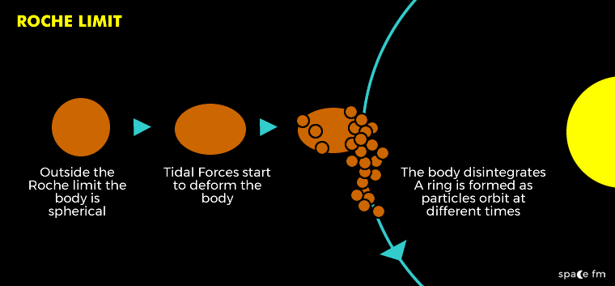
Roche Limit Simulations
Dhruv Gore

Slide 2


Ring Formation Physics
Roche Limit: Distance at which
Given by
Once the planet scatters its satellite, rings form
→ Collisions
→ Particle Gravity
→ Resonance
These are not truly modeled, but the effects approximated (except resonance)
Assumptions: Rigid (no deformation), non-rotating satellite; quick ring formation

Slide 3

Code
KeplerODE: Updates velocities/ accelerations. If bound, particle get COM velocities/ accelerations
init
for timesteps:
RK4(KeplerODE)
updateBound
circularize
updateBound: Updates if bound particle remains bound to satellite by checking surface gravity to planetary gravity
circularize: Dampens radial velocity of all free particles artificially on an exponential timescale 𝜏, given by

Slide 4
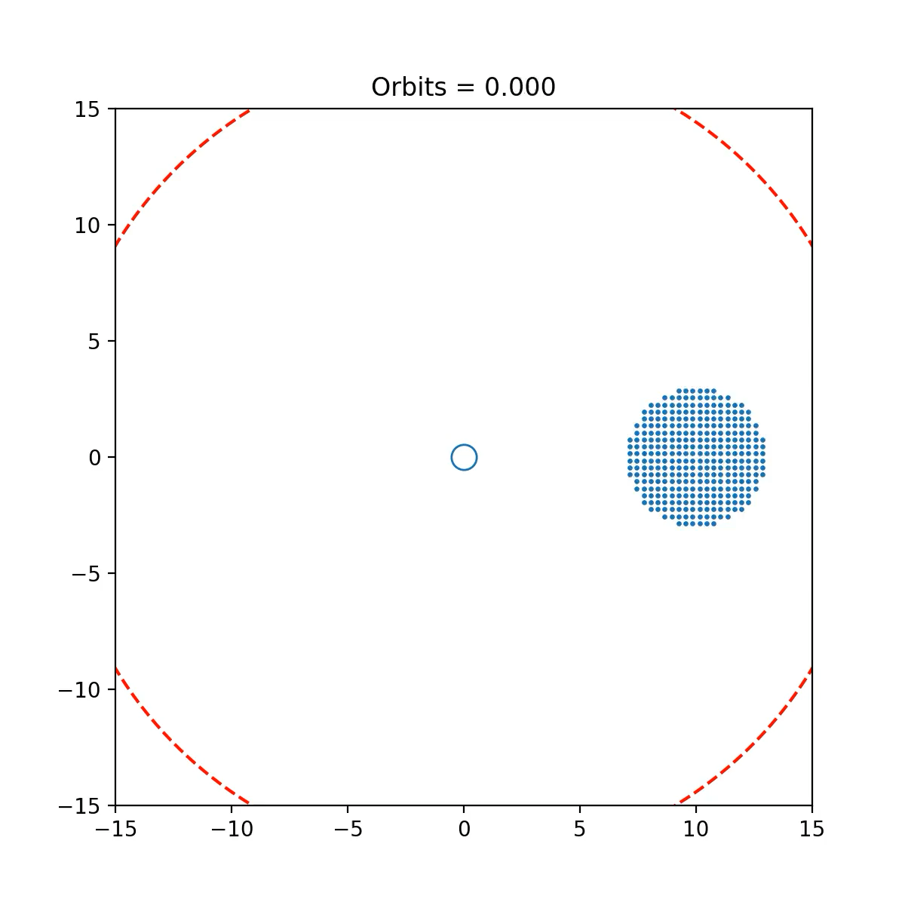
Object in Roche Limit (Total Disruption)

Slide 5
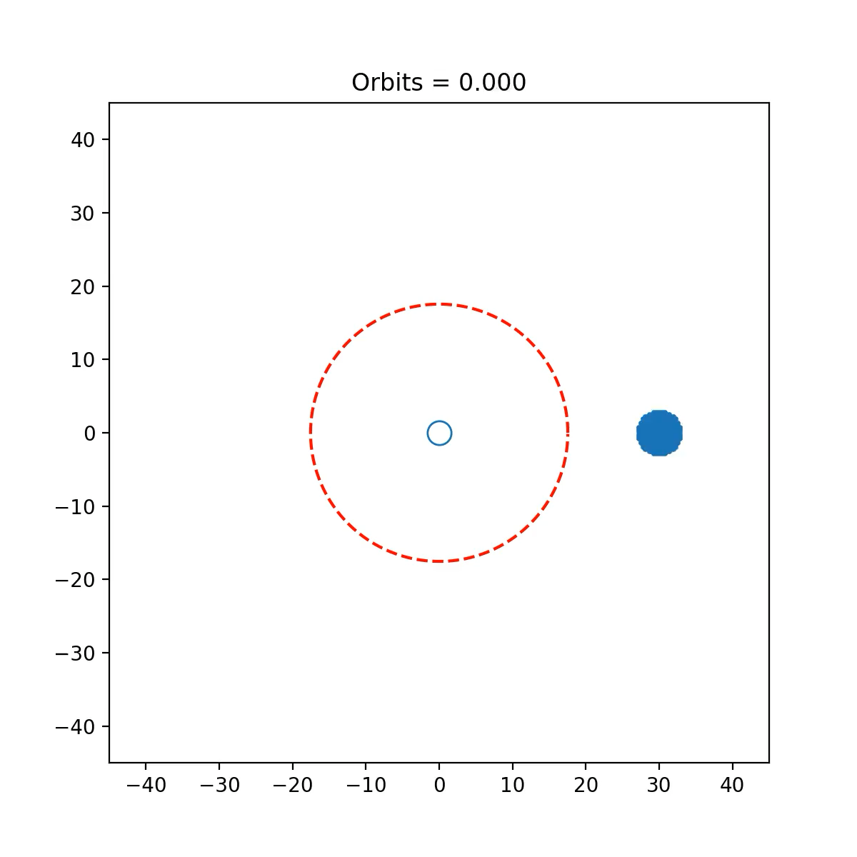
Object Passing Roche Limit (Partial Disruption)

Slide 6
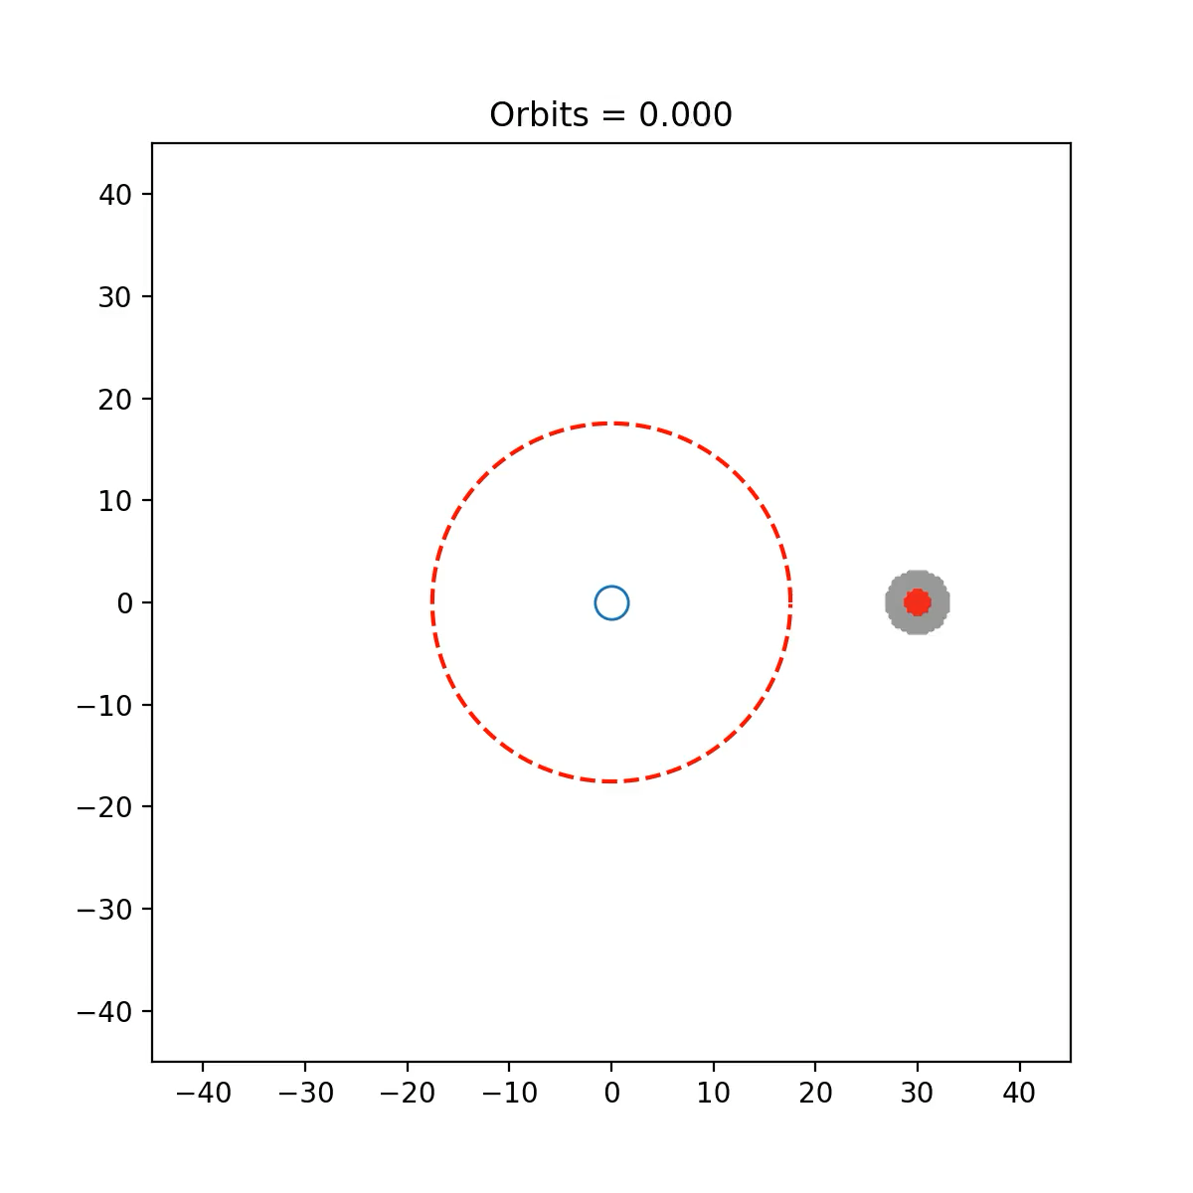
2-Layer Object Passing Roche Limit (Partial Disruption)

