Slide 1

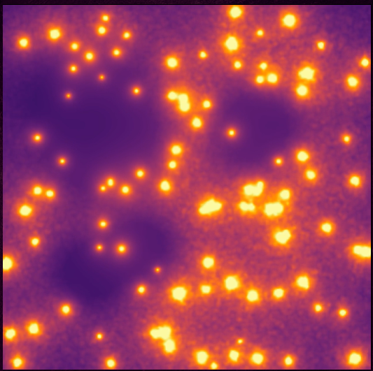
Ionization Fronts in a Nebula Simulation
Madison catalano

Slide 2
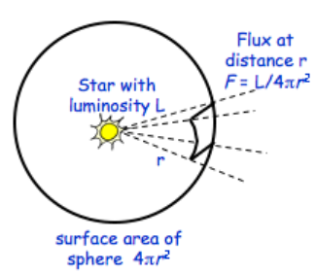
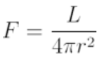

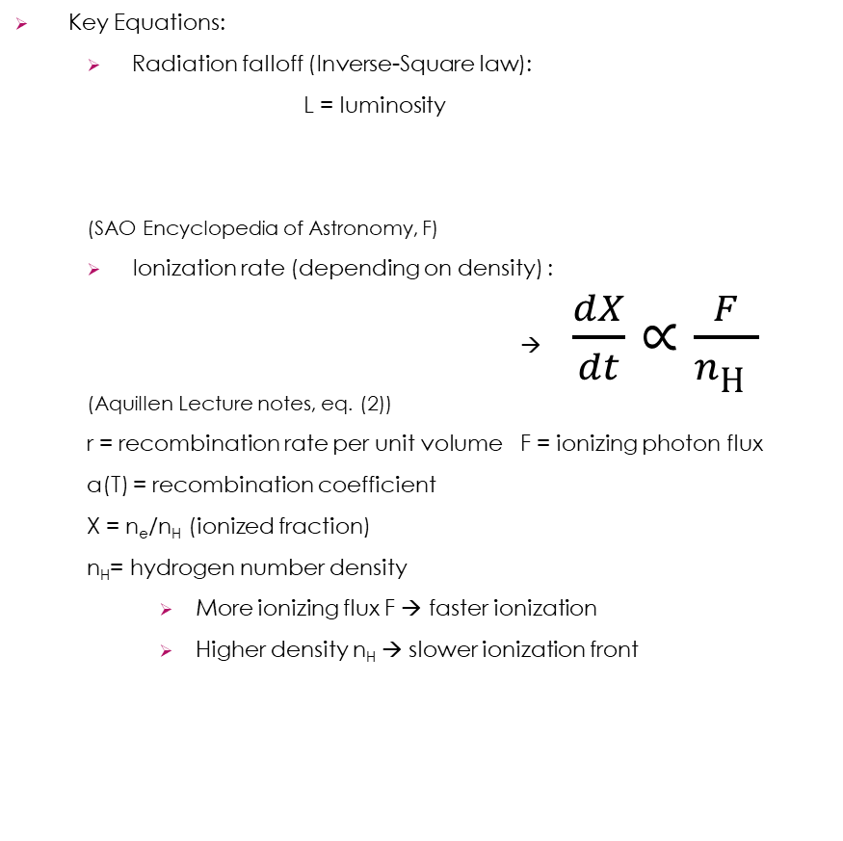
Background: Ionization Fronts in Molecular Clouds
Description:
Simulation of expanding ionization fronts from many stars in a clumpy nebula, demonstrating star formation, increasing luminosity, and a zoom-out view revealing growth of H II region
What’s physically happening?
Young massive stars emit ionizing UV radiation → creates expanding H II region inside cold molecular cloud
Speed and shape of front controlled by ionization from radiation, and recombination due to density
Ionization front expands faster in low-density molecular clouds, and slows in dense clumps, creating irregular shapes, with multiple stars, ionization bubbles overlap, distort, and merge
Key Equations:
Radiation falloff (Inverse-Square law):
L = luminosity
(SAO Encyclopedia of Astronomy, F)
Ionization rate (depending on density) :
→ $\frac{dX}{dt}∝\frac{F}{n\text{H} }$
(Aquillen Lecture notes, eq. (2))
r = recombination rate per unit volume F = ionizing photon flux
a(T) = recombination coefficient
X = n_{e}/n_{H} (ionized fraction)
n_{H}= hydrogen number density
More ionizing flux F → faster ionization
Higher density n_{H} → slower ionization front

Slide 3

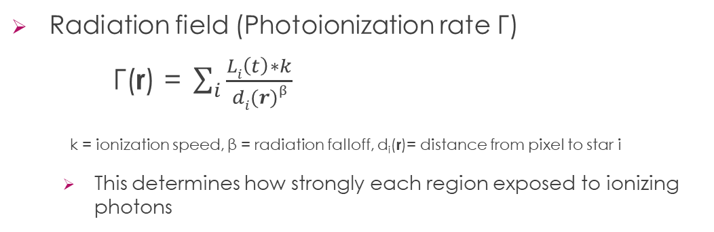
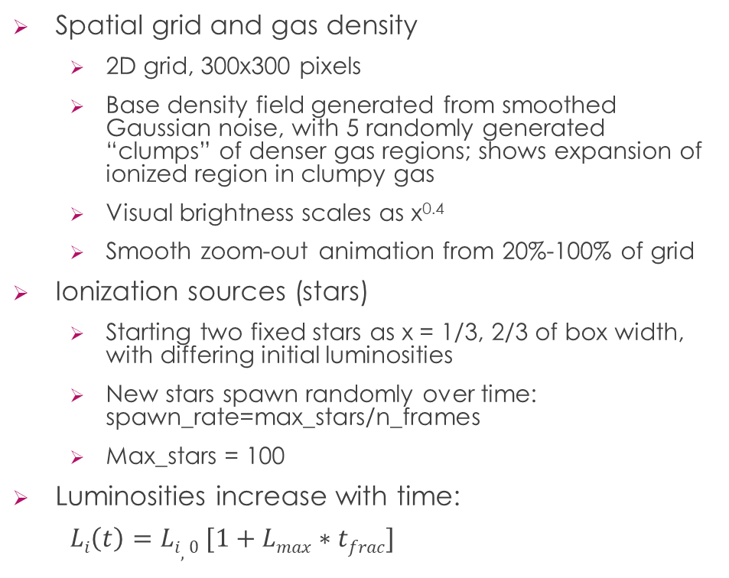
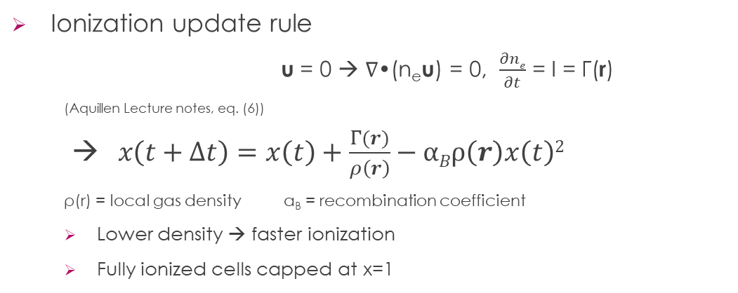
Methods
Spatial grid and gas density
2D grid, 300x300 pixels
Base density field generated from smoothed Gaussian noise, with 5 randomly generated “clumps” of denser gas regions; shows expansion of ionized region in clumpy gas
Visual brightness scales as x^{0.4}
Smooth zoom-out animation from 20%-100% of grid
Ionization sources (stars)
Starting two fixed stars as x = 1/3, 2/3 of box width, with differing initial luminosities
New stars spawn randomly over time: spawn_rate=max_stars/n_frames
Max_stars = 100
Luminosities increase with time:
$Li\left(t\right)=Li,0 [1+Lmax∗tfrac]$
Radiation field (Photoionization rate Γ)
$\text{Γ}\text{(}\text{r}\text{) = }\sum_{i}{\frac{Li\left(t\right)∗k}{di(r)β}}$
k = ionization speed, β = radiation falloff, d_{i}(r)= distance from pixel to star i
This determines how strongly each region exposed to ionizing photons
Ionization update rule
u = 0 → ∇•(n_{e}u) = 0, $\frac{∂ne}{∂t}$ = I = Γ(r)
(Aquillen Lecture notes, eq. (6))
→$x\left(t+∆t\right)=x\left(t\right)+\frac{Γ(r)}{ρ\left(r\right)}−αBρ\left(r\right)x\left(t\right)2$
ρ(r) = local gas density α_{B} = recombination coefficient
Lower density → faster ionization
Fully ionized cells capped at x=1

Slide 4


Slide 5

Sources
Aquillen, Alice. AST 242: Lecture Notes 7 – Ionization Fronts. University of Rochester, 2023, https://astro.pas.rochester.edu/~aquillen/ast242/lecturenotes7.pdf
Krumholz, Mark R. The Formation of Massive Stars: Chapter 2.2.1 – Ionization Fronts. NASA/IPAC Extragalactic Database (NED), 2010, https://ned.ipac.caltech.edu/level5/Sept10/Krumholz/Krumholz2.html#2.2.1https://academic.oup.com/mnras/article/483/2/2547/5228761?searchresult=1#127802525
Swinburne University of Technology. COSMOS – The SAO Encyclopedia of Astronomy: Flux https://astronomy.swin.edu.au/cosmos/F/Flux
Tomisaka, Kohji. Star Formation: Lecture Notes — Ionization Fronts (Section 5). National Astronomical Observatory of Japan, http://th.nao.ac.jp/MEMBER/tomisaka/Lecture_Notes/StarFormation/5/node21.html

