Slide 1
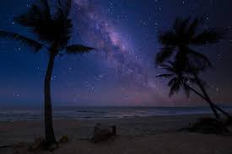
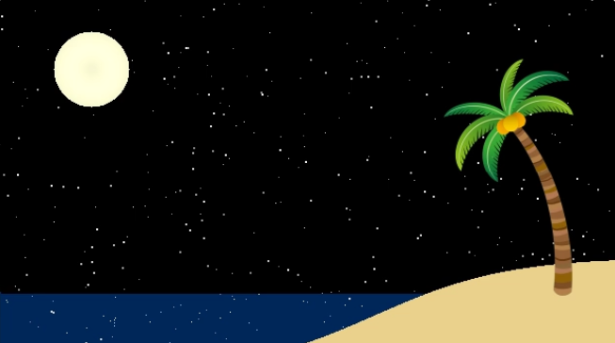
Moonlit Waves on a Serene Tropical Shore
Brock Bass

Slide 2
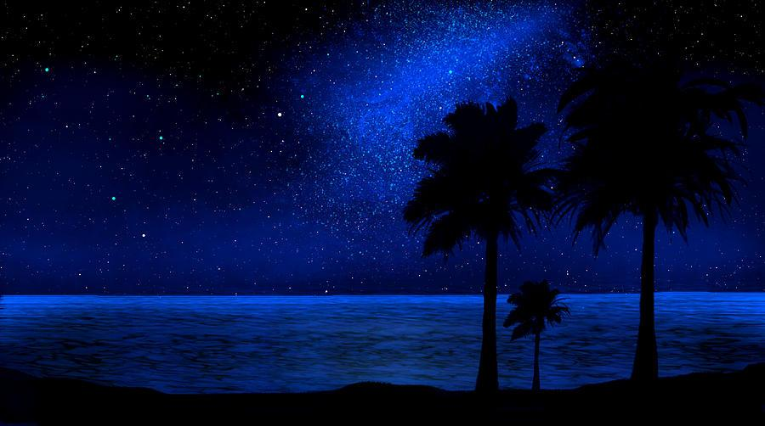




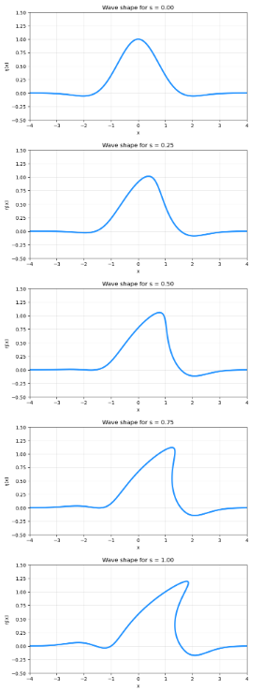
The Math Behind the Wave
Notes:
- To create a realistic looking wave moving, I used this function: [click]. The cosine term gives the crest shape, while the Gaussian ensures the wave is localized rather than repeating across the whole ocean. I also made the amplitude A grow as the wave moves, giving the appearance of the wave rising out of the ocean, then breaking.
- As it gets closer to the shore, I want it to break, so I add this function: [click] This multiplier adds skew. When s is small, the wave is symmetric. As s increases—meaning the wave is closer to shore—the front of the wave leans forward, just like a real breaking wave.
-Next, this formula makes the crest curl over [click]. The displacement grows where the crest is high, and the exponent p controls how abruptly the curl forms. Increasing s increases the curl strength, which is what produces the ‘barreling’ effect.
- Finally, this formula gives the motion of the wave traveling rightward across the screen [click].
- The whole wave will look something like this: [click]

Slide 3
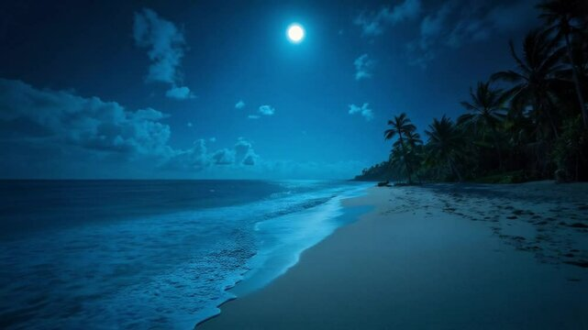
How the Code Works
Background grid with stars and night sky
  Shooting stars for good luck (:
Add flat baseline ocean
  Make it sparkle!
Beach, moon, palm tree
Wave
  The most interesting part!
Save as mp4 using FFmpeg
Add audio
Feel inner peace <3
Notes:
- First, add background grid with stars and night sky. I used the standard aspect ratio of a YouTube video in landscape orientation. This is first because I want it behind everything. The stars are randomly generated, with a small chance (1% per frame) of a shooting star appearing.
-Next, I add the flat baseline ocean.
-and make ocean sparkle!
-Next I add shoreline (using a logistic function), moon, and a palm tree on the shore, which is a clipart from google images that I mirrored.
- Next, add the wave (interesting part–talk about whitewater generation, then getting sand wet)
- Then, save as animation
- Then, add audio.
- Finally, watch the animation and feel inner peace

Slide 4
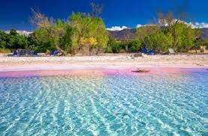

Enjoy! (:

