Slide 1
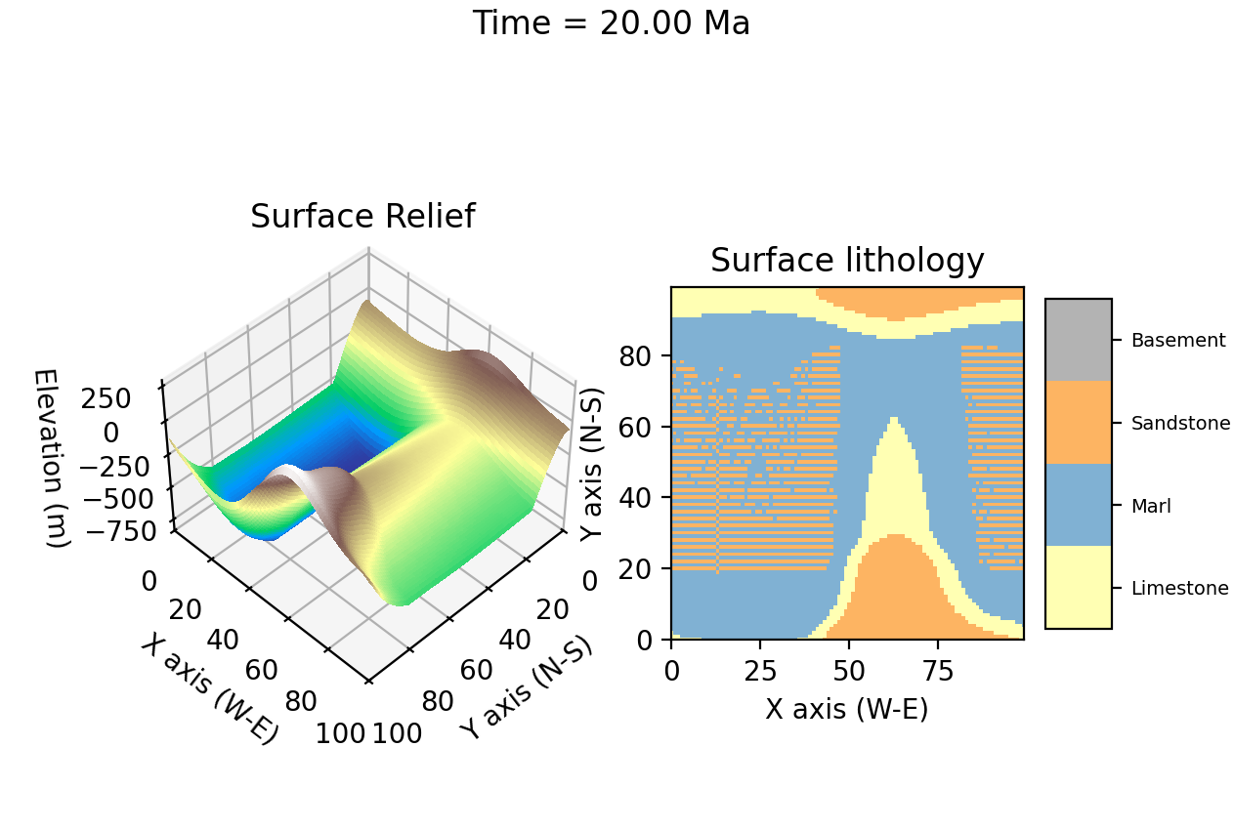
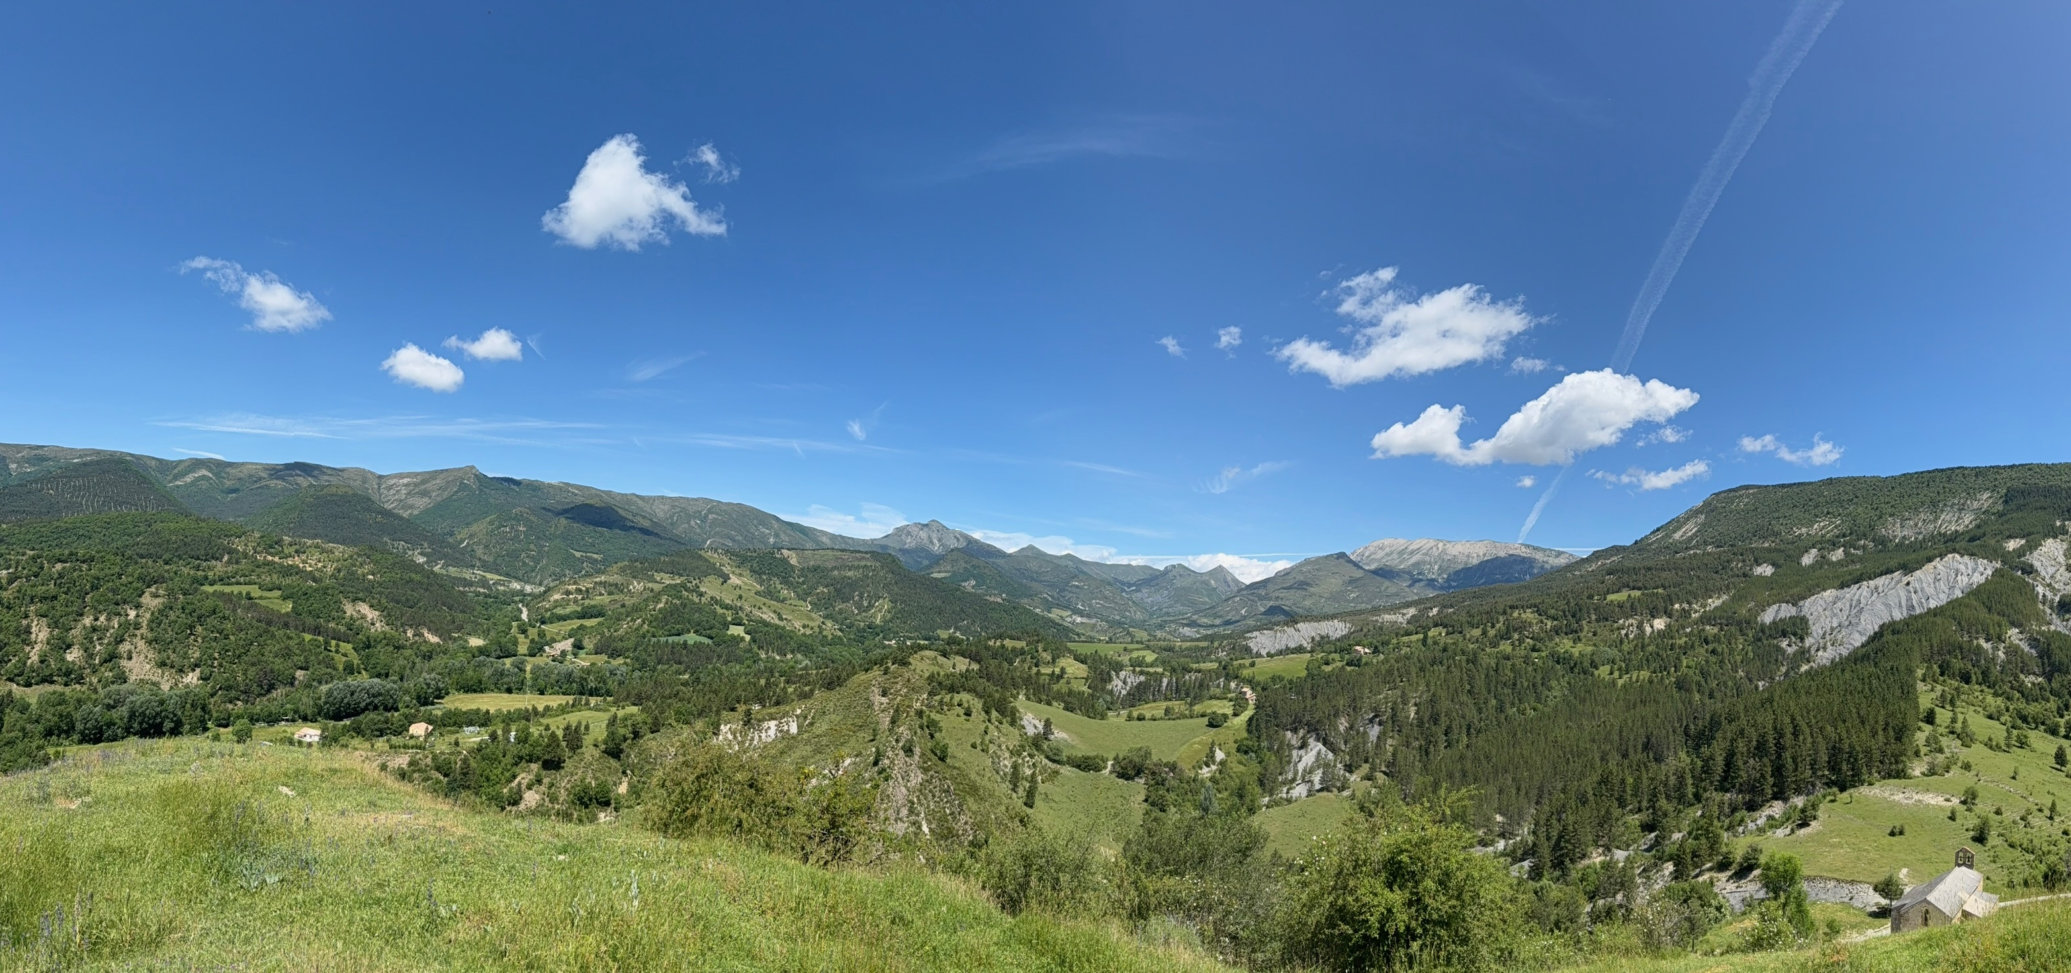
Structural and Depositional Evolution of the Barreme Basin (40-20Ma)
Jason Arya

Slide 2
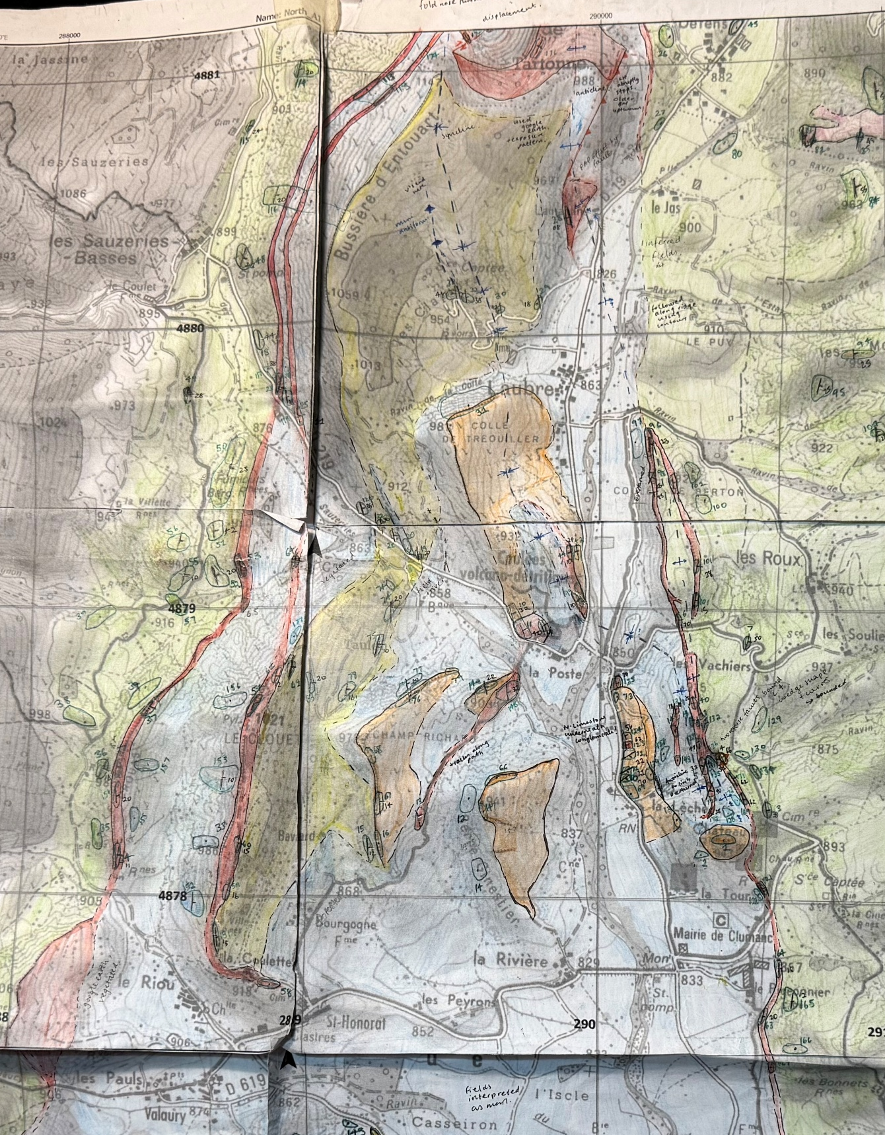
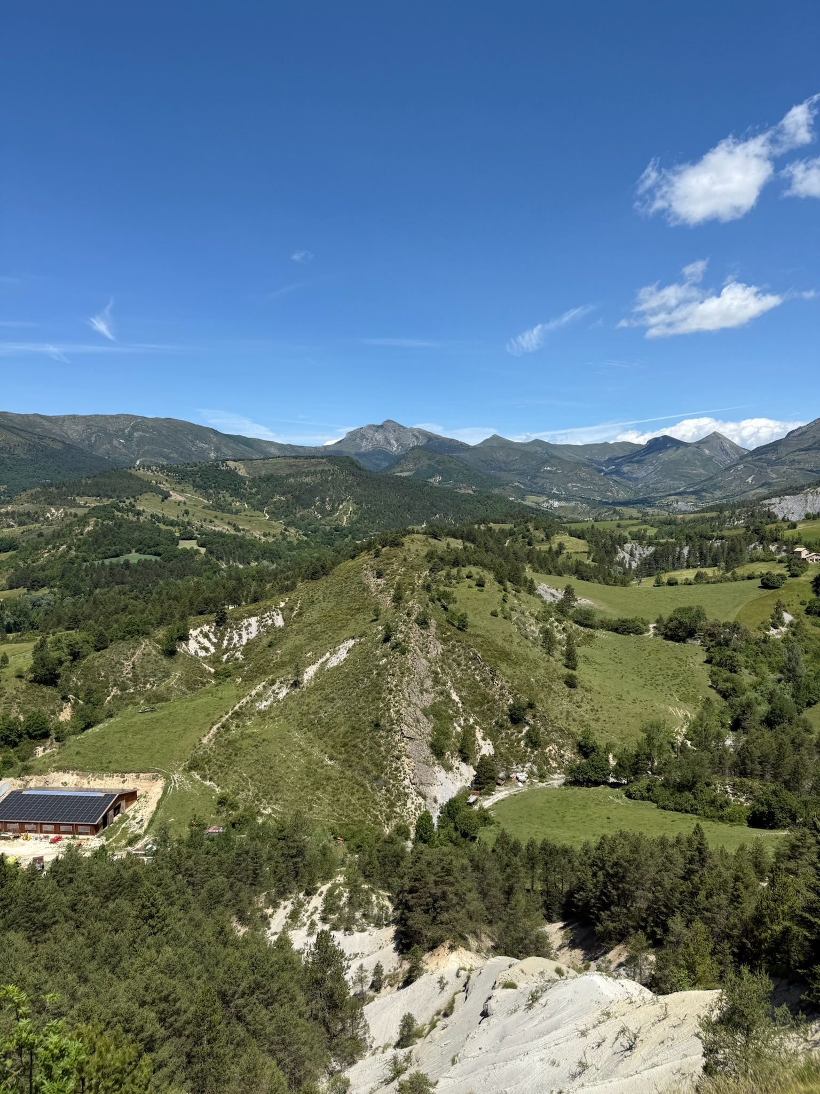
Barreme: piggy-back basin in a thrust belt, SE France
Mapped in field : structural and stratigraphic constraints
Initial sagging marine basin (40Ma-30Ma): flexural sag + sea level change -shallow marine limestones and deeper marl deposition
Later Alpine compression (30-20Ma): growth fault related folding produces westward verging Clumanc anticline, with small syncline to the west and the major basin syncline towards the east
Model
2D PDE surface evolution model (built on top of Homework/Lab 9 code)
Initial topography: Basin with N-S Pyreenees folds consisting of Cretaceous Marls and Limestones.
Tectonic functions: functions for flexural subsidence, sag, Alpine folding and uplift
Surface processes: Depth dependent deposition with fluvial incision switched off to focus on tectonics and basin infill
Each cell stores: elevation and lithology.
Model runs for 1000 steps with dt of 20kyr, outputs every 10 steps. Total 20Myr

Slide 3
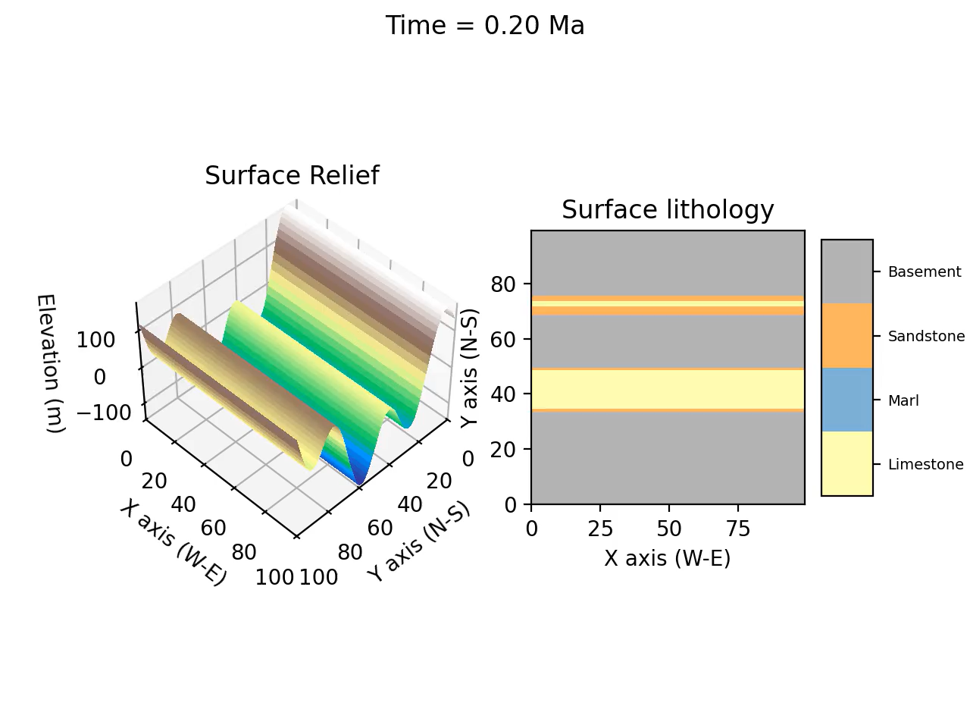
Timeline:
0-10Ma: Flexural sagging basin
Flexural subsidence and sag creates shallow marine basin above relic Pyrenean folds
Depth controlled deposition builds Nummulitic Limestone (shallow) and Blue Marl (deeper).
10Ma: Beginning of Alpine Compression
New E-W compression begins new folding and regional uplift. Turbiditic sandstones infill deep basin
10-20Ma: Growth of Clumanc anticline and synclines
Growth of west verging Clumanc anticline, with western syncline and major eastern basin syncline
Limestones folded and uplifted
Turbidites accumulate syntectonically

