Slide 1
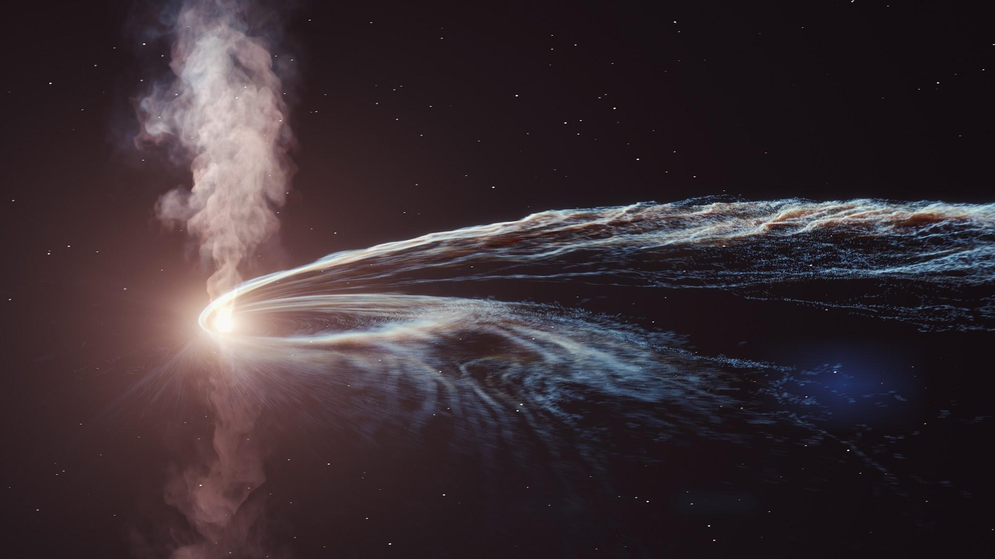
Black Hole Tidal Disruption
Robert Adams

Slide 2
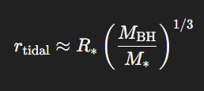
What is Stellar Tidal Disruption?
Occurs primarily with black holes/supermassive black holes
When the BH’s gravitational force overcomes the star’s internal gravity
  After the object passes the Tidal Radius
Causing the star to “tear apart”, having the strongest amount of pulling on the portion closest to the BH’s center

Slide 3
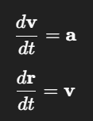


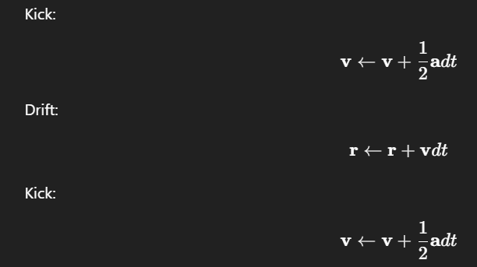
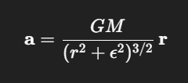


Used Equations
ODEs:
Newton’s 2nd Law
Linear Drag
Specific Orbital Energy
Kick-Drift-Kick Leapfrog Integrator
Softened Newtonian Gravity
Radial Distance
Rotational Velocity

Slide 4
