Slide 1
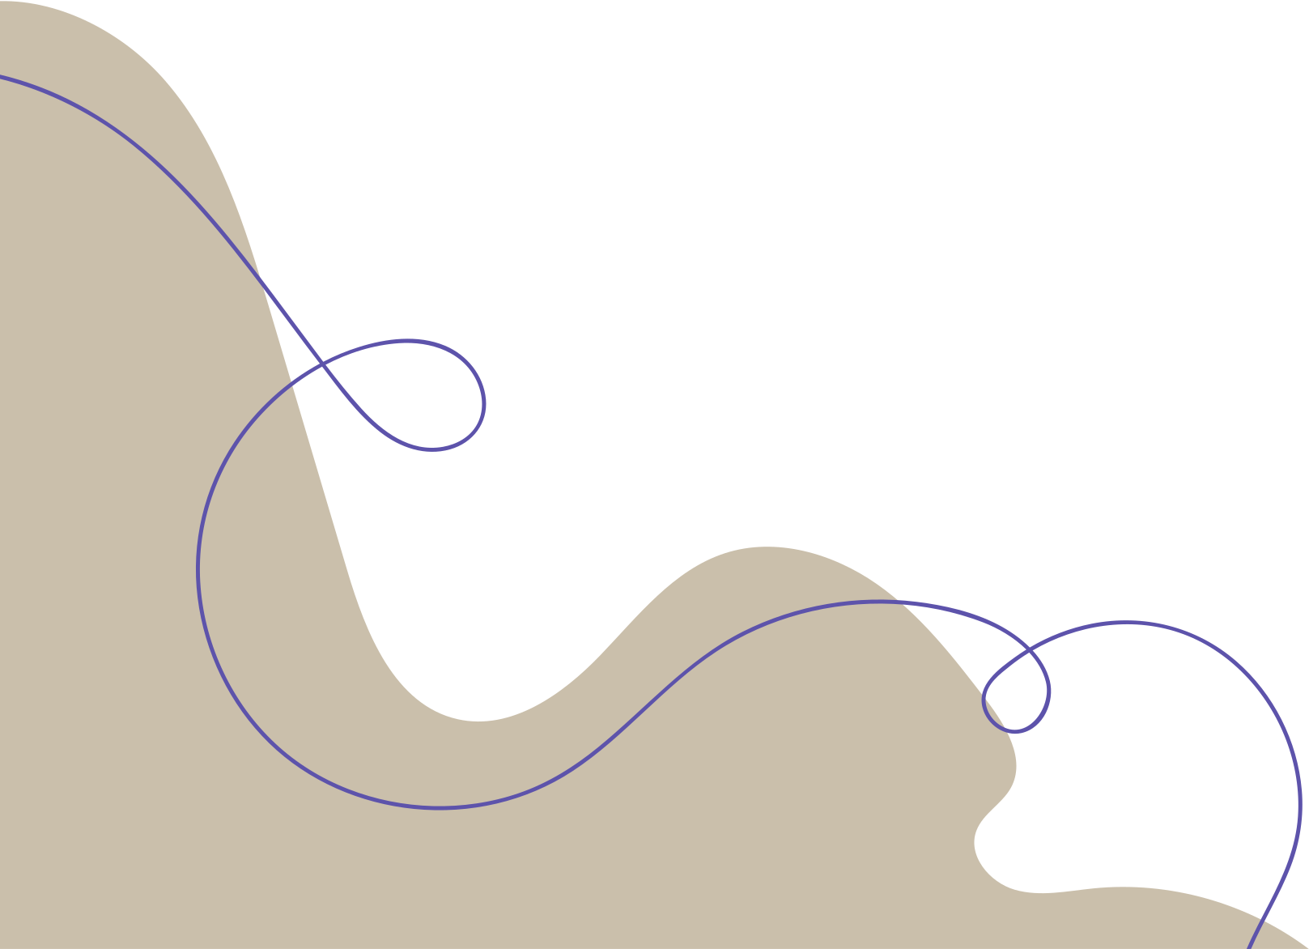
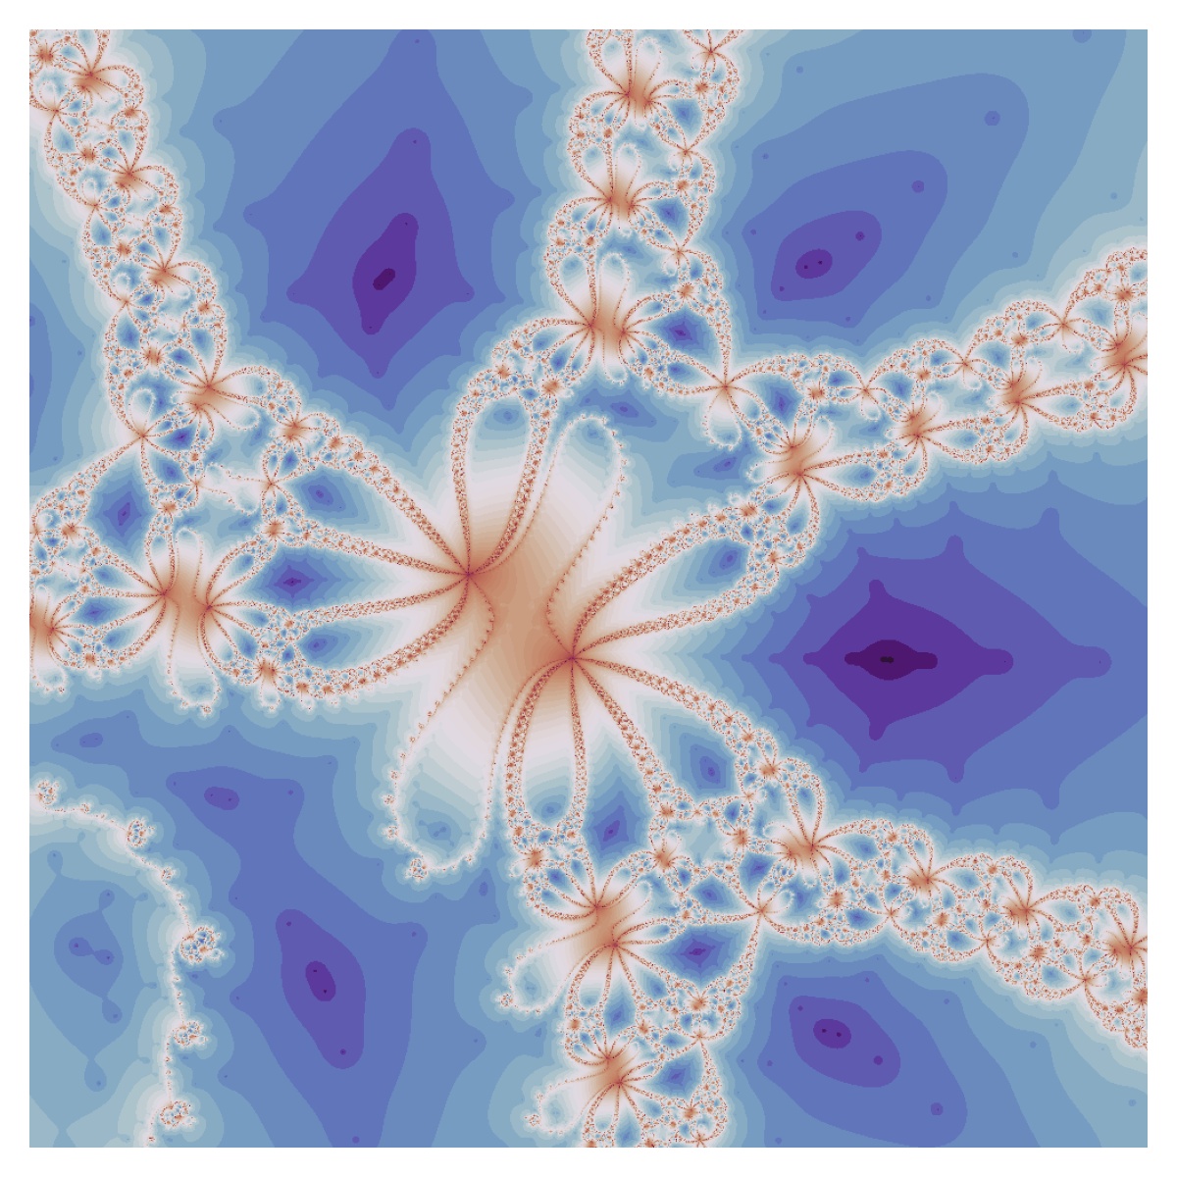

REM SLEEP DRIVEN NEWTONIAN FRACTALS
ANUSHKA RAJASEKHAR

Slide 2
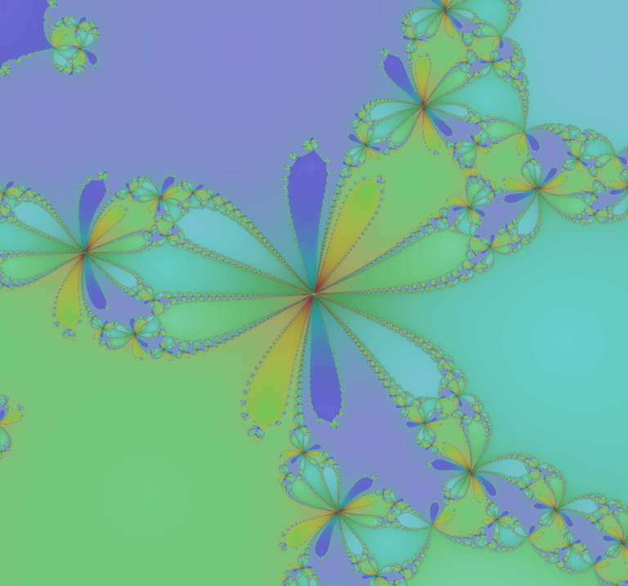
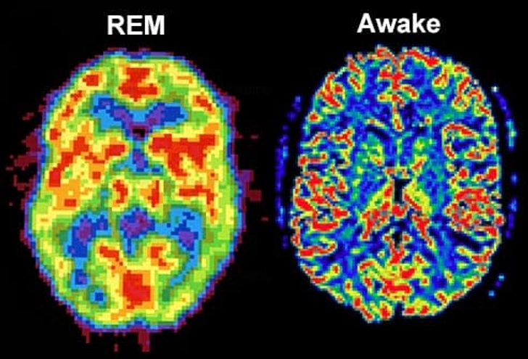
REM to Newtonian Fractals
REM is a unique brain state with interesting features in EEG waves - how can we simulate these features in a newtonian fractal?

Slide 3

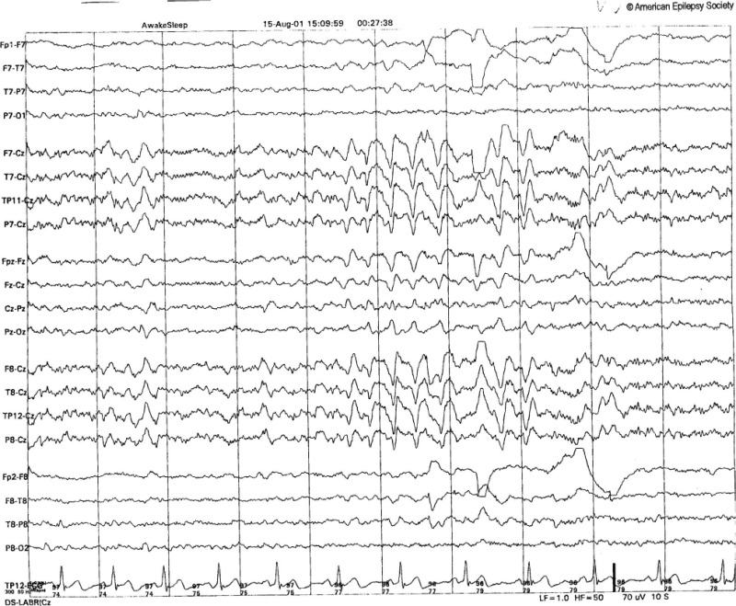
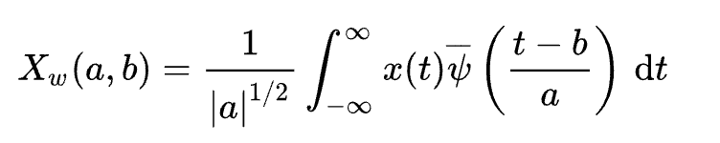
Methods
Morlet wavelet
CWT
  Want to extract band powers for mapping
  Use Morlet Wavelet Transform ⟶ band powers
1. Alexandre Gramfort, Martin Luessi, Eric Larson, Denis A. Engemann, Daniel Strohmeier, Christian Brodbeck, Roman Goj, Mainak Jas, Teon Brooks, Lauri Parkkonen, and Matti S. Hämäläinen. MEG and EEG data analysis with MNE-Python. Frontiers in Neuroscience, 7(267):1–13, 2013. doi:10.3389/fnins.2013.00267.
2. Michael X Cohen. A better way to define and describe Morlet wavelets for time-frequency analysis. NeuroImage, 199:81–86, 2019. doi:10.1016/j.neuroimage.2019.05.048.

Slide 4
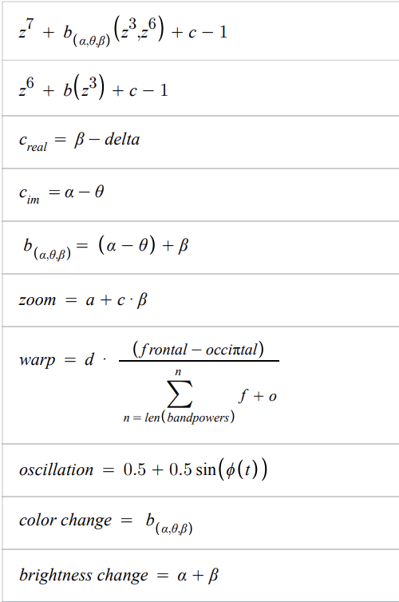
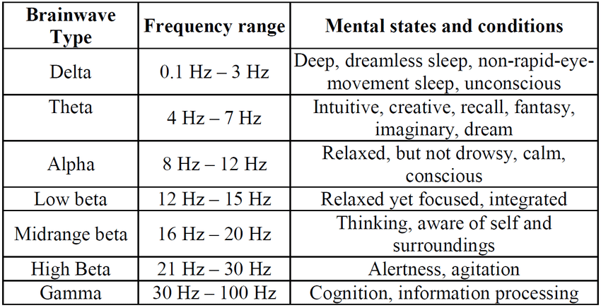
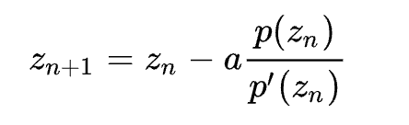
Methods
Defined polynomials for fractal
Affect fractal basin + geometry
Internal morphing/shape changes
Beta-driven zoom
Warping/distortion: powered by frontal, occipital difference
"Heart-beat" - amplified by Power
B Kemp, AH Zwinderman, B Tuk, HAC Kamphuisen, JJL Oberyé. Analysis of a sleep-dependent neuronal feedback loop: the slow-wave microcontinuity of the EEG. IEEE-BME 47(9):1185-1194 (2000).

Slide 5
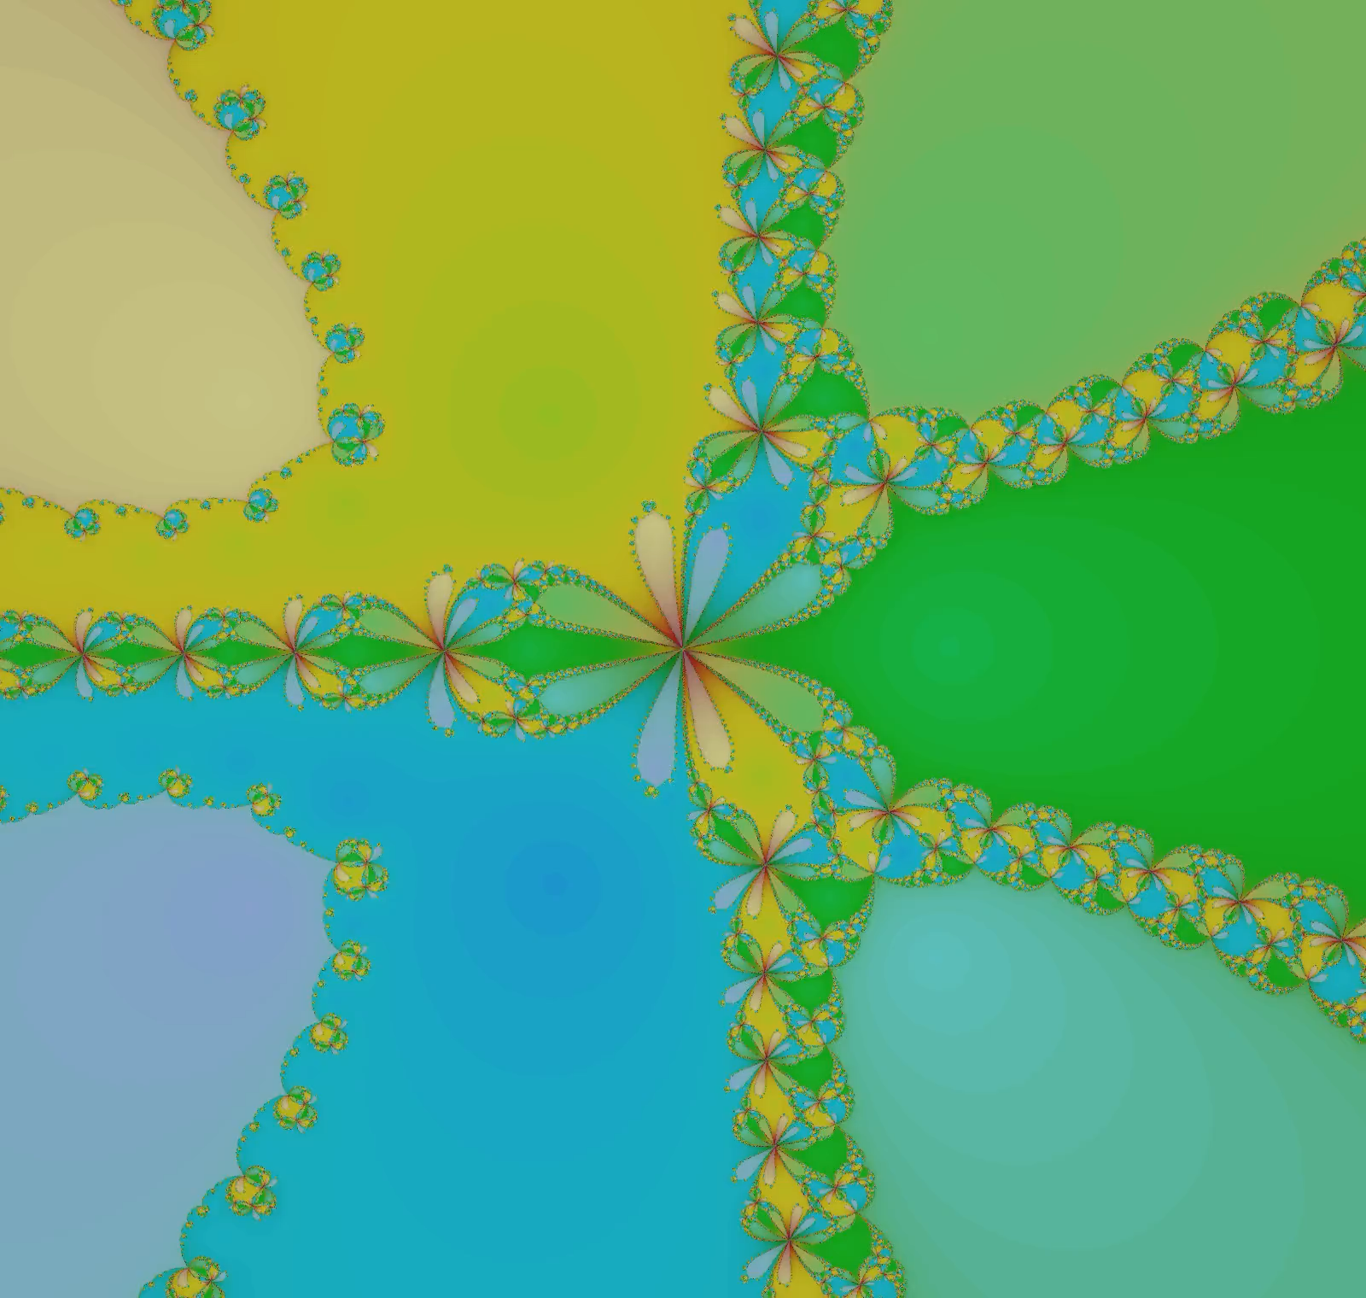
NORMAL REM PATTERN
  https://darkeclipz.github.io/fractals/
2. https://bastian.rieck.me/blog/2015/simple_fractals_shader/

Slide 6
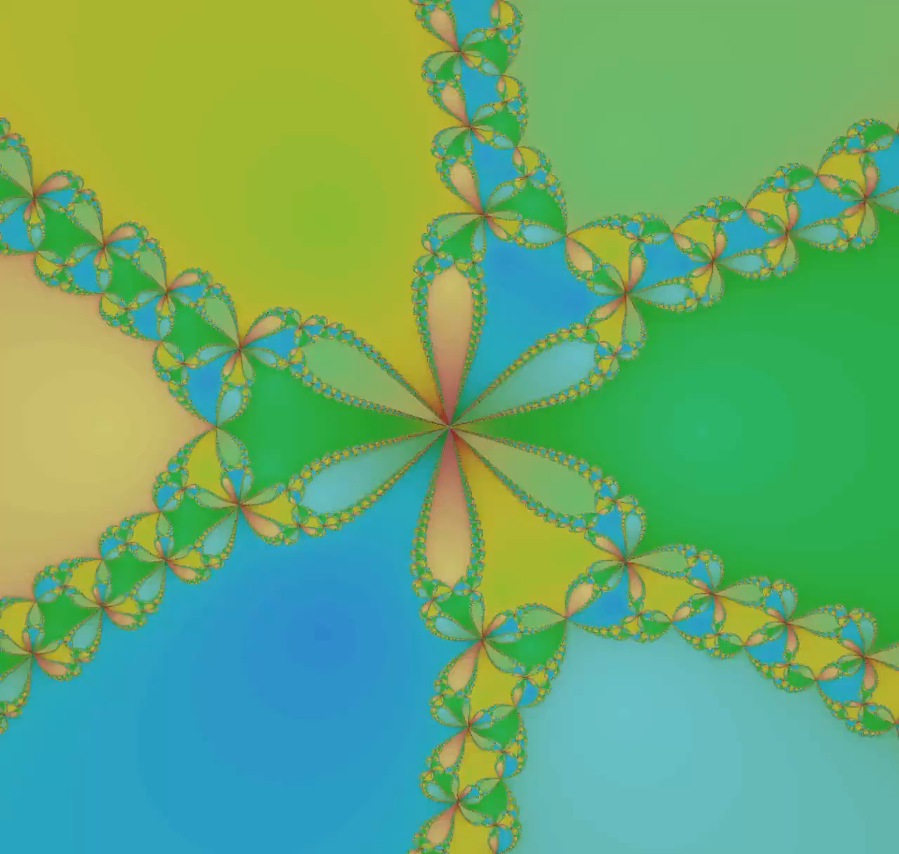
DISTURBED REM PATTERN
  https://darkeclipz.github.io/fractals/
2. https://bastian.rieck.me/blog/2015/simple_fractals_shader/

